Slide 1

Pesticide Program Dialogue Committee Meeting
Ed Messina, Director
Office of Pesticide Programs
U.S. Environmental Protection Agency
June 5, 2024

Slide 2
Office of Pesticide Programs
Edward Messina, Director
Leo Gueriguian, Deputy Director, Management
(Vacant), Deputy Director, Programs
Monique Perron, Senior Science Advisor
Catherine Aubee, Senior Advisor (EDSP)
Susan Jennings, Senior Advisor for Public Health
Antimicrobials Division
Anita Pease, Director
Kristen Willis, Deputy Director
Elizabeth Donovan,
Associate Director
Health Effects Division
Dana Vogel, Director
Donald Wilbur, Deputy Director
Greg Akerman, Associate Director
Biological and Economic Analysis Division
Neil Anderson, (Acting) Director
Neil Anderson, Deputy Director
Pesticide Re-evaluation Division
Anne Overstreet, Director
Tim Kiely, Deputy Director
Biopesticides and Pollution Prevention Division
Madison Le, Director
Shannon Borges, Deputy Director
Registration Division
Charles “Billy” Smith, Director
Daniel Rosenblatt, Deputy Director
Jennifer Saunders, (Acting) Assoc. Director
Environmental Fate and Effects Division
Jan Matuszko, Director
Amy Blankinship, Deputy Dir.
Brian Anderson, Assoc. Director
Endocrine Disruptor Screening Program

Slide 3
Appropriations
PRIA minimum appropriations level: $166,000,000
FY 2023 Final budget: $138,646,000
FY 2024 Final budget (projection): $132,464,000
FY 2025 President’s budget: $175,027,000
  STAG: $14,027,000
  EPM: $150,000,000
  S&T: $11,000,000

Slide 5
95 FTE deducted from the OCSPP Program funding levels to normalize the data to reflect OCSPP Reorganization and those FTE being moved to OPS.

Slide 6
95 FTE deducted from the OCSPP Program funding levels to normalize the data to reflect OCSPP Reorganization and those FTE being moved to OPS.
Notes:
$34M reduction to contracts over 3 years, FTE cuts, will deplete FIFRA and PRIA funds during FY26

Slide 7
Immediate FY 24 Budget Impacts
Virtual PPDC
Virtual SAPs
Crop Tours
IT Development Timing
Significant Impacts to Hiring/Backfilling Staff
Significant Cuts to Contracts
Significant Delays to Registrations (upwards of 6 mo to 1 yr)
Delays to other PRIA and Non-PRIA Actions

Slide 8
Priorities
PRIA 5 Implementation ​
Registration and Registration Review​
ESA Efficiencies and Progress on our ESA Obligations ​
Implementation of Agency Priorities ​
  Environmental Justice​
  Climate Change​
Advancing State of the Art Science​​
  PFAS – EDSP – NAMs
Rule-Making, Guidance, Litigation, OIG, and Petition Responses​
Advancing Digital Transformation
Employee Experience/Organizational Development /Process (GP2W) (People, Processes, and Technology)​

Slide 9
OPP FY24 Highlights to Date
Over 7,000 submissions via Portal
PRIA
  1,019 applications received
  772 applications completed
Non-PRIA (notifications, fast track amendments)
  1,835 applications received
  3,583 applications completed

Slide 10
PRIA 5 Implementation- FY 24 Activities
Future PPDC Agenda Item
FY 2023 PRIA Annual Report issued
Training Set-aside:
  Utilizing an existing Office of Water grant to inventory and consolidate existing training
  Establish grant program with the third-party entities identified in PRIA 5 to develop training curricula
Workforce and Process Assessment Contracts
  Utilizing an existing OMS contract for both activities
Non-PRIA backlog reduction and review timeframes for new actions
Farmworker and Health Clinician Cooperative Agreements
  Technical Assistance to support applicants/grantees
Bi-lingual labeling implementation- FAQs, implementation plan, outreach
DER process implementation
IT Modernization Efforts
EPA webpage on PRIA 5 Implementation: https://www.epa.gov/pria-fees/pria-5-implementation

Slide 11
PRIA 5 Implementation
Since our last update in November, EPA has continued to make progress implementing requirements of PRIA 5 - for example, OPP:
  Continues outreach to a broad array of stakeholders regarding bilingual labeling implementation, including accessibility of labels to farmworkers; stakeholders include farmworkers and farmworker advocacy groups, industry, EPA environmental justice and pesticide federal advisory committees, states, and EPA regions;
  Has made progress reducing the backlog of non-PRIA actions and implementing process changes to review these types of actions according to their timeframes;
  Continues development of IT system for electronic registration submission and application tracking;
11
Notes:
11

Slide 12
PRIA 5 Implementation
  In December, established the Vector Expedited Review Voucher (VERV) program to incentivize registration of new insecticides to control the spread of vector-borne diseases;
  Developed and is implementing a process for sharing of EPA data evaluation records with the applicant at the time of the regulatory decision;
  Is supporting farmworker training and education through continuation of existing cooperative agreements, awarding of new Pesticide Safety Education Program cooperative agreement, and announcement of funding opportunity for Partnership Grants; and
  Requested stakeholder input on program design for health care provider training cooperative agreement.
12
Notes:
12

Slide 13
Dicamba Update
On February 6, 2024, the U.S. District Court of Arizona vacated the 2020 registrations for over-the-top (OTT) dicamba products.
On February 14, 2024, EPA issued an Existing Stocks Order for Dicamba Products Previously Registered for Over-the-Top Use on Dicamba-Tolerant Cotton and Soybean.
This Order addresses use of the formerly-registered dicamba products and authorizes limited sale and distribution of dicamba products that are already in the possession of growers or in the channels of trade and outside the control of the pesticide companies.
EPA issued the Existing Stocks Order to allow for limited sale and distribution of dicamba OTT products that were already in the possession of growers or in the channels of trade and outside the control of pesticide companies as of February 6, 2024.

Slide 14
Dicamba Update
The order also prohibits the use of these dicamba products except where the use is consistent with the previously approved labeling, which included measures intended to reduce environmental damage caused by offsite movement of the pesticide.
This Existing Stocks Order is limited in time and scope, allowing for certain sale, distribution, and use of existing stocks of these formerly-registered dicamba products for the 2024 growing season.
EPA has received ample evidence that millions of gallons of OTT dicamba had already entered the channels of trade prior to February 6, 2024.
Under this order, end users of existing stocks may only use the formerly-registered products consistent with the previously approved labeling for the products and must stop use of these products by the relevant dates laid out in the Order.

Slide 15
Dicamba Update
EPA recently received applications from Bayer CropScience LP and BASF for new products containing dicamba. The proposed products includes use of dicamba on dicamba-tolerant soybeans and cotton.
Because the applications involves a new use pattern for dicamba, the Agency is required to provide a 30-day public comment period on the registration applications consistent with FIFRA. EPA is also seeking comment on the associated draft labeling that was submitted, which is available in the dockets.
Should EPA determine that registrant-submitted applications including over-the-top dicamba meets the standard for registration of a new use under FIFRA, EPA will provide a separate opportunity for public comment on the proposed decision at a future time.

Slide 16
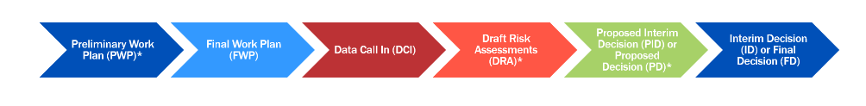
Pesticide Registration Review
The FY 2023 omnibus set a new deadline of October 1, 2026, for completing the first phase of registration review.
There are 789 registration review cases due by October 1, 2026 - 726 cases registered prior to FY 2007 that carried forward, and 63 new active ingredients registered after FY 2007 with registration review due dates that fall before October 2026.
Of the 789, as of the end of FY 2023 there were
  718 cases (or 91%) for which draft risk assessments are completed (71 remain).
  616 cases (or 78%) for which final or interim decisions are completed (173 remain).

Slide 17
Chlorpyrifos Update
On December 28, 2023, the U.S. Court of Appeals for the Eighth Circuit vacated EPA’s August 2021 rule revoking all tolerances.
On February 5, 2024, EPA issued a Federal Register notice to amend the Code of Federal Regulations to reflect the court's reinstatement of those tolerances.
At this time, all the chlorpyrifos tolerances have been reinstated and are currently in effect.
On March 15, 2024, EPA issued an amendment to revise the existing stocks provisions for three Adama chlorpyrifos pesticide products at the request of the registrant following the reinstatement of the tolerances.

Slide 18
Chlorpyrifos Update
In June 2024, EPA is amending the existing stocks provisions in the May 4, 2023 and August 31, 2022 cancellation orders for three chlorpyrifos products from Winfield Solutions and two chlorpyrifos products from Liberty Crop Protection.
In June 2024, EPA is issuing a final cancellation order on the voluntary cancellation of the chlorpyrifos product “Dursban 50W in Water Soluble Packets,” and all but 11 food uses in certain geographical areas for Gharda’s chlorpyrifos technical and two chlorpyrifos end use products.
In June 2024, the updated chlorpyrifos FAQ will be posted to the Agency’s website.
EPA expects to implement the NMFS Biological Opinion for all remaining labels, which contain food uses, by August 30, 2024.
EPA expects to issue a new proposed rule later this year to revoke the tolerances associated with all but the 11 food uses for which EPA could make a safety finding in the 2020 PID.

Slide 19
Acephate Update
On April 30, 2024, EPA released a proposed interim decision (PID) to cancel all but one use of the pesticide acephate.
This decision is based on EPA's updated human health draft risk assessment (HH DRA) and drinking water assessment (DWA) that were released last year, which showed significant dietary risks from drinking water for currently registered uses of acephate.
EPA also identified worker, homeowner, and ecological risks that would be mitigated by the proposed cancellations.
The Agency is proposing to maintain the use of acephate for tree injection because it does not contribute to drinking water exposure, there are no risks for workers, and, with label changes, would not pose risks to the environment.
The revised HH DRA and DWA were released in August 2023.
The PID released in April 2024 is available for public comment until July 1, 2024.

Slide 20
Organophosphates Registration Review Update
18 Organophosphates Currently in Registration Review.
Decisions scheduled to be completed by 2026.
Upcoming Actions
  Acephate Proposed Interim Decision (PID) – Completed April 2024.
  Dicrotophos Proposed Interim Decision (PID) – June 2024.
  Dimethoate Proposed Interim Decision (PID) – June 2024.
  Malathion Proposed Interim Decision (PID) – July 2024.
  TCVP (Tetrachlorvinphos) Interim Decision (ID) – June 2024.

Slide 21
DCPA Update
On April 1, 2024, EPA announced its next steps to protect people from the herbicide dimethyl tetrachloroterephthalate (DCPA, or Dacthal).
EPA warned people of the significant health risks to pregnant individuals and their developing babies exposed to DCPA and will be pursuing action to address the serious, permanent, and irreversible health risks associated with the pesticide as quickly as possible.
EPA has also issued a letter to AMVAC, the sole manufacturer of DCPA, restating the risks the agency found and stating that due to the serious risks posed by DCPA, the agency is pursuing further action to protect workers and others who could be exposed.
EPA took this rare step of warning farmworkers about these concerns while it works on actions to protect workers because of the significant risks the agency has identified.

Slide 22
Rodenticides Update
The Proposed Interim Decisions (PIDs) for the rodenticides were published in November 2022 and the draft Biological Evaluation (BE) was published in November 2023.
There were over 22,000 comments on the PIDs, represented largely by the main themes below:
  Concerns over non-target wildlife exposure, incidents, and protection of listed species;
  Misuse;
  Benefits of rodenticide control;
  Questions on feasibility, enforceability, and effectiveness of proposed mitigation (e.g., carcass search);
  Concerns related to proposing RUP designation;
  Field use restrictions;
  PPE; and
  Refining mitigation further by rodenticide type, other costs and impacts of mitigation.
The PID and BE comments are all being considered as EPA works towards the final BE which will be issued November 2024 and will include the rodenticide strategy.
Amended PIDs will begin to be released in early 2025.

Slide 23
Atrazine Update
Final report from the August 2023 SAP was released in November 2023.
EPA’s response to the SAP was released in March 2024.
EPA will release the revised CE-LOC and updated mitigation maps, along with the next steps and timeline related to proposed mitigation to protect aquatic plant communities in 2024.
EPA anticipates releasing a revised proposal for mitigation by the end of 2024. It will incorporate:
  New CE-LOC.
  New WARP-MP (Watershed Regression for Pesticides for Multiple Pesticides) model runs to address public comments and errors noted.
  Newly available atrazine monitoring data.
  Public comments on the mitigation strategies proposed in 2022.

Slide 24
Paraquat Update
In September 2021, several NGOs, including the Michael J. Fox Foundation and Earthjustice, filed a Petition challenging the EPA 2021 Interim Decision.
In November 2022, EPA and the Petitioners agreed to hold the case in abeyance while EPA considered the issues raised by the Petitioners.
EPA released an initial draft of its reconsiderations in February 2024 and opened a 60-day public comment that closed in April 2024.
A final document describing the next steps and timeline must be completed by January 17, 2025, based on agreement with Petitioners.
The final document will reflect:
    Consideration of additional information/data, including new studies submitted by petitioners.
    Consideration of public comments received on the draft document.
EPA is committed to transparency and continues to monitor the best available science on paraquat to remain informed on adverse health outcomes, including Parkinson's Disease.

Slide 25
Glyphosate Update
As part of registration review, a Glyphosate Interim Decision (ID) was published in February 2020.
The ID was challenged in the Ninth Circuit which resulted in:
  Vacating the human health portion of the ID.
  Granting EPA’s request for voluntary remand of the ecological portion of the ID but with an October 2022 deadline for a new ecological portion of the ID.
  The court held that the ID triggered ESA Obligations.
  In response EPA withdrew the ID as it was unable to meet the October 2022 deadline
EPA’s underlying scientific findings regarding glyphosate, including its finding that glyphosate is not likely to be carcinogenic to humans, remains the same.
In 2026 EPA plans to complete a Proposed Final Decision, which will:
  Revisit and better explain the carcinogenic potential of glyphosate.
  Revisit risk analysis related to in-field effects on the monarch butterfly and revisit the ecological risks versus benefits balancing in light of recent court decisions for other herbicides.
  Complete ESA consultation and respond to an administrative petition before issuing a final decision for glyphosate.

Slide 26
ESA Priorities
Future PPDC Agenda Item
Steady progress, with a recognition we can’t solve this problem all at once
Increasing efficiency of BE development and consultation
Transparency
Opportunities for Stakeholders to be part of the solution
Refined Maps to narrow geographic restrictions to only those areas needed to protect listed species
Early proactive mitigations to protect listed species from pesticide exposure
Flexible and Implementable Mitigations for pesticide users
Off-sets as another tool to minimize impact on pesticide users and protect species

Slide 27
Select Ongoing and Upcoming ESA Activities
Late 2023 (completed)
DRAFT rodenticide BE and mitigation strategy
Early 2024
Mid 2024
Final methomyl and carbaryl BiOps
Finalize herbicide strategy and begin to inform registration and registration review decisions
Late 2024/Early2025
Final BEs for acetamiprid and dinotefuran
2025 and beyond
Finalize insecticide strategy and begin to inform registration and registration review decisions
Draft Herbicide strategy and vulnerable species public comments
Hawaii workshop
Updated Enlist mitigation requirements per BiOp
Release DRAFT insecticide strategy for public comment
DRAFT online mitigation menu
DRAFT acetamiprid and dinotefuran BEs
Final Enlist BiOp
Draft BEs on benzovindiflupyr and bicyclopyrone
Mitigation workshop
Implement NMFS BiOp on 2 OP insecticides
Outreach on refining pesticide use limitation areas (PULAs) and begin process of revising PULAs
Determine if vulnerable species pilot should include additional species and provide additional information on the pilot
Draft Hawaii Strategy for public comment
FINAL rodenticide BE and mitigation strategy
Develop fungicide strategy
Continue revising PULAs for ESA mitigations

Slide 28
ESA Mitigation Menu Webinar
EPA will hold a public webinar on June 18, 2024, from 1-2 p.m. ET to provide an overview of its mitigation menu website that will describe mitigation options for reducing pesticide exposure to nontarget species from agricultural crop uses.
This webinar will provide a description and walkthrough of the draft website where EPA plans to provide this menu of mitigations that pesticide users can select from to meet any requirements to reduce runoff/erosion.

Slide 29
National Environmental Justice Advisory Council (NEJAC) Recommendations on Farmworkers and Pesticides
(Future PPDC Agenda Item on PPDC Farmworker Workgroup)
The National Environmental Justice Advisory Council (NEJAC) is a federal advisory committee to EPA that was established in 1993.
On March 30, 2023, OCSPP and OECA sought the advice and expertise of the NEJAC Farmworker & Pesticides Workgroup to advance how EPA:
  Develops new methods to provide access to information on bilingual (Spanish) pesticide labels for farmworkers;
  Strategizes to create a new farmworker indicator to measure progress in reducing disparities;
  Enhances its understanding and knowledge of exposure related to legally working children in agriculture, and
  Trains inspectors who conduct Worker Protection Standard (WPS) inspections.

Slide 30
NEJAC Workgroup Recommendations
On April 25, 2024, the NEJAC workgroup presented their draft recommendations to EPA. The NEJAC requested an update on how EPA is using the recommendations within six months of the final recommendations, and a full report in one year. A summary of recommendations for each charge question is below:
Bilingual labeling recommendations include conducting additional outreach on implementation, providing pesticide informational materials in multiple languages, sharing Spanish-language pesticide information in multiple venues and situations within and beyond job sites, collaborating with other organizations to expand broadband connectivity in rural areas, and improving annual WPS trainings.
Farmworker indicator recommendations include diseases and disorders associated with pesticide exposure (childhood asthma, cancer rates, birth defects), reported pesticide illnesses, pesticide use, resources devoted to WPS inspections/inspectors, stringency of enforcement, and pesticide monitoring studies.
Legally working children in agriculture recommendations include accounting for the fact that children/children of immigrant farmworkers regularly work in agriculture and are disproportionately exposed to pesticides, accounting for underreporting, creating pesticide education programming for schools and expanding after school programs, creating a WPS training for children, and working with other agencies to expand healthcare in rural communities.
WPS inspection recommendations include conducting unannounced inspections, inspecting all farms, creating ways for workers to feel comfortable making complaints, improving investigation of/increasing fines for violations, collecting better data/more state oversight on WPS compliance, educating employers and inspectors, providing more resources for inspections, implementing stronger restrictions on the use of the most toxic pesticides.

Slide 31
NEJAC Workgroup Recommendations: Next Steps
Within OPP, two working groups have been formed to address the recommendations associated with charge questions 1, 2, and 3.
OPP will coordinate with OECA on a response to recommendations for charge question 4.
OPP has begun separating the recommendations into the following categories:
  Recommendations we are already addressing (whether partially or in full).
  Recommendations we can implement.
  Recommendations we can commit to working towards.
  Recommendations we can engage on with other EPA offices/other federal agencies.
  Recommendations we cannot implement (outside of OPP purview).

Slide 32
Climate Change
Primary efforts are related to climate adaptation activities aligned with overall Agency efforts https://www.epa.gov/system/files/documents/2022-10/bh508-OCSPP_ClimAdaptPlan_FINAL_09-27-2022_pub%23.pdf
Tied to Agency’s strategic goals 1.2.1, 1.2.2, and 1.2.3
Priorities in OCSPP Climate Adaptation Plan include:
  Streamlining processes, training, enhancing rulemaking criteria, and developing a framework to ensure up to date data and tools are used in risk assessment
    In year 2 of a multi-year plan
      Year 1 – develop plans for approaching priority actions
      Year 2 (current) – develop case studies to identify and refine priority actions
      Year 3 – broader implementation of refinements to processes, criteria, and data surety
  State, local, territorial, and/or tribal support for climate topics (values Agency level):
    Assist at least 400 federally recognized tribes
    Assist at least 450 states, territories, local governments, and communities, especially communities that are underserved/disproportionally at risk
  Completed climate change discussion with 75 state and tribal participants during three Pesticide Regulatory Education (PREP) courses.

Slide 33
EDSP Update
Published paper on Availability of NAMS in EDSP (Jan 2023)
Published Near-term Strategies (Oct 2023)
> 2,000 comments received
Currently working on NAMs response-to-comments
DCI issuance to begin this summer
DCI responses due 90 days after DCI receipt

Slide 34
Systematic Review
Standard methods for collecting, evaluating, and integrating scientific data to support decisions​
Fit-for-purpose​
  Concept of fit-for-purpose implies that a particular activity or method is suitable for its intended use​
  Inherent in definition is concept that one size does not fit all situations and thus flexibility is allowed​
Open literature reviews routinely performed to support incident/epidemiological assessments and risk assessments for Registration Review
Problem formulation
What is the scope and purpose?
Search strategy
Document search terms, date, and results
Identify relevant studies
Based on scope and purpose
Study quality evaluation
Use appropriate OPP guidance documents
Data integration
Utilize weight of evidence (WOE) approach
Conclusions

Slide 35
Why Registration Review?
Potential for filling and/or informing data gaps​
Allows time for studies to be conducted and published​
Lack of published data for novel or low-profile chemicals​
Systematic review for new active ingredients or new uses will be less impactful​
However, stakeholders can bring published literature to OPP’s attention at any time for consideration​

Slide 36
New Approach Methodologies (NAMs)
NAM is broadly descriptive reference to any non-animal technology, methodology, approach, or combination thereof that can be used to provide information on chemical hazard and risk assessment
  In vitro, in silico, in chemico, defined approaches (DAs), integrated approaches to testing and assessment (IATA)​​
EPA is working with multiple national/international organizations and stakeholders on development and implementation of NAMs​
  https://www.epa.gov/pesticide-science-and-assessing-pesticide-risks/strategic-vision-adopting-new-approach-methodologies​
EPA NAM workplan lays out Agency’s objectives and strategies
  https://www.epa.gov/chemical-research/epa-new-approach-methods-work-plan-reducing-use-vertebrate-animals-chemical​

Slide 37
Antifungal and Antibacterial Resistance
EPA, HHS, and USDA are working to strengthen assessments where certain antifungal or antibacterial pesticides could potentially cause resistance to medical drugs
Federal government issued a concept note last September asking specific charge questions to help resolve uncertainties and data gaps
Intended as the first step towards strengthened resistance assessments
    Over 5,200 comments submitted from a diverse range of stakeholders
      Most were part of a coordinated effort to promote stricter regulatory oversight, with an emphasis on One Health
      Approximately 25 comments were submitted that contained more details
EPA Draft Framework coming in June.
  The framework will lay out EPA’s intentions for a collaborative interagency process to support EPA’s assessments of potential resistance in pathogenic bacteria or fungi for antibacterial or antifungal pesticides.

Slide 38
Petition for Rulemaking to Require Efficacy Data for Systemic Insecticides
Petitioners (PEER, ABC + others) seek amendment to FIFRA to require all applicants and registrants of neonicotinoid and other systemic insecticide seed treatments to provide performance (efficacy) data to the Agency in application for registration and registration review.
OPP Update published on November 24, 2023 (see slide below) announcing receipt of petition and a public comment period which closed March 25, 2024.
Over 2000 comments received.
Comment review in progress.
Timeline TBD.

Slide 39
Spanish Translations of Emerging Viral Pathogens Information
In Spring of 2021, PPDC requested Spanish translations of Emerging Viral Pathogen (EVP) related documents.
In 2022, recognizing the limitations of Agency resources, the new PPDC Emerging Pathogen Implementation Committee (EPIC) prioritized which documents to be translated, including the Overview of the Emerging Viral Pathogen Guidance and Status for Antimicrobial Pesticides website and Disinfectants for Emerging Viral Pathogens (EVPs): List Q webpage instructions at this time.
As of May 30, 2024, these translations are live and available for public access on EPA’s webpage.

Slide 40
International Work
Active coordination with international regulatory partners
  Organization for Economic Cooperation and Development (OECD) Working Party on Pesticides (Co-chairing)
  U.S.-Mexico-Canada agreement
  Various bilateral and multilateral meetings
  APEC
Example topics
  Precision application and unmanned aerial systems (UAS)
  Problem formulation for biopesticides
  Global awareness and harmonization of data requirements
  Illegal online trade
  MRL harmonization

Slide 41
CY2024 Digital Transformation Roadmap
Internal work on People and Process – what can we improve on, streamline, make life easier?
Minor enhancements to UI/UX to make navigation easier, reduce errors, enhance engagement
DCI OVERHAUL
DCI Form
DCI Communication
DCI Tracking
MIGRATION 2
Completed Cases from 2016-Date of Migration
Close non-migrated cases up to DOM
INFRASTRUCTURE
Underlying physical and information technology devices
Outdated and malfunctioning, causes severe disruption
Initial design session held December ’23
Design sessions with internal and external Q1
Requirements Gathering Q2/Q3
Initial deployment Q3/Q4… project completion mid ‘25
CONTINUOUS IMPROVEMENT
PORTAL

Slide 42
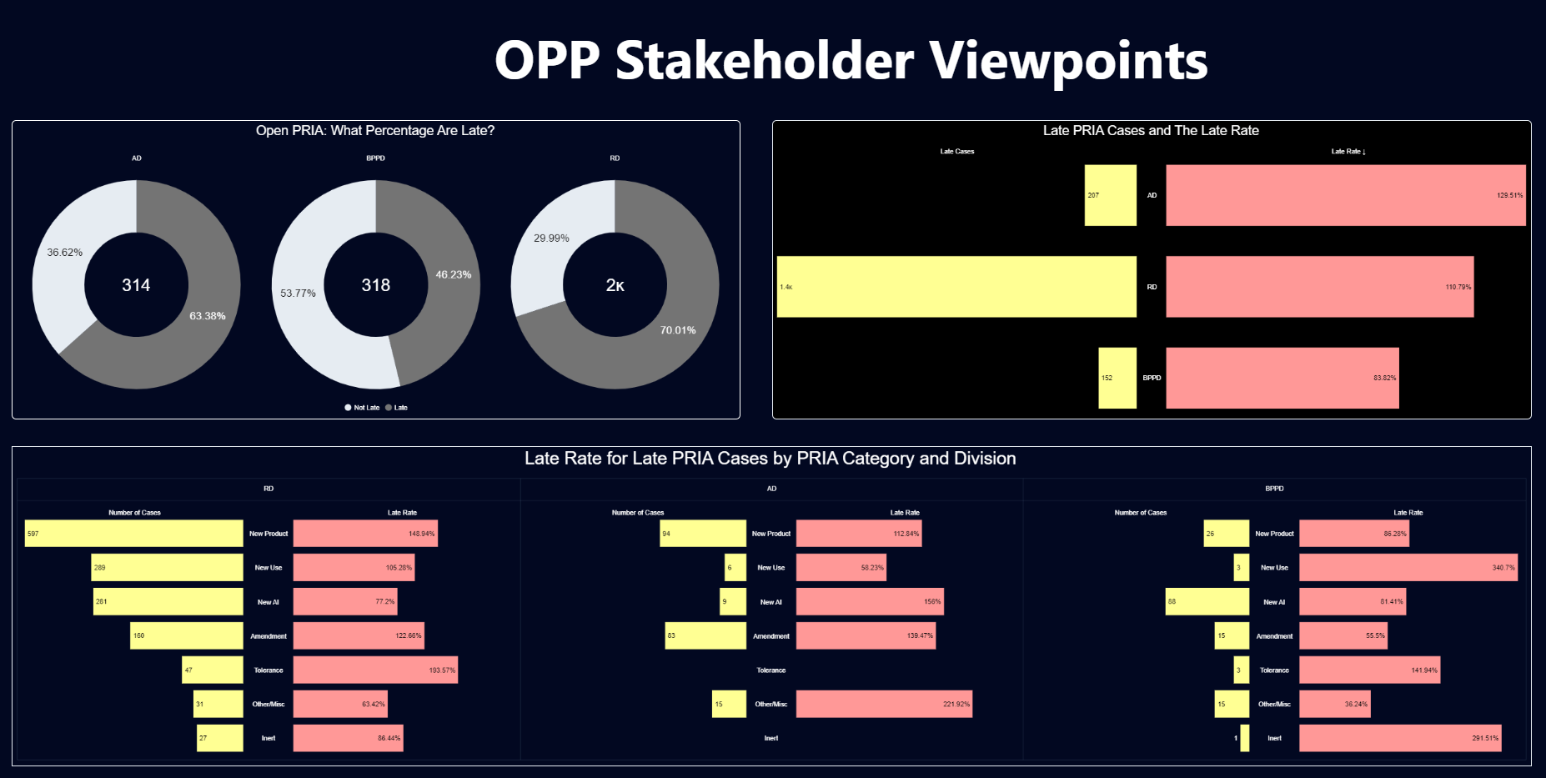

Slide 43
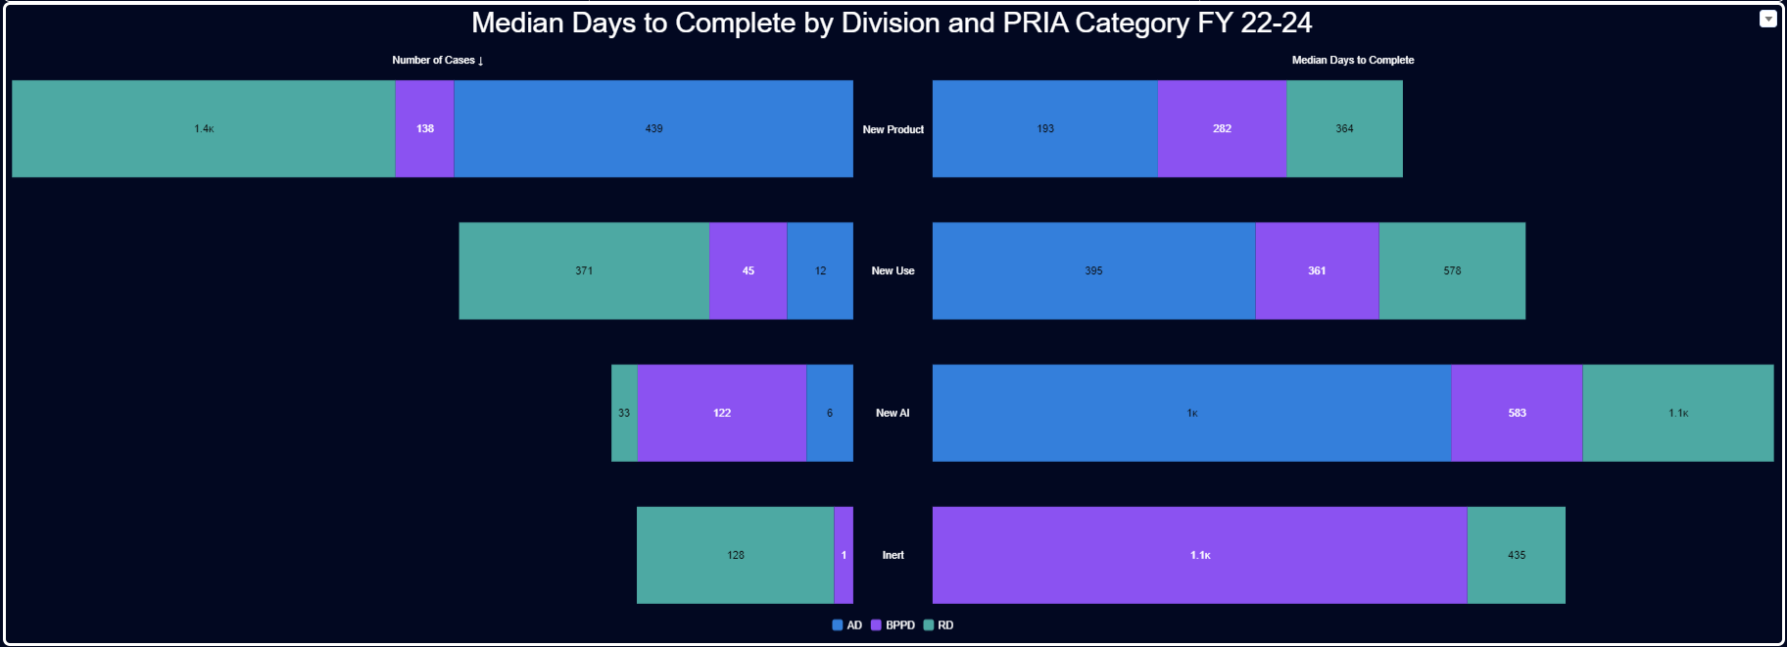

Slide 44
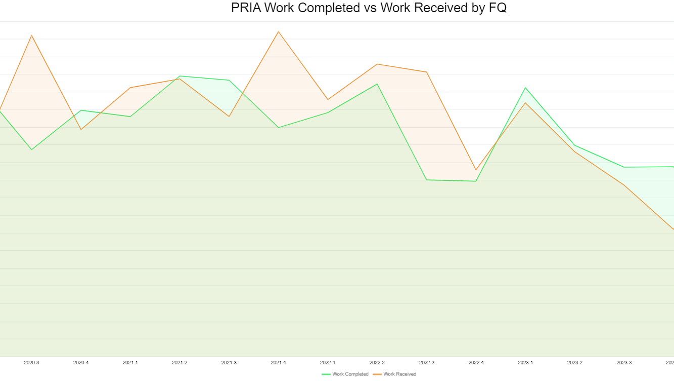

Slide 45
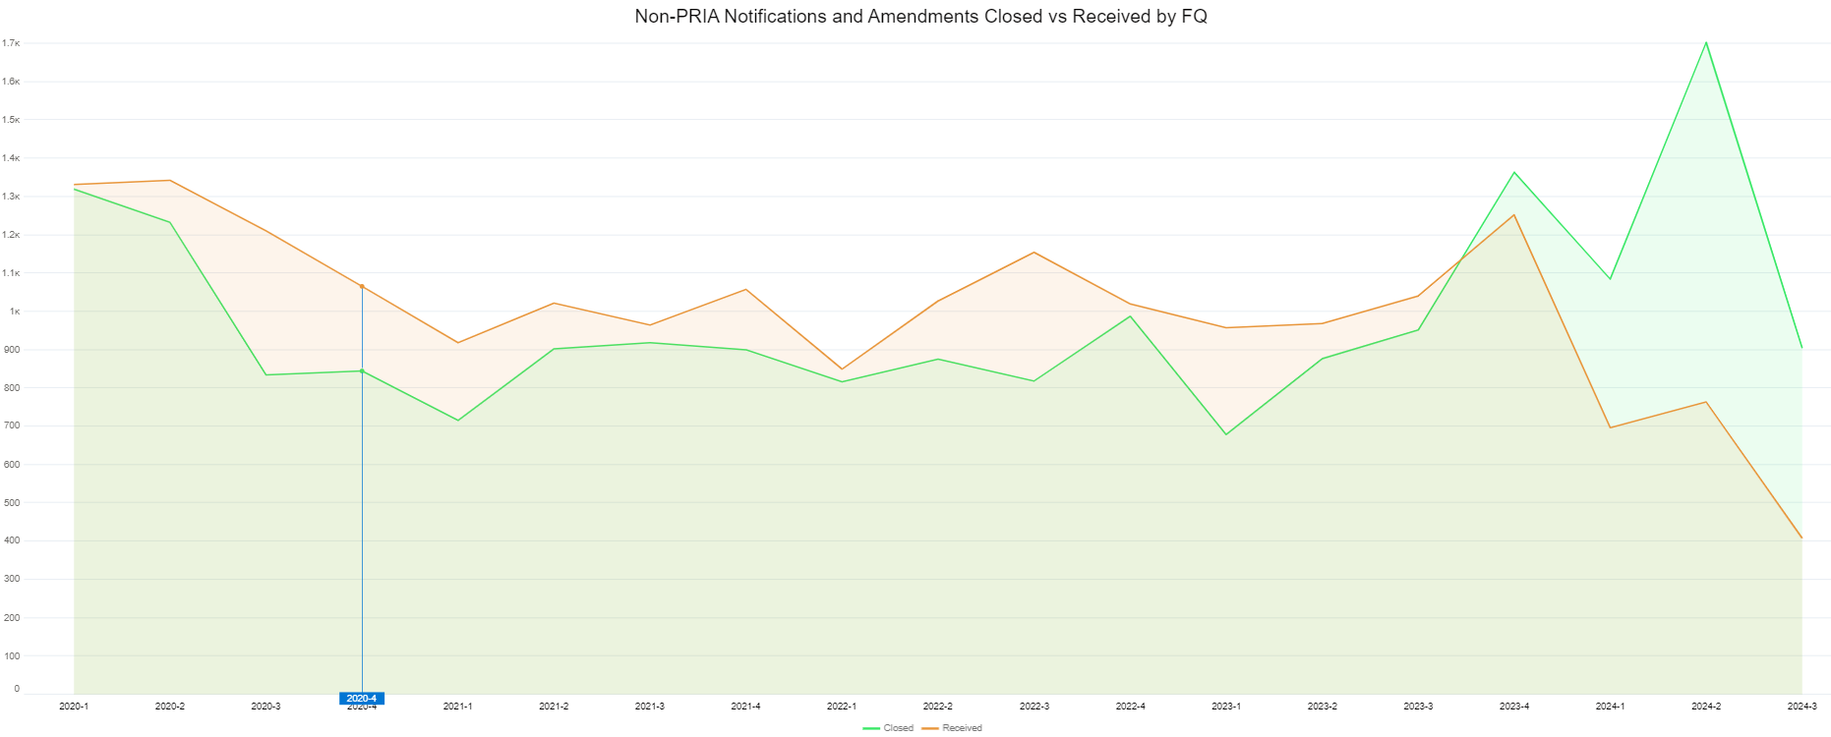

Slide 46
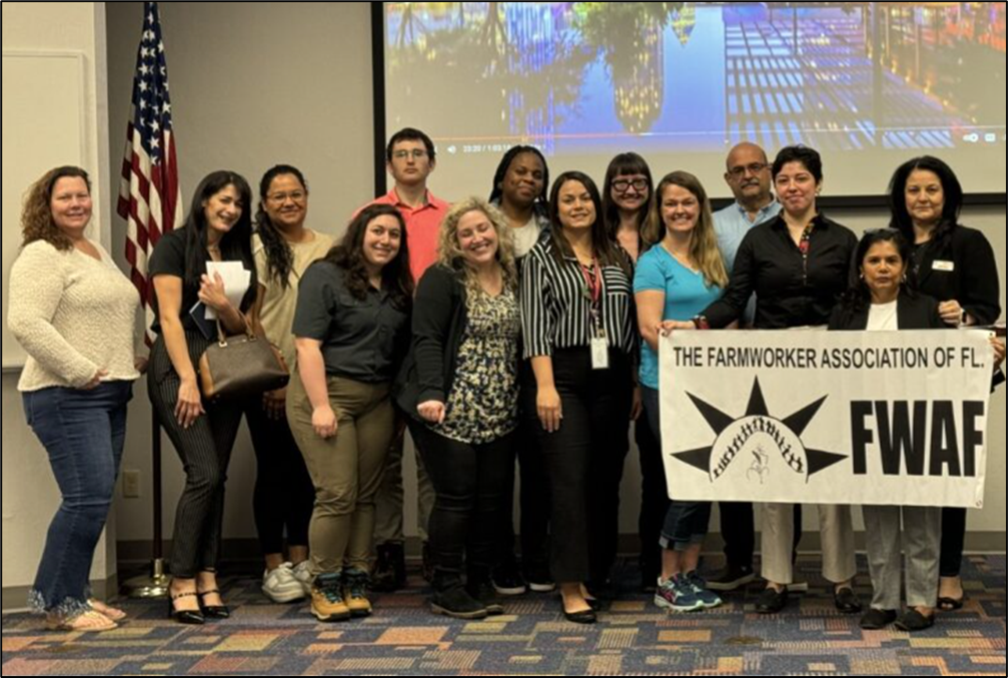
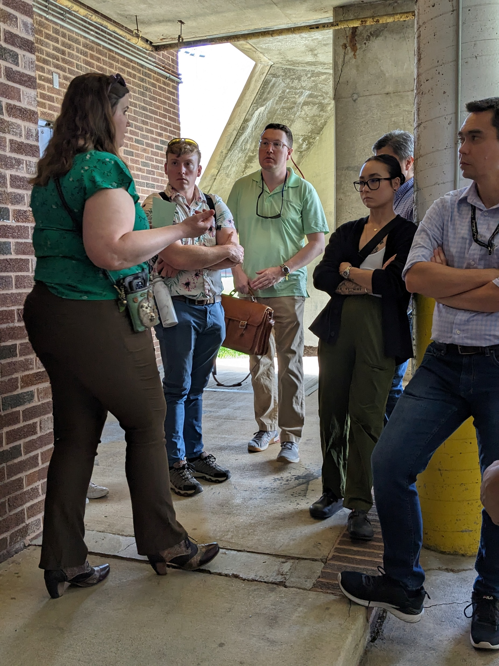
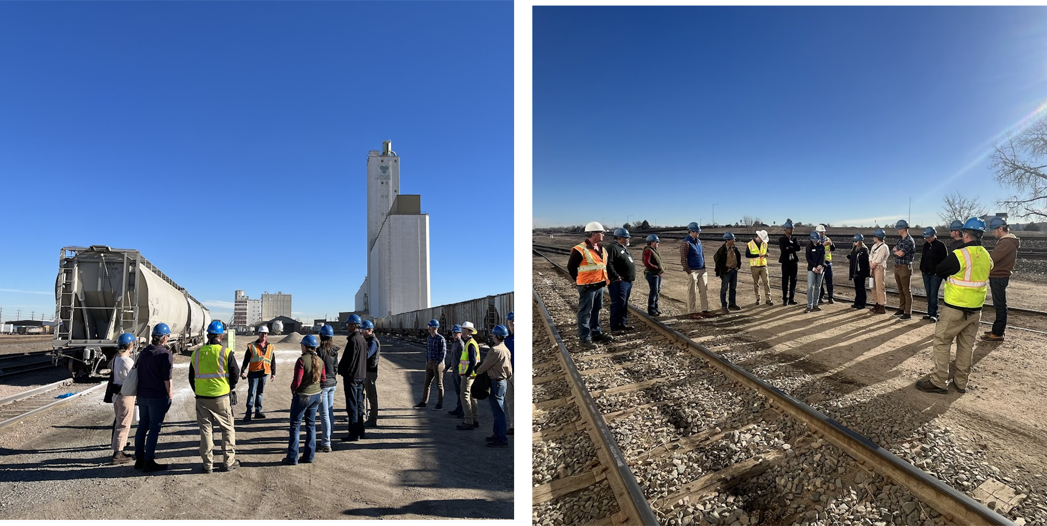
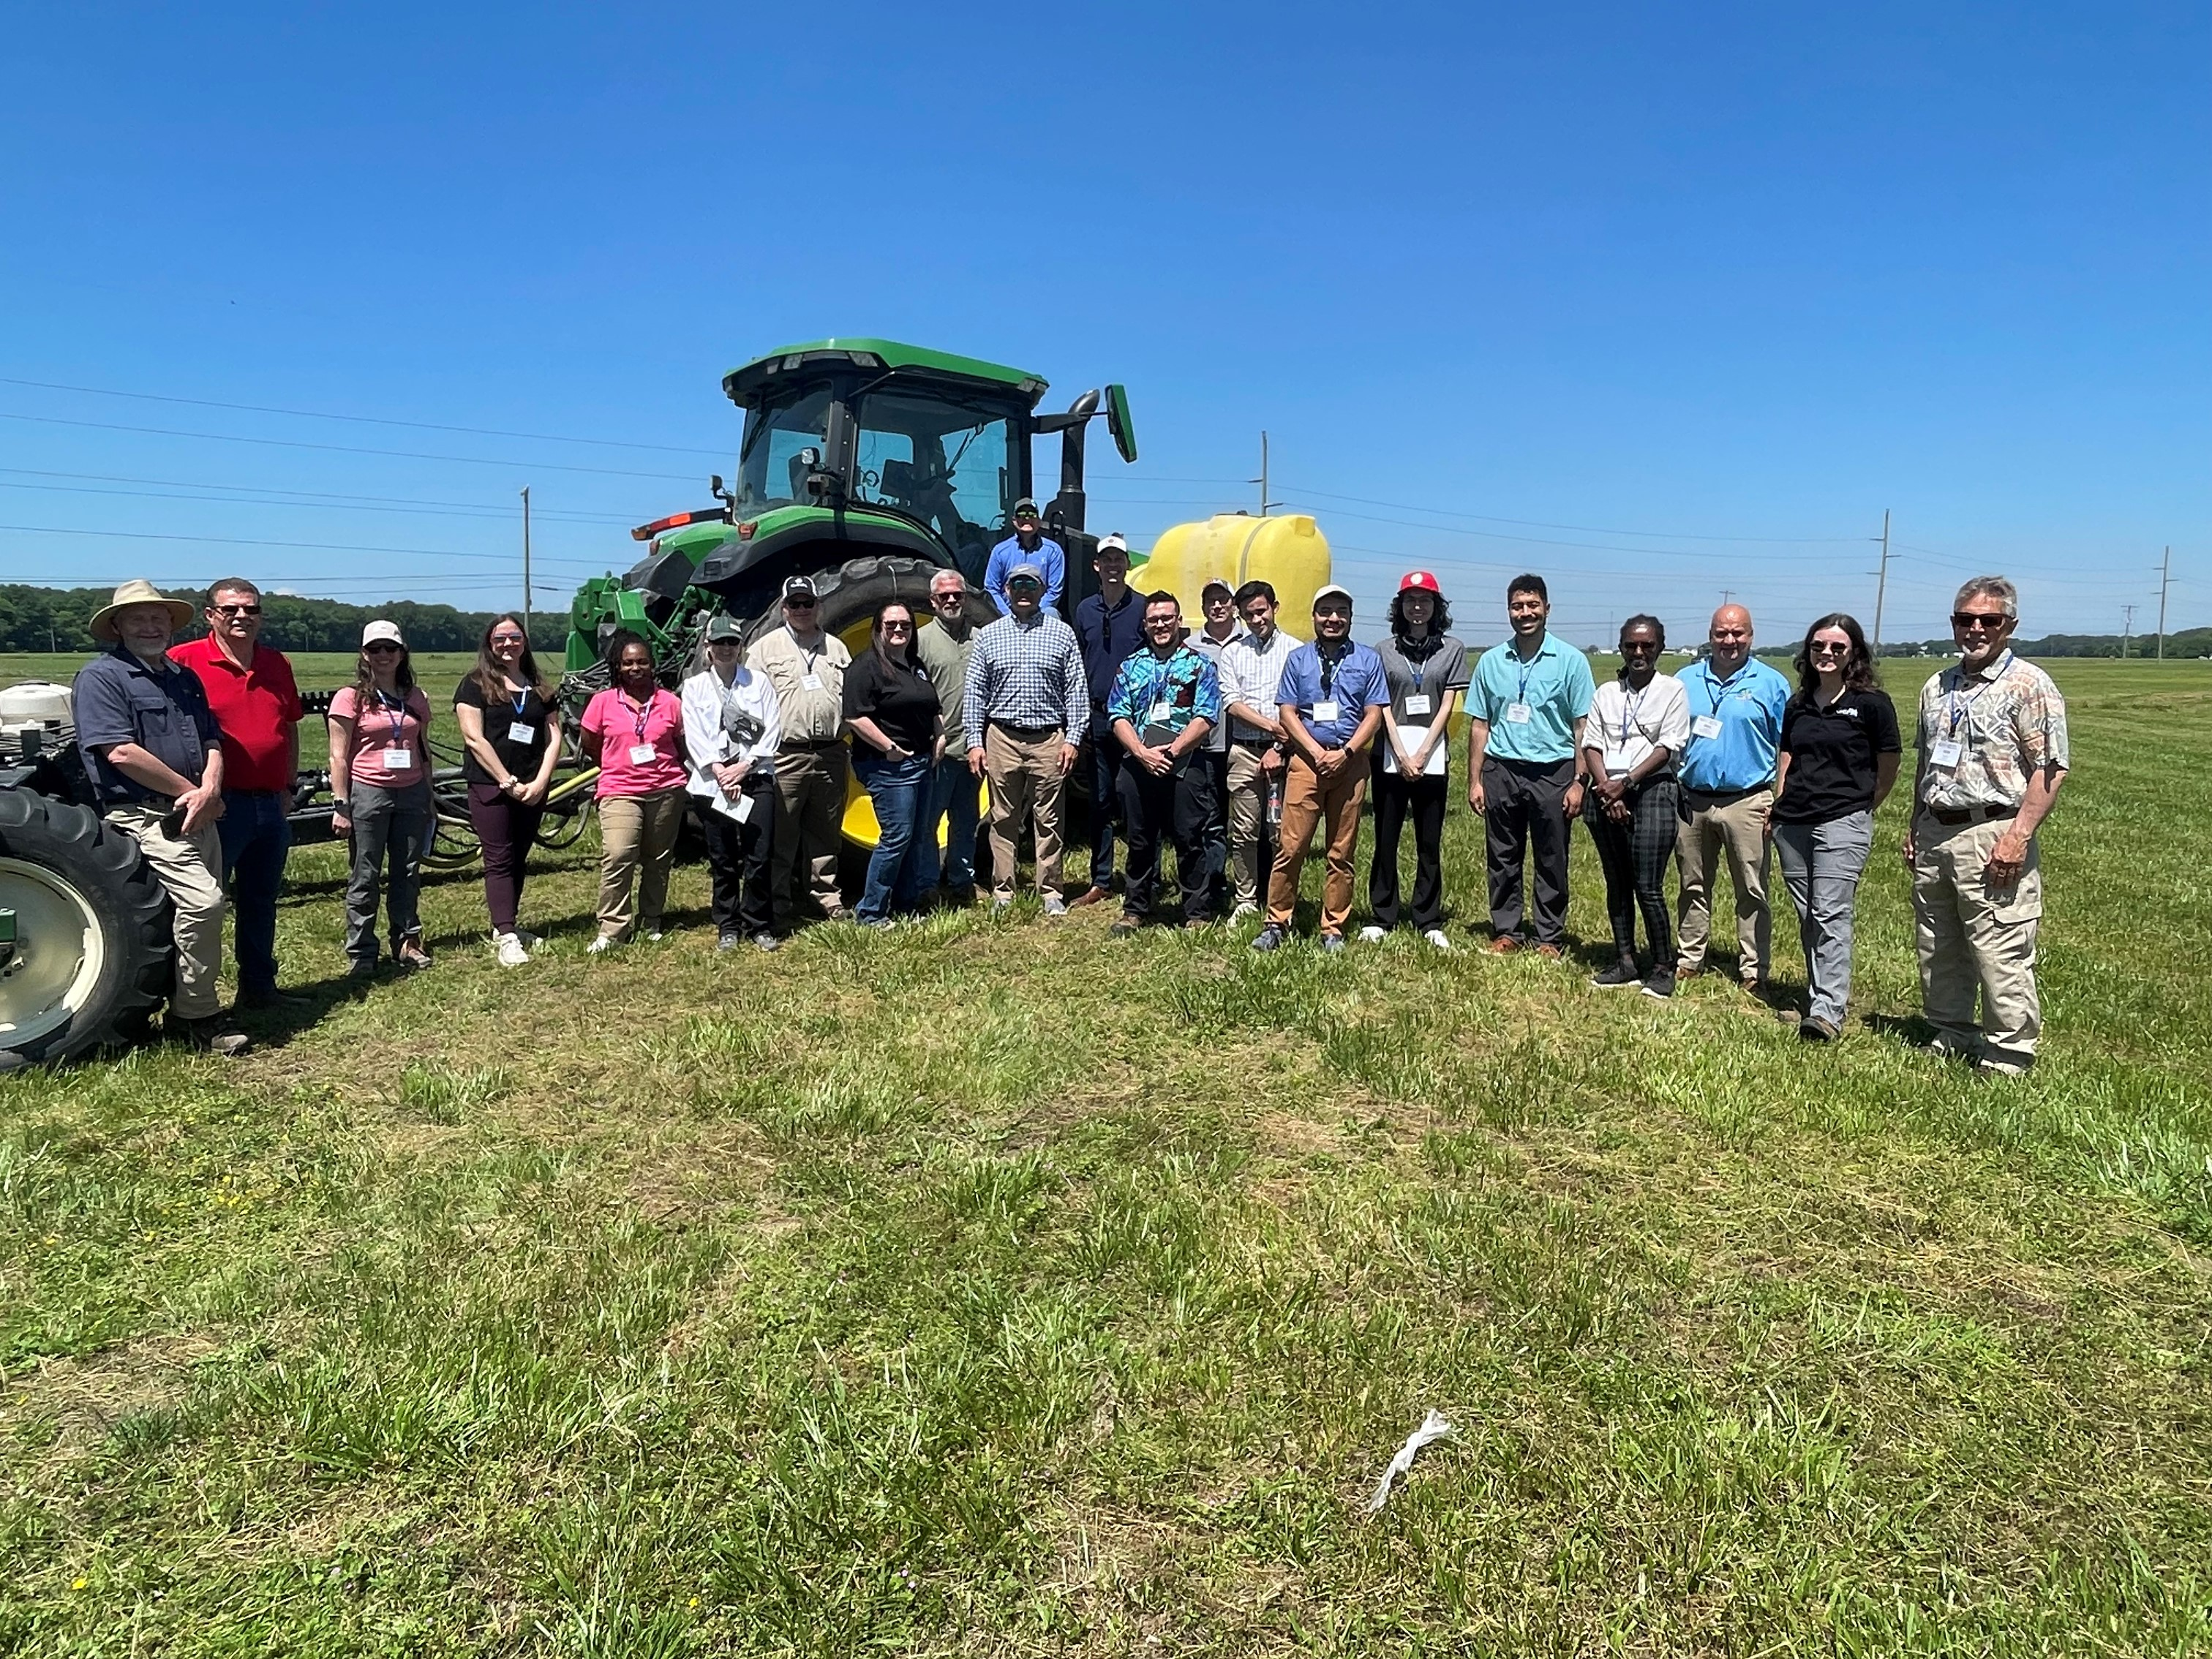

2024 Crop Tours
Meeting with Farmworker Association of Floride at the Florida Fruits and Vegetable Association crop tour, March 2024
Local rodenticide tour hosted by National Pest Management Association
April 2024
Rodenticide Tour hosted by Colorado and Wyoming Departments of Ag, February 2024
MD and NC Potato Tour, May 2024
MD and NC Potato Tour, May 2024
With Ag Commissioner, Rod Snyder

Slide 47
2024 Crop Tours – Still to Come
Aquatic Ecosystem Restoration Foundation: June 5-7, 2024; West Palm Beach and Orlando, Florida
Michigan IPM Alliance: June 24-26, 2024; Southwest Michigan
North Dakota Grain Growers Association: June 24-26, 2024; Bismarck, ND
The IR-4 Project: June 26, 2024; Adams County, PA
USA Rice: August 5-8,2024; Memphis TN
California Specialty Crops Council: August 5-9, 2024; Visalia and Sacramento, CA
National Association of Landscape Professionals: August 20,2024; Richmond, VA
National Cotton Council of American: August 26-30, 2024; Memphis, TN

Slide 48
FY2017: 59
FY2018: 52
FY2019: 46
FY2020: 75
FY2022: 66
FY2023: 96
FY2024 YTD: 53

Slide 49


Sign-up for OPP Pesticide Updates
Get pesticide news story updates by email:
Go to epa.gov/pesticides
Go to the “Recent Highlights and Pesticide News” box in the right corner
Click on “View more pesticide news” at the top
Go to the “Other Resources” box at the right
Under, “Get pesticide updates by email,” enter your email address and click “Sign up”

Slide 50
OPP Updates Since November 15-16, 2023 PPDC Meeting

Slide 51
OPP Updates
November 22, 2023: EPA Publishes Update on Vulnerable Species Project
EPA released an update to its Vulnerable Species Pilot (VSP) to help the public better understand the status of this initiative. As part of implementing the Agency’s Endangered Species Act (ESA) Workplan, EPA released the Draft VSP white paper on June 22, 2023, where the Agency identified 27 federally threatened and endangered (listed) species that are vulnerable to pesticides, identified and proposed mitigations to minimize or avoid pesticide exposure, and described an approach to implement the mitigation in future pesticide decisions.
EPA provided a 45-day public comment period on the draft white paper and the associated technical document and received more than 10,000 comments from a diverse set of groups. Approximately 200 of these were unique comments, with the remainder being a mail-in campaign in support of the VSP.
This update provides additional detail on the major themes in the public comments and potential changes to proposed mitigations. The full update, along with additional details regarding the project and mitigation proposals, are available in the public docket EPA-HQ-OPP-2023-0327 at www.regulations.gov.

Slide 52
OPP Updates
November 24, 2023: EPA Seeks Public Comment on Petition for Rulemaking to Require Efficacy Data for Systemic Insecticides
EPA requested public comment on a petition received from the Public Employees for Environmental Responsibility (PEER), the American Bird Conservancy (ABC), and 63 additional signatories requesting that the Agency initiate a rulemaking for neonicotinoid and other systemic insecticides.
These insecticides are applied directly to the plant, soil, and/or used as a seed treatment depending on the specific use site and target pest.
The petition asserts that data regarding efficacy of these insecticides are necessary to examine if the benefits of use outweigh the potential risks to non-target species and biodiversity.
The petition also sought amendments to the rule to preclude EPA from registering and to require EPA to “revoke any existing registration” for “any neonicotinoid or other systemic insecticide that lacks a demonstration that its benefits exceed its environmental and overall costs.”

Slide 53
OPP Updates
December 1, 2023: EPA Releases Draft Biological Evaluation of 11 Rodenticides’ Effects on Endangered Species
EPA released a draft Biological Evaluation (BE) that includes EPA’s draft effects determinations for federally listed and proposed threatened and endangered (“listed”) species and critical habitats for 11 rodenticide active ingredients.
As part of this analysis, EPA evaluated the effects of the 11 rodenticides on 1,784 listed species and 904 designated critical habitats in the United States and its territories. EPA determined that these rodenticides:
  will cause no effect (NE) on 1,576 listed species (88%) and 857 critical habitats (95%).
  are not likely to adversely affect (NLAA) 72-199 listed species (4%-11%, depending on the chemical and application type) and 9 critical habitats (1%).
  are likely to adversely affect (LAA) 9-136 listed species (1%-8%, depending on the chemical and application type) and 38 critical habitats (4%).
The draft BE (once finalized) would serve as the Agency’s Rodenticide Strategy as outlined in EPA’s Endangered Species Act Workplan to guide how the Agency addresses mitigation for rodenticides going forward and would be available for public comment for 60 days.

Slide 54
OPP Updates
December 1, 2024: EPA Posts Final Endangered Species Act Biological Opinion for Enlist Herbicide Products
EPA posted the U.S. Fish and Wildlife Service’s (FWS) final biological opinion (BiOp) for Enlist pesticide products. Enlist One and Enlist Duo are two herbicides used to control weeds in corn, cotton, and soybean crops.
This final BiOp is the result of EPA’s consultation with FWS and its consideration of information received from EPA, the registrant of the products, states, and stakeholders.
The BiOp contains findings from FWS that the use of Enlist products, as specified in the approved product labels, are not likely to jeopardize any listed species or adversely modify their critical habitats.
It also concludes that off-labeling counties is not needed to prevent J/AM conclusions for species and critical habitats that were part of the January 2022 assessment, but that for some species and critical habitats in those counties, specific species and habitat mitigation measures are still needed to prevent J/AM. EPA has updated its BE to reflect the results this FWS’s BiOp.
To ensure compliance with sections 9 and 4(d) of the ESA (which exempts incidental take of some listed species), EPA will:
  Report annually to FWS with ecological incident data collected and analyzed.
  Review and act on label changes within 18 months of the BiOp issuance.
  Maintain and evaluate data on Enlist products exposure to listed species and critical habitats.
  Provide training and education to pesticide users and applicators.

Slide 55
OPP Updates
December 6, 2023: EPA Approves Additional Use of Biopesticide to Help Suppress Mosquito Populations that Spread Diseases
EPA approved an amendment to expand use of the mosquito control product ZAP Males®, allowing use of the product in all U.S. states and territories.
ZAP Males® is a biopesticide that can suppress invasive local populations of Aedes albopictus or Asian Tiger Mosquitoes, which can spread numerous diseases of significant human health concern, including dengue, Zika, and chikungunya.
The amended registration is term-limited and will expire on December 31, 2028, five years from the date of the amended registration, which will provide an opportunity for EPA to re-evaluate the use and effectiveness of this product.

Slide 56
OPP Updates
December 14, 2023: EPA Releases Final Guidance for Pesticide Submissions for New Outdoor Uses that Require Endangered Species Act Reviews
EPA released final guidance to pesticide registrants to improve the efficiency of EPA’s Endangered Species Act (ESA) analyses for new outdoor uses of existing conventional pesticides and biopesticide active ingredients.
This guidance fulfills requirements outlined in the Pesticide Registration Improvement Act of 2022 (PRIA 5) and furthers goals outlined in EPA’s 2022 ESA Workplan to protect listed species from exposure to pesticides.
The recommendations focus on actions that applicants can voluntarily pursue to inform their proposed mitigation measures for listed species.
These actions include identifying where a pesticide will be used, how species may be exposed to the pesticide, and how to select mitigation to reduce the exposure.

Slide 57
OPP Updates
December 19, 2023: EPA Update on Next Steps for Chlorpyrifos
On November 2, 2023, the Eighth Circuit issued a ruling vacating EPA’s final rule and remanding the matter to EPA for further proceedings.
The ruling did not include a timeframe or specific instructions for EPA to take a final action on the use of chlorpyrifos in food or feed crops without public comment.
Upon issuance of the Eighth Circuit’s mandate, all chlorpyrifos tolerances would automatically be in effect once again.
The Eighth Circuit’s decision stated that EPA should have considered modification of tolerances in addition to complete revocation and noted that the Agency had “identified 11 specific candidates” of food and feed crop uses whose tolerances could be so modified in a Preliminary Interim Decision EPA issued in 2020.
Consequently, the Agency expects to expeditiously propose a new rule to revoke the tolerances associated with all but the 11 uses referenced by the court.
In conformance with the Eighth Circuit’s ruling and after issuance of the mandate, EPA intends to issue a notice correcting the Code of Federal Regulations to reflect the court’s reinstatement of chlorpyrifos tolerances.

Slide 58
OPP Updates
December 21, 2024: EPA Launches New Program to Incentivize the Development of Novel Mosquito Control Product
EPA is launched the Vector Expedited Review Voucher (VERV) Program, to incentivize companies to develop novel or unique mosquito control products to help prevent the spread of mosquito-borne diseases like malaria, dengue, and Zika.
The Agency is required to implement this program under the Pesticide Registration Improvement Act of 2022 (known as “PRIA 5”).
Under the VERV Program, EPA will issue a voucher to the registrant of a new, qualifying pesticide product for mosquito control when it is successfully registered.
An applicant may then redeem this voucher when submitting a future application for a different product under one of the specified PRIA codes. EPA will then expedite its review of the application, potentially allowing a shorter time to market for the product involved. Once issued, vouchers may be sold or transferred to other registrants.

Slide 59
OPP Updates
December 22, 2023: EPA Registers Novel Pesticide Technology for Potato Crops
EPA registered biopesticide products containing the new active ingredient Ledprona for three years, a timeframe that is consistent with EPA’s approach to other novel biopesticide products.
Ledprona is a new type of pesticide that relies on a natural mechanism--called RNA interference (RNAi)--used by plants and animals to protect against disease.
Ledprona is a sprayable double-stranded ribonucleic acid (dsRNA) product that targets the Colorado potato beetle (CPB), a major pest of potato crops grown in the United States, including in the potato-growing states of Colorado, Idaho, Maine, Michigan, Minnesota, North Dakota, Oregon, Washington, and Wisconsin.

Slide 60
OPP Updates
January 8, 2024: EPA Issues Advisory on Pesticides Used to Control Varroa Mites in Beehives, Including Coordinated Efforts to Support the Beekeeping Community
EPA issued an advisory to clarify what pesticide products and active ingredients are registered to control Varroa mites (Varroa destructor) in beehives, what tolerances or exemptions under the FFDCA apply to those products, and how the Agency views the use of unregistered products to treat beehives for one’s own personal use.
EPA learned that beekeepers may be using products containing pesticide active ingredients (e.g., oxalic acid, formic acid, amitraz, and thymol) that are not registered pesticides to control Varroa mites in bee colonies.
In the advisory, EPA affirmed that the use of registered pesticides must comply with labeling requirements under FIFRA, that pesticide residues in or on food derived from beehives (e.g., honey, comb, wax, propolis, royal jelly, pollen) must comply with any federal tolerances under FFDCA, that use of unregistered pesticides to control varroa mites cannot extend beyond personal use, and that there may be more restrictive state requirements that must also be followed.

Slide 61
OPP Updates
January 10, 2024: Update on EPA’s Progress for Implementing the Pesticide Registration Improvement Act of 2022
EPA announced the Agency’s first year progress on deliverables under the Pesticide Registration Improvement Act of 2022 (PRIA 5).
Registration service fees authorized by PRIA fund approximately one third of EPA’s pesticide program activities.
In recent years, EPA received an increased number of applications requiring the Agency to review more scientifically complex topics, including implementation of Endangered Species Act (ESA) compliance as part of its regulatory determinations.
Fee increases and revised decision review timeframes authorized by PRIA 5 help improve EPA’s performance in its review of new applications and reevaluation of older registered pesticides.
In addition to revised fees and decision timeframes, PRIA 5 included new provisions, such as implementation of farmworker protections and health clinician training, bilingual pesticide labeling, targeted funding to address the backlog of non-fee related applications, and development of ESA guidance to registrants.

Slide 62
OPP Updates
January 25, 2024: EPA Requests Input on Pesticide Safety Education Program for Farmworkers
EPA sought public input on the design of a new National Farmworker Training and Education Program (NFTEP) on pesticide safety.
The NFTEP is a grant program funded through the Pesticide Registration Improvement Act of 2022 (PRIA 5) and will support activities such as pesticide safety training, materials development, and outreach to farmworkers.
EPA released a Request for Information (RFI) on potential program design elements and activities to be funded under the NFTEP.
The RFI also posed a series of questions to stakeholders about barriers to involvement in safety trainings and education programs and applying for grant funding.

Slide 63
OPP Updates
January 29, 2024: EPA Taking Public Comment on Draft Policy to Strengthen Scientific Integrity
EPA released draft updates to its Scientific Integrity policy for public comment.
The updates would include adopting a new Federal definition of scientific integrity and improving the culture of scientific integrity at the Agency.
EPA developed the updated policy in response to the 2021 Presidential Memorandum on Restoring Trust in Government Through Scientific Integrity and Evidence-Based Policymaking.
The draft policy is built on the Office of Science and Technology Policy A Framework for Federal Scientific Integrity Policy and Practice, the lessons EPA has learned from over 10 years of implementing its Scientific Integrity Program, and results from past EPA scientific integrity surveys.

Slide 64
OPP Updates
On February 1, 2024: EPA Issues Guidance on “Absence of an Ingredient” Claims for Pesticide Products
EPA issued guidance to clarify how it will evaluate “absence of an ingredient” claims for pesticide products regulated under FIFRA. These claims appear on pesticide labeling and state that the product is free of a particular ingredient.
EPA will consider “absence of ingredient” claims on a case-by-case basis and may allow those claims if there is information that ensures the claims are not false or misleading.
In addition, in some instances, “absence of an ingredient” claims should include a qualifying statement that is prominently displayed and adjacent to the claim (e.g., “Not a safety claim”), so that the potential to mislead or confuse the public is limited.

Slide 65
OPP Updates
February 7, 2024: EPA Outlines Implementation Approaches for Endangered Species Act Pesticide Policies
EPA announced its plans to address key concerns, expand its partnership with the USDA, and seek additional stakeholder engagement as it continues to address the challenge of protecting endangered species from pesticide exposure.
The plan includes:
  Improved Species Maps
  Credit for using Voluntary USDA Conservation Practices
  Online Mitigation Menu
  Offsets for Endangered Species Protections

Slide 66
OPP Updates
February 14, 2024: EPA Awards $10 Million to Oregon State University to Support Pesticide Safety Education
EPA awarded a $10 million cooperative agreement to Oregon State University to support the operations of the National Pesticide Information Center (NPIC), a resource that provides the public with objective, science-based information on pesticide-related subjects.
Funding under this agreement supports the safe use of pesticides through information provided via the web, phone, and direct outreach.

Slide 67
OPP Updates
February 14, 2024: EPA Provides Update on Over-the-Top Uses of Dicamba
In light of the February 6, 2024, ruling by the U.S. District Court of Arizona vacating the 2020 registrations for over-the-top (OTT) dicamba products, EPA provided the following update:
On February 14, 2024, EPA issued an Existing Stocks Order for Dicamba Products Previously Registered for Over-the-Top Use on Dicamba-Tolerant Cotton and Soybean.
This Order addresses use of the formerly-registered dicamba products and authorizes limited sale and distribution of dicamba products that are already in the possession of growers or in the channels of trade and outside the control of the pesticide companies.

Slide 68
OPP Updates
February 15, 2024: EPA Releases New Methodology to Detect Low Levels of PFAS in Plastic Containers:
EPA released a new methodology for detecting per- and polyfluoroalkyl substances (PFAS) in plastic containers, taking another step to protect the public from these harmful chemicals.
The new method will provide an additional tool for EPA and for industries that use high-density polyethylene (HDPE) containers to identify PFAS contamination.
This action also supports EPA’s PFAS Strategic Roadmap, which renewed the Agency’s commitment to using sound science and investing in research to proactively stop PFAS chemicals from entering the environment.

Slide 69
OPP Updates
February 26, 2024: EPA Launches New List of Disinfectants Effective Against HIV, Hepatitis B, and Hepatitis C Viruses
EPA has combined and updated information from several disinfectant lists to create a new list titled “EPA-Registered Antimicrobial Products Effective Against Bloodborne Pathogens (HIV, Hepatitis B and Hepatitis C) [List S]." EPA launched this new disinfectant list to increase the accessibility, accuracy, and functionality of the information for all readers, including health care providers and hospital staff.
  The new List S combines product information from the following former EPA disinfectant lists:
  List C: EPA’s Registered Antimicrobial Products Effective Against Human HIV-1 Virus;
  List D: EPA’s Registered Antimicrobial Products Effective Against Human HIV-1 and Hepatitis B Virus;
  List E: EPA’s Registered Antimicrobial Products Effective Against Mycobacterium tuberculosis, Human HIV-1 and Hepatitis B Virus; and
  List F: EPA’s Registered Disinfectants for use Against Hepatitis C.
EPA Lists C, D, E and F are now retired and will be redirected to the new List S.
This new list includes products that are effective against HIV, Hepatitis B and Hepatitis C viruses and specifies which products are not effective against one or more of these viruses.

Slide 70
OPP Updates
March 1, 2024: EPA Releases Updated Draft Risk Assessment for Pesticide Malathion
EPA released an updated draft human health risk assessment (HH DRA) for the pesticide malathion.
The updated HH DRA amends the 2016 malathion dietary, occupational, and residential risk assessments using updated information and techniques.
The updated HH DRA finds no human health risks of concern for malathion when used in accordance with label instructions.
EPA is also proposed several food tolerance changes, based on commodity definition revisions and to harmonize tolerance levels with those of other countries.

Slide 71
OPP Updates
March 3, 2024: EPA Provides Update on Streptomycin Uses on Citrus
EPA provided an update in light of the Ninth Circuit’s December 2023 decision that vacated the 2021 registration amendments for streptomycin because of the Agency’s failure to comply with the Endangered Species Act.
The 2021 amendments added a time-limited use on citrus crop group 10-10 for two streptomycin sulfate pesticide products. The Citrus crop group 10-10 includes orange, tangerine, lime, grapefruit commodities and varieties of these citrus fruits.
On February 5, 2024, the Court’s order vacating the 2021 amendments became effective, making it unlawful to sell or distribute AGRI-SEEDTM 50 WP also branded as FirewallTM 50 WP (EPA Reg. No. 80990-3) and EACTM Streptomycin Manufacturing Use Product (EPA Reg. No. 91275-1) labeled for use on citrus. On March 4, 2024, EPA issued a Notice of Use Termination and an Existing Stocks Order for Time-Limited Use on Citrus Crop Group 10-10 for these products. The existing stocks order addresses use of these streptomycin products on citrus and authorizes limited sale and distribution of some of these products that are already in the possession of growers or in the channels of trade and outside the control of the pesticide companies.

Slide 72
OPP Updates
March 5, 2024: EPA to Host Webinar on Best Practices for Antimicrobial Product Registration
EPA hosted a webinar on the pesticide registration process for antimicrobial products.
Experts from EPA’s Office of Pesticide Programs:
  Provided an overview of the pesticide registration process under the Federal Insecticide, Fungicide, and Rodenticide Act;
  Provided information on what to do before applying for antimicrobial product registration;
  Discussed how to prepare Confidential Statements of Formula as well as various other documents and forms that need to be submitted to the Agency;
  Discussed non-PRIA submissions (i.e., notifications and fast track amendments under PRN 98-10);
  Shared examples of submission cover letters and common labeling issues as well as information on efficacy data, and registration review.

Slide 73
OPP Updates
March 14, 2024: EPA Update on Existing Stocks Provisions for Three Chlorpyrifos Products
EPA issued an update on existing stocks provisions for three chlorpyrifos pesticide products made by the company Adama – Pyrinex Chlorpyrifos Insecticide, Chlorpyrifos 4E AG (alternate brand name Quali-Pro Chlorpyrifos 4E), and Vulcan.
In a final rule issued in August 2021, EPA revoked all tolerances for chlorpyrifos.
On May 4, 2023, EPA granted Adama’s request to cancel food and tobacco use of its chlorpyrifos products.
On November 6, 2023, EPA granted Adama’s request to terminate the food processing and food manufacturing site uses on those same three chlorpyrifos products.
On December 28, 2023, the U.S. Court of Appeals for the Eighth Circuit vacated EPA’s August 2021 rule revoking all tolerances.
On February 5, 2024, EPA issued a Federal Register notice to amend the Code of Federal Regulations to reflect the court's reinstatement of those tolerances.
At this time, all the chlorpyrifos tolerances have been reinstated and are currently in effect.
Adama has requested amendments to the cancellation orders governing disposition of their existing stocks to allow for sale, distribution, and use.
At this time, EPA is amending the existing stocks provisions in the May 4 and November 6 cancellation orders.

Slide 74
OPP Updates
April 1, 2024: EPA Warns Farmworkers about Risks of Dacthal
EPA announced its next steps to protect people from the herbicide dimethyl tetrachloroterephthalate (DCPA, or Dacthal).
EPA is warning people of the significant health risks to pregnant individuals and their developing babies exposed to DCPA and will be pursuing action to address the serious, permanent, and irreversible health risks associated with the pesticide as quickly as possible.
EPA has also issued a letter to AMVAC, the sole manufacturer of DCPA, restating the risks the agency found and stating that due to the serious risks posed by DCPA, the agency is pursuing further action to protect workers and others who could be exposed.
EPA is taking this rare step of warning farmworkers about these concerns while it works on actions to protect workers because of the significant risks the agency has identified.

Slide 75
OPP Updates
April 2, 2024: EPA Announces the Implementation of Mitigation Measures for Insecticides Chlorpyrifos, Diazinon, and Malathion to Protect Endangered Species
EPA is implementing measures to protect federally threatened or endangered (listed) species and their designated critical habitats from the effects of the insecticides chlorpyrifos, diazinon, and malathion.
The measures include changes to pesticide labeling requirements and issuing of Endangered Species Protection Bulletins that set geographically specific limitations on pesticide use.
Registrants have submitted these product labeling amendments to EPA, as well as amendments describing how to report ecological incidents associated with pesticide applications, should users observe any.
Amended label guidance will be included on the next printing of product labels, with a 12-month existing stock provision included in the agreement.

Slide 76
OPP Updates
April 16, 2024: EPA Publishes Update on Herbicide Strategy Progress
EPA released an update to its draft Herbicide Strategy, which is part of the Agency’s plan to improve how it meets its ESA obligations. The purpose of this update was to describe some improvements that EPA plans to make as it continues finalizing the strategy to increase flexibility and improve ease of implementation while still protecting federally listed species.
The draft strategy, which EPA released for public comments in July 2023.
EPA received extensive comments on the draft strategy, with many reiterating the importance of protecting listed species from herbicides. EPA plans to make a number of improvements to the draft based on this feedback, with the primary changes falling into three categories:
  Making the strategy easier to understand;
  Increasing flexibility for growers to implement the mitigation measures in the strategy; and
  Reducing the amount of mitigation that may be needed when growers have already adopted voluntary practices to reduce pesticide runoff or where runoff potential is lower due to geography.
EPA continues to consider the public comments, meet with stakeholders, and collaborate with FWS, USDA, and state agencies. EPA expects to publish the final strategy by August 30, 2024.

Slide 77
OPP Updates
April 19, 2024: EPA Issues Draft Risk Assessment for Use of Formaldehyde as a Pesticide under FIFRA
EPA is released its draft risk assessment for formaldehyde and paraformaldehyde under FIFRA for public comment.
Draft risk assessment identifies risks to human health and the environment from the pesticidal uses of formaldehyde and describes some of the sources of uncertainties in EPA’s findings.
EPA also evaluated formaldehyde’s impact on the environment and found the potential for risk to terrestrial organisms from the registered pesticidal uses of formaldehyde and paraformaldehyde to fumigate various agricultural, commercial, and industrial areas.
EPA is accepting public comments on the FIFRA draft risk assessment for 60 days via docket EPA-HQ-OPP-2015-0739 at www.regulations.gov.

Slide 78
OPP Updates
April 30, 2024: EPA Proposes to Cancel All but One Use of Pesticide Acephate to Protect Human Health
EPA released a proposed interim decision (PID) to cancel all but one use of the pesticide acephate.
This decision is based on EPA's updated human health draft risk assessment (HH DRA) and drinking water assessment (DWA) that were released last year, which showed significant dietary risks from drinking water for currently registered uses of acephate.
EPA also identified worker, homeowner, and ecological risks that would be mitigated by the proposed cancellations.
The Agency is proposing to maintain the use of acephate for tree injection because it does not contribute to drinking water exposure, there are no risks for workers, and, with label changes, would not pose risks to the environment.
The revised HH DRA and DWA released in August 2023 and the PID released today are open for public comment for 60 days.

Slide 79
OPP Updates
May 3, 2024: EPA Opens Required Public Comment Period for Proposed Dicamba Herbicide from Bayer CropScience
EPA received an application from Bayer CropScience LP for a new product containing the currently registered active ingredient dicamba.
The proposed product includes use of dicamba on dicamba-tolerant soybeans and cotton.
Because the application involves a new use pattern for dicamba, the Agency is required to provide a 30-day public comment period on the registration applications consistent with FIFRA 3(c)(4).
EPA is also seeking comment on the associated draft labeling that was submitted by Bayer, which is available in the docket.
The proposed labels would allow application to dicamba-tolerant soybeans made before, during, or immediately after planting until emergence of the seedling, but no later than June 12 of each year.
Application to dicamba-tolerant cotton in this proposal would be allowed before, during, immediately after planting, or ‘over the top’ of the cotton plant, but no later than July 30 of each year.
Should EPA determine that this or any other registrant-submitted application including over-the-top dicamba meets the standard for registration of a new use under FIFRA, EPA will provide a separate opportunity for public comment on the proposed decision at a future time.

Slide 80
OPP Updates
May 8, 2024: EPA, FDA and USDA Issue Updates to the Joint Regulatory Plan for Biotechnology
EPA, USDA and FDA have developed a plan to update, streamline and clarify their regulations and oversight mechanisms for products of biotechnology.
The agencies have identified five major areas of biotechnology product regulation where these actions will focus:
  Modified plants
  Modified animals
  Modified microorganisms
  Human drugs, biologics and medical devices
  Cross-cutting issues
EPA, the FDA and USDA intend to implement the following joint efforts:
Clarify and streamline regulatory oversight for genetically engineered plants, animals and microorganisms;
Update and expand their information sharing through an MOU to improve and broaden communication and coordination of oversight of modified microbes; and
Undertake a pilot project focused on modified microbes to explore and consider the feasibility and costs of developing a web-based tool that informs developers about which agency may regulate a given product category.

Slide 81
OPP Updates
May 9, 2024: EPA Proposes to Register New Pesticide Active Ingredient, Glufosinate-P
EPA released for public comment its proposed registration decision for pesticide products containing the new active ingredient glufosinate-P to control weeds in non-tolerant and glufosinate-resistant corn, sweet corn, soybean, cotton, and canola. In addition to its proposed registration decision, EPA has also released its draft biological evaluation for the pesticide under the Endangered Species Act (ESA).
Based on the Agency’s human health risk assessment, the proposed uses of glufosinate-P have no human health risks. EPA’s ecological draft risk assessment identified risks for terrestrial and aquatic plants and chronic risk to mammals, bees, and non-bee terrestrial invertebrates that forage in treated fields and may be exposed to residues on food items exposed to off-site spray drift. EPA is proposing the following mitigation measures under FIFRA and ESA to address on- and off-field effects to non-target species.
EPA is accepting comments on the proposed registration of glufosinate-P through June 8, 2024, via the public document at EPA-HQ-OPP-2020-0250 at www.regulations.gov.

Slide 82
OPP Updates
May 17, 2024: EPA Issues 2023 Annual Report for Pesticide Registration Improvement Act
EPA issued the Fiscal Year (FY) 2023 PRIA Annual Report, the first one published since PRIA 5 was authorized in 2022. This report describes EPA’s implementation of PRIA 5 including: tracking and status for EPA’s review of pesticide registration actions, registration review cases, process improvements relating to the review of PRIA submissions, and maintenance fee set-asides for farmworker and health care provider training, partnership grants, and the pesticide safety education program.
Despite budget constraints, EPA continued to improve its regulatory processes in FY 2023. The following improvements, along with others described in the report, cannot make up for the resources constraints but will lessen the impacts of the budget shortfalls.
  Began work to reduce the backlog of non-PRIA actions by directing resources and engaging in process improvements around those actions, such as closing out 3,000 notifications received under Pesticide Registration Notice 98-10 as minor label or product formulation changes.
  Made significant and timely progress toward PRIA 5 milestones, including farmworker protection and health clinician training programs, bilingual pesticide labeling, and upgrades to information technology systems.

Slide 83
OPP Updates
May 24, 2024: EPA Halts Acceptance of Data for Pesticide Registration from a Non-compliant Laboratory
The U.S. Environmental Protection Agency (EPA) has halted the acceptance of studies generated by Palamur Biosciences Lab (Palamur) in Telangana, India, due to the possible falsification of data following an inspection by the Indian National Good Laboratory Practice Compliance Monitoring Authority (NGCMA).
In May 2023, EPA reviewed two suspicious studies conducted at Palamur, which led our reviewer to conclude there was possible falsification of data.
In July 2023, NGCMA conducted an inspection of Palamur and confirmed that data were falsified for most of the 58 studies audited, which were conducted between January 2020 and July 2023. NGCMA issued a ‘Not in Compliance’ status for the laboratory, which the Agency received in September 2023.
At this time, EPA is not accepting any studies from this lab, and registrants should not submit any new data from this lab.
EPA has determined that only one registrant has pending registration actions that rely on Palamur-generated product chemistry or acute toxicity data and four companies have existing registrations that rely on product chemistry or acute toxicity data generated by Palamur lab during this time-frame. EPA will work with each affected registrant to obtain appropriate replacement data or take other appropriate action such as cancellation or suspension.

