Slide 1
PPDC Label Reform Workgroup Update
June 5, 2024

Slide 2
PPDC Label Reform Workgroup Members
Lisa Dreilinger (Co-Chair) - Arxada
Sarah Hovinga (Co-Chair) - Bayer Crop Science
Michelle Arling (Co-Chair) - EPA
Gretchen Paluch - Iowa Agriculture
Steve Bennett – Household and Commercial Products Association (HCPA)
Liza Fleeson Trossbach - Virginia Department of Agriculture and Consumer Services
Anastasia Swearingen - Center for Biocide Chemistries– CBC
Karen Reardon - RISE - Responsible Industry for a Sound Environment)®
Amanda Burwell - Stepan
Claire Paisley-Jones - USDA
Amy Asmus - Asmus Farm Supply
Garrett Goins - John Deere
Wendy Sue Wheeler - Washington State University
Diana Stoyanova – Bayer
Jasmine Brown – Tribal Pesticide Program Council
Ligia Duarte – HCPA
Bob Mann – Landscape Professionals
B Chennupati – Pebble Labs
George Parker – Crop Jet/NAAA
Hannah Alleman – American Chemistry Council
Bill Jordan - Environmental Protection Network
Monty Dixon/ Kristian Paul - Syngenta Crop Protection
Dennese (Flores) Grimm - Gowan Company, LLC
Rhonda Jones / Tony Herber - Scientific & Regulatory Consultants (SRC)
Shannon Whitlock - Corteva (CLA/Rise Label WG Chair)
Joseph G. Grzywacz -San Jose State University
Diane Boesenberg - Exponent
Ray McAllister - RSM Consulting LLC
Daniel Skall - LANXESS Corp.
Erik Janus - Vive Crop
Paul Enwerekowe - Crop Life America
Tasha Lott – Albaugh LLC
Terry Kippley – CDPA
Julie Schlekau - Valent
Walter A. Alarcon MD MSc. – CDC NIOSH
Russell Darling- California DPR
Sarah Caffery – Office of Indiana State Chemist
Nina Heard - Independent Technology Consultant
Dan Schoeff, Charles “Billy” Smith, Christian Bongard, Steve Schaible, Bob Schultz, Jackie Hardy, Elizabeth Donovan, Steve Savage - EPA

Slide 3
Summary of Workgroup Members

Slide 4
Workgroup Charge Questions
Overall workgroup goals
To develop recommendations that support:
improvement to efficiency of the review and approval process
quality and consistency of review and approval of labeling
adoptability by industry and consumers
Charge questions 1 – Submission & Approval / Technology
Short term: Are there tools that could be utilized for improving/maximizing efficiency during the label submission and review process? (e.g., PDF comparison tools, new software, e-CSF; structure/layout of labels; might distinguish between types of product labeling; recordkeeping/information within salesforce; optimization of salesforce usage)
Long term: Ideally, what does the optimum electronic experience look like to maximize Agency resources and to maximize user adoption (submission, review, data tagging, and approval)?
Charge questions 2 – Content & Accessibility
With DEIA (diversity, equity, inclusion, accessibilities) principles in mind, what are the requirements of accessibility for labeling? (e.g., scannable technology, blind, deaf, color blind, non-English speakers, illiterate, no access to internet)
The EPA’s Label Review Manual guides what’s allowed on the label; what are the opportunities for modernization of claims and content? And how would we communicate this to stakeholders?
Parking lot issues:
  Display issues
  End user experience/accessibility
  Directions for use (temporary)

Slide 5

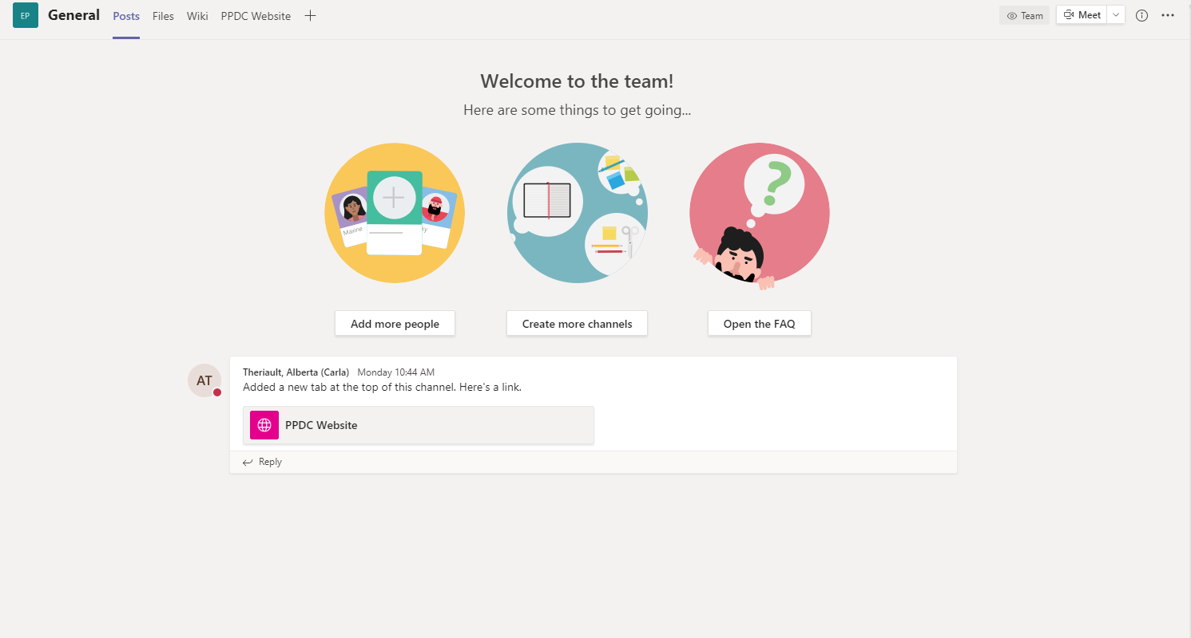
Timeline & Tools
PPDC LRWG Formed
June 2023
Progress Update at PPDC Meeting
Nov 2023
Target recommendations Completed
Spring 2024
Weekly Meetings
Teams Site

Slide 6
Structured Digital Labeling is Necessary for Label Reform
Short Term – Create Voluntary Label Structure*
Overall Goal: Share information with US EPA in consistent order and recommend similar words, stock language, and/or controlled vocabulary
All types of pesticide products use the same structure* for labeling material submitted to EPA
‘Data elements’ identified
  Note the source information (regulation/Label Review Manual/PR notice, CFR)
  Identify data elements that could have a “pick list” for harmonization
  Started to create detailed “pick lists” for identified data elements
  Controlled vocabulary or phrase sources needed
Recommend data elements for representative/placeholders to minimize submissions (e.g., QR codes and websites to be representative)
Recommend that EPA use document/section compare technology
  Would enable EPA with automation that could support ceasing de novo reviews when previously reviewed in the last {insert time frame} (e.g., 1 year/2 years) in most cases
(*discussion on terminology is on-going and could be a work product of year 2)

Slide 7
Structured Digital Labeling is Necessary for Label Reform
Long Term – Ability for EPA to Capture Labeling as “Digital Data”
Use short-term approach to inform foundational information and concepts important for digital labeling
EPA to determine what system is necessary based on needs of approach (in current parking lot)
Determine what parts of the Master Label can be ideally auto populated with information from the dossier submitted including:
  eCSFs
  Use Directions
  Precautionary Information
  Storage and Disposal
Determine how data submitted for Master Label can be utilized for risk assessments
Information on automating the label for end use customers where applicable (e.g., end-user specifics, auto programming tractors, etc.)
Move from document centric to data centric label information

Slide 8
Electronic Labeling – Short Term Proposals
This is a voluntary approach
Not every data element is mandatory on every label
Pick list information has been initially complied
There will be the option to add free text
All the “data” / “information” of the label will fit into one of these data elements
The information should be understandable to all audiences
If possible, approach should be prepared for use with technology advances that can reduce review time (e.g, a compare tool)
Proposal to house in a central guidance document that includes:
  Standardized/approved language
  Definition of the structure of where information appears
  If this guidance document is the Label Review Manual, would need refinement and updating to ensure user ease and to be consistent with other sources (e.g., CFR)
Source information and requirements will be highlighted (e.g., location requirements)
Recommend placeholder allowed for Website / QR Code /Telephone Number
Abbreviations will be defined
Use of this approach could result in quicker review times
  Consider metrics that can be used as a baseline and to then show progress as process improves

Slide 9
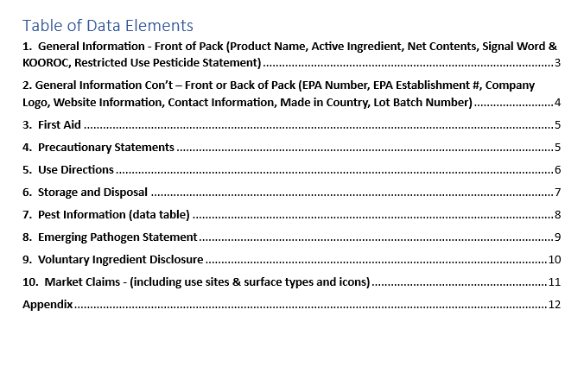
Electronic Labeling – Structured Label (Antimicrobial Example)

Slide 10
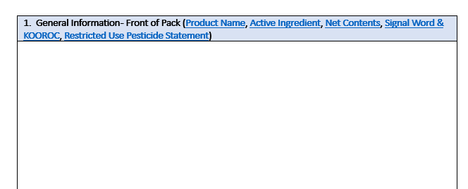
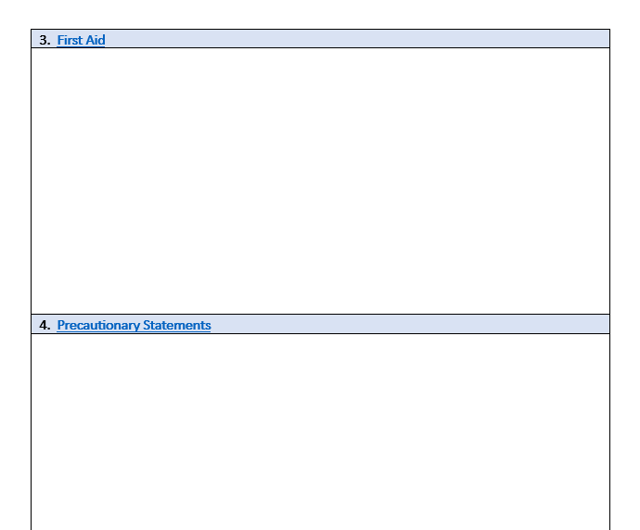
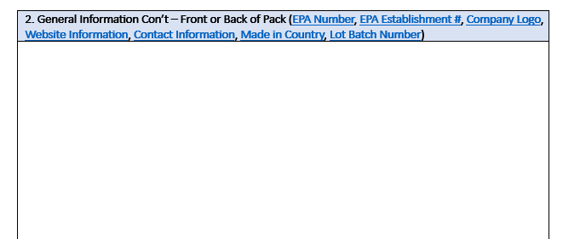
Electronic Labeling – Structured Label (Antimicrobial Example)

Slide 11
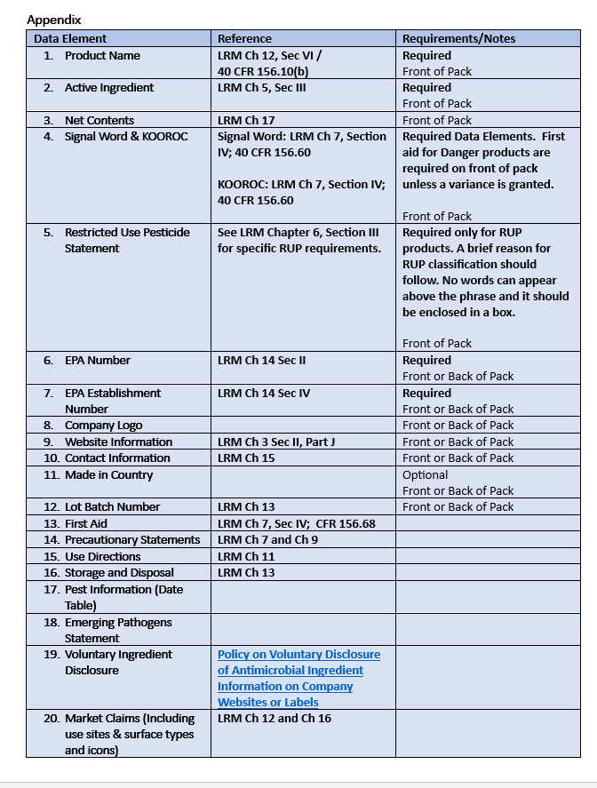
Electronic Labeling – Structured Label (Antimicrobial Example)

Slide 12
Information Sharing on Existing Technologies and Approaches
Caliper Content Services
AgGateway
Telus Agriculture and Consumer Goods
Canada CPSA (CCSPA)
Weed Science Society of America

Slide 13
Summary
A diversity of stakeholders important for progress in this space are engaged and contributing
PASSION, DILLIGENCE, PERSISTENCE has led to AMAZING PROGRESS
Digital data and electronic labeling is necessary for the future of labels
  However, full benefits will only be realized when full digitization is achieved
US EPA’s Label Reform Whitepaper has been reviewed and overlaps with much of the work progress by PPDC Label Reform Work Groups recommendations
Data elements have been identified and where there is potential for pick lists (or not), automation, and/or referencing databases and possibilities for controlled vocabulary
Pick lists have been initially created with source referencing
Good progress on Master Label format
Reviewed existing technology platforms/approaches and learned from experiences
  Key needs of software tools being identified as the group progresses (document compare technology, evergreen updating to allow for incorporation of new free text/standard language options, self-certification fields, prompting of mandatory text, auto population and “if, then” logic, interoperability with other systems [e.g., Bulletins Live, PPIS, etc.], version control, publishing, etc.)
Optimize label reform to ultimately be a single source of truth for automation of registration dossiers

Slide 14
Next Steps
Stakeholders in PPDC group can be considered as a source for testing, education, consultation and discussion
Work with Federal EPA to explore the digital platforms, controlled vocabularies and phrases, and metrics to monitor benefits gained along the journey
Work with states to understand their needs for an electronic system
  Understand where parking lot theme information is helpful in the scope of this work (e.g, Display issues, End user experience/accessibility, Directions for use (temporary)
Further refinement needed to progress on terminology/vocabulary
Refine short term proposed structured Master Label

