Slide 1
Office of Environmental Justice and External Civil Rights (OEJECR)
A New EPA National Program Office
Tribal EPA Region 9 Conference
October 24, 2022
Danny Gogal, Tribal and Indigenous Peoples Program Manager, OEJECR

Slide 2
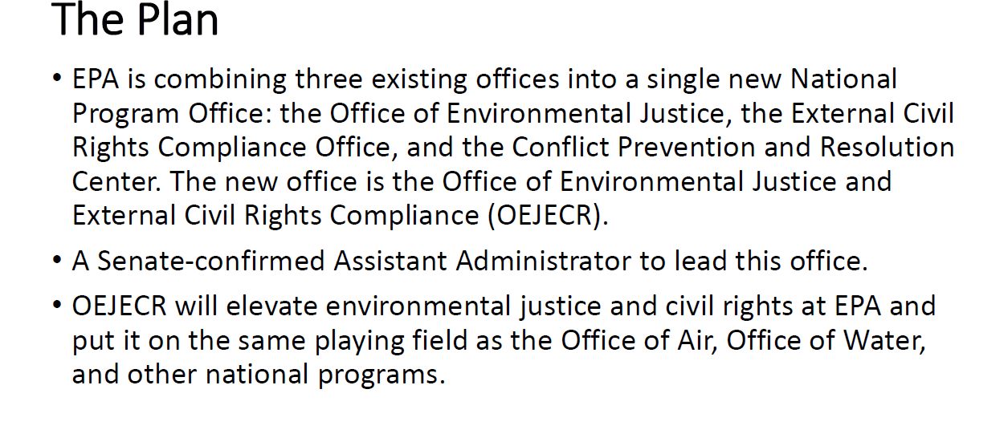
Office of Environmental Justice and External Civil Rights (OEJECR)
A New EPA National Program Office

Slide 3
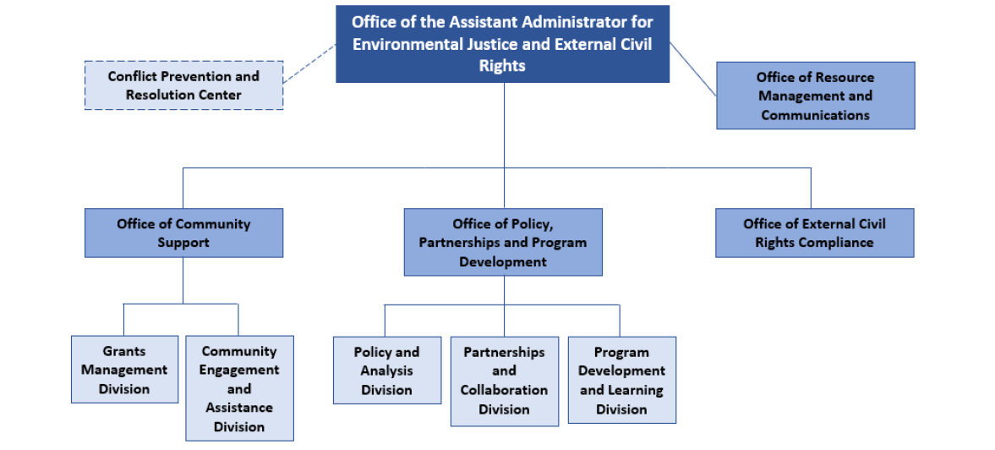
Office of Environmental Justice and External Civil Rights
Organizational Chart

Slide 4

EJ Grants & Thriving Communities Technical Assistance Overview (‘22-23)
Office of Environmental Justice & External Civil Rights
October 24, 2022

Slide 5
EPA EJ Grants and Technical Assistance (TA) Strategy
EJ Capacity and Implementation Grants
EJ Tech Assistance
EPA
EJ Staff

Slide 6
FY 2022 - 2023 EJ Grants & TA Budget
Approximately $2.8 billion through Inflation Reduction Act (IRA) + funding from baseline EJ appropriations
Tentative breakdown:
  $100 million for new Thriving Communities Technical Assistance Centers Program (EJ-TCTAC)
  $100 million for new EJ Communities Pass-through Funder Program (EJCPF) – to determine which external organization(s) will manage the EJ Small Grants program
  $30 million for EJ Collaborative Problem-Solving (EJCPS)
  $60+ million for Government grants (State, Local, Tribal, Territories, Freely associated States)
    Separate tracks for Tribes, States, and Local governments
    Set-aside for US Territories and Freely Associated States (FAS)
  $2+ billion for Environment and Climate Justice Block Grants

Slide 7
EJ Thriving Communities Technical Assistance Centers (EJ-TCTAC)
In 2023, EPA plans to create EJ Thriving Communities Technical Assistance Centers by providing funding to 5 - 10 centers
  Each center will provide TA and resources to communities and stakeholders on a nationwide and/or regional basis
Deadline for applications: November 1, 2022
Eligible entities to serve as centers: public/private universities, nonprofits, Intertribal Consortia
Who can receive services from centers: All community stakeholders, including underserved communities interested in EPA grant programs such as community residents, nonprofits, grassroots organizations, local government entities, and state governmental entities

Slide 8
Technical Assistance Services to be provided by TA Centers
Examples of TA to underserved communities and stakeholders:
  “How to” assistance on writing competitive grant proposals
  Financial resource management assistance
  Community engagement
  Tracking and analyzing results
  Environmental justice analysis of communities (EJSCREEN analysis, on-the-ground problem site identification, and/or interviews of community residents detailing their EJ concerns)
  Energy justice support and the transition to clean energy (e.g., workforce development)
  Coordination and/or facilitation services for meetings between local stakeholders (community residents, local elected officials, port authority, industry, etc.)
  Translation and interpreting services for meaningful engagement with Limited English-Speaking participants

Slide 9
Excerpts from IRA Legislation
SEC. 60201. ENVIRONMENTAL AND CLIMATE JUSTICE BLOCK GRANTS.
$2,800,000,000 to remain available until September 30, 2026
  (a)(1) to award grants for periods of up to 3 years to eligible entities to carry out activities described in paragraph
  (2) that benefit disadvantaged communities, as defined by the Administrator.
(3) ELIGIBLE ENTITIES.—In this subsection, the term ‘eligible entity’ means—
  (A) a partnership between— (i) an Indian tribe, a local government, or an institution of higher education; and (ii) a community-based nonprofit organization;
  (B) a community-based nonprofit organization; or
  (C) a partnership of community-based nonprofit organizations.

Slide 10
Excerpts from IRA Legislation - Continued
SEC. 60201. ENVIRONMENTAL AND CLIMATE JUSTICE BLOCK GRANTS.
(2) ELIGIBLE ACTIVITIES. —An eligible entity may use a grant awarded under this subsection for
—“(A) community-led air and other pollution monitoring, prevention, and remediation, and investments in low- and zero-emission and resilient technologies and related infrastructure and workforce development that help reduce greenhouse gas emissions and other air pollutants;
(B) mitigating climate and health risks from urban heat islands, extreme heat, wood heater emissions, and wildfire events;
(C) climate resiliency and adaptation;
(D) reducing indoor toxics and indoor air pollution; or
(E) facilitating engagement of disadvantaged communities in State and Federal advisory groups, workshops, rulemakings, and other public processes.

Slide 11
Details for other Environmental Justice Grants Programs
2022 - 2023

Slide 12
New Implementation Authority
Previously, EJ grant activities were limited to:
  Research
  Demonstrations
  Training, and/or
  Education activities
Now, EJ grant activities have been expanded to include implementation activities:
  Small scale construction
  Refurbishment and Mitigation
  Hazardous Waste Disposal and general Clean ups
  Installations
Notes:
Not a new concept. We’ve been hearing from EJ stakeholders for years. We finally have resources to do it. Plus there’s a great need.
REACH hubs are striving to lay the foundation for these multiple efforts

Slide 13

Redesign of EJ Small Grants
EJ Communities Pass-through Funder (EJCPF) Program
EPA
Funder(s) - nonprofit or college/university
Communities / Subgrantees
Agency will provide all funds for EJ Small Grants to 1 - 2 entities to manage the program
This organization will manage the competition process and subaward funds to communities
Communities will technically be subgrantees and will receive the funds through the Funder(s) instead of directly through EPA
Two or more entities could manage the program collectively
The EPA Project Officer team will communicate primarily with funders, not necessarily communities
Communities will submit reports and project updates to the funder(s)
1 to 2-year projects

Slide 14
Things to Consider (EJ Small Grants)
Easier Application Process - These small grants are specifically for community orgs who are capacity-constrained and will avoid Grants.gov and lengthy workplans.
Open Call - There will likely be an open call for applications so eligible entities can apply when they are ready rather than by a certain deadline.
Subaward Model Expedites Funding Process – this restructuring will get funds to eligible recipients as expeditiously as possible
Connection/History with Communities - All applicants will be evaluated on their historical connections with underserved communities/populations and capacity to do broad outreach
Direct Involvement/Oversight/Scoring by EPA - EPA will have a direct hand in how the funder(s) develop the evaluation/scoring and management processes for the EJ Small Grants. Additionally, Regional EJ staff will be on the subaward evaluation panels (i.e., scoring community applications)

Slide 15
Summary of EJ Grants Plan (22-23)
Here is a timeline and general details on the upcoming EJ grant opportunities:
  EJ Thriving Communities Technical Assistance Centers Program (EJ-TCTAC) *NEW
    RFA deadline date: November 1, 2022
    $100 Million for 5 – 10 centers (colleges/universities, nonprofits, intertribal consortia)
  EJ Communities Pass-through Funder (EJCPF) Program *NEW
    RFA release date: early November 2022
    $100+ Million for 1 – 2 pass-thru funders (colleges/universities, nonprofits, intertribal consortia)
  EJ Collaborative Problem-Solving Program (EJCPS)
    RFA release date: mid-November 2022
    $30 Million (~60 awards) of up to $500K each (nonprofits)
  State EJ Cooperative Agreement Program (SEJCA)
    RFA release date: mid-November 2022
    $60 - $70 Million (60+ awards) of up to $1M each (states, local governments, tribes, territories, FAS)

