Slide 1

EPA Career Visitor CXSA
Strategic Analysis
Phil Gonska, Analyst
Michelle Miller, Customer Success Manager
January 2022

Slide 2
Your Verint Team
Phil Gonska
Analyst
Phil.Gonska@verint.com
Michelle Miller
Customer Success Manager
Michelle.Miller@verint.com
(734) 205-2636

Slide 3
Agenda
Methodology, Objectives and Executive Summary
Aggregate Performance
Detailed Career Segment Data
Key Findings, Recommendations and Next Steps

Slide 4
METHODOLOGY,
OBJECTIVES AND EXECUTIVE SUMMARY

Slide 5
Verint Predictive Methodology
Verint applies proven science and technology to the measurement and analysis of the visitor experience through the lens of visitor satisfaction.
EXPERIENCE &
EXPECTATIONS
BUSINESS OUTCOMES
SATISFACTION
CONVERSION
RETENTION
LOYALTY
WORD-OF-MOUTH
Analysis of the visitor experience will enable your organization to understand…
How are you doing? What should you do? Why should you do it?

Slide 6
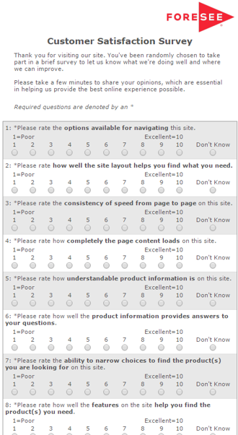

Capturing The Voice of Customer
KEY FACTS
Collection began:
August 31, 2015
Reporting Period:
October 1, 2020 - November 22, 2021
Completion Percentage:
❶
Visitor is on the EPA site
❷
Visitor is shown an invite
3 pages viewed
100% of sample invited
❸
Accepting the invite loads hidden tracker window
Career Segment n=111 All Other Visitors n=21,796
❹
Survey presents to the front when site is exited
Desktop=35% *40%
* Public Sector Desktop Index – Q3 2021 Completion Benchmark

Slide 7
Strategic Analysis Objectives
AGGREGATE PERFORMANCE | VISITOR EXPERIENCES | IMPROVEMENT OPPORTUNITIES
Review the high-level performance of Career visitors and compare to all other visitors to the EPA Desktop site. | Understand Career visitor experiences through the review of segmented custom question detailed data. | Understand Career visitor pain points and improvement opportunities.

Slide 8



Executive Summary
Career visitor satisfaction (79) is strong and exceeds all other EPA site visitors’ satisfaction (72) as well as comparative industry segment benchmark averages (high: 73 to low: 68)
Career segment satisfaction has been stable and consistent throughout 2021 but trends lower across a small sample, partially complete Q4 through mid November. Career net performance scores are very strongly positive as 71% recommend the EPA, while 14% are not likely to.
Site information and information browsing are key drivers of satisfaction among both Career and all other EPA site visitor segments.
Drivers for Career and all other visitor segments are similarly positioned with site information and information browsing attributes most affecting visitor satisfaction. Relevance of site information and ability to sort information are low-rated opportunities for improvement.
About half of Career visitors do not fully find information sought on the EPA site resulting in much lower satisfaction. Successful visitors finding sought information are much more highly satisfied.
Information not found by Career visitors consisted of employment, local job, EPA jargon, requirements, how to help, password/login, conservation and career/benefits content. About a third of Career visitors experience both navigation (finding sought content, “other” difficulties and link misdirection) and search (irrelevant, too few or too many returned results) difficulties.
Almost two-thirds of Career visitors are first-time users of the EPA website and a third are students. More than half of Career users visit for “other” primary reasons, including job postings/employment/internships, qualifications/requirements, career information, environmental justice and EPA organization.
Career visitor suggestions include search, layout, navigation, public involvement, return, organization, requirement and relevance related improvements.
October 1, 2020 – November 22, 2021

Slide 9
AGGREGATE
PERFORMANCE

Slide 10
Career visitors are more satisfied than other visitors with higher information browsing and recommend scores. Site information and information browsing are key drivers.
SCORE |  | IMPACT
76.5 | Information Browsing | 1.2
80.1 | Look and Feel | 0.8
79.6 | Navigation | 0.9
77.7 | Site Information | 1.6
85.8 | Site Performance | 0.3
72.0*
IMPACT |  | SCORE
4.2 | Recommend Agency | 83.1
4.5 | Use Information | 82.7
79.0
0
100
Career Segment
C.I. +/- 0.1 at 90% level of confidence
DRIVERS
OUTCOMES
SCORE |  | IMPACT
71.7 | Information Browsing | 1.5
78.5 | Look and Feel | 0.5
74.9 | Navigation | 1.1
75.2 | Site Information | 2.1
83.2 | Site Performance | 0.4
72.0*
IMPACT |  | SCORE
4.4 | Recommend Agency | 77.9
4.2 | Use Information | 79.4
72.2
0
100
All Other Visitors
C.I. +/- 0.1 at 90% level of confidence
* Public Sector Benchmark – November 2021
/
- Denotes Career segment higher/ lower score than All Other Visitors at 90% C.I.
October 1, 2020 – November 22, 2021
Career Segment n=111
All Other Visitors n=21,796

Slide 11
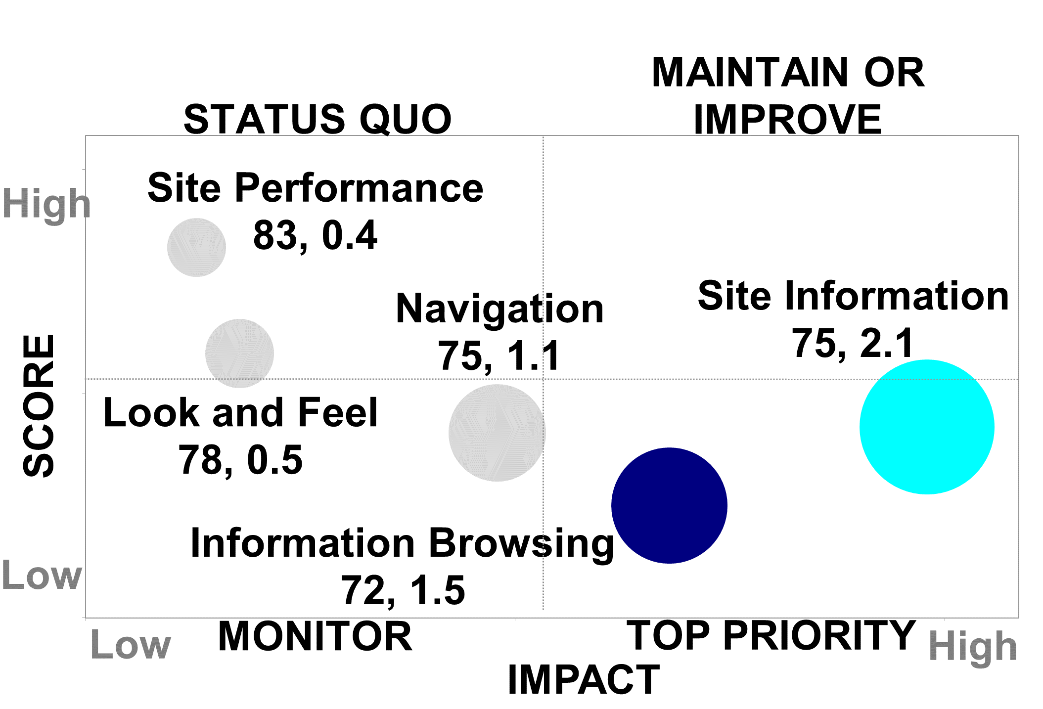
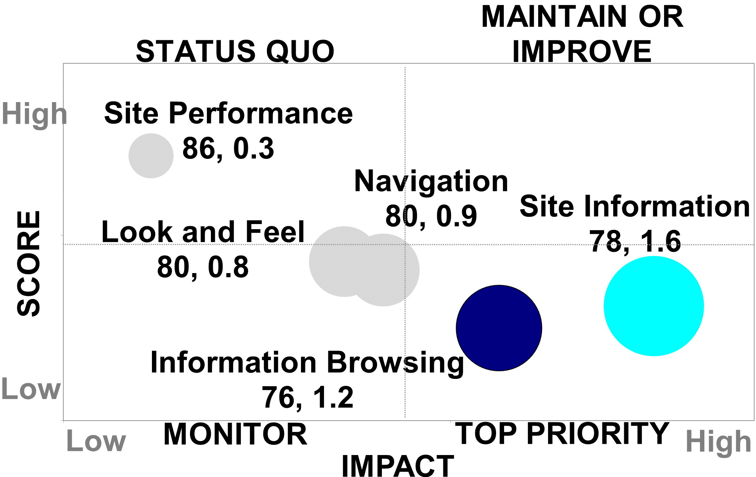
Career and visitor segment drivers are similarly positioned – key areas of focus (site information, information browsing) are the same for all users.
All Other Visitors
Career Segment
October 1, 2020 – November 22, 2021
Career Segment n=111
All Other Visitors n=21,796

Slide 12
Relevance of site information and ability to sort information are low-rated opportunities for improvement.
October 1, 2020 – November 22, 2021
Career Segment n=111
All Other Visitors n=21,796

Slide 13
Career visitor satisfaction exceeds benchmark averages of comparative industry segments by 6 to 11 points.
 | Website/Index- Desktop | Public Sector - Desktop | Browse (non-retail) - Desktop | Federal Government - Desktop | Regulatory - Desktop | Portal - Desktop
79
MAX
Career Segment
72
All Other Visitors
 Avg
MIN
October 1, 2020 – November 22, 2021
Career Segment n=111
All Other Visitors n=21,796

Slide 14
Career net performance scores are very strongly positive as 71% recommend the EPA while 14% are not likely to.
How likely are you to recommend this agency to someone else?
All Other Visitors
Career Segment
Period
NPS
39
58
0
100
0
100
Detractors:
21%
Detractors:
14%
October 1, 2020 – November 22, 2021
Career Segment n=111
All Other Visitors n=21,796

Slide 15
Career satisfaction and key driver scores have been stable and consistent but trend lower in Q4 though mid November.
Career Segment Quarterly Performance Scores
n = | 21 | 39 | 19 | 19 | 13
October 1, 2020 – November 22, 2021
Career Segment n=111
All Other Visitors n=21,796

Slide 16
CAREER
SEGMENT
DATA

Slide 17
Students, “other” roles and government employees are top Career site visitors.
For this visit to the EPA website, which of the following best describes you? (Top Mentions)
Aggregate
satisfaction scores:
72 / 79
74
/
Satisfaction scores where n<20 not displayed.
- Denotes higher/lower proportion than All Other Visitors at 90% C.I.
October 1, 2020 – November 22, 2021
Career Segment n=111
All Other Visitors n=21,796

Slide 18
“Other” Career visitors include job seekers, employment researchers, senior citizens, recruiters, contractors, consultants and graduates.
Please explain your role in visiting this website. (Career segment responses)
“Recruiter.” Sat: 33, 11/5/2021 “Looking for a job.” Sat: 100, 11/9/2021 “Job seeker, looking at necessary qualifications.” Sat: 96, 10/20/2021 “Looking for work.” Sat: 44, 10/4/2021 “Employment potential.” Sat: 96, 9/20/2021 “Gov’t contractor.” Sat: 85, 7/28/2021 “Job seeker seeking clarification about whether or not I qualify for a position that I saw posted, which I am very interested in.” Sat: 67, 7/26/2021 “Looking at seniors and jobs with the EPA.” Sat: 74, 6/12/2021 “Can’t find how to log in.” Sat: 18, 5/27/2021 | “Looking for career opportunities.” Sat: 18, 4/18/2021 “Consultant.” Sat: 93, 2/22/2021 “Employment research for region 6.” Sat: 100, 2/10/2021 “Looking at job postings related to USAJOBS.gov.” Sat: 100, 2/6/2021 “Job Seeker.” Sat: 93, 2/1/2021 “Low-income senior.” Sat: 85, 12/21/2020 “Job seeker.” Sat: 85, 12/8/2020 “Recent Graduate.” Sat: 100, 11/5/2020 “Senior adult looking for a way to give time and energy to helping our precious EARTH. This will be an opportunity of a lifetime for me to release this yearning for learning, for doing my part and adventure! ...” Sat: 89, 10/24/2020
October 1, 2020 – November 22, 2021
Career Segment n=111
All Other Visitors n=21,796

Slide 19
Almost two-thirds of Career visitors are first time users of the EPA website. First time visitors are slightly less satisfied than aggregate visitors.
How frequently do you use the EPA website?
Aggregate
satisfaction scores:
72 / 79
/
Satisfaction scores where n<20 not displayed.
- Denotes higher/lower proportion than All Other Visitors at 90% C.I.
October 1, 2020 – November 22, 2021
Career Segment n=111
All Other Visitors n=21,796

Slide 20
About two-thirds of Career visitors seek “other” information on the EPA site and they are slightly less satisfied.
What kind of information were you looking for today? (Please check all that apply)
Aggregate
satisfaction scores:
72 / 79
/
Satisfaction scores where n<20 not displayed.
- Denotes higher/lower proportion than All Other Visitors at 90% C.I.
October 1, 2020 – November 22, 2021
Career Segment n=111
All Other Visitors n=21,796

Slide 21
“Other” information sought by Career visitors relates to job postings/opportunities, qualifications/requirements, internships, applications and organization of the EPA.
Please tell us what information were you looking for today. (Career segment responses)
“Job application.” Sat: 100, 11/182021 “Job opportunity recent college grads.” Sat: 33, 11/152021 “Employment opportunities.” Sat: 100, 11/9/2021 “Job openings and career information.” Sat: 49, 11/6/2021 “Employment.” Sat: 67, 10/20/2021 “Looking at expected skills necessary for entry level positions.” Sat: 96, 10/20/2021 “Career opportunities.” Sat: 44, 10/5/2021 “Internships.” Sat: 100, 9/29/2021 “Training.” Sat: 100, 9/28/2021 “Information on Spring 2022 internships.” Sat: 29, 9/8/2021 | “JOB WORKING WITH THE EPA AGENCY.” Sat: 100, 9/3/2021 “Fellowships, internships, job opportunities.” Sat: 89, 8/12/2021 “I wanted to see what kind of careers the EPA offers.” Sat: 96, 8/4/2021 “How to receive email notification once my job application has been completed and submitted.” Sat: 78, 7/6/2021 “I wanted to look into what types of jobs the EPA offers for after I graduate, or how I could get involved.” Sat: 93, 3/30/2021 “Organization structure, reach, related careers/personnel, overall work.” Sat: 59, 3/23/2021 “Organization, responsibilities and qualifications of regional staff.” Sat: 34, 1/17/2021
October 1, 2020 – November 22, 2021
Career Segment n=111
All Other Visitors n=21,796

Slide 22
More than half of Career users visit for “other” primary reasons and they are less satisfied than the aggregated segment.
Which of the following topics best describes the information you wanted today?
(Top Mentions)
Aggregate
satisfaction scores:
72 / 79
/
Satisfaction scores where n<20 not displayed.
- Denotes higher/lower proportion than All Other Visitors at 90% C.I.
October 1, 2020 – November 22, 2021
Career Segment n=111
All Other Visitors n=21,796

Slide 23
“Other” reasons for visiting include job postings/employment/internships, qualifications/ requirements, career information, environmental justice and EPA organization interests.
What other topic best describes the reason for your visit? (Career segment responses)
“Jobs.” Sat: 100, 11/18/2021 “Employment opportunities.” Sat: 100, 11/9/2021 “Career opportunities.” Sat: 49, 11/6/2021 “Benefits information.” Sat: 100, 10/22/2021 “Employment.” Sat: 67, 10/20/2021 “Jobs in environmental clean up.” Sat: 44, 10/4/2021 “Training.” Sat: 100, 9/28/2021 “Required employment documents.” Sat: 85, 7/28/2021 “I came here seeking information on how to help you save the world. Now, please: Help me help you…” Sat: 67, 7/26/2021 “Employment.” Sat: 100, 6/15/2021 | “Career information.” Sat: 100, 6/11/2021 “Engineering opportunities.” Sat: 85, 4/7/2021 “Environmental Justice.” Sat: 100, 3/27/2021 “Organization structure.” Sat: 59, 3/23/2021 “Job Announcements – Job Fair led me here.” Sat: 67, 3/15/2021 “Info about careers at the EPA.” Sat: 93, 2/25/2021 “Internship.” Sat: 81, 2/22/2021 “Job Listings.” Sat: 93, 2/1/2021 “Working at the EPA!” Sat: 70, 12/16/2020 “High school internship.” Sat:22, 11/15/2020
October 1, 2020 – November 22, 2021
Career Segment n=111
All Other Visitors n=21,796

Slide 24
About half of Career visitors do not fully find information sought on the EPA site resulting in much lower satisfaction. Successful visitors are much more satisfied.
Did you find the information you were looking for today?
Aggregate
satisfaction scores:
72 / 79
/
Satisfaction scores where n<20 not displayed.
- Denotes higher/lower proportion than All Other Visitors at 90% C.I.
October 1, 2020 – November 22, 2021
Career Segment n=111
All Other Visitors n=21,796

Slide 25
Information not found by Career visitors consisted of employment, local job, EPA jargon, requirements, how to help, pw/login, conservation and career/benefits content.
Please tell us what couldn’t you find? (Career segment responses)
“Employment was lacking greatly - your Human Resources needs to step up very poor.” Sat: 0, 11/15/2021 “Jobs open to non-US citizens.” Sat: 100, 11/9/2021 “Environment Agency Job located in my home location.” Sat: 77, 11/8/2021 “I wish I was able to find a way to help out like the planting a tree page…” Sat: 96, 10/24/2021 “As someone who isn’t employed by the federal government, some of the jargon was not easy to understand at first.” Sat: 44, 10/5/2021 “Precise information on requirements.” Sat: 96, 9/20/2021 “What a day in the life of EPA scientist looks like, salary estimates.” Sat: 96, 8/4/2021 “I wanted part senior jobs and could not find in my city.” Sat: 0, 7/11/2021 | “I was searching for the types of jobs/careers. The requirements as well.” Sat: 100, 6/9/2021 “No reset password links.” Sat: 100, 5/27/2021 “Can’t log in.” Sat: 18, 5/27/2021 “I could not find average salaries for the jobs listed.” Sat: 81, 4/19/2021 “Job Career Tab.” Sat: 67, 3/15/2021 “Information about environmental conservation.” Sat: 89, 3/8/2021 “The visit was more of a job search for jobs in the state of Texas. Texas has plenty of areas that are environmentally challenged.” Sat: 100, 2/6/2021 “Related careers, their jobs, and education requirements.” Sat:59, 12/14/2020
October 1, 2020 – November 22, 2021
Career Segment n=111
All Other Visitors n=21,796

Slide 26
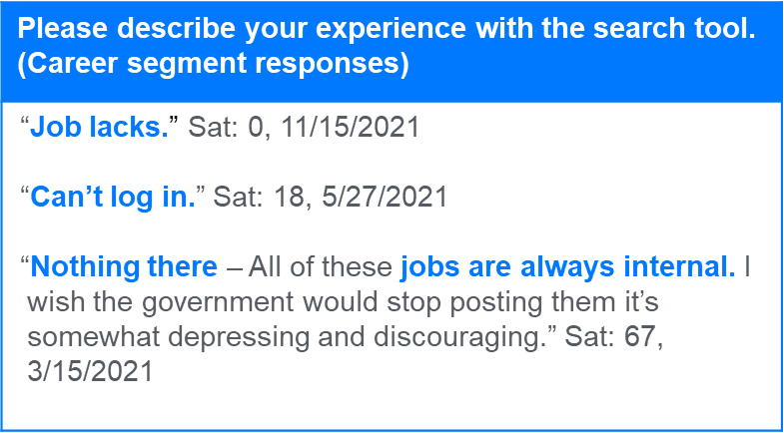
About a third of Career search users have difficulty – most often with irrelevant, too few or too many returned results. Successful visitors are much more satisfied.
If you used the site search tools today, which of the follow best describes your experience? (Please check all that apply)
Aggregate
satisfaction scores:
72 / 79
/
Satisfaction scores where n<20 not displayed.
- Denotes higher/lower proportion than All Other Visitors at 90% C.I.
October 1, 2020 – November 22, 2021
Career Segment n=111
All Other Visitors n=21,796

Slide 27
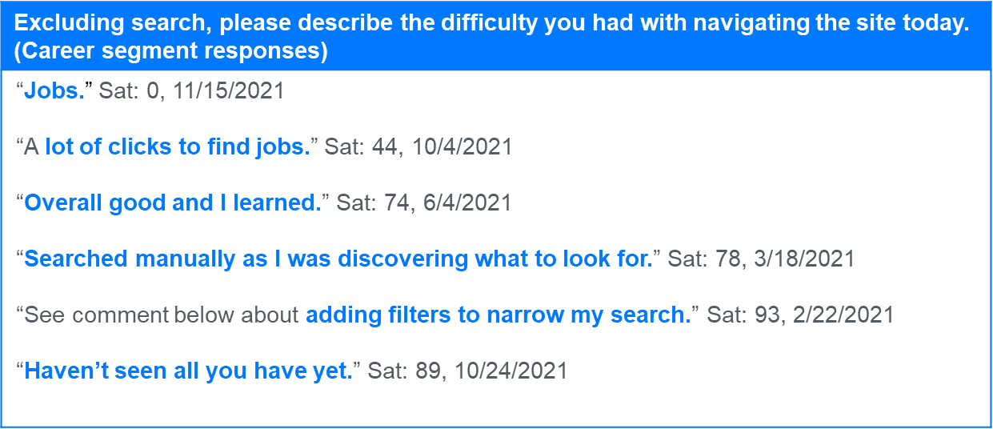
About a third of Career visitors experience navigation difficulty - finding sought content, “other” difficulties and link misdirection.
How was your experience navigating epa.gov today? (Please check all that apply)
Aggregate
satisfaction scores:
72 / 79
October 1, 2020 – November 22, 2021
Career Segment n=111
All Other Visitors n=21,796

Slide 28
Career suggestions include search, layout, navigation, public involvement, return, organization, requirement and relevance related improvements.
What is the one change EPA could made to this site that would make it easier to use? (Career segment responses)
“Search job openings in research entry level science.” Sat: 33, 11/15/2021 “The page layout was distracting. There was a column on the right and a column on the left and boxes of links within the main center column. The links within sentences of a paragraph are distracting while reading. I would prefer links be more obvious than one blue word in an entire paragraph of writing.” Sat: 49, 11/6/2021 “…I’d put up different ways that ppl could do there part bc id think thats what most wanted to know…” Sat: 96, 10/24/2021 “Make use more GUI-friendly and can be easy to browse through.” Sat: 67, 10/20/2021 “…On your site, please: when you're telling citizens how to get involved, give us more info, and direct links to information…” Sat: 67, 7/26/2021 | “Going back to the original map of job locations after looking at state info. Every time the site threw me out clear to opening of site to start again.” Sat: 74, 6/12/2021 “Balance the amount of text/white space/graphics a little better. The web pages were a bit more crowded and slightly less organized than I would have liked...” Sat: 89, 5/27/2021 “Greater division of themes, and each with its link.” Sat: 93, 5/16/2021 “Clear Job Requirements and Prerequisites for Non-Government employees would be helpful.” Sat: 85, 4/7/2021 “Waterfall menu, where you don't have to access each topic page to find any of its sub-topic.” Sat: 59, 3/23/2021 “Improve search and search filters to provide relevant results; better page layout that also lists ALL pages under relevant links/menus.” Sat: 22, 11/14/2020
October 1, 2020 – November 22, 2021
Career Segment n=111
All Other Visitors n=21,796

Slide 29
KEY FINDINGS, RECOMMENDATIONS
AND NEXT STEPS

Slide 30
Key Findings & Recommendations
Satisfaction
Career visitor satisfaction has been stable and consistent throughout 2021 but trends lower across a small sample, partially complete Q4 through mid November.
  ID “Career” respondents and run SIR reports for these visitors in Q4’21 and Q1’22.
  Monitor satisfaction trends among the Career segment quarterly. Initiate further analysis if scores fail to rebound with a larger sample.
Site information and information browsing are key drivers of satisfaction among both Career and all other EPA site visitor segments. Relevance of site information and ability to sort information are low-rated opportunities for improvement.
  Improve visitors’ ability to sort and find useful content that answers questions and meets needs.
  Organize information intuitively to make it easier to find, route to and require fewer clicks to reach. Create short clear direct paths and navigation options to popular information.
  Improve search/filtering capabilities to better find content – strengthen GUI operator capabilities.
  Remove outdated, irrelevant or unnecessary material to improve routing to remaining topics.
  Conduct a Usability review focusing on site organization, locating content, routing and searching.
Drivers

Slide 31
Key Findings & Recommendations
Content
About half of Career visitors do not fully find information sought on the EPA site resulting in much lower satisfaction.
  Enable visitors to better find information they are seeking but have difficulty finding – job postings, employment opportunities, local jobs, internships, specific position requirements, career/benefits content, EPA jargon and organization, conservation and environmental justice initiatives.
  Develop a site usage brief for first-time visitors to set expectations, explain how the site is organized, where to find information, how best to use the site and how to obtain assistance.
  Develop direction on how to involve senior citizens and other passionate visitors in EPA efforts and integrate into the site.
  Provide specific direction on how to address password or login difficulties.

Slide 32
Next Steps
1) | Plan 2022 EPA areas of interest, supporting CXSA analyses and calendar timing
 | Identify future topics, segments or issues on which to focus. Plan and schedule analyses and timing.
2) | Evolve reporting/deliverables to monitor and address top concerns
 | Leverage data collection to develop insight, understanding and drive improvement. Develop/evolve dashboards, reports or scorecards that can assist in monitoring performance, identifying specific concerns, understanding root causes and developing corrective actions.
3) | Review survey to maximize insight and add value
 | Remove questions/responses not providing useful information – International Cooperation (only 3% of users visit)? Add questions/responses to provide greater insight and address concerns - such as what content that can’t be found, navigation or search difficulties.

Slide 33
Thank You

Slide 34
Appendix

Slide 35
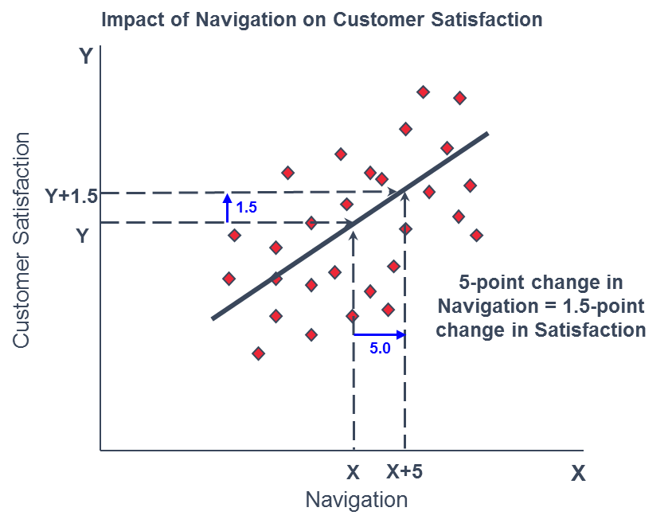
Understanding Impacts
The rate of change between an element and satisfaction is represented by an Impact. In simple terms, an impact can be understood as something like a slope of a line defining the relationship between two variables.

Slide 36



Satisfaction Summary:
The relationship between drivers, outcomes, and satisfaction
DRIVERS
OUTCOMES
SCORE |  | IMPACT
83 | Look and Feel | 0.1
72 | Navigation | 2.8
77 | Account Management | 2.2
70 | Site Information | 3.1
86 | Site Performance | 0.0
IMPACT |  | SCORE
5.1 | Recommend | 73
4.6 | Return | 83
75
0
100
The Score is a composite of the responses to 2-4 individual questions using optimal weights and converted to a 0-100 scale.
The Impact on Satisfaction is the improvement to the satisfaction score we would expect based on improving that driver's score by 5 points.
The Impact on Outcomes is the improvement to that future behavior we expect based on improving overall satisfaction by 5 points.
The Score is a composite of the responses to 1-4 individual questions using optimal weights and converted to a 0-100 scale.
If Navigation improved by 5 points
If Customer Satisfaction improved by 5 points
Customer Satisfaction would improve 2.8 points to 71.8
Recommend would improve 5.1 points to 78.1
Navigation = 72 → 77
Customer Satisfaction = 75 → 80

Slide 37
How Scores Are Calculated
(Applies to all driver, satisfaction, and outcome scores)
7 |  | What is your overall satisfaction with this site?
8 |  | How well does this site meet your expectations?
8 |  | How does this site compare to your idea of an ideal website?
74.1 |  | A composite rating is calculated using optimal weights to average the 3 responses. This composite rating is converted from 1-10 scale into a 0-100 index score.
 |  | ((x-1)/9)*100
71
74.1
0
100

