Slide 1
Environmental Protection Agency
Beaches Site (Desktop) - Strategic Analysis
Blake Wilson
Associate Analyst
FEBRUARY 23, 2021

Slide 2
Agenda
Methodology & Objectives
Overview of Data
Visitor Profile Analysis
Key Findings & Recommendations

Slide 3
Methodology & Objectives

Slide 4
Verint Predictive Methodology
Verint applies proven science and technology to the measurement and analysis of the visitor experience through the lens of visitor satisfaction.
EXPERIENCES & EXPECTATIONS
SATISFACTION
BUSINESS OUTCOMES
Analysis of the visitor experience will enable your organization to understand…
How are you doing? What should you do? Why should you do it?

Slide 5
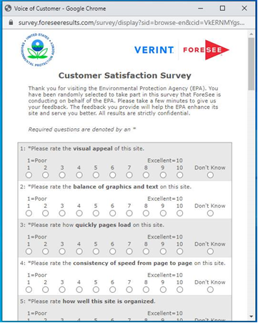
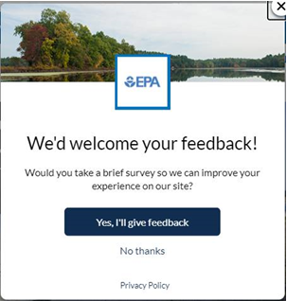
Capturing The Voice of Customer
KEY FACTS
Collection began:
August 2015
Reporting Period:
May 5, 2020-January 31, 2021
Completion Percentage:
❶
Visitor is on your site
epa.gov
❷
Visitor is shown an invite 3 number of pages
100% sample
❸
Accepting the invite loads hidden tracker window
n=399 Desktop
❹
Survey presents to the front when site is exited
Desktop=39% (Aggregate)

Slide 6
Strategic Analysis Objectives
EXAMINE SATISFACTION | IMPROVEMENT OPPORTUNITES | IDENTIFY RECOMMENDATIONS
Understand the drivers of satisfaction and overall satisfaction with visitor experience on the Beaches site. | Identify pain points and improvement opportunities for the Beaches site based on data findings and themes from customer comments. | Provide recommendations that further the goals of efficiently improving the experience for the site.

Slide 7
BEACHES SITE
Overview of Data

Slide 8
Overview of Beach Site Questions
399 respondents visited a page about Beaches
84%
of Visitors found the information clear
74%
of Visitors reported Yes
56%
of Visitors used Google
88%
of Visitors reported Yes
500K
450K
480K
510K
Describe the Beach information on EPA.gov
10% found information slightly unclear
6% found the information unclear
Do you know who to contact to get more Beach information?
Where do you typically go first to find Beach related information
29% reported EPA Beach site
15% reported “Other”
Is the Beach information broken out by specific topic organized in a way to help you find what you need?
May 5, 2020 – January 31, 2021 | n=399

Slide 9
Satisfaction for Beach visitors trended upwards for the past 9 months and has outperformed the other site visitors.
n count
*
*May 5, 2020 – January 31, 2021
Interpret satisfaction scores with caution when n count is low

Slide 10
Improvements made to satisfaction will increase the likelihood for Beach visitors to recommend the agency and use the information.
DRIVERS
SATISFACTION
OUTCOMES
Which drivers of customer experience should I address?
What’s the impact to my business?
SCORE |  | IMPACT
78 | Information Browsing | 1.2
81 | Look and Feel | 0.3
80 | Navigation | 1.0
80 | Site Information | 1.8
82 | Site Performance | 1.0
67.8
IMPACT |  | SCORE
4.5 | Recommend Agency | 83
4.6 | Use Information | 83
78.8
0
100
Where am I right now?
How do I compare?
Benchmark: Verint Website Index
May 5, 2020 – January 31, 2021 | n=399

Slide 11
Beach visitors are more satisfied than other site visitors and perform above or at all relevant benchmark averages.
 | Verint Website Index – Desktop | Public Sector - Desktop | Federal Government – Desktop | Regulatory – Desktop | Independent Agencies – Desktop
BEACH VISITORS
SATISFACTION
78.8
MAX
Other Site Visitors
Satisfaction:
 Avg
71.8
MIN
May 5, 2020 – January 31, 2021

Slide 12
Among top priority drivers focus should be on the ability to sort and narrow information, along with how well the information provides answers.
STATUS QUO REQUIRED
MAINTAIN OR IMPROVE
Site Information
8.2 | 8.5 | 8.1
Thoroughness of Information | Understandable Information | Information provides answers
Information Browsing
8.0 | 8.0 | 8.2
Ability to sort information | Ability to narrow choices | Helpfulness of site features
Score
Navigation
8.2 | 8.3 | 8.2
Site organization | Options available for navigating | Helpfulness of site layout
MONITOR
TOP PRIORITY
Impact
May 5, 2020 – January 31, 2021 | n=399

Slide 13
Water and air quality are common themes for information that visitors could not find.
Comments related to information |  | Restrictions
“2020 Beach water quality for Outer Banks (North Carolina)” Sat: 56, 1/26/21 “Climate Change progress and measures to protect the public from it.” Sat: 22, 12/15/20 “If it is safe to swim at Lake St. Croix in MN/WI” Sat: 82, 12/14/20 “I was trying to figure out who to contact in my area to get help about encroaching building and soil into a nearby wetland. It is changing the topography of the line and flooding land that was once high ground. It is also contaminating the wetlands.” Sat: 52, 10/19/20 “Only found one location for beaches, Florence Oregon.” Sat: 60, 9/15/20 |  | “Specific information about the air quality in Ocean Beach.” Sat: 71, 9/15/20 “How wastewater gets into regular water.” Sat: 60, 9/14/20 “I was looking for specific information about climate change, but only found information about ozone depletion. I understand the two are related, but I was looking for specific information about how much our world has warmed and I could not find it.” Sat: 70, 9/10/20 “I wanted detailed historical information and details on Joint Base Pearl Harbor-Hickam environmental actions or spills and clean-ups.” Sat: 78, 7/30/20 “Couldn't tell if Huntington Beaches are closed for today” Sat: 100, 7/11/20
May 5, 2020 – January 31, 2021 | n=399

Slide 14
BEACHES SITE
Visitor Profile Analysis

Slide 15
About 30% of visitors who viewed the Beaches web page did so for the first time, satisfaction is steady across visitor frequency.
SATISFACTION
*
May 5, 2020 – January 31, 2021 | n=399
*Interpret satisfaction score with caution when n<30

Slide 16
Concerned citizens are the largest group visiting the Beaches site, they also report the lowest satisfaction score and success rate.
*
*
May 5, 2020 – January 31, 2021 | n=399
*Interpret satisfaction score with caution when n<30

Slide 17
Nearly 60% of visitors are looking for reports /guidance documents and they are more successful than those looking for data or other information. Air and water quality are top themes among "other" information.
FOUND INFORMATION
Specified Data or Statistic Themes from Comments:
Air Quality Water Map
74%
62%
60%
PROPORTION
Specified Themes from “Other” Comments:
Air Quality Grants (e.g., submission, recipients) Water Quality
SATISFACTION
May 5, 2020 – January 31, 2021 | n=300

Slide 18
Roughly two-in-five Beach visitors are coming for air or water quality/pollution. Climate change, water and “other” information seekers struggle the most.
7%
11%
19%
13%
4%
0%
SATISFACTION
Proportion of visitors who did not find the information
Themes: 1. COVID-19 | 2. Sustainable living
*
*
May 5, 2020 – January 31, 2021 | n=399
*Interpret satisfaction score with caution when n<30

Slide 19
Comments focused on pain points where respondents felt the information could be organized better or gave examples of specific information they were looking for.
Comments related to information |  | Restrictions
“The things I wrote above: I would like air quality info for my specific zip code (so more air monitors are needed), and then water quality info at a particular beach. Thanks very much!” Sat: 48, 1/26/21 “Translate "impairment type" into "what it means to me" i.e. Impairment due to Mercury probably means it is okay to swim in the water, but do not eat fish (or how many fish, or what kind of fish) from those waters based on the most current data.” Sat: 82, 12/14/20 “Well I thought the site overall was easy to use, but I was not able to find climate change information, so I would make it easier to find information about climate change if I were working on the issue at the EPA. If it is not there, I would be appalled as to why it was not there, as this is simply a critical issue, and would hurry to include this information in its own, very obvious link.” Sat: 70, 9/10/20 |  | “Information needs to be organized more consisely. Page looks very busy and confusing.” Sat: 45, 9/08/20 “More explanations of where the air quality data come from so that we know if air quality is being measured consistently and whether apparently clear areas are measured at all.” Sat: 56, 8/22/20 “I think that more and more people ar elooking for specific and very concrete things they can do to reduce their carbon footprint.” Sat: 55, 6/09/20 “add more information on poverty climate change and green living” Sat: 96, 5/28/20
May 5, 2020 – January 31, 2021 | n=399

Slide 20
Roughly half of visitors who viewed the Beaches web page used links within pages, followed by those using the basic search feature.
SATISFACTION
May 5, 2020 – January 31, 2021 | n=236

Slide 21
Over two-in-three visitors found the navigation experience as perfect. Navigation difficulties were experienced with links and not finding information.
SATISFACTION
*
*
*
May 5, 2020 – January 31, 2021 | n=327
*Interpret satisfaction score with caution when n<30

Slide 22
Over half the Beach visitors reported the search feature worked well. However, those with issues reported the feature returning too many results or providing irrelevant results.
*
*
*
May 5, 2020 – January 31, 2021 | n=255
*Interpret satisfaction score with caution when n<30

Slide 23
Visitors want clear links on the home page and search improvements.
Navigation related comments |  | Restrictions
“There should be a clear link to Beaches on the EPA homepage! I had to search for Beach information.” Sat: 56, 1/26/21 “a Quick Link, EASY to FIND, for Business that need to file regulatory items... your site is too crowded with All the "News Items" and other unnecessary graphics, it takes some searching to get to what you NEED” Sat: 26, 1/05/21 “Climate Change Tab?” Sat: 22, 12/15/20 “have links related to climate change on the home page” Sat: 81, 12/14/20 “to be able to search specific terms and get to relevant pages” Sat: 52, 10/19/20 |  | “Search function for eir reports” Sat: 37, 10/06/20 “some type of list to tell me where i had been” Sat: 78, 9/28/20 “Fix all the broken links and 404 errors!” Sat: 60, 9/15/20 “Make it easier on the map to pinpoint a specific area. Everything is too clustered. Still it is very useful.” Sat: 85, 8/22/20 “The BEACON "Find a Beach" feature is pretty cool. However, for a lot of links, the links open in a new tab, so it's hard to keep track of. It might be helpful to open the new information in the same tab. Some links also open up in an entirely new window, so that's also hard to keep track of. Sat: 52, 5/19/20
May 5, 2020 – January 31, 2021 | n=399

Slide 24
Key Findings
Recommendations
Next Steps

Slide 25
Key Findings & Recommendations
Satisfaction Overview
Beach Visitors are significantly more satisfied compared to other site visitors and perform at or above relevant benchmark category averages.
Site information and information browsing are the most impactful drivers on overall satisfaction.
Explore areas of the site to improve the filtering and ability to narrow information on the site. This could improve how well the information provides answers.
Concerned citizens are the largest group of Beach visitors and struggle the most with finding information.
Those coming for data or statistics struggle more than those seeking reports and guidance documents. Key areas of information are air or water information. Visitors who were looking for water information struggled more than those looking for air information.
Visitors are most likely using links or the search feature to navigate the site. Roughly two-in-three visitors reported the navigation experience as perfect. Difficulties reported by a small number of respondents involve links not taking them where they expected or the search function returning too many results or irrelevant information.
Ensure that air and water information are easily accessible as the majority visitors are seeking this type of information.
Identify any links that may be misleading and examine if there are improvements that could be made to the search function to narrow the search results.
Improvement Opportunities

Slide 26
Next Steps
1) | Review Survey with Account Team
 | Remove Beaches questions if no longer desired.
2) | Stay in touch with your Verint team about Engagement surveys
 | When contextual targeting becomes available on Engagement surveys, this could be a good option for asking beach questions only for users on relevant pages.
3) | Consider a usability audit
 | Verint usability team could provide best practices to improve site features, etc.

Slide 27
Thank You

Slide 28
Appendix

Slide 29
Benchmark Participants
Verint Website Index - Desktop
Regulatory - Desktop
AARP | Citizens Energy Group | Harvard Business School | New York Times | Synchrony Financial | US HHS - NIH NHLBI
Abbott.com | College of American Pathologists | Health & Human Services | NOAA NWS | T-Mobile.com | US HHS - NIH NIDCR
Ace Hardware Corporation | Comerica | Health Care Service Corporation | NOAA/NOS CO-OPS, Tides & Currents | Talbots | US HHS - NIH NIDDK
AES Corporation | Commonwealth of Massachusetts | Hermes Parcelnet Limited | Norton Healthcare | Tesco | US HHS - NIH, NICHD
Allen Edmonds | Constellation Energy | Hertz Corporation | npower | The Buckle | US HHS - SAMHSA
Allina Health | CoreLogic | Hickory Farms | NSF Research | The North Face | US Homeland Security - CRC
Allstate | Cox Automotive | Home Depot Canada | O'Reilly Automotive, Inc. | Torrid | US International Trade Commission
Allstate Canada | Cox Communications | Horizon Blue Cross Blue Shield of New Jersey | Office Depot UK | Tractor Supply Company | US Justice - FBI
AMD | Crucial | Hot Topic | ONE Gas | Train Information Services Limited | US Justice - OJP
American Battle Monuments Commission | Cummins Inc | Humana | Opel | TUI Travel | US Labor
American Chemical Society | CVS Caremark Corporation | Hunter Douglas | OPM Retirement Services | TXU Energy | US Labor - BLS
American College of Cardiology | DELTA AIR LINES | International Monetary Fund | Oriental Trading Company | U.S. Department of Homeland Security | US Nuclear Regulatory Commission
American Society of Civil Engineers | DFS | Johns Hopkins Medicine | Partnership for Public Service | U.S. Department of Veterans Affairs | US Office of Personnel Management
Amica Mutual Insurance Company | DHS CIS | Johnson & Johnson | PNC Bank | UGI Utilities | US Pension Benefit Guaranty Corporation
Anthem Insurance Companies, Inc. | Dignity Health | Kantar Health (Jazz Pharma) | Proactiv | University of Maryland GC | US Securities and Exchange Commission
Argos | Direct Energy | Kingdom of Saudi Arabia | Progressive Insurance | UPMC | US State
Arizona State University | Domestic & General | La Senza | Quaker Oats | UPS | US Transportation - FAA
Arlington National Cemetery | DTE Energy | La-Z-Boy | Qualcomm | US Agriculture - ERS | US Transportation - NHTSA
Asset Marketing Services | Dyson | Laboratory Corporation of America | Rakuten, Inc | US Agriculture - Forest Service | US Treasury - EFTPS
Association of American Medical Colleges | Elsevier | LEDVANCE | Ralph Lauren | US Agriculture - NASS | US Treasury - IRS
AT&T | Enterprise Holdings Inc | Lennox | Regulatory Information Service Center | US Commerce - BEA | US Treasury - TreasuryDirect - Bureau of the Public Debt
Atlantic Union Bank | Equifax | Lockheed Martin Corporation | Robert Bosch Tool Corporation | US Commerce - NOAA | US Treasury - TTB
Avista Utilities | Evergy | LovelySkin | Robert Wood Johnson Foundation | US Commerce - NOAA, NMFS | US Treasury - U.S. Mint
AvMed | Exelon (BGE) | Lovesac Furniture | RS Components | US Commerce - NOAA, NOS | USA Staffing
Banfield Pet Hospital | Exelon (ComEd) | MacArthur Foundation | S.A.C.I. Falabella | US Commerce - NOAA, NOS-NGS | USAA
Barneys New York | Exelon (PECO) | Magazine Luiza | Saint Louis University | US Commerce - USPTO | UVA Health System
Behr | ExxonMobil | McDonald's | Security Service Federal Credit Union | US Courts | VANS
Bio-Rad Laboratories | Fanatics | MD Anderson Cancer Center | Shoe Carnival | US Defense - AAFES | Vera Bradley
Blue Cross Blue Shield Association | FDA | MD Financial Management | Shutterstock Images, LLC | US DoD - Defense Counterintelligence and Security Agency | Via Varejo
Blue Cross Blue Shield Massachusetts | Federal Trade Commission | Medicaid.gov | Smithsonian | US DoD - Defense Health Agency | Virgin Atlantic
Blue Cross Blue Shield Michigan | FEMA - NFIP | Michigan Economic Development Corporation | Snapfish | US DoD - DLA | Virginia Lottery
Boots UK | Financial Stability | Michigan Lottery | Social Security Administration | US DoD - DoDEA and DDESS | Walgreens
Boston Scientific | FindLaw | Micron Technology, Inc. | Sony Global | US Education | Walmart Canada
Canadian Government (Treasury) | Flagstar Bank | Military OneSource | Southern California Edison | US Environmental Protection Agency | Wells Fargo Advisors
Canadian Real Estate Association | Freddie Mac | MilliporeSigma-Merck | Stage Stores | US Government Accountability Office | Wells Fargo Bank
CaringBridge | GOL Airlines | Montgomery County | Stanford Hospital | US HHS - AHRQ | Wings Financial
Centers for Disease Control | Grand & Toy | MSC Industrial Supply | State of New York | US HHS - CDC | Yaskawa
Central Intelligence Agency | Graybar Electric | NASA | State of Ohio | US HHS - CMS
Children's Hospital & Clinics of Minnesota | GSA Auctions | National Library of Medicine | Stouffer's | US HHS - e-grant
CIT Group (NJ) LLC | Hannaford Brothers Inc | Navy Exchange Service Command | Subaru | US HHS - NIH
FDA
Regulatory Information Service Center
U.S. Department of Veterans Affairs
US Environmental Protection Agency
US International Trade Commission
US Nuclear Regulatory Commission
US Securities and Exchange Commission
US Transportation - FAA
US Treasury - TTB
Independent Agencies - Desktop
Central Intelligence Agency
Federal Trade Commission
GSA Auctions
NASA
NSF Research
OPM Retirement Services
Regulatory Information Service Center
Social Security Administration
US Environmental Protection Agency
US International Trade Commission
US Nuclear Regulatory Commission
US Office of Personnel Management
US Pension Benefit Guaranty Corporation
US Securities and Exchange Commission
USA Staffing

Slide 30
Benchmark Participants
Public Sector - Desktop
Federal Government - Desktop
AARP | National Library of Medicine | US HHS - AHRQ
American Battle Monuments Commission | NOAA NWS | US HHS - CDC
American Chemical Society | NOAA/NOS CO-OPS, Tides & Currents | US HHS - CMS
American College of Cardiology | NSF Research | US HHS - e-grant
American Society of Civil Engineers | OPM Retirement Services | US HHS - NIH
Arizona State University | Partnership for Public Service | US HHS - NIH NHLBI
Arlington National Cemetery | Regulatory Information Service Center | US HHS - NIH NIDCR
Association of American Medical Colleges | Robert Wood Johnson Foundation | US HHS - NIH NIDDK
Canadian Government (Treasury) | Smithsonian | US HHS - NIH, NICHD
CaringBridge | Social Security Administration | US HHS - SAMHSA
Centers for Disease Control | State of New York | US Homeland Security - CRC
Central Intelligence Agency | State of Ohio | US International Trade Commission
College of American Pathologists | U.S. Department of Homeland Security | US Justice - FBI
Commonwealth of Massachusetts | U.S. Department of Veterans Affairs | US Justice - OJP
DHS CIS | University of Maryland GC | US Labor
FDA | US Agriculture - ERS | US Labor - BLS
Federal Trade Commission | US Agriculture - Forest Service | US Nuclear Regulatory Commission
FEMA - NFIP | US Agriculture - NASS | US Office of Personnel Management
Financial Stability | US Commerce - BEA | US Pension Benefit Guaranty Corporation
Freddie Mac | US Commerce - NOAA | US Securities and Exchange Commission
GSA Auctions | US Commerce - NOAA, NMFS | US State
Harvard Business School | US Commerce - NOAA, NOS | US Transportation - FAA
Health & Human Services | US Commerce - NOAA, NOS-NGS | US Transportation - NHTSA
International Monetary Fund | US Commerce - USPTO | US Treasury - EFTPS
Kingdom of Saudi Arabia | US Courts | US Treasury - IRS
MacArthur Foundation | US DoD - Defense Counterintelligence and Security Agency | US Treasury - TreasuryDirect - Bureau of the Public Debt
Medicaid.gov | US DoD - Defense Health Agency | US Treasury - TTB
Michigan Economic Development Corporation | US DoD - DLA | US Treasury - U.S. Mint
Michigan Lottery | US DoD - DoDEA and DDESS | USA Staffing
Military OneSource | US Education | Virginia Lottery
Montgomery County | US Environmental Protection Agency
NASA | US Government Accountability Office
American Battle Monuments Commission | US Commerce - USPTO | US Treasury - IRS
Arlington National Cemetery | US Courts | US Treasury - TreasuryDirect - Bureau of the Public Debt
Centers for Disease Control | US DoD - Defense Counterintelligence and Security Agency | US Treasury - TTB
Central Intelligence Agency | US DoD - Defense Health Agency | US Treasury - U.S. Mint
DHS CIS | US DoD - DLA | USA Staffing
FDA | US DoD - DoDEA and DDESS
Federal Trade Commission | US Education
FEMA - NFIP | US Environmental Protection Agency
Financial Stability | US Government Accountability Office
GSA Auctions | US HHS - AHRQ
Health & Human Services | US HHS - CDC
Medicaid.gov | US HHS - e-grant
Military OneSource | US HHS - NIH
NASA | US HHS - NIH NHLBI
National Library of Medicine | US HHS - NIH NIDCR
NOAA NWS | US HHS - NIH NIDDK
NOAA/NOS CO-OPS, Tides & Currents | US HHS - NIH, NICHD
NSF Research | US HHS - SAMHSA
OPM Retirement Services | US Homeland Security - CRC
Regulatory Information Service Center | US International Trade Commission
Smithsonian | US Justice - FBI
Social Security Administration | US Justice - OJP
U.S. Department of Homeland Security | US Labor
U.S. Department of Veterans Affairs | US Labor - BLS
US Agriculture - ERS | US Nuclear Regulatory Commission
US Agriculture - Forest Service | US Office of Personnel Management
US Agriculture - NASS | US Pension Benefit Guaranty Corporation
US Commerce - BEA | US Securities and Exchange Commission
US Commerce - NOAA | US State
US Commerce - NOAA, NMFS | US Transportation - FAA
US Commerce - NOAA, NOS | US Transportation - NHTSA
US Commerce - NOAA, NOS-NGS | US Treasury - EFTPS

Slide 31
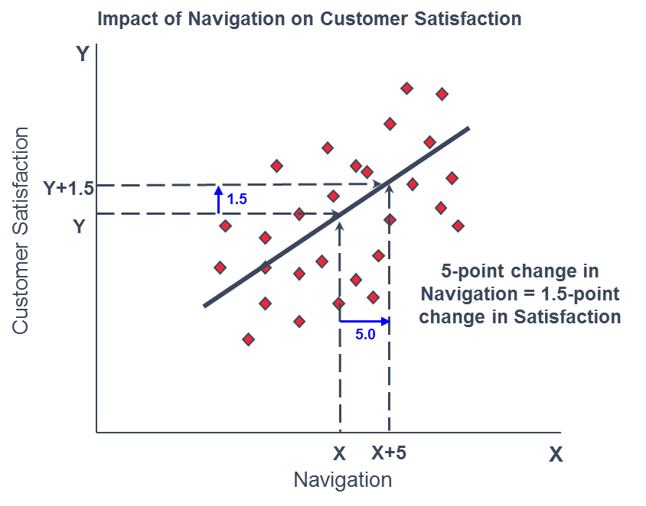
Understanding Impacts
The rate of change between an element and satisfaction is represented by an Impact. In simple terms, an impact can be understood as something like a slope of a line defining the relationship between two variables.

