Slide 1
Environmental Protection Agency
Acid Rain – Initial Data Overview
Dave Rassenfoss, Senior Data Analyst
Michelle Miller, Customer Success Manager
December 14, 2020
© 2020 Verint Systems Inc. All Rights Reserved Worldwide. CONFIDENTIAL AND PROPRIETARY INFORMATION OF VERINT SYSTEMS INC. The contents of this material are confidential and proprietary to Verint Systems Inc. and may not be reproduced, published, or disclosed to others without express authorization of Verint Systems Inc.

Slide 2
Your Verint Team
Dave Rassenfoss
Senior Analyst
David.Rassenfoss@verint.com
(734) 352-6325
Michelle Miller
Customer Success Manager
Michelle.Miller@verint.com
(734) 887-7439

Slide 3
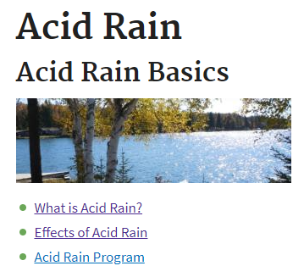
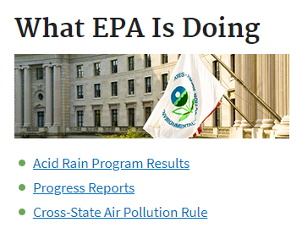
Agenda
Methodology & Objective
Acid Rain – Aggregate Results
Acid Rain Data Overview
Findings and Recommendations
Appendix
© 2020 Verint Systems Inc. All Rights Reserved Worldwide.
CONFIDENTIAL AND PROPRIETARY INFORMATION OF VERINT SYSTEMS INC.

Slide 4
METHODOLOGY
&
OBJECTIVE
© 2020 Verint Systems Inc. All Rights Reserved Worldwide.
CONFIDENTIAL AND PROPRIETARY INFORMATION OF VERINT SYSTEMS INC.

Slide 5
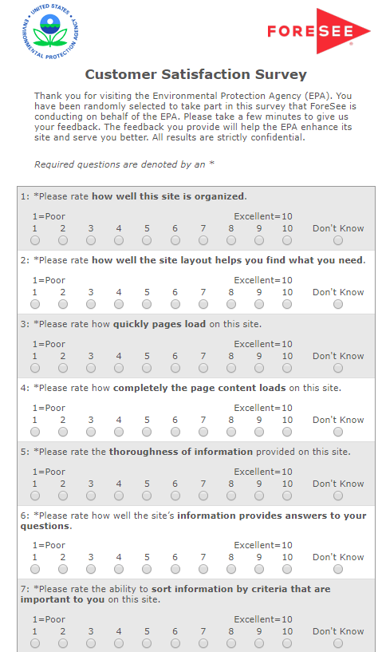
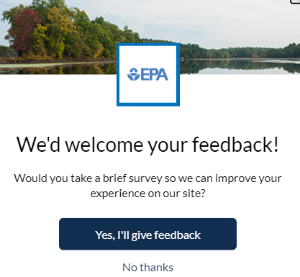
Capturing The Voice of the EPA.gov Visitor
KEY FACTS
Collection began:
Desktop: August 2015
Reporting Period:
January 1 - October 31, 2020
Completion Percentage:
❶
Visitor is on your site
epa.gov
❷
Visitor is shown an invite:
3 - Number of pages viewed
100% – Sampling %
❸
Accepting the invite loads hidden tracker window
n=327 Desktop
Extra numbers
❹❺❻
❹
Survey presents to the front when site is exited
Desktop=40% *42%
Public Sector– Desktop
Completion Percentage Benchmark Q3-2020

Slide 6
Verint Predictive Methodology
Verint applies proven science and technology to the measurement and analysis of the visitor experience through the lens of visitor satisfaction.
EXPERIENCE & EXPECTATIONS
SATISFACTION
BUSINESS OUTCOMES
Information Browsing
Look and Feel
Navigation
Site Information
Site Performance
Recommend Agency
Use information
Analysis of the visitor experience will enable your organization to understand…
How are you doing? What should you do? Why should you do it?

Slide 7
Strategic Analysis Objectives
MEASUREMENT OBJECTIVES | CXSA FOCUS FOR TODAY
As a Federal Government site, the primary focus of EPA.gov is to provide information to the public to protect human health and the environment. EPA is using Verint to help measure who is coming to the website, ease of site use, whether they were able to find what they were looking for and improve the visitors overall experience on the site. | Provide a segmented analysis of the Acid Rain visitor journey to better understand their experiences on the site, review issues and determine ways to improve their experience.

Slide 8
ACID RAIN
AGGREGATE
RESULTS
© 2020 Verint Systems Inc. All Rights Reserved Worldwide.
CONFIDENTIAL AND PROPRIETARY INFORMATION OF VERINT SYSTEMS INC.

Slide 9
Acid Rain visitor's satisfaction has increased as the 2020 progressed. Response rate has steadied in the last three months after a slow start.
Satisfaction and N:Count trend for 2020
Acid Rain questions
went live 1/27/2020
January 1 – October 31, 2020 | n=327

Slide 10
Satisfaction Summary – Acid Rain Web Page
=TOP PRIORITY DRIVER
DRIVERS
SATISFACTION
OUTCOMES
Which drivers of customer experience should I address?
What’s the impact to my business?
Benchmark:
Public Sector-Desktop
SCORE |  | IMPACT
74 | Information Browsing | 1.3
77 | Look and Feel | 1.1
77 | Navigation | 1.1
78 | Site Information | 1.2
81 | Performance | 0.4
75.0
IMPACT |  | SCORE
4.5 | Recommend Agency | 77
4.4 | Use Information | 80
73.9
0
100
N=327
Where am I right now?
The Impact on Sat is the improvement to overall satisfaction we would expect based on improving that driver's score by 5 points.
How do I compare?
The Impact on Outcomes is the improvement to that future behavior we expect based on improving overall satisfaction by 5 points.
The Score is a weighted average of responses to 2-4 individual questions, which comprise the overall score for an outcome.
The Score is a weighted average of responses to 2-4 individual questions, which comprise the overall score for a driver.
January 1 – October 31, 2020 | n=327

Slide 11
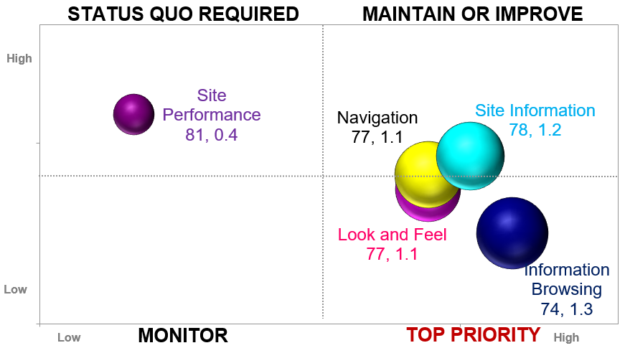
Information browsing is the highest impacting driver on customer satisfaction followed by site information, look and feel, and navigation.
Information Browsing
7.6 | 7.6 | 7.8
Sort information | Narrow choices | Features helpful
Site Information
8.0 | 8.2 | 8.1
Thoroughness of info | Info understandable | Info answers questions
Score
Look and Feel
7.8 | 7.8 | 8.2
Visual appeal | Balance of graphics/text | Readability of pages
Navigation
8.0 | 7.9 | 8.1
Site organization | Navigation options | Site layout
Impact
January 1 – October 31, 2020 | n=327

Slide 12
Acid Rain visitor’s score trends for Information Browsing and Site Information coincide with the rise in satisfaction throughout 2020.
Information Browsing and Site Information trend for 2020
January 1 – October 31, 2020 | n=327

Slide 13
Satisfaction scores below average for most applicable public sector and government benchmark categories.
Satisfaction Benchmarks
 | Public Sector-Desktop | Federal Government-Desktop | Overall Government -Desktop | Regulatory -Desktop | Independent Agency- Desktop
* EPA score represents the aggregate score for the measure.
71*
MAX
 Avg
 BENCHMARK AVERAGE
MIN
74
Acid Rain Satisfaction Score
January 1 – October 31, 2020 | n=327

Slide 14
Information browsing scores below average for most applicable public sector and government benchmark categories except regulatory agencies where the score is on the average.
Information Browsing Benchmarks
 | Public Sector-Desktop | Federal Government-Desktop | Overall Government -Desktop | Regulatory -Desktop | Independent Agency- Desktop
* EPA score represents the aggregate score for the measure.
70*
MAX
 Avg
 BENCHMARK AVERAGE
MIN
74
Acid Rain Site Information Browsing Score
Acid Rain webpage scores for Information Browsing
Score just above or at applicable benchmark averages
for public sector and government.
January 1 – October 31, 2020 | n=327

Slide 15
ACID RAIN
DATA OVERVIEW
© 2020 Verint Systems Inc. All Rights Reserved Worldwide.
CONFIDENTIAL AND PROPRIETARY INFORMATION OF VERINT SYSTEMS INC.

Slide 16
Nearly a third of visitor's who visited the Acid Rain web page were students and had a satisfaction score of 77.
For this visit to the EPA website, which of the following best describes you?
Nearly 50% of visitors fall
Into the education segment
Satisfaction →
N:327
January 1 – October 31, 2020 | n=327

Slide 17
Over a third of visitors who viewed the Acid Rain web page did so for the first time and had one of the lowest satisfaction scores.
How frequently do you use the EPA website?
First time visitors are a bellwether for site accessibility and usability And should be closely monitored to gauge site health.
These answer choices
removed on 9/30/20
Satisfaction →
N:327
January 1 – October 31, 2020 | n=327

Slide 18
A third of visitors who viewed the Acid Rain web page were also looking for information about COVID-19, specifically disinfectants to be used for COVID.
Were you looking for information related to COVID-19 today?
Comments about COVID-19
“List the cleaning supplies that kill Covid 19 on the disinfectants home page please. other than that good job :)” SAT:67, 9/24/20
“Like EPA HQ officially requested of Regions this week and other Regions have done, please post COVID -19 Regulatory Discretion ASAP!” SAT:70, 3/27/20
“disinfectants against sars cov2” SAT:93, 7/8/20
“ covid-19 disinfectant products” SAT:81, 4/9/20
“current cov19 info for disinfecting AND disposing of these chemicals.” SAT:70, 4/1/20
“Covid 19 research and cleaning guidelines.” SAT:70, 3/30/20
SAT:70
SAT:88
N:51
January 1 – October 31, 2020 | n=327

Slide 19
Acid Rain viewers were looking primarily for reports or guidance documents and data or statistics around acid rain, but also air quality and water issues as well.
What kind of information were you looking for today? (Please check all that apply)?
Acid Rain
Air quality
Water issues
Emissions
NOTE: Answers with _OLD suffix
were removed on 9/30/20
Satisfaction →
NEW
NEW
N:327
January 1 – October 31, 2020 | n=327

Slide 20
Besides the topic of acid rain, Acid Rain viewers were also looking for topics such as also air pollution and air quality as well as water pollution and water quality issues.
Which of the following topics best describes the information you wanted today?
Satisfaction
Acid Rain
Air quality
Pollution
N:327
January 1 – October 31, 2020 | n=327

Slide 21
About 2 in 10 Acid Rain visitors did not find the Acid rain web page helpful. The main reason was that they could not find the information they were looking for.
Did you find the Acid Rain web page to be helpful?
What about the Acid Rain web page was not helpful?
SAT:80
SAT:44
N:327
N:58
January 1 – October 31, 2020 | n=327

Slide 22
Acid Rain viewers primarily visited the What is Acid Rain? and the Effects of Acid Rain web pages during their visit.
What section(s) of the Acid Rain web page did you visit? (Please check all that apply)
Satisfaction
Web pages that could be possible
areas of focus for improvement
due to their low satisfaction scores.
N:327
January 1 – October 31, 2020 | n=327

Slide 23
30% of Acid Rain web page viewers did not find what they were looking for during their visit. Issues mentioned were more complete graphics on charts, information on stages of acid rain, and information on disinfectants and COVID.
Did you find the information you were looking for today?
Please tell us what couldn't you find
“Is looking for some more statistics on the link between the acid rain pollutants and human health. I have a very old article from the 90s about the link between acid rain pollutants, vitamin D deficiency, and breast cancer. I don't have the publisher or the author on the article and my copy has been photocopied so often it is illegible. I was looking for some more up-to-date information on this topic.” SAT:70, 5/5/20
“Your info on pH tolerance of living organism's graphic doesn't have a key, although it is color coded. The whole 'effects of acid rain section' is set up like you are trying to hide info. I would know, as I teach env. science, and I have been to many, many websites that blow yours out of the water. Where are the graphics to show effects of acid rain on the environment?” SAT:19, 4/23/20
“offer MUCH MORE simple language AND GRAPHICS re disinfectants for Specific Corona19 , give references for LOCAL access & availability hot line /email site for counties. Your info re 70% alcohol/bleach not clear ! i.e. local accessibility, how to dilute /combine solutions.” SAT:70, 4/1/20
“I couldn't find the stages of acid rain.” SAT:67, 6/18/20
“I was looking for basic information about air pollution and how it's measured but the amount of links I had to click to navigate made it confusing and difficult to find anything related to what I needed.” SAT:45, 5/18/20
“Like EPA HQ officially requested of Regions this week and other Regions have done, please post COVID -19 Regulatory Discretion ASAP!” SAT:70, 3/27/20
SAT:84
SAT:61
SAT:29
N:327
January 1 – October 31, 2020 | n=327

Slide 24
42% of Acid Rain viewers had an issue with the site search tool during their visit on the site. Scientist had the lowest percentage that said search worked well.
If you used the site search tools today, which of the following best describes your experience? (Please check all that apply)
Search Success for Top 5 Roles
(Search worked well %)
Student | 52%
Educator | 63%
Citizen | 64%
Business Rep | 80%
Scientist | 36%
NOTE: Answers with _OLD suffix
were removed on 9/30/20
Satisfaction →
83
NEW
N:170
January 1 – October 31, 2020 | n=327

Slide 25
Comments regarding web page improvement were mainly focused on making it more interactive, visually appealing, and easier to read.
How can we improve the Acid Rain web page?
“ For me to be able to use the information from this source, which I would very much like to do, the author(s) name is required, so I would be very grateful if the author's or authors' name(s) are provided anywhere on the page.” SAT:85, 6/25/20
“ I had a hard time finding what exactly the government was doing to stop acid rain. Eventually I found it but it felt buried under too many links.” SAT:92, 4/15/20
“Just add some pictures of acid rain results instead of those annoying bad pixel art things. or you can keep them. just add some picture and maybe make the text larger.” SAT:34, 4/21/20
“ Make it more HTML 5 friendly. Add more resources for high school level students learning environmental science/chemistry applications.” SAT:70, 5/5/20
“ Make it more visually appealing, better typography, better graphics, better color scheme.” SAT:4, 3/22/20
“ Provide a page that has figures related to impact of current use, future use, and use if/when reduced with a usable sliding scale for adjustments for reports etc.” SAT:78, 10/16/20
“Provide comparisons across the country. Take a look at how IQAir's website informs people about air quality around the world. You could do the same thing for water. Certainly, if that small company has the money to do that presentation our government has the money to do it even better.” SAT:0, 8/8/20
“The section on the effect of acid rain on forest and plants was sufficient, however more links leading to other resources would help for the Tree people.” SAT:96, 10/21/20
“The site was really laid out well. The only thing I would change is maybe to add a little bit more functionality to it. By it becoming more interactive and maybe real-time stats.” SAT:96, 4/10/20
“Make it less laggy it goes very slow once you get half way through What is acid rain?” SAT:67, 9/24/20
SAT:84
January 1 – October 31, 2020 | n=327

Slide 26
KEY FINDINGS
&
NEXT STEPS
© 2020 Verint Systems Inc. All Rights Reserved Worldwide.
CONFIDENTIAL AND PROPRIETARY INFORMATION OF VERINT SYSTEMS INC.

Slide 27
Key Findings & Recommendations
Information Browsing
Information Browsing was the highest impacting driver, especially the aspects of the ability to sort information and narrowing choices.
Consider a usability audit focused on search in order to improve its functionality within the bounds you can given the templatized nature of the site and the limitations to update it.
A third of Acid Rain web page viewers were looking for data or statistics which was the lowest scoring of the top 5 reasons for visiting the site
Open-ended comments indicated opportunities of improvement in the areas of locating information about acid rain, specifically it’s cause, forms of acid Rain, and measurement.
42% of Acid Rain web page viewers indicated that the site search tool did not work well for them.
The heaviest users (students and educators - 49% of total) had some of the lowest success rates. Monitor search terms used by these segments in order to indicate if it is information that isn’t included on the site or that the search term as entered did not bring back a result.
Data and Statistics
Search

Slide 28
Next Steps
1) | Review survey early in the year to make sure it aligns with internal KPI’s for 2021
 | Changes made early in the year (ex. continue with Acid Rain questions?) will allow for enough time for any new or modified questions to get a sufficient response rate for analysis later in the year.
2) | Set up dashboards in CX Suite to help monitor KPI’s
 | Work with Michelle on setting up dashboards in the CX Suite that will allow you to easily see how important KPI’s, key user segments, and satisfaction or driver trends are performing at a glance.

Slide 29
THANK YOU!
© 2020 Verint Systems Inc. All Rights Reserved Worldwide.
CONFIDENTIAL AND PROPRIETARY INFORMATION OF VERINT SYSTEMS INC.

Slide 30
APPENDIX
© 2020 Verint Systems Inc. All Rights Reserved Worldwide.
CONFIDENTIAL AND PROPRIETARY INFORMATION OF VERINT SYSTEMS INC.

Slide 31
Appendix - Glossary of Verint Terminology
The Verint Predictive Methodology: The Verint methodology is an advanced statistical engine proven by years of research that measures the customer experience and utilizes cause-and-effect modeling to radically change the way that organizations make strategic investments and decisions for better bottom-line results. Backed by three decades of rigorous scientific research, Verint methodology has a rich heritage of highly diagnostic performance measurements coupled with sensitive improvement prescriptions and powerful prognostic capabilities.
Custom Questions: Each Customer Satisfaction Survey includes two different types of questions: model questions and custom questions. Custom questions are unique to each survey and can take a variety of different forms, including radio buttons, drop-down menus, check boxes, and open-ended text. The custom question responses are not used to derive the results using the Verint methodology; so custom question results are reported separately in the Online Reporting Facility. Custom questions provide an excellent opportunity for data segment analysis.
Elements: An element is a measure of the customer's experience with a defined and manageable property of a website (e.g., Look and Feel, Navigation, etc.). It is composed of several survey items that provide performance ratings about various aspects of the customer's experience with the website property being measured. The separate ratings are combined as part of the modeling process into a summary score reflecting the overall experience of the customer with the website property.
Random Sampling: We use a Sampling Percentage to determine the proportion of site visitors that will receive a survey invitation on your site. We try to attain a good balance between collecting enough information to provide you with in-depth analysis, while remaining unobtrusive to your site visitors.
Impact: Impact is the numeric representation of the cause-and-effect relationship between an element (e.g., Site Navigation) and customer satisfaction or customer satisfaction and a future behavior (e.g., Likelihood to Purchase). An impact represents the increase in customer satisfaction resulting from a 5-point increase in an element score. For example, if the impact of Site Navigation is 1.2, then a 5-point increase in Site Navigation’s score would lead to an increase in customer satisfaction by 1.2 points.
Loyalty Factor: The Loyalty Factor is a number that establishes how many pages with survey code a site visitor must visit before they are eligible to receive a survey. Loyalty Factors are utilized to ensure that respondents have experienced enough of a site before completing the Customer Satisfaction Survey.
Model Questions: In order to utilize the Verint methodology to calculate Satisfaction and Future Behavior scores and impacts, Verint asks standard model questions. These model questions are targeted toward the key Elements (i.e., “main areas”) of the site that drive customer satisfaction (e.g., Functionality, Navigation, Product Browsing, etc.), Overall Satisfaction, and Future Behaviors such as Likelihood to Recommend or Likelihood to Purchase.
Future Behaviors: Future Behaviors are the things you want your customers to do more of as a result of visiting your website, such as recommend your site to others or complete a purchase. The cause-and-effect Verint methodology enables us to quantify the impact that improving satisfaction with your site would have on increasing future behaviors such as site visitors’ likelihood to recommend your site.

Slide 32
Benchmark Participants
Federal Government - Desktop
Public Sector-Desktop
Overall Government - Desktop
AARP
American Battle Monuments Commission
American Chemical Society
American College of Cardiology
American Society of Civil Engineers
Arizona State University
Arlington National Cemetery
Association of American Medical Colleges
California Health Care Foundation
CaringBridge
Centers for Disease Control
Central Intelligence Agency
College of American Pathologists
Commonwealth of Massachusetts
DHS CIS
Earthwatch Institute
FDA
Federal Trade Commission
FEMA - NFIP
Financial Stability
Freddie Mac
Girl Scouts of the USA
GSA Auctions
Harvard Business School
Health & Human Services
HealthNet Federal Services
International Monetary Fund
Kingdom of Saudi Arabia
MacArthur Foundation
Medicaid.gov
MESSA
MI Workforce Development Agency
Michigan Economic Development Corporation
Michigan Lottery
Military OneSource
Montgomery County
NASA
National Fire Protection Association
National Library of Medicine
NIH NCCIH
NOAA NWS
NOAA/NOS CO-OPS, Tides & Currents
NSF Research
OPM Retirement Services
Partnership for Public Service
Regulatory Information Service Center
Robert Wood Johnson Foundation
Smithsonian
Social Security Administration
State of New York
State of Ohio
U.S. Department of Homeland Security
U.S. Department of Veterans Affairs
University of Maryland GC
US Agriculture - ERS
US Agriculture - Forest Service
US Agriculture - FSIS
US Agriculture - NAL
US Agriculture - NASS
US Agriculture - NRCS
US Commerce - BEA
US Commerce - NOAA
US Commerce - NOAA, NESDIS
US Commerce - NOAA, NMFS
US Commerce - NOAA, NOS
US Commerce - NOAA, NOS-NGS
US Commerce - USPTO
US Courts
US DoD - Defense Counterintelligence and Security Agency
US DoD - Defense Health Agency
US DoD - DLA
US DoD - DoDEA and DDESS
US Education
US Environmental Protection Agency
US Environmental Protection Agency (Regulations.gov)
US Government Accountability Office
US HHS - AHRQ
US HHS - CDC
US HHS - CMS
US HHS - e-grant
US HHS - NIH
US HHS - NIH NHLBI
US HHS - NIH NIAMS
US HHS - NIH NIDCR
US HHS - NIH NIDDK
US HHS - NIH, NICHD
US HHS - SAMHSA
US Homeland Security - CRC
US International Trade Commission
US Justice - BOP/Unicor
US Justice - FBI
US Justice - OJP
US Labor
US Labor - BLS
US Nuclear Regulatory Commission
US Office of Personnel Management
US Pension Benefit Guaranty Corporation
US Securities and Exchange Commission
US State
US State - Office of Recruitment
US Transportation - FAA
US Transportation - NHTSA
US Treasury - EFTPS
US Treasury - IRS
US Treasury - TreasuryDirect - Bureau of the Public Debt
US Treasury - TTB
US Treasury - U.S. Mint
USA Staffing
Virginia Lottery
Wayne County Airport Authority
Workplace Safety & Insurance Board

Slide 33
Benchmark Participants
Overall Government - Desktop
Federal Government - Desktop
American Battle Monuments Commission
Arlington National Cemetery
Centers for Disease Control
Central Intelligence Agency
Commonwealth of Massachusetts
DHS CIS
FDA
Federal Trade Commission
FEMA - NFIP
Financial Stability
GSA Auctions
Health & Human Services
HealthNet Federal Services
Kingdom of Saudi Arabia
Medicaid.gov
MI Workforce Development Agency
Michigan Economic Development Corporation
Military OneSource
Montgomery County
NASA
National Library of Medicine
NIH NCCIH
NOAA NWS
NOAA/NOS CO-OPS, Tides & Currents
NSF Research
OPM Retirement Services
Regulatory Information Service Center
Smithsonian
Social Security Administration
State of New York
State of Ohio
U.S. Department of Homeland Security
U.S. Department of Veterans Affairs
US Agriculture - ERS
US Agriculture - Forest Service
US Agriculture - FSIS
US Agriculture - NAL
US Agriculture - NASS
US Agriculture - NRCS
US Commerce - BEA
US Commerce - NOAA
US Commerce - NOAA, NESDIS
US Commerce - NOAA, NMFS
US Commerce - NOAA, NOS
US Commerce - NOAA, NOS-NGS
US Commerce - USPTO
US Courts
US DoD - Defense Counterintelligence and Security Agency
US DoD - Defense Health Agency
US DoD - DLA
US DoD - DoDEA and DDESS
US Education
US Environmental Protection Agency
US Environmental Protection Agency (Regulations.gov)
US Government Accountability Office
US HHS - AHRQ
US HHS - CDC
US HHS - e-grant
US HHS - NIH
US HHS - NIH NHLBI
US HHS - NIH NIAMS
US HHS - NIH NIDCR
US HHS - NIH NIDDK
US HHS - NIH, NICHD
US HHS - SAMHSA
US Homeland Security - CRC
US International Trade Commission
US Justice - BOP/Unicor
US Justice - FBI
US Justice - OJP
US Labor
US Labor - BLS
US Nuclear Regulatory Commission
US Office of Personnel Management
US Pension Benefit Guaranty Corporation
US Securities and Exchange Commission
US State
US State - Office of Recruitment
US Transportation - FAA
US Transportation - NHTSA
US Treasury - EFTPS
US Treasury - IRS
US Treasury - TreasuryDirect - Bureau of the Public Debt
US Treasury - TTB
US Treasury - U.S. Mint
USA Staffing
Virginia Lottery
Wayne County Airport Authority
American Battle Monuments Commission
Arlington National Cemetery
Centers for Disease Control
Central Intelligence Agency
DHS CIS
FDA
Federal Trade Commission
FEMA - NFIP
Financial Stability
GSA Auctions
Health & Human Services
HealthNet Federal Services
Medicaid.gov
Military OneSource
NASA
National Library of Medicine
NIH NCCIH
NOAA NWS
NOAA/NOS CO-OPS, Tides & Currents
NSF Research
OPM Retirement Services
Regulatory Information Service Center
Smithsonian
Social Security Administration
U.S. Department of Homeland Security
U.S. Department of Veterans Affairs
US Agriculture - ERS

Slide 34
Benchmark Participants
Federal Government – Desktop (cont.)
Regulatory – Desktop
Independent Agency – Desktop
US Agriculture - Forest Service
US Agriculture - FSIS
US Agriculture - NAL
US Agriculture - NASS
US Agriculture - NRCS
US Commerce - BEA
US Commerce - NOAA
US Commerce - NOAA, NESDIS
US Commerce - NOAA, NMFS
US Commerce - NOAA, NOS
US Commerce - NOAA, NOS-NGS
US Commerce - USPTO
US Courts
US DoD - Defense Counterintelligence and Security Agency
US DoD - Defense Health Agency
US DoD - DLA
US DoD - DoDEA and DDESS
US Education
US Environmental Protection Agency
US Environmental Protection Agency (Regulations.gov)
US Government Accountability Office
US HHS - AHRQ
US HHS - CDC
US HHS - e-grant
US HHS - NIH
US HHS - NIH NHLBI
US HHS - NIH NIAMS
US HHS - NIH NIDCR
US HHS - NIH NIDDK
US HHS - NIH, NICHD
US HHS - SAMHSA
US Homeland Security - CRC
US International Trade Commission
US Justice - BOP/Unicor
US Justice - FBI
US Justice - OJP
US Labor
US Labor - BLS
US Nuclear Regulatory Commission
US Office of Personnel Management
US Pension Benefit Guaranty Corporation
US Securities and Exchange Commission
US State
US State - Office of Recruitment
US Transportation - FAA
US Transportation - NHTSA
US Treasury - EFTPS
US Treasury - IRS
US Treasury - TreasuryDirect - Bureau of the Public Debt
US Treasury - TTB
US Treasury - U.S. Mint
USA Staffing
FDA
Regulatory Information Service Center
U.S. Department of Veterans Affairs
US Agriculture - FSIS
US Environmental Protection Agency
US Environmental Protection Agency (Regulations.gov)
US International Trade Commission
US Nuclear Regulatory Commission
US Securities and Exchange Commission
US Transportation - FAA
US Treasury - TTB
Central Intelligence Agency
Federal Trade Commission
GSA Auctions
NASA
NSF Research
OPM Retirement Services
Regulatory Information Service Center
Social Security Administration
US Environmental Protection Agency
US International Trade Commission
US Nuclear Regulatory Commission
US Office of Personnel Management
US Pension Benefit Guaranty Corporation
US Securities and Exchange Commission
USA Staffing

Slide 35
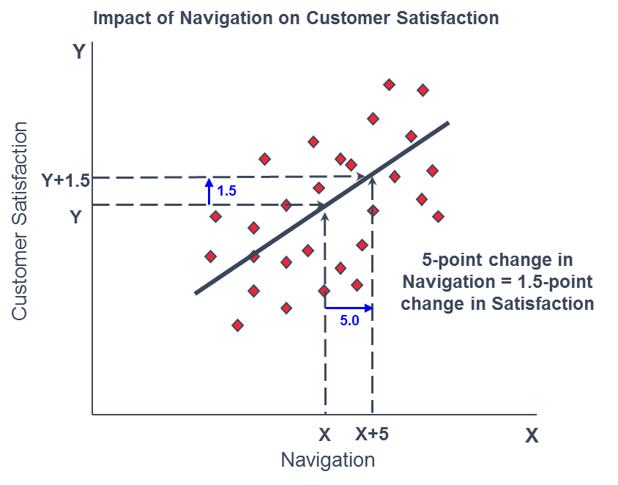
Understanding Impacts
The rate of change between an element and satisfaction is represented by an Impact. In simple terms, an impact can be understood as something like a slope of a line defining the relationship between two variables.

