Slide 1
Environmental Justice Primer for Ports
Module 3: The Good Neighbor Guide to Building Partnerships and
Social Equity with Communities
U.S. EPA Office of Transportation and Air Quality
Notes:
This presentation provides an overview of the EJ Primer for Ports. You are encouraged to follow along with your guide and identify areas you may want to explore further after the training.

Slide 2
Tools
Ports Primer for Communities: An Overview of Ports Planning and Operations to Support Community Participation
Community Action Roadmap: Empowering Near-Port Communities
Environmental Justice (EJ) Primer for Ports: The Good Neighbor Guide to Building Partnerships and Social Equity with Communities
Notes:
The Environmental Justice (EJ) Primer for Ports is one of 3 tools in the community-port collaboration toolkit for collaboration that includes:
Ports Primer for Communities: An Overview of Ports Planning and Operations to Support Community Participation
An interactive tool and reference document that characterizes the port industry sector, including environmental and community health impacts associated with port activities.
Community Action Roadmap: Empowering Near-Port Communities
An implementation companion for the Ports Primer for Communities that provides a step-by-step process for building collaborations and preparing community stakeholders.
Environmental Justice (EJ) Primer for Ports: The Good Neighbor Guide to Building Partnerships and Social Equity with Communities
Designed to inform the port industry sector of the perspectives, priorities, and challenges often unique to communities with EJ concerns.

Slide 3
Pilots & Toolkit Update
Community-Port Collaboration Pilot Projects - Technical assistance provided to 4 pilot communities
Includes an updated community-port collaboration toolkit consisting of 3 documents and webpages
Key lessons learned and additional tools developed based on pilot outcomes
Notes:
EPA conducted community-port collaboration pilot projects and provided technical assistance to 4 communities (Seattle, WA, Providence, RI; New Orleans, LA; Savannah, GA). The community-port collaboration toolkit was utilized.
The toolkit was updated based on input received from pilot partners along with other port stakeholders.
The pilot projects supported the goal of improving air quality and environmental conditions at and near ports that can lead to improved public health in communities and better outcomes for port infrastructure development. Successful partnerships were developed from the pilot projects by equipping port operators and community stakeholders with information, skills and tools to effectively develop and implement collaborative actions.
Key lessons learned and additional tools were developed based on pilot outcomes. A separate training on the pilots and lessons learned is available.

Slide 4
Goals of the EJ Primer for Ports
Offers resources for ports seeking to build partnerships and social equity with near-ports communities.
Help port decision-makers better understand the needs of near-port communities
Learn how port decision makers can help address community needs
Build productive community relationships
Notes:
Offers resources for ports seeking to build partnerships and social equity with near-ports communities.
Intended to help port decision-makers better understand the needs of near-port communities
How port decision-makers can help address these needs and build productive community relationships during planning activities and operations.
Proactively engage community stakeholders in addressing these pressing challenges to ensure shared prosperity and regional resilience.

Slide 5
EJ Primer for Ports
Good Neighbor Roadmap
Provides a step-by-step process for ports agencies to proactively engage community stakeholders in addressing port-related impacts and promote local prosperity and regional resilience.
Notes:
The EJ Primer for Ports provides a step-by-step process, called the Good Neighbor Roadmap, for ports agencies to proactively engage community stakeholders in addressing port-related impacts and promote local prosperity and regional resilience.

Slide 6
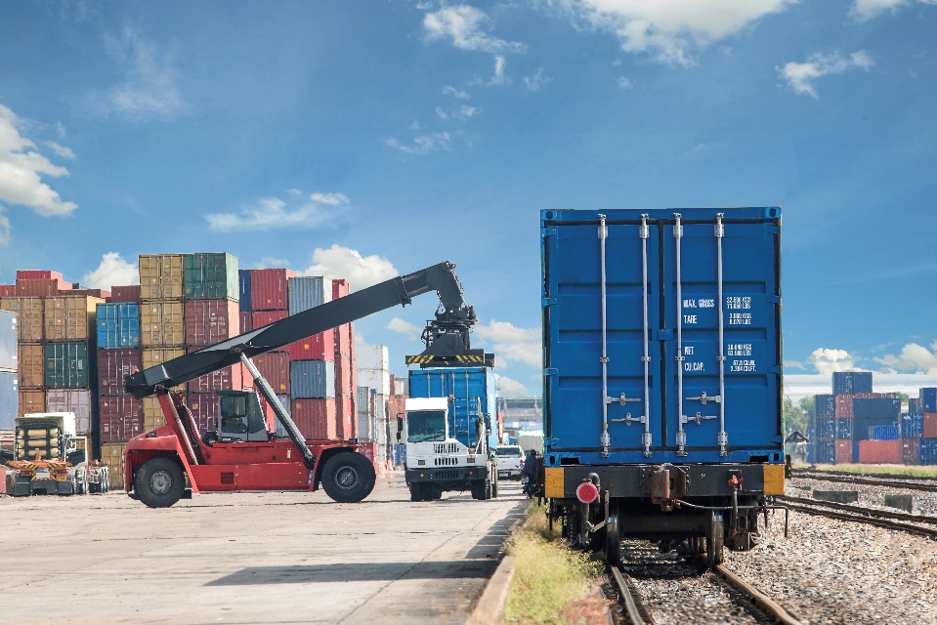
Training Overview
1: Environmental Justice
2: Community Engagement
3: Good Neighbor Roadmap
Notes:
The EJ Primer for Ports covers 3 primary areas:
1: Environmental Justice
2: Community Engagement
3: Good Neighbor Roadmap
As we walk through this training, you may notice footnotes on some of the slides. These correspond to references found on the web and PDF versions of this document.

Slide 7
The Business Case
  Business leaders are recognizing they need broader coalitions to deal with new, complex drivers.
  Business models are shifting to a triple-bottom-line approach that includes social, economic and environmental performance measures.
  Forward-thinking businesses and governments are starting to consider social and environmental impacts as part of standard operating procedures.
  Ports play an important role in sustaining local, regional and national economies.
Notes:
Business Case
Global climate change, natural resource depletion and international competitiveness are shifting business models to a triple-bottom-line approach that includes social, economic and environmental performance measures.
Consideration of social and environmental impacts has become a defining characteristic of forward-thinking businesses and governments. These leaders benefit from increased community and stakeholder trust as well as resource efficiency and innovation.¹ These approaches also help businesses and governments meet regulatory requirements and avoid risks and losses from lack of community support, negative press and litigation.
Ports play an important role in sustaining local, regional and national economies. Port operations and associated freight transport activities also inevitably impact near-port communities. They can cause cumulative environmental challenges such as air, water and land pollution, as well as land use conflicts that impact local quality of life. As port decision-makers consider how to address community impacts, they are balancing a range of new industry challenges including climate adaptation, post-Panamax shipping infrastructure needs, and workforce development.

Slide 8
Defining Environmental Justice

Slide 9
Current and Historical Disparities
Communities of color and low income and tribal communities have historically been home to many toxic and polluting facilities and land uses.
EPA acknowledges, “These communities face an array of challenges, including;
Proximity to polluting facilities,
Barriers to participating in decision-making processes,
Disproportionate levels of chronic disease,
Neighborhood disinvestment, and
Poor or no access to jobs and services.” ³
Notes:
Why do current disparities exist?
Communities of color and low income and tribal communities have historically been home to many toxic and polluting facilities and land uses.
EPA acknowledges, “These communities face an array of challenges, including proximity to polluting facilities, barriers to participating in decision-making processes, disproportionate levels of chronic disease, neighborhood disinvestment, and poor or no access to jobs and services.” ³

Slide 10
Environmental Justice Defined by EPA
“the fair treatment and meaningful involvement of all people regardless of race, color, national origin, or income, with respect to the development, implementation, and enforcement of environmental laws, regulations, and policies.”⁴
Notes:
What is environmental justice?
EPA defines environmental justice as “the fair treatment and meaningful involvement of all people regardless of race, color, national origin, or income, with respect to the development, implementation, and enforcement of environmental laws, regulations, and policies.”⁴

Slide 11
Environmental Justice Defined by EJ Leaders
Environmental justice is served when people can realize their highest potential...where both cultural and biological diversity are respected and highly revered and where distributive justice prevails.__ Bunyan Bryant
Notes:
Additional definitions with a vision that goes beyond regulatory requirements include:
Environmental Justice...refers to those cultural norms and values, rules, regulations, behaviors, policies, and decisions [that] support sustainable communities where people can interact with confidence that the environment is safe, nurturing, and productive. Environmental justice is served when people can realize their highest potential...where both cultural and biological diversity are respected and highly revered and where distributive justice prevails.⁴
Bunyan Bryant
What do you notice about the differences in these two definitions?

Slide 12
Social Equity in Public Policy and Planning
Many disproportionate impacts on near-port communities are the result of long-term, policy and siting decisions across various levels of decision-making.
Cumulative impacts for these communities include adverse health outcomes and reduced quality of life.
In contrast, policies and decision-making tools that are nondiscriminatory and promote equitable distribution of benefits and mitigation of burdens across society result in environmental justice.
Notes:
Many disproportionate impacts on near-port communities are the result of long-term, policy and siting decisions across various levels of decision-making.
Cumulative impacts for these communities include adverse health outcomes and reduced quality of life.
In contrast, policies and decision-making tools that are nondiscriminatory and promote equitable distribution of benefits and mitigation of burdens across society result in environmental justice.

Slide 13

Port-related Pollutants and Health Hazards
Air pollution from emissions
Related Health Impacts
Water pollution
Light and noise pollution
Notes:
Port-related pollutants and health hazards
Near-port communities and tribes can face challenges due to sustained exposure to pollutants and toxins, and health impacts from this exposure can span across multiple generations.
Communities and tribes face a range of health and welfare risks from environmental problems, including surface and groundwater contamination, illegal dumping, hazardous waste disposal, air pollution, mining wastes, habitat destruction and climate change.
Air pollution
The emissions from goods movement through trucks, marine vessels, trains, cargo handling equipment as well as from stationary sources such as refineries, oil and gas storage facilities, power generation and storage of open coal piles found near port facilities can introduce many air pollutants that severely impact the health of near-port communities.
Exposure to air pollution associated with emissions from diesel engines can contribute to significant health problems—including premature mortality, increased hospital admissions for heart and lung disease, increased cancer risk, and increased respiratory symptoms—especially for children, the elderly, outdoor workers and other sensitive populations.
Water pollution
Port operations can have a significant impact on neighborhood water quality. Runoff from impervious surfaces can carry pollutants that may prevent people from enjoying local creeks, lakes or bays, and from eating fish and shellfish from these waters. In some cases, community members may rely on fishing as a subsistence source of food.
Light and noise pollution
Health impacts of light and noise pollution from port operations can include hearing impairment, high blood pressure and sleep deprivation.

Slide 14
Cumulative Impacts on Quality of Life
Neighborhood disinvestment
Income inequality
Public safety concerns around truck routes and rail crossings
Coastal-related threats from extreme weather events
Barriers to grocery stores, health services, pharmacies, etc. due to port-related infrastructure.
Lack of adequate sidewalks, street trees, safe intersection crossings and other basic infrastructure.
Notes:
Cumulative impacts on quality of life
Environmental justice communities often experience stressors beyond health disparities, such as neighborhood disinvestment, income inequality, public safety concerns around truck routes and rail crossings, and coastal-related threats from extreme weather events and climate change. In addition, the industrial super blocks, rail lines and highways surrounding ports can create barriers between residents and basic necessities such as grocery stores, health services, pharmacies, retail centers, transit and recreational spaces. Industrial features in near-port areas mean that near-port neighborhoods often lack adequate sidewalks, street trees, safe intersection crossings and other basic infrastructure.

Slide 15
Community Engagement

Slide 16
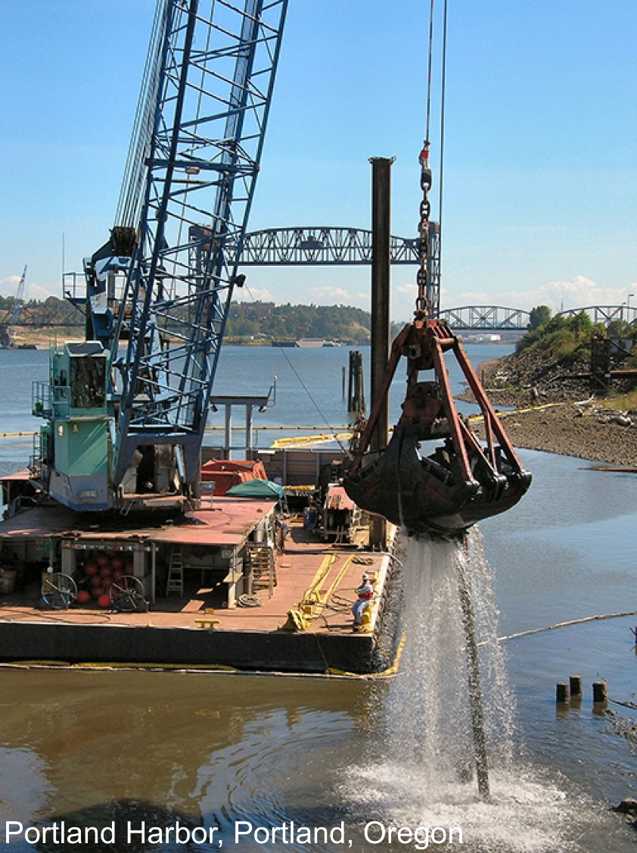
Benefits of Effective Community Engagement
Legitimacy and increased support for plans and projects.
Improved community/government relations.
Deeper understanding of the issues.
Increase in community collaboration abilities to achieve equitable outcomes and leverage additional resources, outside of public processes.
Democracy in action.
Notes:
According to The Community Engagement Guide for Sustainable Communities, community engagement is a process through which community members are empowered to own the change they want to see. The process involves communication, problem-solving, governance, and decision-making skills and strategies. The report summarizes the benefits of effective engagement as:
Legitimacy and increased support for plans and projects.
Improved community/government relations.
Deeper understanding of the issues.
Increase in community collaboration abilities to achieve equitable outcomes and leverage additional resources, outside of public processes.
Democracy in action.
Community engagement is, in many ways, a microcosm of our American democratic system of government. It is one of the best ways that community residents can connect to and shape local and regional decision-making processes.
Ports and near-port communities share infrastructure, regulatory jurisdictions, local governments and climate-related risks. While these communities face quality of life impacts, the ports face business risks and potential losses from non-compliance with legal obligations. Extreme weather events and climate change threaten both ports and near-port communities, requiring adaptation to increase resilience to these events. Ports decision-makers can help communities and ports navigate these challenges and shared interests by providing opportunities for joint-problem solving. The goal is straightforward – a more compatible, sustainable and resilient future for all parties.

Slide 17
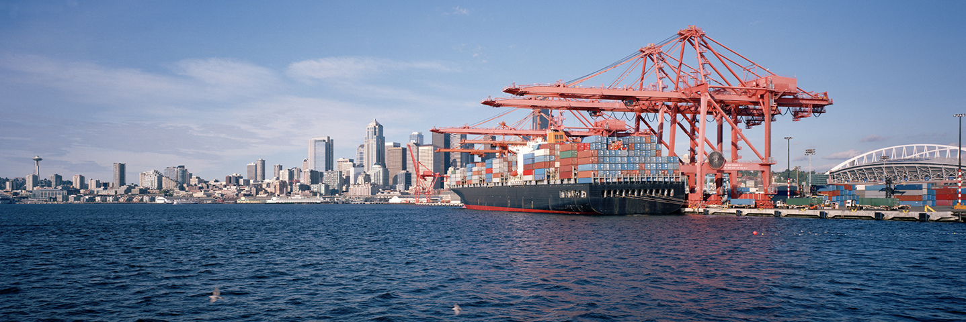
Regulatory Requirements
Most federal regulations require public participation as part of a new action or permit. Examples include:
National Environmental Policy Act
Federal Executive Order 12898
Tribal Rights
Notes:
The drivers for port decision-makers to engage near-port communities can be divided into three broad categories:
Regulatory requirements
Risk management
Increased resilience and innovation
Regulatory requirements
Most federal regulations require public participation as part of a new action or permit. Visit PortCompliance.org to review all potentially applicable federal regulations. Permits especially relevant to near-ports communities include the Clean Air Act Title V permitting process and the Clean Water Act Stormwater permitting process. In addition to public participation, NEPA and Executive Order 12898 specifically require consideration of impacts to nearby communities, and Executive Order 13175 requires agencies to consult with tribes on all actions that could impact the tribal community. State and local regulatory requirements should be considered as well.
National Environmental Policy Act
The National Environmental Policy Act (NEPA) requires the evaluation of environmental impacts for any major federal action, including issuing federal permits, typically resulting in an Environmental Assessment or a full Environmental Impact Statement (EIS). As part of the NEPA process, agencies are required to provide meaningful opportunities for public participation.
Key stages in the process include:
When an agency starts a NEPA analysis.
When a NEPA document is published for public review and comment.
When mitigation alternatives are being considered.
Meaningful engagement with communities can occur prior to and throughout the entire NEPA process, including when defining the affected environment, identifying minority and low-income populations, assessing potential impacts, assessing potential alternatives, determining whether impacts are disproportionately high and adverse, and developing mitigation and monitoring measures.
Methods used by agencies to engage communities in scoping and development for environmental impact statements (EIS) include public meetings, conference calls, formal hearings, informal workshops and opportunities to submit written comments. Specific guidance, methods and tools are available for analysis and consideration of environmental justice as part of the NEPA review process.
Federal Executive Order 12898
Under federal Executive Order 12898, all federal agencies are required to identify and address the disproportionate impacts of their programs, policies and activities on low-income communities and communities of color. Near-port communities often reflect these demographics, making this requirement particularly relevant for ports where activities require a federal action, such as deepening or widening a harbor or channel, bridge elevations, and multimodal infrastructure investments.
Executive Order 12898 requires an environmental justice analysis as part of a NEPA review.
Further, Further, Title VI of the Civil Rights Act of 1964 requires that recipients of federal funding including BUILD (formally known as TIGER) and the Diesel Emissions Reduction Act (DERA) not utilize those funds in a way that discriminates again protected groups as defined by the Civil Rights Act. The Civil Rights Act “prohibits discrimination on the basis of race, color, and national origin in programs and activities receiving federal financial assistance.“
In addition, Executive Order 12898 requires federal agencies to develop strategies to address environmental justice. EPA’s strategy includes an overarching effort to instill a culture among all federal agencies in which environmental justice is a priority by incorporating EJ language in applicable external funding opportunities. This cultural change is reflected in some federal grants, such as DERA, in prioritizing funding to areas that experience disproportionate adverse impacts
Tribal Rights
Tribal communities often have special treaty rights that must be considered, such as access to and protection of treaty-protected rights, the health of plants and animals, federal trust responsibility protections, and government-to-government consultation. The Executive Order 13175: Consultation and Coordination with Indian Tribal Governments protects the sovereignty and right to self-determination of Indian Tribes and requires agencies to consult tribes on all policies, rules and guidance with Tribal Implications (TI).
Tribes have the authority to govern the environment within Trust lands and other areas where they can demonstrate jurisdiction, which includes implementing federal laws when they have delegated programs. Tribes also may have treaty rights in other areas that are important in protecting traditional lifeways such as subsistence hunting, fishing and cultural practices.
While part of the environmental justice community, tribal governments also carry a special distinction, conferred by statute, affirmed in the Clean Air Act, and upheld by the Supreme Court, and their status as sovereign nations means that they have additional legal rights. Examples of such rights are the right to hunt, fish, gather and otherwise use the resources found in treaty-protected lands.
In addition, the federal government has a trust responsibility to tribes, which is carried out through government to government consultation. With respect to emissions from ports, this means tribes must be not just consulted, but engaged as government-to-government partners, wherever and whenever there are federal permits or reviews. This may include consultation on emissions from the sources found in ports but may also include the use of waters in the ports areas, traffic in ports areas, and the health of the plant and animal species found in treaty-protected areas. Tribes may have additional considerations than other populations due to their subsistence lifestyle, to the higher than average prevalence of COPD, diabetes and asthma in tribal communities, and the use of resources for medicinal and ceremonial purposes. Also, places of cultural or spiritual significance can be impacted by pollution, as these places are likely to be outdoors rather than inside a building.

Slide 18
Effective Community Engagement Methods
Meaningful Community Engagement
Communicating directly with the impacted communities
Providing a means for their input to influence the decision outcomes.
Defining community stakeholder groups
Building relationships with near-port communities
Determining the level of community engagement
Notes:
Effective Community Engagement Methods
Meaningful community engagement is essential to environmental justice and relies on communicating directly with the impacted communities and providing a means for their input to influence the decision outcomes. Creating a permanent community advisory committee (CAC) is an effective method for keeping the community informed and gathering input. Ports may also designate a community liaison to ensure information flows between community leaders and port decision-makers.

Slide 19
Effective Community Engagement
Defining Community Stakeholder Groups
Resident Groups
Community-Based Partners
Local Unions
Tribes
Government
Educational Institutions
Environmental Groups
Internal Port Stakeholders
Port-Sector Stakeholders
Notes:
Defining community stakeholder groups
Community stakeholder groups can be divided into the following categories by role in the process.
Community Resident Groups: community residents and resident organizations from near-port communities
Community-Based Partners: organizations working with near-port communities to support local goals
Local Unions: organizations representing workers at the port, goods movement industries, etc.
Tribes: Native American Tribes have unique rights as sovereign nations.
Government Stakeholders: local, regional or federal government entities with port and community responsibilities
Local Educational Institutions: local universities, colleges, schools and minority serving institutions (historical black colleges and universities, tribal universities and Hispanic serving institutions)
Local Environmental Groups: environmental and/or environmental justice advocacy groups
Internal Port Stakeholders: port authority or agency departments
Port-Sector Stakeholders: port tenants, nearby industrial facilities and goods movement sector
Relations between the port and each of these groups can vary widely based on the degree of shared interests, trust level and past conflicts. Engagement efforts can tend to focus on those stakeholder groups with shared interests and low conflict. However, reaching out directly to impacted communities, despite past communication challenges is essential to begin to understand community concerns and explore feasible ways to address concerns in planning and decision-making. The resources section in the Appendix includes more information on the benefits of effective community engagement and approaches to collaborative problem solving.

Slide 20
Effective Community Engagement Methods
Determining the Level of Community Engagement
INFORM Build community support
CONSULT Invite feedback on port projects and policies
INVOLVE Develop port-community collaborations
COLLABORATE Build partnerships to mitigate impacts
EMPOWER Designate citizen representatives
Notes:
Determining the level of community engagement
The International Association for Public Participation’s (IAP2’s) Spectrum of Public Participation discusses public participation levels in increasing order of the potential impact of public involvement on decision-making (see Table 2 on Page 13 of the PDF document). Increased levels of engagement can lead to decisions with more public support.
The appropriate level of community engagement can vary depending on specific outreach goals, timing, location, community culture and access to technology. Table 2 outlines IAP2 levels of engagement illustrated with example actions and considerations for selection.
Depending on time, the trainer could invite participants to break into groups to explore Table 2 and determine what level is most common with their agency/organization and why. And what actions they might take to increase the level of engagement .

Slide 21
Collaborative Problem Solving
Consensus Building
Dispute Resolution
Community Benefit Agreements
Notes:
Collaborative Problem Solving Tools include:
Consensus Building
At the heart of collaborative problem-solving is consensus building. Building consensus means seeking agreement among different and, often times, competing interests by encouraging all participating stakeholders to seek common ground and derive mutual gains. Consensus building requires members to work together to seek creative solutions to meet the needs and interests of each member of the group.
Dispute Resolution
A dispute happens when a conflict between different parties has reached an impasse. Dispute resolution processes can be legally mandated or consensual. Enlisting a third-party, neutral facilitator or mediator can greatly assist in resolving disputes productively and provide the parties with greater control over the process and outcomes. Disagreements about facts or the interpretation of data may arise in virtually all situations involving disproportionate environmental and/or public health issues. When disagreements about facts or data occur, the stakeholders can jointly choose to use an expert or team of experts to conduct neutral fact-finding.
Community Benefit Agreements
A Community Benefits Agreement (CBA) is, “a legally enforceable contract, signed by community groups and a project developer, detailing a range of community benefits that the developer agrees to provide as part of a proposed project” (EPA Region 8). CBAs represent community concerns and directly relate to the land use and/or environmental impacts of the proposed development.
Past CBAs have included a range of benefits, including construction of affordable housing, job hiring commitments, living wage jobs, new public facilities and amenities, new or improved transportation infrastructure, environmental remediation, commitment to sustainable construction practices.
Community Benefit Agreements (CBA) can play an important role in engaging near-port communities and ports in mutually beneficial partnerships. Employment and job training is a particularly important issue for near-port communities. An example of a CBA is when the ports and communities enter into a job training and labor agreement that pertains to a new development project proposed by the port. Existing conditions assessments can compare the conditions in near-port communities with conditions across the region to assess potential disparities and establish a baseline for improving quality of life.

Slide 22
Planning and Decision-Making Tools
Impact assessments
Performance measures
Monitoring and reporting
Notes:
Impact assessments
Impact assessment tools evaluate social and environmental impacts on communities, guiding informed selection of strategies and decision-making. The resource section in the Appendix includes a range of specific assessment tools to explore. Including:
Environmental Impact Assessments (EIAs)
Strategic Environmental Assessments (SEAs)
Human Health Risk Assessments (HHRA)
Health Impact Assessments (HIAs)
Social Impact Assessments (SIAs)
Performance measures
A performance measure is a unit of information measured over time to help evaluate and report progress toward goals. Determine a starting baseline and a desired target to effectively track performance measures over a pre-established period. Performance measures can include inputs (the amount of investment), outputs (the resulting change in operations), and outcomes, (the change in the social or environmental conditions). Refer to your EJ Primer for additional considerations for establishing and tracking performance metrics.
Monitoring and reporting tools
Measuring indicators of performance can help assess progress toward the port and community’s goals. When identifying what to monitor and report, consider employing citizen science (also known as community science) to engage the community in monitoring an issue of concern. Reporting back to the community helps bring transparency and accountability to port operations.

Slide 23
Case Study: Air Quality Settlement Funding
Los Angeles and Long Beach Ports
Port of Los Angeles had plans to expand an existing shipping terminal.
Nearby residents formed a coalition to oppose the expansion due to pollution, blight, noise and congestion.
They filed a lawsuit and won a landmark settlement resulting in a $50 million fund to mitigate the impacts of port operations.
Required the Port of Los Angeles to adopt pollution prevention measures that reduced air pollution by a ton a day per ship.
Notes:
CASE STUDY 1 | Los Angeles and Long Beach Ports: Air Quality Settlement Funding
In 2001, the Port of Los Angeles had plans to expand an existing shipping terminal. Residents in the San Pedro and Wilmington neighborhoods formed a coalition to oppose the expansion. Their concerns included increased pollution, blight, noise and congestion. Two San Pedro homeowner associations, the Natural Resources Defense Fund, and the Coalition for Clean Air, filed a lawsuit against the City of Los Angeles and the Port of Los Angeles, citing violations of the California Environmental Quality Act.
The lawsuit was successful and a landmark settlement followed. In 2003, a $50 million fund was established to mitigate the impacts of port operations in San Pedro and Wilmington. This settlement also required that the Port of Los Angeles adopt pollution prevention measures. The measures, which included shoreside power for container vessels and alternative-fuel yard equipment, had never been implemented at a shipping terminal. The project reduced air pollution by a ton a day per ship, and became a model for future port development.

Slide 24
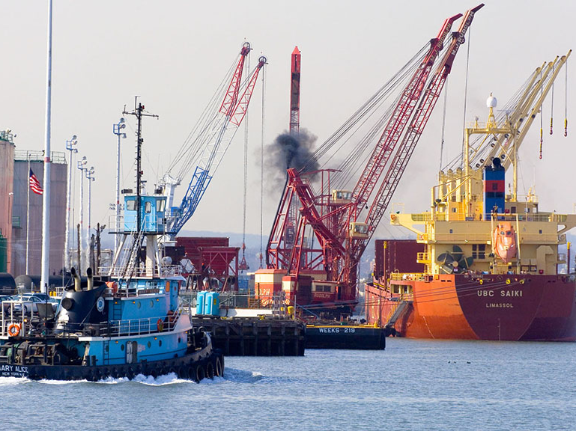
Case Study:
Proactive Community Engagement
Baltimore Port Alliance
A coalition of maritime businesses that come together to present, discuss and decide on issues that impact the Port Community (nearby residents).
The Education and Outreach Committee supports educational partnerships across the Chesapeake region.
The Environmental Committee has hosted compliance assistance workshops for the maritime community and participated in cleanup efforts.
Notes:
CASE STUDY 2 | Baltimore Port Alliance: Proactive Community Engagement
The Baltimore Port Alliance represents a coalition of maritime businesses. Its mission is to “improve the Port of Baltimore by creating a forum where information that impacts the Port Community (nearby residents) can be presented in a constructive environment and acted upon in support of the members and the Port as a whole.” As part of the 2013 and 2014 National Conversation on Ports, EPA recognized the Alliance as a model for engaging community stakeholders.
The Alliance has two subcommittees. The Education and Outreach Committee focuses on supporting educational partnerships with entities across the Chesapeake region. The Environmental Committee is responsible for (1) informing Alliance members about key environmental issues, and (2) sharing the Port’s role in environmental stewardship with community stakeholders. Activities have included hosting compliance assistance workshops for the maritime community and participating in cleanup efforts across the Chesapeake Bay region.

Slide 25
Case Study
The Harbor Community Benefit Foundation (Los Angeles)
Founded to “assess, protect, and improve the health, quality of life, aesthetics, and physical environment of the harbor communities
Based on an agreement between the Port of LA and 17 environmental and community groups.
As the port grows, so does the grant fund for air quality mitigation and a community benefit program.
As of 2019, invested $6.3 million back into the community.
Notes:
CASE STUDY 3 | The Harbor Community Benefit Foundation (Los Angeles)
The Harbor Community Benefit Foundation (HCBF) was founded in 2008 based on an agreement the Port of LA entered into with 17 environmental and community groups. As the port grows, so does the fund. The money is invested and grants are made from the interest.
HBCF’s mission is to “assess, protect, and improve the health, quality of life, aesthetics, and physical environment of the harbor communities of San Pedro and Wilmington, California, which have been impacted by the Port of Los Angeles.” Grant focus areas include an air quality mitigation program and a community benefit program. As of 2019, HCBF has invested $6.3 million back into the Los Angeles community through 124 grants to 71 recipients.
For more information, including documentation on how the foundation is structured, see https://hcbf.org/ about/.

Slide 26
Case Study:
Air Quality Project
Port of Portland: Swan Island Air Quality Project
Funded a two-year community involvement program in coordination with a study that explored chemical emissions and health impacts.
Created a cross-sector Task Force
Based on the outcomes, the shipyard operator agreed to make significant changes in operations to reduce emissions.
Notes:
CASE STUDY 4 | The Port of Portland: Swan Island Air Quality Project
The Port of Portland funded a two-year community involvement program in coordination with a study that explored levels of chemical emissions from nearby industrial facilities and the potential for exposure and health impacts on the local community. The Port felt that there were environmental, political and business reasons to conduct the study and sought data in a conscientious and careful manner.
The Port created a Task Force that included the shipyard operator, the Department of Environmental Quality, three neighborhood associations, and two outside experts on toxic health and environmental issues communications.
Through this initiative, the shipyard operator agreed to eliminate certain paints; improved practices and changed operational technologies; provided a model for technical and community input on the state hazardous air pollution program; increased public education; and improved relations between communities, businesses, agencies and the Port.

Slide 27
Good Neighbor Roadmap
Notes:
In this next section, we will walk through the steps of developing a Good Neighbor Roadmap.

Slide 28
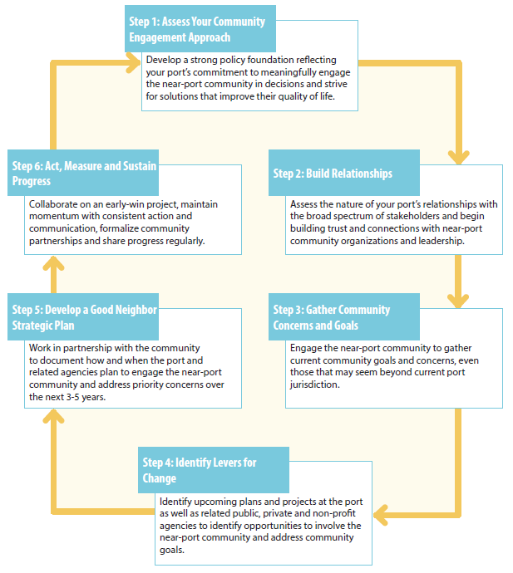
Steps in the Good Neighbor Roadmap Process
Notes:
The guide includes 6 steps to developing a Good Neighbor Roadmap:
Step 1. Assess your Community Engagement Approach
Step 2. Build Relationships
Step 3: Identify Community Concerns and Goals
Step 4: Identify Levers for Change
Step 5. Develop a Good Neighbor Strategic Plan
Step 6. Act, Measure and Sustain Progress

Slide 29
Step 1. Assess your Community Engagement Approach
Assess your agency’s community engagement philosophy, goals, policies, plans and relationships with stakeholders
Develop a strong policy foundation reflecting the port’s commitment to meaningful community engagement and solutions that improve their quality of life.
Notes:
This step focuses on assessing your agency’s community engagement philosophy, goals, policies, plans and relationships with stakeholders. This is an opportunity to evaluate how your agency’s policy framework can reflect a commitment to engage near-ports communities and strive for solutions that improve their quality of life. In some cases, port agencies may be examining the extent to which a port’s mission statement, core values and goals reflect a commitment to social responsibility, community engagement and impact mitigation for the first time.
Depending on time, the trainer can invite participants to complete the assessment on page 22 either individually or in groups and then report back on what was learned.

Slide 30
Step 1. Assess your Community Engagement Approach
For your port, review the IAP2 levels of engagement examples outlined in Table 2 on page 13 and then explore the following questions:
What engagement methods has the port used in the past that were successful? Which methods were less successful? Why?
What expectations does the near-port community have about engagement in the decision-making process?
What are the port’s expectations?
Was there a recent decision where the community expected a much greater level of engagement?
Is there an upcoming decision where the port might increase the level of engagement?
Notes:
Digging Deeper Exercise
For your port, review the IAP2 levels of engagement examples outlined in Table 2 on page 13 and then explore the following questions:
What engagement methods has the port used in the past that were successful? Which methods were less successful? Why?
What expectations does the near-port community have about engagement in the decision-making process?
What are the port’s expectations?
Was there a recent decision where the community expected a much greater level of engagement?
Is there an upcoming decision where the port might increase the level of engagement of near-port communities?

Slide 31
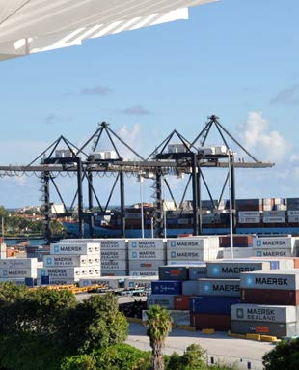
Step 2: Build Relationships
Assess the nature of your port’s relationships with the broad spectrum of stakeholders
Begin building trust and connections with near-port community organizations and leadership.
Notes:
Building strong relationships with community members and other diverse stakeholder groups is a prerequisite for effective community engagement and addressing environmental justice concerns. Once your port’s community engagement policy is in place, it is time to identify stakeholders and their needs, interests and priorities. Ports can be a driver of change by serving as a convener. While ports only directly cause a portion of the impacts experienced by near-port communities, they can bring other stakeholders to the table to build a more effective, collaborative approach to addressing these impacts.

Slide 32
Step 2: Build Relationships
Identify key stakeholder groups.
Explore the current levels of engagement across stakeholder groups.
What are the gaps in relationships?
Where are there opportunities for collaboration among different stakeholders based on shared interests?
What does the community identify as assets and challenges?
Notes:
Building relationships starts with reaching out and getting to know each stakeholder group, their goals, concerns and interests.
Outreach to groups and organizations can be tailored using Stakeholder Interests Mapping, which captures community and stakeholder interests, current levels of engagement, gaps in relationships, as well as opportunities for collaboration. In framing community and stakeholder interests and opportunities for collaboration, outreach can broaden beyond environmental concerns to include opportunities such as job training, student education and community cleanup activities.
Focus on developing strong relationships between the port and community partners by sharing your commitment to working together and developing services and programs built around that goal. Once core relationships are in place with the near-port community, reach out to additional stakeholders. Developing cross-sector support and collaboration opportunities can help ensure buy-in and effective implementation.
Know Your Community
As you build relationships and conduct outreach, try to gain an understanding of: (a) community assets and liabilities, (b) community challenges including health, employment, education, and quality of life concerns, and (c) community aspirations and goals. Tips include:
Build relationships with key community decision makers. See how you can help them, and what the community needs.
Be open to the possibility that community members want to collaborate with you and might have valid concerns that it would benefit both the port and the near-port community to address.
Research what else is going on in the community. Understanding current events will help you communicate in an informed manner and build relationships. It may also spark some ideas of ways that you can offer resources and assistance.
Consider the benefits of paying community representatives for their time consulting with you about what the community needs. Compensation is a sign of respect for their time and knowledge.
Map Stakeholder Interests
Capture your current understanding of stakeholder interest, levels of engagement and opportunities for collaboration:
Stakeholder Group
Stakeholder Interests
Current Level of Engagement
Which interests need more engagement?

Slide 33
Step 3: Identify Community Concerns and Goals
Engage the near-port community to gather current community goals and concerns.
Build trust by listening to concerns that may seem beyond the port authority.
Inviting the community to a discussion of priority community concerns outside a decision process can take the pressure off a single plan or project to address all the concerns.
Notes:
This step provides an opportunity to engage near-port communities to gather current community goals and concerns, even if they may seem outside the port’s authority. Inviting the community to a discussion of priority community concerns outside a decision process can take the pressure off a single plan or project to address all the concerns. This approach allows for collaborative problem-solving to clarify concerns, translate concerns into concrete goals, establish performance measures and set targets for achieving each goal.

Slide 34
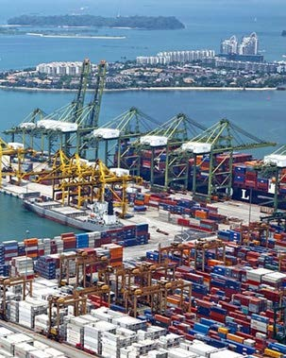
Step 3: Identify Community Concerns and Goals
Identify community concerns.
Add detail.
Describe impacts.
Set goals.
Identify opportunities and barriers to achieving goals.
Prioritize for action.
Notes:
Meet with near-port community representatives to identify community goals. Over the course of discussions, learn how concerns could be translated into goals and prioritized actions.
Identify community concerns. Review the community concerns checklist. Note the concerns of most importance in your community. Add these priority concerns and any others not in the checklist to the table below.
Add detail. Once you have listed the key concerns, describe each one in as much detail as possible. For example, for air quality, identify the location of operations and times when potential air quality impacts are of most concern.
Describe impacts. Describe the community impacts of each concern. For example, does air quality impact sensitive populations such as children or the elderly? Or homes along a truck route? Have community members experienced increased or exacerbated health issues that they associate with poor air quality? It is important during the relationship building phase to honor the community’s concerns as true for them, even if the port’s current understanding of conditions is different. Then, undertaking joint research between port owners/operators and community stakeholders can be fruitful in building trust and identifying solutions.
Set goals. Translate each concern into a goal. For example: Improved air quality with a focus on reducing air pollution that directly impacts sensitive populations such as children.
Identify opportunities and barriers to achieving goals. Barriers can by within the community or outside the community. What resources can be leveraged to overcome barriers?
Prioritize for action. Number the concerns and goals in order of importance. Ask the community, “If we could make only one change this year, what would it be?”

Slide 35
Step 3: Identify Community Concerns and Goals
When there is a significant gap between the goals of the community and the port, Collaborative Problem Solving approach can help move past a stalemate.
Collaborative problem solving is when stakeholders come together around an issue to explore solutions towards mutually beneficial outcomes.
Convening a range of stakeholders can increase areas of overlapping interest and leverage resources to develop mutually beneficial solutions.
Notes:
Collaborative Problem Solving to Develop Shared Goals
When there is a significant gap between the goals of the near-port community and those of the port agency, a polarized stalemate can result. Adopting a Collaborative Problem Solving approach can help multiple stakeholders reach agreement on top priority goals. As discussed in Section A, collaborative problem solving happens when stakeholders come together around an issue to explore solutions towards mutually beneficial outcomes. Convening a range of stakeholders and partners can increase areas of overlapping interest between two or more stakeholders, and bring more resources to the table that can be leveraged to develop creative, mutually beneficial solutions.

Slide 36
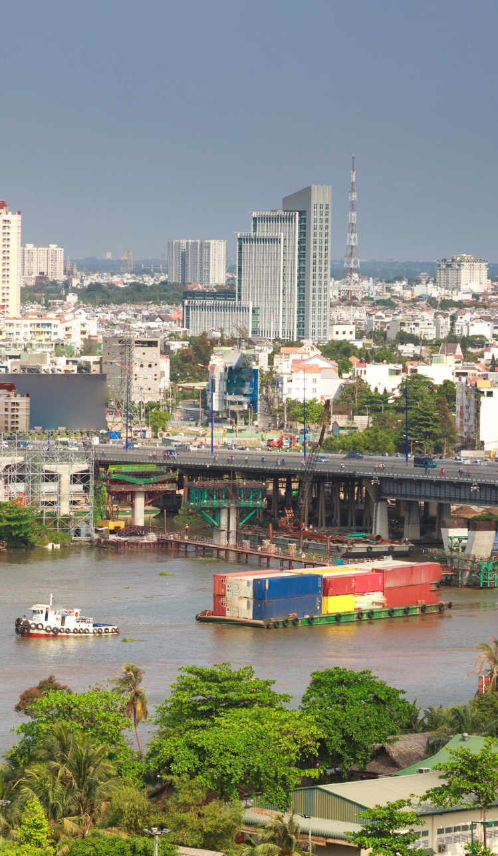
Step 4: Identify Levers for Change
Identify upcoming plans and projects at the port as well as related public, private and non-profit agencies to identify opportunities to involve the near-port community and address community goals.
Notes:
Start to consider how to address the prioritized community goals by identifying upcoming projects and plans that could be leveraged to mitigate impacts or develop innovative solutions to the community issues. Further, evaluate key regulatory planning or policy documents related to these projects, and identify existing requirements and guidance for social responsibility, impact mitigation and community engagement. After evaluating potential levers of change, various opportunities and scenarios can be explored to achieve community goals.

Slide 37
Step 4: Identify Levers for Change
What are the potential negative impacts on near-port communities?
What are the potential positive impacts on near-port communities?
What are specific community goals that could be considered during the planning process?
Notes:
Review upcoming expansion or infrastructure projects at your port as well as related projects and plans proposed by other agencies and organizations (e.g., transportation corridor upgrades, waterfront development, job training programs).
Identify how each of these efforts could impact near-port communities and explore opportunities to align efforts to meet shared goals.
What are the potential negative impacts on near-port communities?
What are the potential positive impacts on near-port communities?
What are specific community goals that could be considered during the planning process?

Slide 38
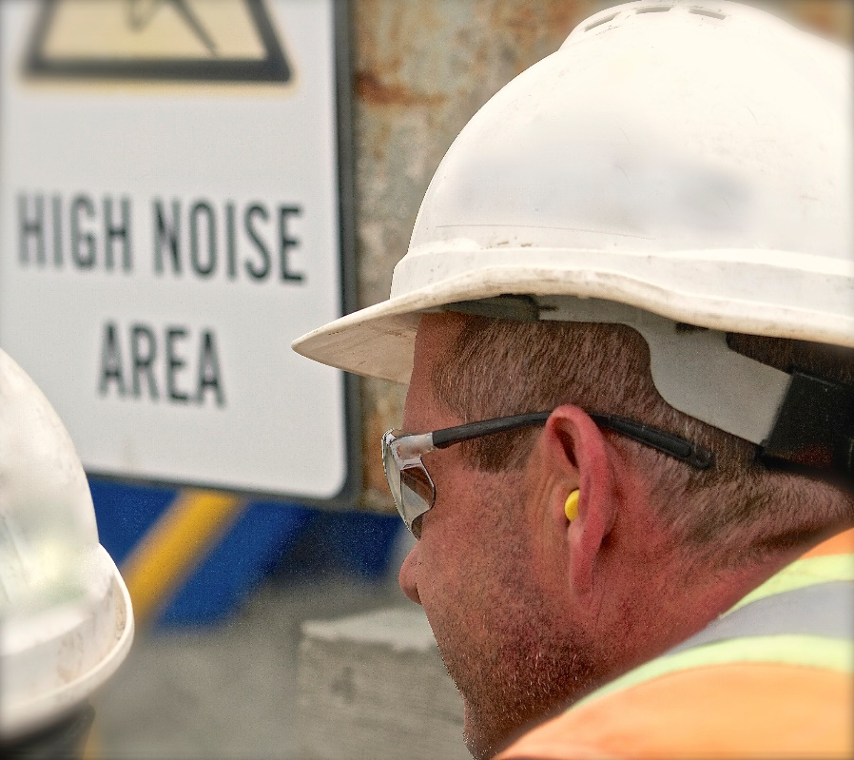
Step 5. Develop a Good Neighbor Strategic Plan
Work in partnership with the community to document the goals, priorities, actions and timeline to address key challenges.
Notes:
A Good Neighbor Strategic Plan provides a foundational document to inform community engagement for each future port policy and project update. The plan is a comprehensive multi-year document developed with community input and should be reviewed and updated periodically (for example every 1-2 years) to track goals, and stay current and relevant. The Plan serves as an ongoing reference resource for port staff and the community by outlining how the port will address local concerns and goals across upcoming projects, decision documents, planning processes, and pilot projects or programs.
In this step, consider how the information developed through Steps 1-4 can be refined and captured in your Good Neighbor Strategic Plan.

Slide 39
Step 5. Develop a Good Neighbor Strategic Plan
Define
Define a Good Neighbor Policy
Develop
Develop an engagement plan
Document
Document community concerns and goals
Identify
Identify levers for change
Identify
Identify feasibility and mitigation studies
Establish
Establish tracking and reporting mechanisms
Notes:
Key sections of a Good Neighbor Plan could include:
Define a Good Neighbor Policy: Develop a policy for community engagement based on the mission statement and assessments from steps 1 through 4.
Define areas of focus for the port as a Good Neighbor.
Define community engagement goals.
Define decision-making criteria and outcomes.
Define reporting mechanism and accountability measures.
Develop an engagement plan: Develop a community and stakeholder engagement plan enlisting stakeholder groups identified in Step 2. The plan should outline when, where and how the community will be engaged during the project.
Convene partners. Federal, state or local government staff or non-profit organizations can assist in convening.
Convene a Community Advisory Group to ensure equitable local representation.
Regularly update partnership goals and objectives.
Structure partnership agreements. Identify key partner roles and responsibilities.
Conduct a joint tour of the port and community with tour guides and attendees from both parties.
Document community concerns and goals: Document local concerns, establish measurable goals, and develop performance measures in coordination with the community. This can be done based on the framework established in Step 3.
Document and prioritize community concerns and goals.
Conduct existing condition assessments.
Establish qualitative and quantitative performance measures to gauge progress.
Identify levers for change: Summarize your findings from Step 4, covering upcoming projects, plans, pilot projects and programs that could relate to community goals.
Identify how upcoming projects, plans and strategic documents will contribute to community goals.
Identify specific actions in each process that can reduce community impacts or increase local benefits.
Consider pilot projects or new programs that can be established to meet community goals.
Identify feasibility and mitigation studies: Identify health, social or environmental assessments that may be needed to evaluate and quantify community concerns. These studies can inform key project plans with the greatest potential to address community goals.
Identify opportunities for assessments to consider cumulative impacts from past and future changes.
Work with the community to identify and address any technical assistance needs to ensure well-informed discussions.
Establish tracking and reporting mechanisms: Establish an implementation timeline for tracking progress and connecting with the near-port community.
Develop an implementation timeline with performance metrics and a monitoring and reporting process (e.g., periodic newsletters, annual progress reports for the community).
Identify specific points to engage the stakeholders.
Identify an internal coordination process to make sure all port departments are fully engaged.

Slide 40
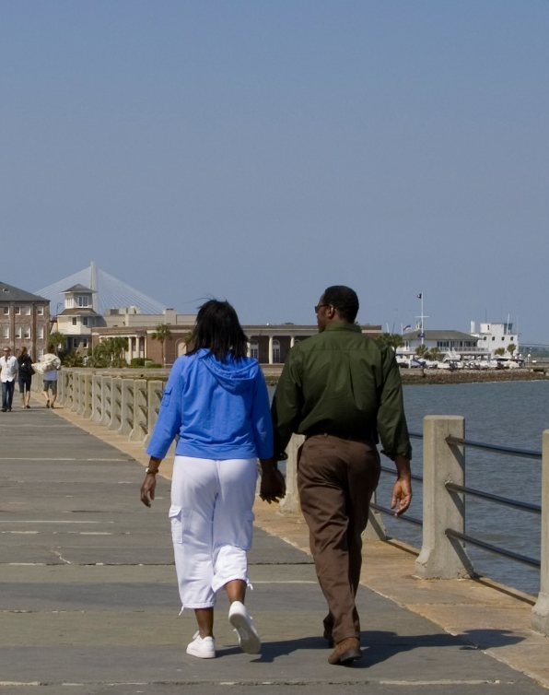
Step 6. Act, Measure and Sustain Progress
Collaborate on an early-win project
Maintain momentum with consistent action and communication
Formalize community partnerships
Share progress regularly
Notes:
This step enables you to maintain momentum from the development of the Good Neighbor Strategic Plan by collaborating with the community on a near-term project, formalizing your Community Advisory Group and tracking progress. This section describes tips and resources for continuing to build strong local relationships as you work with community partners to move your Plan into action.

Slide 41
Step 6. Act, Measure and Sustain Progress
Collaborating on an early-win project
Effective community collaboration
Tracking progress
Notes:
Collaborating on an early-win project
Engaging with the community on a near-term project builds goodwill and deepens relationships before tackling more challenging issues. The project could be working with the community to address a priority concern in an upcoming decision, or identifying grant funding to implement a pilot program to address broader concerns. If possible, identify a strong leadership role with funding support for a central community organization. For example, depending on the project and the organization’s capacities, the community organization could lead local outreach, job training or monitoring. Investing in an early success with a community organization helps build a strong foundation for future collaborative problem-solving.
Effective community collaboration
Some community groups, while invested in port-related decisions, lack the resources to participate effectively. A port may need to consider creative strategies to support full and meaningful participation by these organizations. These organizations may lack full-time paid staff or office space, or face limitations on when and where staff can attend meetings if they are volunteering on top of work commitments. Finding creative solutions that address these logistical needs can allow community members to participate more effectively.
Community groups may also benefit from technical assistance to better understand the science and engineering of proposed decisions and potential impacts. Port agencies can pursue grants or other resources from partner agencies to enhance technical understanding so people can participate fully in discussions and offer informed input. In some cases, community members may be upset about cumulative impacts that have affected their friends and family. Making time to listen and document their concerns – even if they seem beyond the scope of port decisions and responsibilities – may be needed before being able to move into problem-solving mode.
Tracking progress
The Good Neighbor Strategic Plan should include realistic timelines and performance measures that reflect community needs and concerns. Identify in advance a way to share regular progress updates such as an annual report card. To build and maintain trust with the community, the report card needs to be more than a marketing tool – It should be an accurate assessment of accomplishments and areas needing attention.
Performance measures to track progress in addressing community goals can use quantitative and qualitative indicators. Measures can include outputs that measure direct port actions – such as the number of trucks converted from using diesel fuel – as well as outcomes that measure changes in environmental quality – such as the measured reduction in particulate matter in an adjacent neighborhood. Refer back to the goals and performance measures identified in Step 3 and ensure a plan is in place for tracking and reporting progress.
Performance measures can also evaluate the effectiveness of community engagement processes. The text box below includes sample assessment questions for evaluation of community engagement impacts.

Slide 42
How are Ports Engaging Communities?
Port of Oakland, CA
Port of Bellingham, WA
Port of Baltimore, MD
Port Authority of New York and New Jersey
Port of Seattle, WA
Port of Portland, OR
Port of Houston Authority
Port of Los Angeles, CA
Notes:
Examples of other Good Neighbor Ports….
Port of Bellingham, WA
The Port’s mission is based on its commitment to “work cooperatively with other entities, within the framework of community standards.“
The Port has an extensive community outreach program as well as cross-sector projects such as Waterfront District Redevelopment with the City. Public involvement is highly regarded, and the Port incorporates varied views while making difficult decisions, such as through the Community and Environment program that links community and environmental health.
Port of Oakland, CA
The Social Responsibility Division “aims to facilitate inclusion, fairness, equity, as well as access to economic opportunities, programs, and services of the Port for the people and businesses in the Port community.” The Port supports this goal through proactive community relations and community engagement programs and community-positive policies, including the Commitment to Accountability & Transparency and Powering Jobs, Empowering Communities.
Port of Seattle, WA
The port offers boat tours of area waterways to help people understand its mission, operations and environmental initiatives. The boat tours, since 2017 after the port’s participation in EPA’s community-port collaboration pilot project, are designed for English, Spanish, Cambodian and Vietnamese speakers and feature information presented in plain language with technical details available if desired. Additionally, the port has recently created an Equity Department, and the Duwamish Valley Community Equity Program.
Port of Baltimore, Maryland Port Administration, MD
The Port is “committed to being a good neighbor” and meet its obligations for “improved air and water quality, reduction of impacts to the Patapsco River and the Chesapeake Bay, and sound environmental management.”
The MPA Environmental Strategy 2015 forms the basis of the Greenport program that includes mitigation projects under environment, port operations and community.
Port Authority of New York and New Jersey
In alignment with its commitment to “safeguarding the land, water, air, natural resources, flora, fauna people and their interrelation,” the Port’s Government and Community Relations Department manages programs, partnerships and federal initiatives, and the Port undertakes several environmental initiatives and environmental stewardship programs focused on clean air, harbor restoration and shoreline stabilization.
Port of Portland, Oregon
The Port’s comprehensive Environmental Policy combines natural resource, community and stakeholder relations, performance monitoring and evaluation requirements.
The port’s environmental efforts focus on air quality, energy management, land quality, natural and water resources. They also have several community engagement advisory committee activities.
Port of Houston Authority
The Port Authority is the first U.S. port to attain the world standard for environmental excellence, ISO 14001. In 2017, the port adopted an environmental policy to: protect and preserve the natural environment including complying with laws and regulations, conduct business to prevent pollution and sustainability, engage with stakeholders, be a leader in environmental stewardship, and continually improve environmental performance.
The port approved a community engagement plan in 2015 that provides a framework for effectively engaging and support communities while efficiently leveraging and optimally utilizing resources.
Port of Los Angeles, CA
The port-wide Project Labor Agreement (PLA) is a ten-year agreement between the harbor and local building and trade unions to address unemployment and underemployment in neighborhoods near the Port of Los Angeles and seeks to advance the skills of local workers.

Slide 43
Tools
Ports Primer for Communities: An Overview of Ports Planning and Operations to Support Community Participation
Community Action Roadmap: Empowering Near-Port Communities
Environmental Justice (EJ) Primer for Ports: The Good Neighbor Guide to Building Partnerships and Social Equity with Communities
Notes:
The tools in the community-port collaboration toolkit for collaboration were mentioned at the beginning. Just a reminder that there are training modules available for the other two tools as well.. We’ve just completed the module on the Environmental Justice (EJ) Primer for Ports: The Good Neighbor Guide to Building Partnerships and Social Equity with Communities.
The other training modules are on the
Ports Primer for Communities: An Overview of Ports Planning and Operations to Support Community Participation
An interactive tool and reference document that characterizes the port industry sector, including environmental and community health impacts associated with port activities.
Community Action Roadmap: Empowering Near-Port Communities
An implementation companion for the Ports Primer for Communities that provides a step-by-step process for building collaborations and preparing community stakeholders.
Additionally, there is training that provides an Overview & Lessons Learned for the Community-Port Collaboration Pilot Projects that were conducted in four communities.

Slide 44
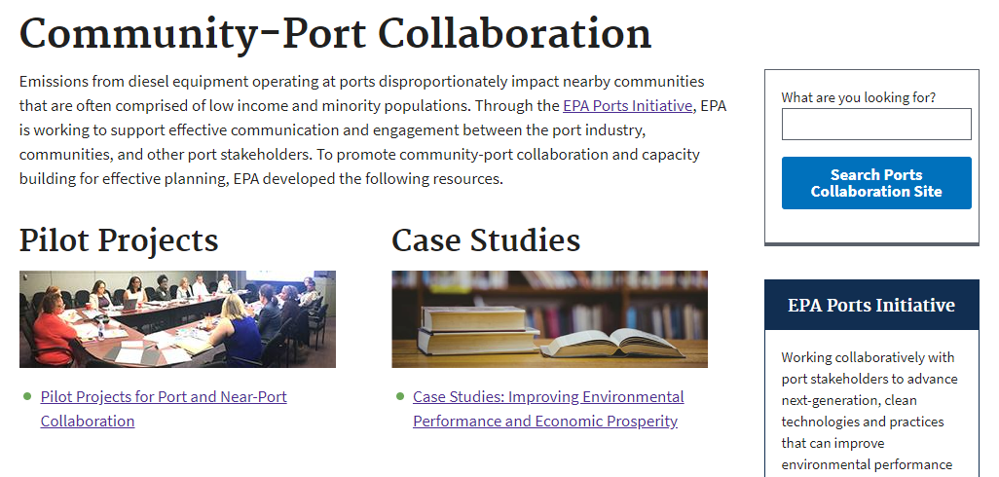
Website
Visit the Website for more Tools
Case Studies
Worksheets
Training modules
Resource materials
And more!
www.epa.gov/community-port-collaboration
Notes:
Visit the program website to access more tools including:
Case Studies
Lessons Learned Report
Worksheets
Training modules
Resource materials
And more!

Slide 45
Acknowledgements
The Environmental Justice Primer for Ports has been developed by:
Environmental Protection Agency’s Office of Transportation and Air Quality (OTAQ),
In partnership with Regional Offices and the Office of Environmental Justice,
To support ports and near-ports communities in improving local quality of life.

