Slide 1
Environmental Protection Agency
How’s My Waterway
CX Strategic Analysis
June 21, 2019

Slide 2
Your ForeSee Team
Account Management
Jessica Smack
Enterprise Account Manager
Jessica.Smack@foresee.com
(734) 205-2555
Customer Success
Ray Seghers
Client Analyst, Data
Ray.Seghers@foresee.com
(734) 352-6346
Customer Success
Andrea Rodriguez
Customer Success Manager
Andrea.Rodriguez@foresee.com
(734) 352-6213
Headquarters
2500 Green Road, Suite 400 | Ann Arbor, MI 48105
Tel: (800) 621-2850 | Fax: (734) 205-2601
Cleveland Office 1111 Chester Avenue, Suite 101 Cleveland, OH 44114 (216) 812-3200
St. Louis Office 6665 Delmar Boulevard, Suite 3000 St. Louis, MO 63130
U.K. Office 49 Southwark Bridge Road London, SE1 9HH United Kingdom +44 (0) 20 3697 2361
Notes:
FILTER: Reason: Water
N=329 for mar 15 - may 27

Slide 3
AGENDA
Voice of How’s My Waterway Visitor
ForeSee Methodology & Objectives
How’s My Waterway Satisfaction Overview
Visitor Experience
Key Findings, Recommendations, Next Steps

Slide 4
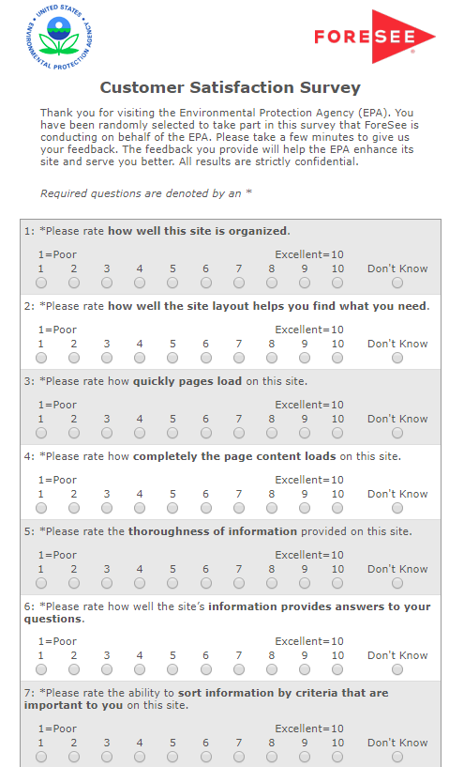
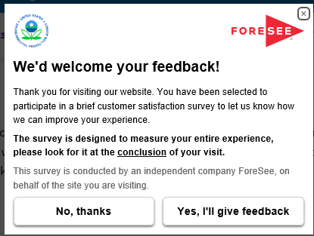
Capturing the Voice of the How’s My Waterway? Visitor
KEY FACTS
How’s My Waterway collection began:
Desktop: March 15, 2019
Reporting Period:
March 15, 2019 – May 27, 2019
Aggregate Completion Percentage:
1
Visitor is on EPA.gov
2
Visitor is shown an invite:
100% sample
After 4 pages
3
Accepting the invite loads hidden tracker window
n=329
Desktop
Survey goes to front when the site is exited
4
Desktop=40% *
Participant indicates interest in water issues
5
* 47%
* Public Sector Completion Percentage Benchmark
Completion Percentage represents aggregate data for March 15, 2019 – May 27,2019 (n=2,463).

Slide 5
DRIVERS
OUTCOMES
WEBSITE EXPERIENCE
SATISFACTION
FUTURE BEHAVIORS
Our Methodology Connects Attitudes with Outcomes

Slide 6
CX Strategic Analysis Objective
MEASUREMENT OBJECTIVES
As a Federal Government site, the primary focus of EPA.gov is to provide information to the public to protect human health and the environment. EPA is using ForeSee to help measure who is coming to the website, ease of site use, whether they were able to find what they were looking for, and improve the visitors’ overall experience on the site.
TODAY’S CXSA CONCENTRATION
Examine the web experience of those who came to the website looking for water-related information, including the How’s My Waterway section of the website.

Slide 7
How’s My Waterway Satisfaction Overview

Slide 8
Information browsing, navigation, and site information are key drivers of satisfaction. Improving satisfaction will have a major impact on outcomes.
DRIVERS
OUTCOMES
Which drivers of customer experience should I address?
What’s the impact to my business?
SCORE |  | IMPACT
66 | Information Browsing | 1.2
76 | Look and Feel | 0.6
71 | Navigation | 1.4
70 | Site Information | 2.4
82 | Site Performance | 0.0
IMPACT |  | SCORE
4.3 | Recommend Agency | 73
4.5 | Use Information | 73
66
0
100
n=329
How’s My Waterway
Satisfaction
Where am I right now?
C.I. +/- 3.0 at 90%
level of confidence
Note: Aggregate EPA Sat=69
March 15, 2019 – May 27, 2019
Standard Deviation = 32.6

Slide 9
How site information provides answers to questions is key to improving satisfaction and outcomes.
n=329
STATUS QUO REQUIRED
MAINTAIN OR IMPROVE
Score
MONITOR
TOP PRIORITY
Impact
C.I. +/- 3.0 at 90% level of confidence
C.I. +/- 0.3 at 90% level of confidence
March 15, 2019 – May 27, 2019

Slide 10
Satisfaction and top drivers for How’s My Waterway stand at or slightly below key ForeSee benchmarks and the EPA aggregate.
April 2019 Benchmarks
Benchmarks | EPA How’s My Waterway n=329 | All EPA n=2,463 | ForeSee Website Index | Public Sector | Federal Gov | Regulatory | Executive Branch
Satisfaction | 66 | 69 | 68 | 73 | 74 | 68 | 72
Navigation | 71 | 73 | 71 | 75 | 75 | 72 | 74
Site Info | 70 | 73 | 70 | 76 | 76 | 72 | 75
Info Browsing | 66 | 69 | 65 | 71 | 71 | 66 | 71

Slide 11
Although scores are below benchmarks, they have been increasing since March.
n=329
March 15, 2019 – May 27, 2019

Slide 12
Concerned citizens represent over one-quarter of visitors and struggle the most with getting around the website to find the info they are looking for.
Role
Sat / Nav / Info Browsing
51 / 60 / 54
C.I. +/- 5.5 at 90%
level of confidence
75 / 78 / 75
66 / 69 / 64
71 / 75 / 70
76 / 77 / 73
72 / 76 / 70
77 / 79 / 77
n=329
March 15, 2019 – May 27, 2019
Top 7 Answer Choices Only

Slide 13
Most visitors are infrequent or first-timers. First-timers are less satisfied since they struggle the most with finding the info they are looking for.
Visit Frequency
*
Sat 70
Nav 73
Info B 68
Sat 61
Nav 67
Info B 62
Infrequent
n=329
* C.I. +/- 5.0 at 90%
level of confidence
March 15, 2019 – May 27, 2019

Slide 14
Understanding the How’s My Waterway Visitor Experience

Slide 15
Nearly one-half reported that the information made sense.
46%
n=326
March 15, 2019 – May 27, 2019

Slide 16
Concerned citizens and “others” gave much lower ratings for the information making sense.
Role | How’s My Waterway Info Makes Sense %8 – 9 –10 Overall 46%
Concerned citizen (n=95) | 30%
Student (n=55) | 55%
Represent business (n=50) | 42%
Government employee (n=36) | 56%
Educator (n=30) | 63%
Scientist (n=28) | 57%
Other (n=17) | 30%
n=326
March 15, 2019 – May 27, 2019
Top 7 Answer Choices Only

Slide 17
Visitors were unclear about standards, testing procedures, and pollutants in the water.
Please describe what was unclear about the information you viewed today.
Site does not address drinking water (Concerned citizen)
No info on testing well water (Concerned citizen)
Standards for water reuse (Student)
Info on arsenic in well water (Concerned citizen)
Unable to load images (Concerned citizen)
List of priority pollutants (Represent business)
Needed it in easy to read format for students (Educator)
Unable to find EPA 502.2 (Other)
March 15, 2019 – May 27, 2019

Slide 18
Concerns about water quality and availability are top concerns.
What are your top three questions about water resources?
Is my drinking water safe (Concerned citizen)
Best practices for erosion sediment control (Government employee)
Water quality (Educator)
Water accessibility (Concerned citizen)
Excess fluoride exposure (Scientist)
Oil spill liability (Other)
Testing my well (Concerned citizen)
Costs of water (Concerned citizen)
Municipal discharges (Concerned citizen)
Wetlands (Educator)
March 15, 2019 – May 27, 2019

Slide 19
Only a little over one-third felt that How’s My Waterway was helpful in answering their top 3 questions. One-fifth reported that the info was not at all helpful.
38%
n=326
March 15, 2019 – May 27, 2019

Slide 20
Concerned citizens find How’s My Waterway the least helpful in answering their key questions.
Role | How’s My Waterway Helpful in Answering Top 3 Questions %8 – 9 –10 Overall 38%
Concerned citizen (n=95) | 24%
Student (n=55) | 52%
Represent business (n=50) | 34%
Government employee (n=36) | 41%
Educator (n=30) | 53%
Scientist (n=28) | 54%
Other (n=17) | 36%
n=326
March 15, 2019 – May 27, 2019
Top 7 Answer Choices Only

Slide 21
Semi-regular visitors (monthly/few times a year) find How’s My Waterway more helpful in answering key questions.
Visit Frequency | How’s My Waterway Helpful in Answering Top 3 Questions %8 – 9 –10 Overall 38%
First time (n=115) * | 32%
About once a year (n=15) | 30%
A few times a year (n=101) | 46%
Monthly (n=60) | 46%
Weekly (n=34) | 30%
Daily (n=4) | 25%
* Note: 50% of first-timers are concerned citizens.
n=326
March 15, 2019 – May 27, 2019

Slide 22
Visitors were generally looking for very specific information.
What additional information are you looking for that you did not find today?
Working link to an interactive isoerodent map (Government employee)
List of the state agencies that can provide CCRs for drinking water (Concerned citizen)
List of CWA priority pollutants (Represent business)
General info on water quality, air pollution and EPA regulations that are current (Educator)
How to test water in my residence (Concerned citizen)
Information regarding disinfection of repaired water lines (Government employee)
History and specifics on the clean water act of 1972 (Student)
Name of watershed, map that shows pathway to larger body of water (Educator)
What does the revision of the WOA law mean in plain English? (Represent business)
March 15, 2019 – May 27, 2019

Slide 23
Maps and water quality were key pieces of information that visitors were struggling to find.
Did you find the information
you were looking for today?
Please tell us what couldn't you find.
Task Accomplishment
Current quality of tap water in my area (Concerned citizen) Historic Webinars (Government employee) How to obtain a test kit to measure PDAs in well water, ground contamination (Concerned citizen) Invasive species and privatized water systems (Non-profit community group) Guidelines of nitrate concentration in surface water (Student) Maps of bodies of water to show where they are "good," "threatened," or "impaired.“ (Concerned citizen)
Sat
64
Sat
86
Sat
23
n=329
March 15, 2019 – May 27, 2019

Slide 24
Links and the EPA basic search are the most common ways of looking for info. There is little impact on satisfaction, but those using “other” ways or the A-Z index struggle a little with navigation and browsing for info.
How did you look for information?
(select all that apply)
Google
Email link
Looked around
Sat / Nav / Info B
Sat / Nav / Info B
Sat / Nav / Info B
62 / 68 / 66
63 / 64 / 59
Sat / Nav / Info B
64 / 66 / 59
n=329
March 15, 2019 – May 27, 2019

Slide 25
One-quarter of visitors report issues with links on the website. This is important since 60% use links to find information.
Navigation Experience
Text and font not
easy to read
SATISFACTION
n=329
March 15, 2019 – May 27, 2019

Slide 26
Four-in-ten search users reported issues, getting too many/few or irrelevant/redundant results.
Search Experience
SATISFACTION
81
n=109
March 15, 2019 – May 27, 2019

Slide 27
Information will be used to do research, analysis, and planning.
How do you use the information provided by How's My Waterway?
Present to our township council (Concerned citizen)
Teaching students (Educator)
HACCP Analysis (Other)
Studying for a state board exam (Concerned citizen)
Legal research (Government employee)
Development, Pollution Prevention Planning (Represent business)
SWPPP planning (Represent business)
To better manage the water resources on my farm. (Scientist)
Research paper on coal ash polluting rivers (Student)
March 15, 2019 – May 27, 2019

Slide 28
User suggestions include maps, online webinars, improved search, and links that work.
What suggestions do you have to help improve How's My Waterway tool and content?
More sub-categories. An advanced search engine so that less than 65,000 documents show up when you search using the title of the report. (Government employee)
Not enough specification when listing water sources – Unnamed Waters. Perhaps give location of waters if no name is available. (Non-profit community group)
Make sure all links work (Government employee)
Fix the internal links from Watershed Academy (Student)
Publish the webinars online (Government employee)
Provide FAQ for impaired per 303(d) protected coastal habitat wetlands (Non-profit community group)
Give names of companies that could test or names of home testing kits (Concerned citizen)
Interactive map for use by educators/students (Educator)
Keep road locations on filter maps so you know what your looking at (Government employee)
March 15, 2019 – May 27, 2019

Slide 29
Key Findings, Recommendations, and Next Steps

Slide 30
Key Findings: How’s My Waterway
Driving
Satisfaction
Satisfaction and top drivers for How’s My Waterway stand at or slightly below key ForeSee benchmarks. Information browsing, navigation, and site information are key drivers of satisfaction. Improving satisfaction will have a major impact on outcomes.
Most visitors are infrequent or first-timer users. First-timers are less satisfied. Concerned citizens represent over one-quarter of the visitor group and are less satisfied.
How’s My
Waterway
Overview
Nearly one-half reported that the How’s My Waterway information made sense. However, only a little over one-third felt that How’s My Waterway was helpful in answering their top 3 questions.
Finding
Information
Links and the EPA basic search are the most common ways of looking for information. Over one-third of search users reported having problems.
Maps and water quality were key pieces of information that visitors were struggling to find.
March 15, 2019 – May 27, 2019

Slide 31
Recommendations
Site information, information browsing, and navigation are key drivers, focus on the content itself as well as getting around the website to find it.
Specific search/browsing/navigation suggestions include:
• An enhanced search feature to narrow down results
• Fix broken links
• Fix image loading problems
• Enhance FAQs to provide better guidance for visitors, especially first timers
Finding
Info
Specific content areas include:
• Drinking water quality
• More information on water pollutants
• Residence water testing
• More information on water quality
More research results
• More detailed and interactive maps
Content
March 15, 2019 – May 27, 2019

Slide 32
Next Steps
ForeSee Feedback.
Feedback presents visitors with the opportunity to communicate their experience at any given point of their visit and allows participants to select specific or general areas to rate or comment on.
Consider Feedback for pages like How’s My Waterway? to allow them to continue to gather feedback from their visitors.
1
2
Monitor Scores.
Continue to monitor How’s My Waterway? metrics through ForeSee’s CX Suite. A Waterway Dashboard has been created and will be shared with the team to continue to monitor scores and track progress based on changes made to the How’s My Waterway? pages.
March 15, 2019 – May 27, 2019

Slide 33
Appendix

Slide 34
Appendix - Glossary of ForeSee Terminology
The ForeSee ® CXASM Methodology: The ForeSee CXA methodology is an advanced statistical engine proven by years of research that measures the customer experience and utilizes cause-and-effect modeling to radically change the way that organizations make strategic investments and decisions for better bottom-line results. Backed by three decades of rigorous scientific research, ForeSee CXA methodology has a rich heritage of highly diagnostic performance measurements coupled with sensitive improvement prescriptions and powerful prognostic capabilities.
Custom Questions: Each Customer Satisfaction Survey includes two different types of questions: model questions and custom questions. Custom questions are unique to each survey and can take a variety of different forms, including radio buttons, drop-down menus, check boxes, and open-ended text. The custom question responses are not used to derive the results using the ForeSee CXA methodology; so custom question results are reported separately in the Online Reporting Facility. Custom questions provide an excellent opportunity for data segment analysis.
Elements: An element is a measure of the customer's experience with a defined and manageable property of a website (e.g., Look and Feel, Navigation, etc.). It is composed of several survey items that provide performance ratings about various aspects of the customer's experience with the website property being measured. The separate ratings are combined as part of the modeling process into a summary score reflecting the overall experience of the customer with the website property.
Random Sampling: We use a Sampling Percentage to determine the proportion of site visitors that will receive a survey invitation on your site. We try to attain a good balance between collecting enough information to provide you with in-depth analysis, while remaining unobtrusive to your site visitors.
Impact: Impact is the numeric representation of the cause-and-effect relationship between an element (e.g., Site Navigation) and customer satisfaction or customer satisfaction and a future behavior (e.g., Likelihood to Purchase). An impact represents the increase in customer satisfaction resulting from a 5-point increase in an element score. For example, if the impact of Site Navigation is 1.2, then a 5-point increase in Site Navigation’s score would lead to an increase in customer satisfaction by 1.2 points.
Loyalty Factor: The Loyalty Factor is a number that establishes how many pages with survey code a site visitor must visit before they are eligible to receive a survey. Loyalty Factors are utilized to ensure that respondents have experienced enough of a site before completing the Customer Satisfaction Survey.
Model Questions: In order to utilize the ForeSee CXA methodology to calculate Satisfaction and Future Behavior scores and impacts, ForeSee asks standard model questions. These model questions are targeted toward the key Elements (i.e., “main areas”) of the site that drive customer satisfaction (e.g., Functionality, Navigation, Product Browsing, etc.), Overall Satisfaction, and Future Behaviors such as Likelihood to Recommend or Likelihood to Purchase.
Future Behaviors: Future Behaviors are the things you want your customers to do more of as a result of visiting your website, such as recommend your site to others or complete a purchase. The cause-and-effect ForeSee CXA methodology enables us to quantify the impact that improving satisfaction with your site would have on increasing future behaviors such as site visitors’ likelihood to recommend your site.

Slide 35
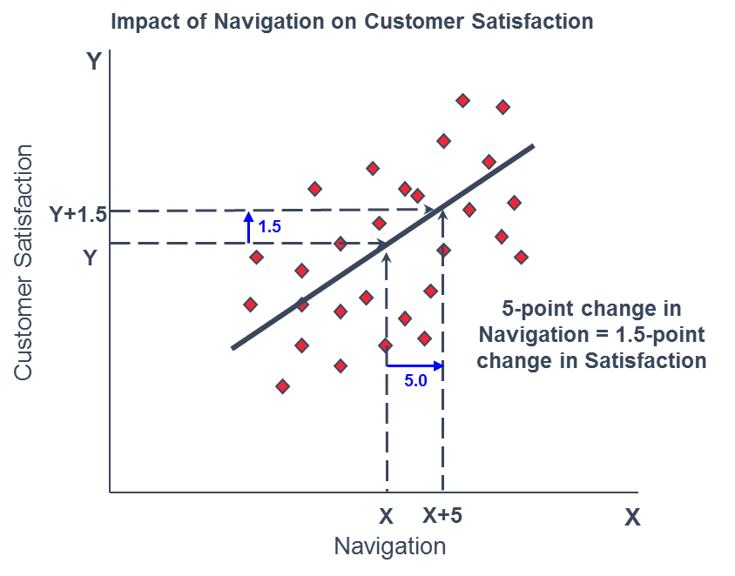
Understanding Impacts
The rate of change between an element and satisfaction is represented by an Impact. In simple terms, an impact can be understood as something like a slope of a line defining the relationship between two variables.

