Slide 1
Environmental Protection Agency
Radiation Segment
Kelly Savage, Analyst
March 2019

Slide 2
Your ForeSee Team
Account Management
Jessica Smack
Enterprise Account Manager
Jessica.Smack@foresee.com
(734) 205-2555
Customer Success
Andrea Rodriguez
Customer Success Manager
Andrea.Rodriguez@foresee.com
(734) 352-6213
Headquarters
2500 Green Road, Suite 400 | Ann Arbor, MI 48105
Tel: (800) 621-2850 | Fax: (734) 205-2601
Cleveland Office 1111 Chester Avenue, Suite 101 Cleveland, OH 44114 (216) 812-3200
St. Louis Office 6665 Delmar Boulevard, Suite 3000 St. Louis, MO 63130
U.K. Office 49 Southwark Bridge Road London, SE1 9HH United Kingdom +44 (0) 20 3697 2361

Slide 3
Agenda
Methodology and Objective
Radiation Segment Overview
Recommendations & Next Steps
Executive Summary

Slide 4
Methodology & Objective

Slide 5
ForeSee Methodology
ForeSee applies proven science and technology to the measurement and analysis of the customer experience through the lens of customer satisfaction.
Analysis of the customer experience will enable your organization to understand…
How are you doing?
What should you do?
Why should you do it?

Slide 6
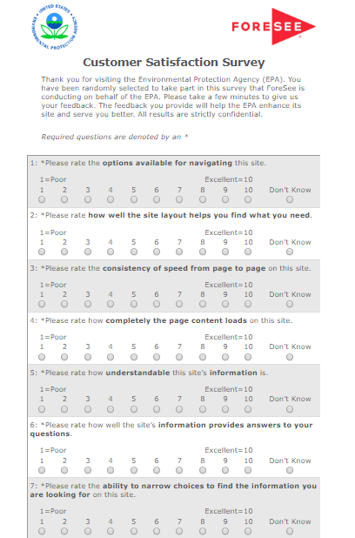
Capturing the Voice of the Visitor
KEY FACTS
Collection began:
Desktop: August 2015
Reporting Period:
March 1, 2017 – February 19, 2019
Completion Percentage:
1
Visitor is on EPA.gov
2
Visitor is shown an invite
4 pages
100% sample
3
Accepting the invite loads hidden tracker window
n=320*
Desktop
4
Survey goes to front when the site is exited
Desktop=47%
*42%
*Regulatory Completion Percentage Benchmark
*Analysis uses the Radiation subset of the entire EPA desktop population

Slide 7
CX Strategic Analysis Objective
OBJECTIVE #1
Review the EPA desktop radiation segment experience through the lens of customer satisfaction.
OBJECTIVE #2
Understand where the radiation segment’s pain points lie within the site by diving into information browsing, site information and navigation.
OBJECTIVE #3
Provide actionable recommendations to improve site experience based on findings in the data.

Slide 8
Executive Summary

Slide 9
Executive Summary
Satisfaction Performance
Satisfaction has improved across Q1 2019 compared to Q4 2018. Aggregate visitor satisfaction (70) is in line with relevant benchmark averages.
Drivers of Satisfaction and Key Outcomes
Navigation, site information and information browsing offer the most opportunity for improvement among visitors satisfaction with their online experience. Improvements to satisfaction will ultimately lead to a higher likelihood for visitors to recommend the EPA site to their friends or family members.
Key findings- Information Browsing
44% of visitors were not able to find the information they were looking for, a common theme being radiation exposure and health risks. Nuclear power issues and regulations are topics visited frequently on the site, yet they have the highest rate of visitors not finding the information they were looking for.
Key findings- Site Information
18% of visitors on the site felt the information was unclear. One third of visitors state that they still do not have a good understanding of what EPA’s role in radiation protection is after leaving the site, and nearly half state they do not know who to go to for more information after they visit the site.
Key findings- Navigation
One quarter of visitors report having navigation difficulties while on the site. Of those having navigation difficulties, 50% experience issues with links on the site.

Slide 10
Radiation Segment Overview

Slide 11
Overall satisfaction for the radiation segment is 70; however, scores have shifted over each quarter.
Satisfaction Trend- Quarterly
*data begins March 1st
*data ends February 19th
n=57 | n=56 | n=46 | n=41 | n=41 | n=37 | n=36 | n=27 | n=16

Slide 12
Increasing customer satisfaction has the greatest impact on radiation visitors likelihood to recommend the agency to their friends and family.
ELEMENTS
FUTURE BEHAVIORS
Which drivers of customer experience should I address?
What’s the impact to my business?
SCORE |  | IMPACT
69 | Information Browsing | 1.5
77 | Look and Feel | 0.5
72 | Navigation | 1.8
73 | Site Information | 1.3
80 | Site Performance | 0.2
70
IMPACT |  | SCORE
4.5 | Recommend Agency | 75
4.0 | Use Information | 75
70
0
100
n=320
*Regulatory Benchmark
EPA Radiation Segment Browse
Satisfaction
Where am I right now?
How do I compare?

Slide 13
Information browsing, site information and navigation offer the greatest opportunity to improve visitors’ overall satisfaction.
MAINTAIN OR IMPROVE
Navigation
STATUS QUO REQUIRED
Information Browsing
Score
Site Information
MONITOR
TOP PRIORITY
Impact
n=320

Slide 14
Making up the majority of EPA’s radiation visitors, consumers and citizens are the least satisfied group behind business representatives.
For this visit to the EPA website, which of the following best describes you?
n=320
Consumer or citizen
Student
Educator
Represent Business
Scientist
Satisfaction: 68 32% | n=103
Satisfaction: 72 12% | n=37
Satisfaction: 64 11% | n= 35
Satisfaction: 74 11% | n=34
Top answer choices shown

Slide 15
Over a third of EPA radiation visitors came to the site to find radiation information because they are a trusted source of information in their community; health effects is the main topic visited.
What let you to visit EPA.gov to find radiation information?
n=320
Radiation topics visited on the site (select all that apply)
n=320
Radiation concerns
Health effects (40%)
Basic radiation science (34%)
Other (23%)
Nuclear power issues (14%)
Regulations (14%)
Document library (12%)
Top answer choices shown

Slide 16
One in five EPA radiation visitors reported that they did not understand site information. Visitors are most likely to note that radiation safety and standards are unclear.
How would you describe the radiation information on EPA.gov?
n=259
Please describe what was unclear about the radiation information you viewed during your site visit today.
n=38
Safe radiation levels / standards
“Using the search box or the topic box was unable to see a clear way to access the EPA's newest regulations about healthy radiation levels.” SAT 15, 10/02/18
“The UV levels do not differentiate between UVA, UVB or UVC” SAT 22, 7/09/18
“You gave me no information on how I can find if radiation around me is dangerous.” SAT 15, 10/04/17
“I was unable to find drinking water standards for allowable levels of iodine 131.” SAT 0, 4/06/17

Slide 17
Following their site visit, one-third of visitors did not have a better idea of EPA’s role in radiation protection and nearly half did not know who to contact for additional information.
After visiting the site, do you have a better idea of EPA’s role in radiation protection?
n=320
After visiting the site, do you know who to contact to get more information or to report an incident?
n=320
No
35%
Sat 45
Yes
65%
Sat 84

Slide 18
Nearly half of EPA’s radiation visitors are coming to the site for the first time, yet are one of the least satisfied groups. Three quarters of visitors are coming to the site a few times per year or less.
How frequently do you use the EPA website?
n=320
Infrequent/first time visitors, 77%
Frequent visitors, 23%
SATISFACTION
74
80
73
77
59
65

Slide 19
Nearly half of EPA’s radiation visitors could not find the information they were looking for in totality. The main topic that could not be found on the site had to do with radiation exposure.
Did you find the information you were looking for today?
n=320
Please tell us what you couldn’t find.
n=124
Radiation Exposure
“Info on the latest healthy radiation level- esp the idea that some radiation is actually 'good' for you..” SAT 15, 10/02/18
“specific health effects as a function of dose.” SAT 82, 4/17/18
“calculation of Radiation dosage to index and/or estimate degree of tissue damage” SAT 89, 9/25/17
“The consequences of exposure to excessive radiation.” SAT 55, 5/23/17
“Home preparedness recommendations for CBR events, especially radiation preparedness.” SAT 26, 4/27/17
No
18%
Sat 31
Yes
56%
Sat 86
Partially
26%
Sat 63

Slide 20
Of the most viewed topics on the site, nuclear power issues and regulations had the highest percentage of visitors stating they could not find information on these topics.
Which of the following radiation information topics did you view during your site visit today? (Please check all that apply)
X
Did you find the information you were looking for today?
n=320
Health Effects
Yes: 60%
No: 15%
Partially: 25%
Basic radiation science
Yes: 64%
No: 13%
Partially: 23%
Other
Yes: 43%
No: 29%
Partially: 28%
Nuclear Power Issues
Yes: 59%
No: 24%
Partially: 17%
Regulations
Yes: 57%
No: 17%
Partially: 26%
Top answer choices shown

Slide 21
Over half of visitors clicked on links within the page to look for information. The majority of visitors who used the search box stated it worked well.
Once you arrived on the site today, how did you look for information?
n=320
Which of the following best describes your experience with the search tools?
n=105
Clicked on links within the page (55%, Sat 74)
Search box (34%, Sat 65)
Other (12%, Sat 57)
A-Z Index (8%, Sat 60)
Top answer choices shown

Slide 22
Visitors that use the A-Z index to search for information on the site report not finding what they were looking for more often than other search routes.
Once you arrived on the site today, how did you look for information? (Please check all that apply)
X
Did you find the information you were looking for today?
n=320
Clicked on links within the page
Yes: 59%
No: 13%
Partially: 28%
Search box
Yes: 45%
No: 30%
Partially: 25%
Other
Yes: 56%
No: 23%
Partially: 21%
A-Z Index
Yes: 33%
No: 38%
Partially: 29%
Went directly to the page needed
Googled it
Top answer choices shown

Slide 23
One in four visitors encountered navigation difficulties. Visitors who had navigation difficulties were most likely to encounter technical difficulties.
Navigation Difficulties?
n=261
Which of the following best describes your navigation experience during your visit to the site today? (Please check all that apply)*
n=82
Yes
25%
No
75%
“The current EPA site doesn't accept "Input", or, "Submit/Submission(s). "Contact" links are broken.” SAT 0, 8/16/18
“Accurate links. I clicked on a link to WIPP compliance application, and it didn't go there.” SAT 81, 9/25/18
“Please add download links for books, thank you.” SAT 96, 1/05/18
“Easier links to scientific studies and/or reports.” SAT 85, 5/16/18
Top answer choices shown
*Asked only of those that had difficulty and who clicked on links within the page, A-Z index or Other

Slide 24
The top radiation information topics that had the highest rates of link issues are the document library, reporting an environmental problem, and EPA emergency response.
Which of the following radiation information topics did you view during your site visit today? (Please check all that apply)
X
Which of the following best describes your navigation experience during your visit to the site today? (Please check all that apply)
n=158
Document library
Report an environmental problem
EPA emergency response capabilities
Links did not take me where I expected: 33%
Links/labels are difficult to understand: 0%
Too many links or navigational choices: 22%
Links did not take me where I expected: 33%
Links/labels are difficult to understand: 33%
Too many links or navigational choices: 17%
Links did not take me where I expected: 17%
Links/labels are difficult to understand: 17%
Too many links or navigational choices: 33%
Top answer choices shown
Results based on navigational issues related to links on the site

Slide 25
Recommendations & Next Steps

Slide 26
Key Findings & Recommendations
Information Browsing
44% of visitors were unable to find the information they were looking for in its entirety. 50% of visitors that had navigation issues encountered some type of link issue.
Audit links/labels to ensure they properly direct visitors to the information they need.
Identify unresponsive links and remove. Add in proper links to subjects on the page.
18% of visitors felt the information on the site was unclear. Nearly half are unclear who to contact for additional information or to report an incident.
Review page content to ensure information is up to date on radiation levels/standards so visitors can find the answers to their questions when visiting the site.
Provide direct contact information (potentially a customer support phone number) so customers can directly talk with someone when needed.
Site Information
Navigation
One-quarter of visitors encountered some sort of navigation difficulty during their visit.
Reduce the number of links available to navigate- condense topics.
Audit the document library, problem report page, and EPA emergency page for link issues.

Slide 27
Next Steps
Consider Usability Services to further aid in best practice for the search feature and identifying ways of combating navigation struggles.
Create and manage Radiation Visitor dashboards in the Suite as well as provide radiation team with access to the data.
Consider Feedback Surveys for the Radiation pages. ForeSee® Feedback presents visitors with the opportunity to communicate their experience at any given point of their visit. ForeSee® Feedback allows participants to select specific or general areas to rate or comment on.

Slide 28
Appendix

Slide 29
Majority of EPA radiation visitors came to look for data, statistics, scientific methods and models, as well as research environmental issues.
Why did you visit the EPA site today?
n=320
What kind of information were you looking for today? (Please check all that apply)
n=272
What did you come to learn about or research? (Please check all that apply)
n=205
Top answer choices shown

Slide 30
Appendix - Glossary of ForeSee Terminology
The ForeSee ® CXASM Methodology: The ForeSee CXA methodology is an advanced statistical engine proven by years of research that measures the customer experience and utilizes cause-and-effect modeling to radically change the way that organizations make strategic investments and decisions for better bottom-line results. Backed by three decades of rigorous scientific research, ForeSee CXA methodology has a rich heritage of highly diagnostic performance measurements coupled with sensitive improvement prescriptions and powerful prognostic capabilities.
Custom Questions: Each Customer Satisfaction Survey includes two different types of questions: model questions and custom questions. Custom questions are unique to each survey and can take a variety of different forms, including radio buttons, drop-down menus, check boxes, and open-ended text. The custom question responses are not used to derive the results using the ForeSee CXA methodology; so custom question results are reported separately in the Online Reporting Facility. Custom questions provide an excellent opportunity for data segment analysis.
Elements: An element is a measure of the customer's experience with a defined and manageable property of a website (e.g., Look and Feel, Navigation, etc.). It is composed of several survey items that provide performance ratings about various aspects of the customer's experience with the website property being measured. The separate ratings are combined as part of the modeling process into a summary score reflecting the overall experience of the customer with the website property.
Random Sampling: We use a Sampling Percentage to determine the proportion of site visitors that will receive a survey invitation on your site. We try to attain a good balance between collecting enough information to provide you with in-depth analysis, while remaining unobtrusive to your site visitors.
Impact: Impact is the numeric representation of the cause-and-effect relationship between an element (e.g., Site Navigation) and customer satisfaction or customer satisfaction and a future behavior (e.g., Likelihood to Purchase). An impact represents the increase in customer satisfaction resulting from a 5-point increase in an element score. For example, if the impact of Site Navigation is 1.2, then a 5-point increase in Site Navigation’s score would lead to an increase in customer satisfaction by 1.2 points.
Loyalty Factor: The Loyalty Factor is a number that establishes how many pages with survey code a site visitor must visit before they are eligible to receive a survey. Loyalty Factors are utilized to ensure that respondents have experienced enough of a site before completing the Customer Satisfaction Survey.
Model Questions: In order to utilize the ForeSee CXA methodology to calculate Satisfaction and Future Behavior scores and impacts, ForeSee asks standard model questions. These model questions are targeted toward the key Elements (i.e., “main areas”) of the site that drive customer satisfaction (e.g., Functionality, Navigation, Product Browsing, etc.), Overall Satisfaction, and Future Behaviors such as Likelihood to Recommend or Likelihood to Purchase.
Future Behaviors: Future Behaviors are the things you want your customers to do more of as a result of visiting your website, such as recommend your site to others or complete a purchase. The cause-and-effect ForeSee CXA methodology enables us to quantify the impact that improving satisfaction with your site would have on increasing future behaviors such as site visitors’ likelihood to recommend your site.

Slide 31
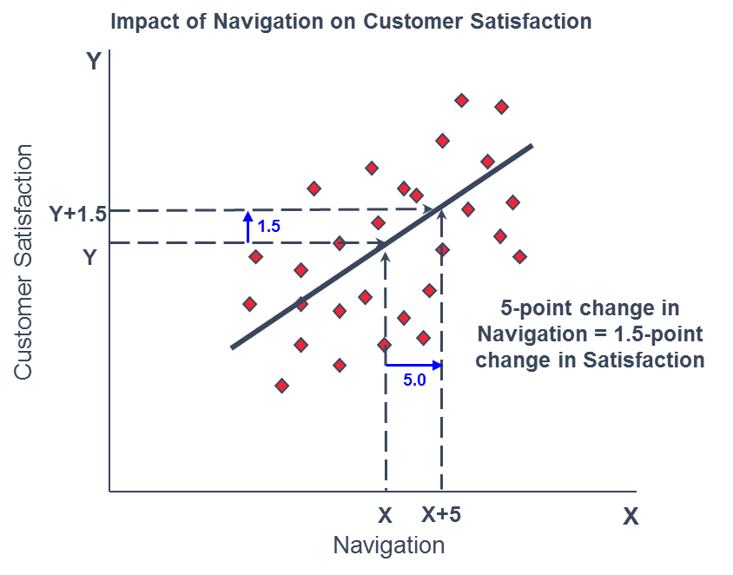
Understanding Impacts
The rate of change between an element and satisfaction is represented by an Impact. In simple terms, an impact can be understood as something like a slope of a line defining the relationship between two variables.

