Slide 1
Environmental Protection Agency
Usability Audit Review
Homepage and Landing Pages: Superfund

Slide 2
Agenda
ForeSee Usability Methodology
Scope and Specifications
Top Usability Issues
Key Points

Slide 3
ForeSee Usability Methodology
Audit
Analysis
Findings
Comparison against proprietary usability indicators
Pass/Fail metric
Measures specific aspects of usability
Established best practice standards
Expert analysis prioritizes key improvements
Most pervasive and severe issues
Most impactful opportunities
Top issues illustrated
Tactical recommendations
Best practice examples from inside and outside industry

Slide 4
Agenda
ForeSee Usability Methodology
Scope and Specifications
Top Usability Issues
Key Points

Slide 5
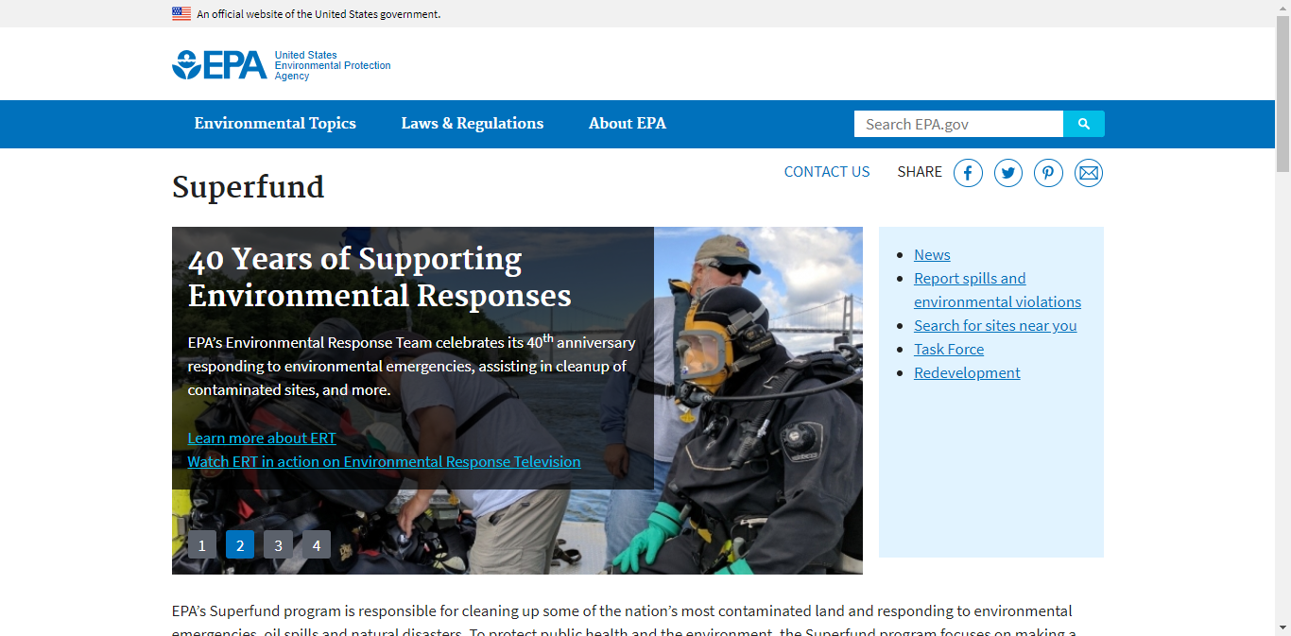
Scope and Specifications
March 2019
1366 x 768
Iterative Evaluation
This audit assesses the EPA/Superfund Homepage and top-level landing pages to evaluate whether each gives visitors a clear understanding of its purpose and what the site offers with regard to content and functionality. The audit evaluates the efficiency of navigation from Superfund Homepage to visually and structurally consistent landing pages to undertake various online goals. Labeling, layout, and orientation are audited to ascertain whether or not the homepage and landing pages set accurate expectations. Content organization is also assessed.

Slide 6
Agenda
ForeSee Usability Methodology
Scope and Specifications
Top Usability Issues
Key Points

Slide 7
Top Usability Issues
Content Introduction
Category Consistency
Uncategorized Content
Linkage to Landing Pages
Labels and Messages
Expected Location
Segmentation
Orientation
Efficient Wayfinding
Readability

Slide 8
Content Introduction

Slide 9
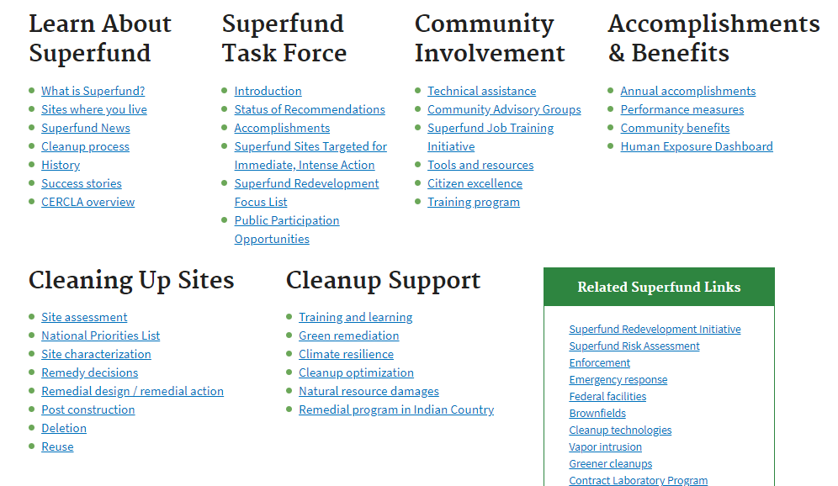
Homepage lacks high level summary of subcategories
Problem: While the Superfund subcategories are listed, and links to specific subsequent categories are available, visitors are denied the convenience of succinct descriptions for each category. Instead, visitors must visit these sections or read all of the links below in order to gain an understanding, which is time consuming and intensive.
Recommendation: Provide a one or two sentence summary of each subcategory directly below the headings.
Content Introduction

Slide 10
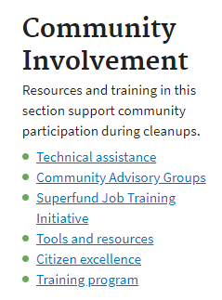
Example: Summary of subcategory on homepage
Mockup
This mockup demonstrates how the content in a section can be summarized to aid visitors with identifying which section to visit based upon their information goals.
Content Introduction

Slide 11
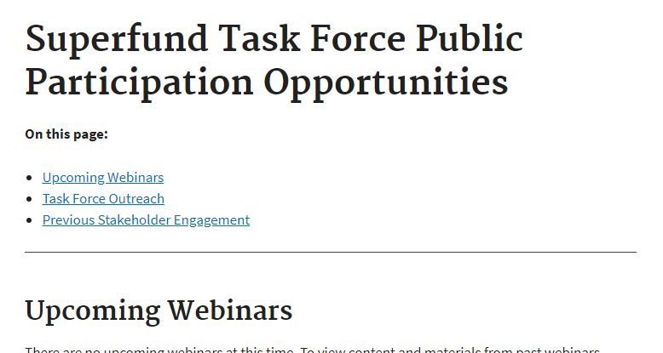
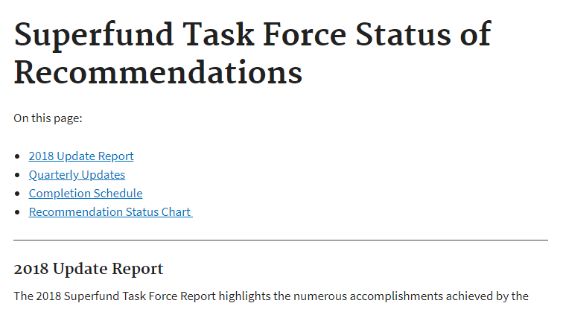
Some subcategory pages omit overviews
Problem: Subcategory pages such as these provide no summary of what these pages contain or link to. The absence of an overview forces visitors to glean what they can from the descriptiveness of the jump links or scroll the page before they can determine if they have reached the best location for their needs. This is inefficient.
Recommendation: Provide a succinct overview of the information and resources offered in the subcategory on each subcategory’s landing page.
Content Introduction

Slide 12
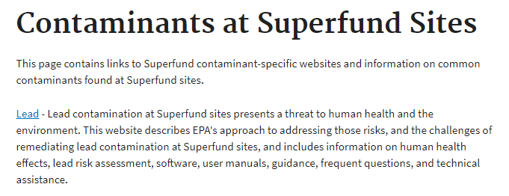
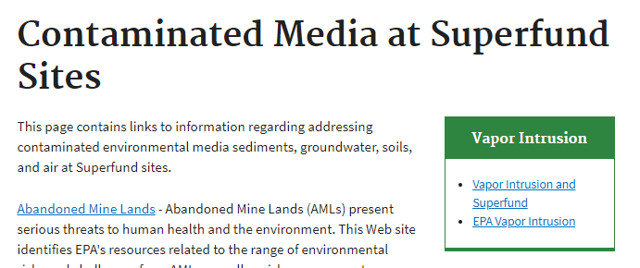
Example: Category overview
These category pages in the Superfund section contain succinct overviews which help set visitors’ expectations about what information and resources are available in this area, thus helping them more quickly confirm whether they have reached the best page to accomplish their goals.
Content Introduction

Slide 13
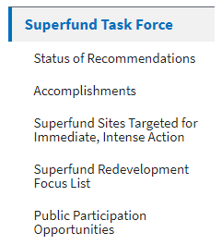
Subtopics are not introduced on landing pages
❶
❷
Content Introduction
Problem: Subsequent category landing pages ❶ sometimes fail to explicitly introduce each of the subtopics in the area, thus forcing visitors to review the local navigation submenu in order to avoid overlooking the information ❷ they are seeking. While identifying a needed subtopic in the local navigation may be minimally viable, visitors would benefit from a more complete introduction of each subtopic in the page centerwell. This would provide an opportunity for additional expectation-setting description, direct linkage to top resources, and supporting imagery.
Recommendation: Ensure subsequent category pages introduce in the centerwell each of the subtopic pages linked in the local navigation.
Content Introduction

Slide 14
Example: Subsequent category introduction
❷
This other site’s category landing page introduces and links to all subcategories in the section, which are also linked in the local navigation menu.
❶
Content Introduction

Slide 15
Content Introduction
Recommendations
Provide a one or two sentence summary of each subcategory directly below the headings.
Provide a succinct overview of the information and resources offered in the subcategory on each subcategory’s landing page.
Ensure subsequent category pages introduce in the centerwell each of the subtopic pages linked in the local navigation.
Content Introduction

Slide 16
Category Consistency

Slide 17
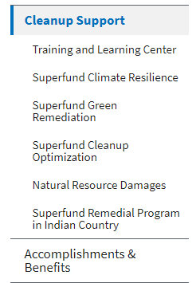
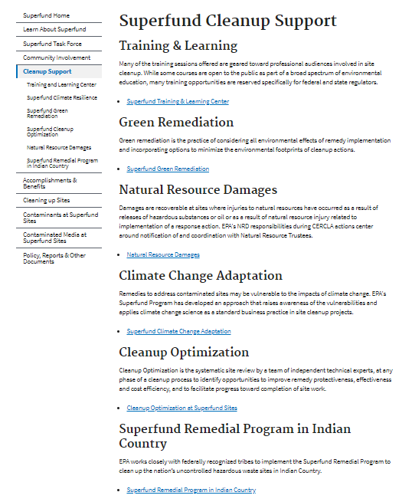
Inconsistent naming of categories is confusing
❶
❷
Shown here, linkage to the Superfund Climate Resilience page ❶ reveals discrepancies in the name used for this category: Superfund Climate Resilience ❷ vs. Climate Change Adaptation ❸. Inconsistent naming of categories makes it difficult for visitors to understand what content is available in
❸
the section and also impedes their ability to reach it with a minimum of navigational errors. Recommendation: Ensure categories are named consistently regardless of where they are mentioned or linked.
Category Consistency

Slide 18
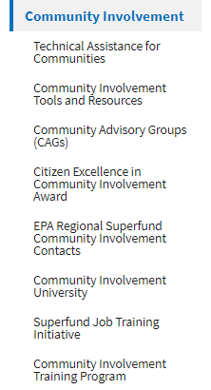
Discrepancies exist between lists of subsequent categories
In this example, the subsequent categories listed under Community Involvement ❶ on the homepage are different from those listed under Community Involvement in this section’s local navigation menu ❷. The inconsistency in options may confuse visitors who review these menus in order to form their mental model of what topics are covered in each section, as well as how they are organized. Recommendations:
Add a ‘View All’ link where all subsequent categories are not listed under a category on the homepage.
For each category or section, strive to list the same subsequent topics in a consistent order.
❷
❶
Category Consistency

Slide 19
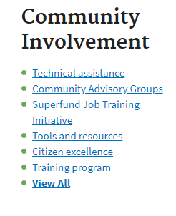
Example: Link to view all subsequent categories
Mockup
This mockup demonstrates how the simple provision of a ‘View All’ link informs visitors that additional subsequent categories are contained in this section, and that they should follow this link if they want to view them.
Category Consistency

Slide 20
Category Consistency
Recommendations
Ensure categories are named consistently regardless of where they are mentioned or linked.
Add a ‘View All’ link where all subsequent categories are not listed under a category on the homepage.
For each category or section, strive to list the same subsequent topics in a consistent order.
Category Consistency

Slide 21
Uncategorized Content

Slide 22
Supplementary linkage is confusing
❶
❷
Problem: The presence of two groups of resources— ‘Additional’ ❶ and ‘Related’ ❷ is likely to confuse visitors, as the distinction between the two is unclear. Furthermore, as these lists lack any obvious internal categorization scheme or organizing principle, visitors may feel compelled to read all of the links, in two disparate locations, simply to avoid overlooking something important.
Recommendations:
Present only one group of ‘Additional’ or ‘Related’ links on a single page.
Where feasible, strive to organize lists of supplementary links into interrelated sub-groups.
Uncategorized Content

Slide 23
Pages outside existing categories may be difficult to locate
epa.gov/superfund-redevelopment-initiative
❶
Problem: While pages outside Superfund should never be misrepresented as existing in the section, visitors may overlook ‘Superfund Redevelopment Initiative’ ❶ and ‘Financial Responsibility’ ❷ as they more likely expect to find them in an existing Superfund category.
Recommendation: Relocate ‘Superfund Redevelopment Initiative’ and ‘Financial Responsibility’ from ‘Related Superfund Links’ into existing Superfund subcategories.
❷
epa.gov/superfund/superfund-financial-responsibility
Uncategorized Content

Slide 24
Uncategorized content
Recommendations
Present only one group of ‘Additional’ or ‘Related’ links on a single page.
Where feasible, strive to organize lists of supplementary links into interrelated sub-groups.
Relocate ‘Superfund Redevelopment Initiative’ and ‘Financial Responsibility’ from ‘Related Superfund Links’ into existing Superfund subcategories.
Uncategorized Content

Slide 25
Linkage to Landing Pages

Slide 26
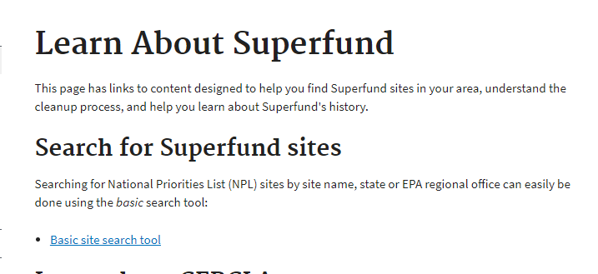
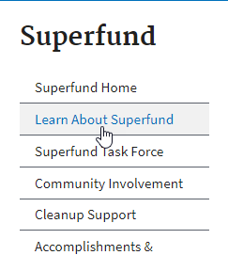
The homepage omits linkage to landing pages
Problem: Although the Superfund subcategories are listed as subheadings on the Superfund homepage, these headings are not linked to their corresponding subcategory landing pages. As a result, visitors may be unaware of the existence of such landing pages until they gain access to the local navigation menu. This means visitors may miss out on their opportunity to better acquaint themselves with the content in each subsection before navigating deeper in the site.
Recommendation: Link the Superfund subcategory headings on the homepage to their corresponding landing pages.
Linkage to Landing Pages

Slide 27
Example: Navigation through landing pages
General
❶
Actively directing visitors to a series of landing pages ❶ ❷ ❸ that effectively introduce subsequent pages can help visitors reach very specific information located deeper in the site ❹.
Although this approach may in some cases require slightly more clicks or page loads over direct quick links from the homepage, it better supports visitors’ understanding of how information is organized should they need to read about several topics during their site visit.
❷
❸
Specific
❹
Linkage to Landing Pages

Slide 28
Linkage to Landing Pages
Recommendation
Link the Superfund subcategory headings on the homepage to their corresponding landing pages.
Linkage to Landing Pages

Slide 29
Labels and Messages

Slide 30
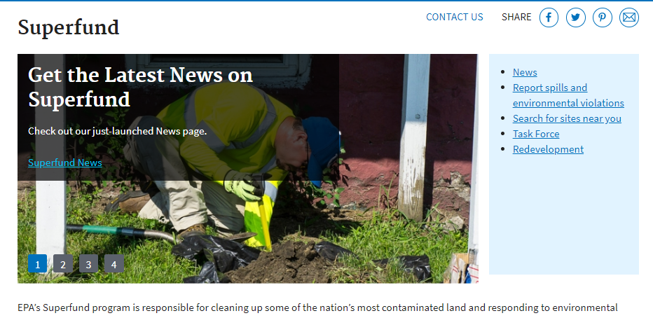
Potentially critical linkage lacks appropriate prominence
Problem: The visibility of ‘Report Spills and Environmental Violation’ relative to surrounding page elements is likely not commensurate with its importance in the minds of many visitors. As a result, visitors are likely to overlook it, either initially or entirely, due to its subtle placement among quick links.
Recommendation: Ensure the relative visibility of links reflects their level of importance; relocate the ‘Report spills and environmental violations’ link to the utility navigation menu and style it as a button.
Labels and Messages

Slide 31
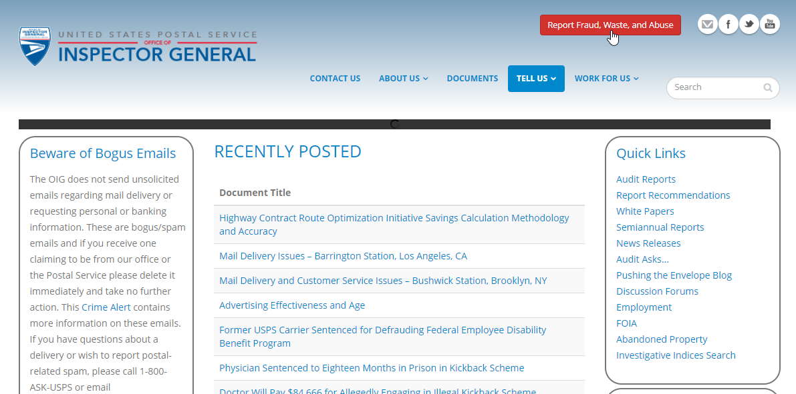
Example: Appropriate visual prominence
❶
❷
This other site’s ‘Report Fraud, Waste, and Abuse’ link ❶ is difficult to overlook due to its placement in the utility navigation (rather than among Quick Links ❷) and its visually arresting button stylization.
Labels and Messages

Slide 32
Example: Clear call to action on EPA.gov
Elsewhere on EPA.gov, the site offers a clear call to action through the use of highly noticeable imagery and supporting text, reducing the likelihood that visitors will overlook this option.
Labels and Messages

Slide 33
Labels and Messages
Recommendation
Ensure the relative visibility of links reflects their level of importance; relocate the ‘Report spills and environmental violations’ link to the utility navigation menu and style it as a button.
Labels and Messages

Slide 34
Expected Location

Slide 35
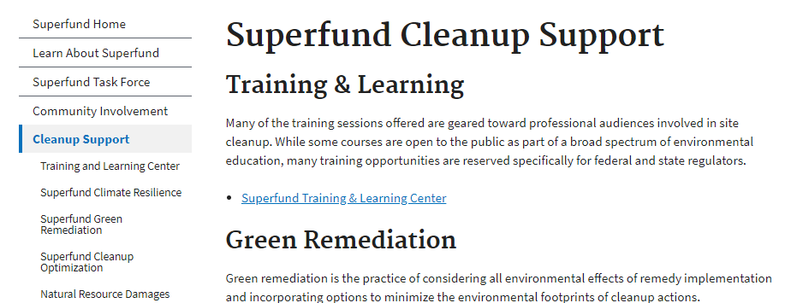
Link labels do not match destination page headings
Problem: As shown, links referring to pages are not phrased in the same manner as the destination page heading. Such discrepancies, however slight, are a distraction because they force visitors to pause and consider whether they have reached the correct and intended page, thus delaying them in reaching their information goals. Recommendation: Ensure referring links and destination page headings always exactly match.
Expected Location

Slide 36
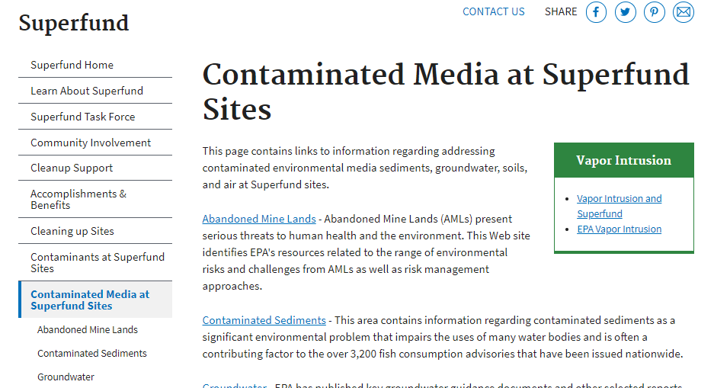
Example: Link label and destination page heading agreement
Elsewhere on the site, referring links are phrased in exactly the same manner as their destination page headings, thus making it easier for visitors to immediately confirm they have reached the intended page.
Expected Location

Slide 37
Expected Location
Recommendation
Ensure referring links and destination page headings always exactly match.
Expected Location

Slide 38
Segmentation

Slide 39
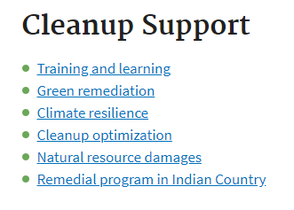
Audience-specific information may be difficult to locate
Problem: It is unclear for what audience or role (such as government employee, contractor, local official, or citizen) the various resources and training are intended. Such ambiguity forces visitors to spend time and cognitive effort determining the intent, and by extension relevance, of each of these resources for themselves, which may be time consuming. Furthermore, the lack of distinct segmentation pathways to content tailored to different roles means visitors must locate them throughout the Superfund section, increasing the likelihood they will overlook items they would otherwise find useful if not essential.
Recommendations:
Where resources are intended for distinct roles, provide explicit segmentation pathways and destination pages for each role.
Consider also providing single page hubs linking to all site resources relevant to specific roles.
Segmentation

Slide 40
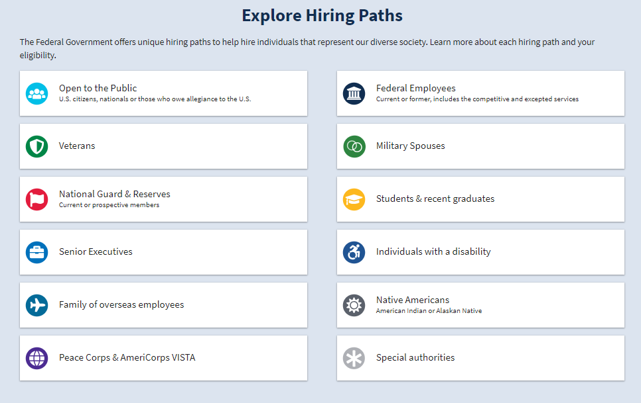
Example: Segmentation pathways
This other government website provides distinct segmentation pathways for job seekers of various backgrounds and roles, thus helping to ensure they have a good chance of finding a hiring path that works best for them.
Segmentation

Slide 41
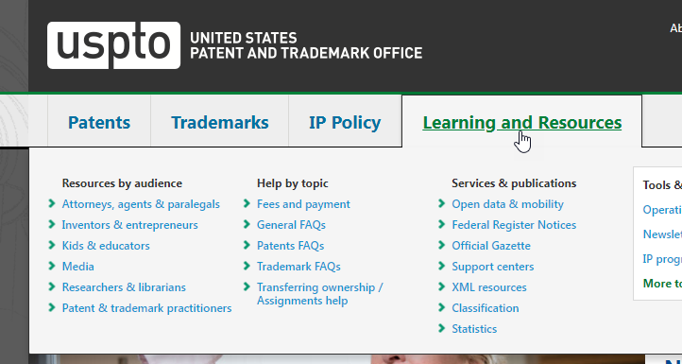
Example: Segmentation pathways
On this government website, visitors of various audience types find immediate access with distinct segmentation pathways via the global menu.
Segmentation

Slide 42
Segmentation
Recommendations
Where resources are intended for distinct roles, provide explicit segmentation pathways and destination pages for each role.
Consider also providing single page hubs linking to all site resources relevant to specific roles.
Segmentation

Slide 43
Orientation

Slide 44
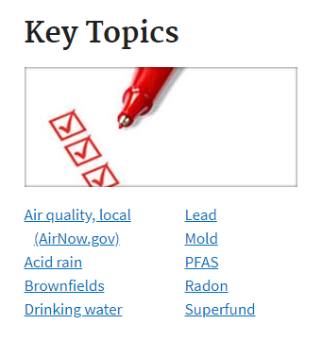
Superfund’s relationship to the rest of the site is unclear
❶
❷
Problem: Visitors need an understanding of the Superfund section’s hierarchical relationship to the rest of the site in order to easily find it upon reaching the site. By withholding what appears to be a top-level category ❶ from the global menu ❷, visitors are forced to spend time locating less obvious pathways, or resort to the site Search ❸.
Once in the Superfund section, its ambiguous location prevents visitors from easily understanding whether hierarchically parent or sibling content—which may be of closely related interest to them—exists, and if so, how to reach it. Recommendations:
Provide a top-level global menu category linking to the Superfund section.
Visually differentiate this category label, such as with unique color(s), when visitors are viewing a page in this section.
❸
Orientation

Slide 45
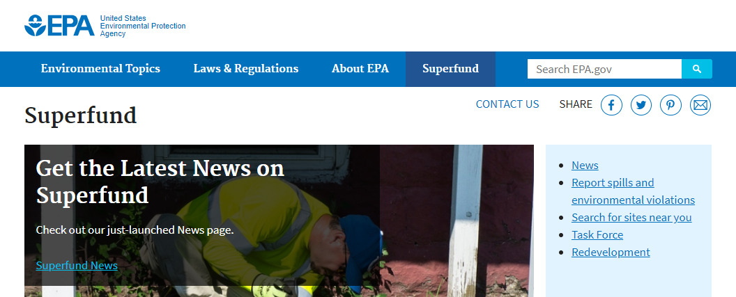
Example: Global access and orientation cue
Mockup
In this mockup, Superfund’s position as a top-level site category is evident thanks to its inclusion within the global menu, which also provides a clear path to the Superfund category from any page on the site. This mockup also shows how a change in global menu label’s background color can provide visitors with persistent awareness about which section they currently browsing, which supports their efforts to navigate.
Orientation

Slide 46
Breadcrumb trails are not provided
Problem: The site does not provide breadcrumb trails. This denies customers a linear and hierarchical pathway that would otherwise reflect where they are currently, which negatively impacts both orientation and navigation. For example, visitors arriving on the page shown above are not provided with any visual indication of where they are within the EPA site hierarchy. Recommendation: Provide breadcrumb trails on all EPA.gov pages with the exception of the homepage.
Orientation

Slide 47
Orientation
Recommendations
Provide a top-level global menu category linking to the Superfund section.
Visually differentiate this category label, such as with unique color(s), when visitors are viewing a page in this section.
Provide breadcrumb trails on all EPA.gov pages with the exception of the homepage.
Orientation

Slide 48
Efficient Wayfinding

Slide 49
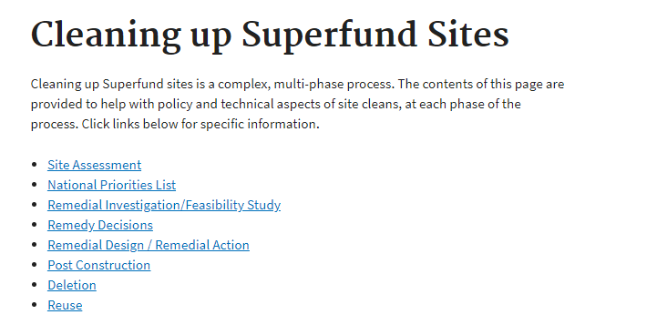
Link destinations may be unclear without scope notes
Problem: Scope notes are supplementary descriptions for links which help describe the content at each link destination. When they are omitted, as in this example, visitors have only the descriptiveness of the link labels to identify and decide which path they follow. As a result, it may take visitors longer than expected to answer their questions, and they may inadvertently visit pages which are not relevant or useful.
Recommendation: Pair links with succinct summaries of the content and resources found at each link’s destination.
Efficient Wayfinding

Slide 50
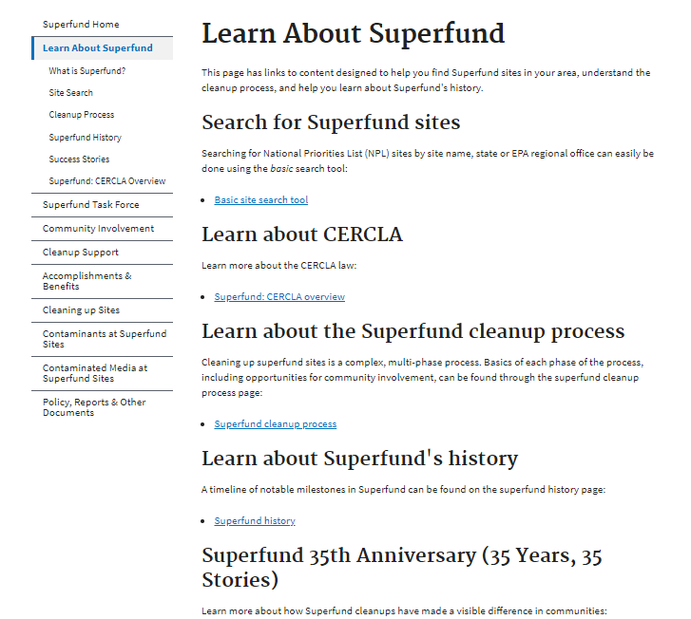
Without graphics, visitors must rely solely upon reading
Problem: Visitors to landing pages such as the one shown here would benefit from judiciously selected graphics, paired with each section or topic, to help convey the essential meaning of the content therein.
Were such graphics provided, the need for visitors to closely read all text, which they may find painstaking, would be reduced, as they could also scan the page for imagery that appears to match their information needs. Recommendation: Supplement topics and information with representative graphics or images that convey the essential theme or meaning of each topic.
Efficient Wayfinding

Slide 51
Example: Supplemental images
This website supplements content options with images that help convey the essential meaning of each. As a result, visitors’ need to closely read text is reduced, and they can identify the most relevant information more rapidly and with less perceived effort.
Efficient Wayfinding

Slide 52
Efficient Wayfinding
Recommendations
Pair links with succinct summaries of the content and resources lying at each link’s destination.
Supplement topics and information with representative graphics or images that convey the essential theme or meaning of each topic.
Efficient Wayfinding

Slide 53
Readability

Slide 54
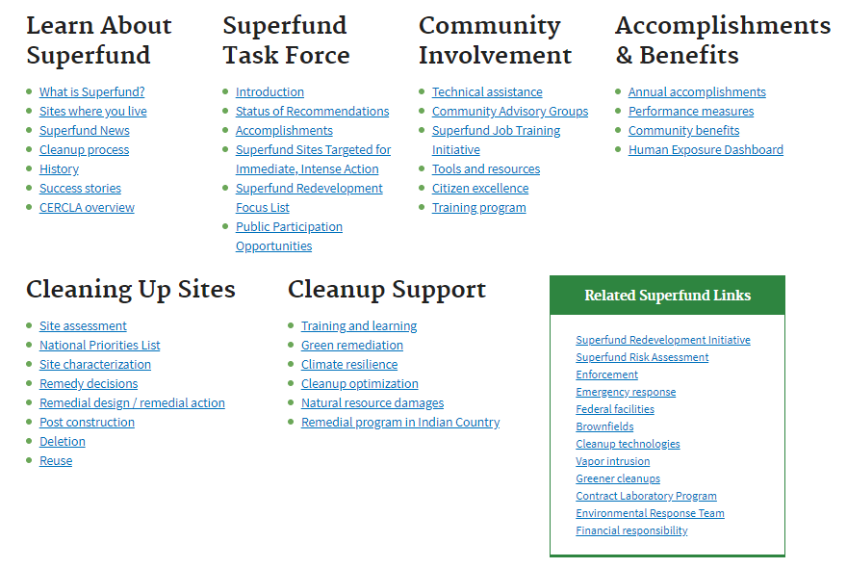
Overuse of text-underlining impedes readability
Problem: This example from the Superfund homepage illustrates how underlining hyperlinks can impede readability –especially where links appear close together in lists.
Given that the links are rendered in a standard blue format, and that the site appears to reserve blue text for hyperlinks, visitors have sufficient indication of where links are present via this blue color without the need for text-underlining.
Recommendation: Remove text-underlining format from hyperlinks rendered in blue text.
Readability

Slide 55
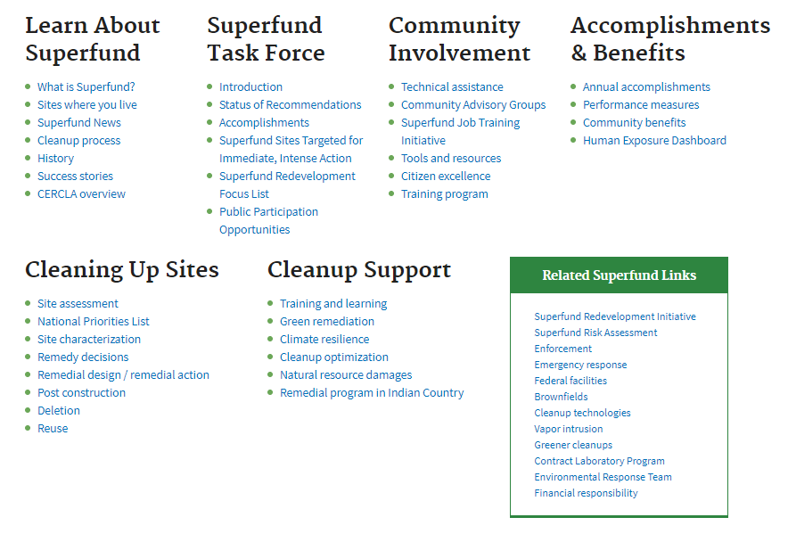
Example: Judicious withholding of text-underlining
Mockup
This mockup demonstrates how the readability of hyperlinks, especially for those appearing close together in lists, is noticeably improved when the text-underlining format is not used.
Readability

Slide 56
Hyperlink hover state is too subtle
Video, duration 11 Seconds
Problem: As shown in the video at right, when visitors hover over hyperlinks, the result link color change is extremely subtle. This makes it difficult for visitors to determine without close scrutiny that they are targeting the intended link, and may result in navigational errors. Recommendation: Provide a more obvious color change upon link hover.
Readability

Slide 57
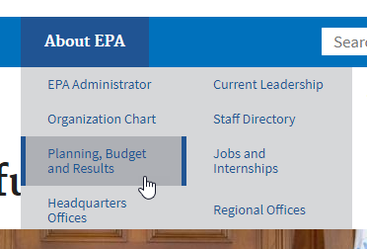
Global dropdown menu links are difficult to discern
Problem: Links in the global menu dropdowns are undersized and contrast weakly with their text backgrounds—especially on hover. As a result, visitors may feel more an unacceptable level of effort is required to read them.
Were a ‘Superfund’ category added to the global menu-as is recommended in the ‘Orientation’ issue of this report-its dropdown menu links would presumably present similar challenges to readability as shown in the example at right. Recommendation: Increase the font-size and contrast of links in the global menu dropdowns.
Readability

Slide 58
Readability
Recommendation
Remove text-underlining format from hyperlinks rendered in blue text.
Provide a more obvious color change upon link hover.
Increase the font-size and contrast of links in the global menu dropdowns.
Readability

Slide 59
Agenda
ForeSee Usability Methodology
Scope and Specifications
Top Usability Issues
Key Points

Slide 60
Key Points
Visitors to the Superfund section would benefit from:
Categorization and segmentation pathways for various visitor roles.
Summaries of what each page covers, located at the top.
More complete and consistent description for links and categories.
Simple graphics or images to help visitors scan for the best option.

Slide 61
Has a New Home at
Notes:
The ForeSee Summit has found a new home at Engage!
Verint is eager to welcome ForeSee clients into the fold.
There will be a track specific to ForeSee clients, which will include case studies, product insights and CX Suite training.
The larger number of attendees (1400+) means even more networking opportunities.
The Engage and Summit teams are working to integrate systems and programming to deliver the best possible experience for ForeSee attendees. Stay tuned for additional updates.

Slide 62
Loews Royal Pacific and Sapphire Falls Resorts
Universal Studios Orlando
May 20-23 – Orlando, FL

