Slide 1
SAVE THE DATE
THE 2017 SUMMIT
April 4-6, 2017
Sign up for email updates: learn.foresee.com/summit_update
JW Marriott Desert Ridge | Phoenix, AZ

Slide 2
Environmental Protection Agency
Radiation Segment
Satisfaction Insight Review

Slide 3
Voice of Visitor
ForeSee Methodology
Radiation Segment Overview
Key Findings, Recommendations, Next Steps
Appendix
AGENDA

Slide 4
ForeSee Methodology
ForeSee applies proven science and technology to the measurement and analysis of the visitor experience through the lens of visitor satisfaction.
EXPERIENCE & EXPECTATIONS
FUTURE BEHAVIORS
SATISFACTION
CONVERSION
RETENTION
LOYALTY
WORD-OF-MOUTH
Analysis of the visitor experience will enable your organization to understand…
How are you doing? What should you do? Why should you do it?

Slide 5
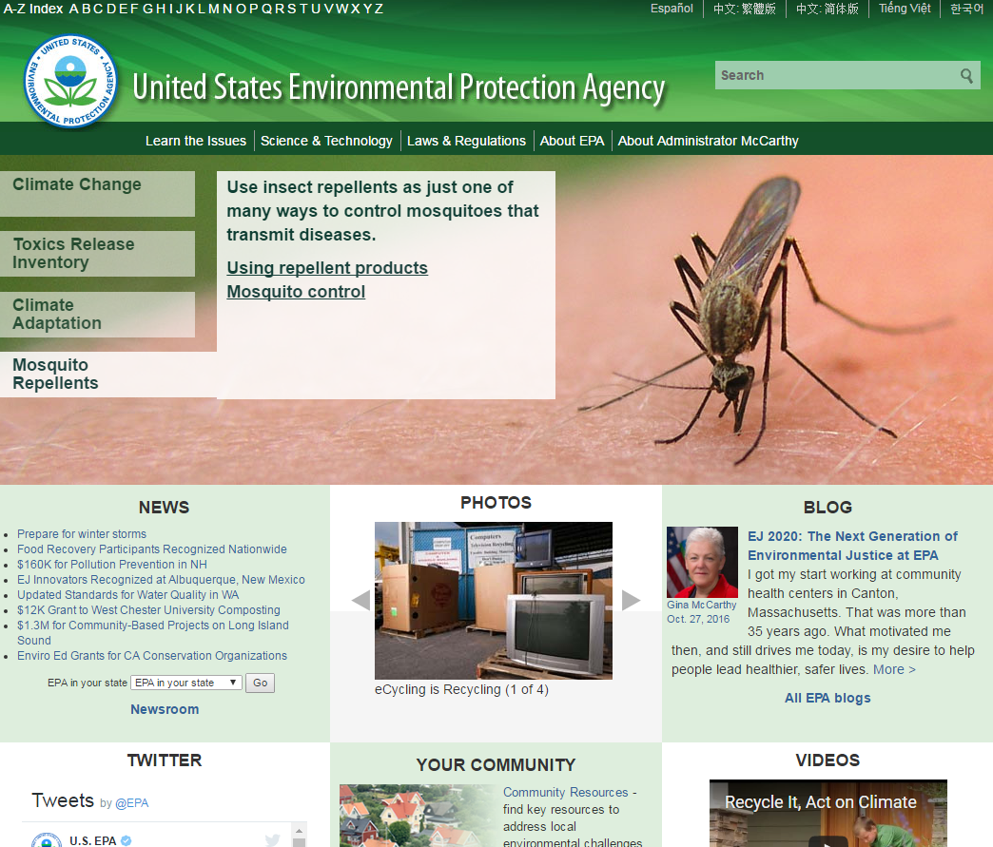
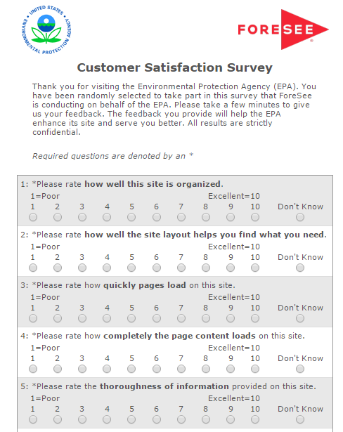
Capturing the Voice of the EPA.gov Visitor
EPA v6
August 2015
Completion Percentage: 47%
Survey invitation presents randomly to 100% of visitors who view 4+pages of your website.
September 2015
To
November 2016
Start of collection:
Reporting Periods:
Survey Details:
Collection method:
Notes:
ForeSee Completion: 47%; Independent agencies: 57%; eGov: 52%; Public Sector: 50%; Overall Gov: 49%; Fed Gov: 50%; Informational: 49%

Slide 6
Radiation Segment Overview
Introduction to Scores
September 1, 2015 – November 30, 2016

Slide 7
Overall satisfaction for the radiation segment is 67; however, the monthly trendline highlights the shift in scores month to month due to small sample sizes.
Radiation Segment | 22 | 25 | 17 | 24 | 23 | 26 | 24 | 27 | 8 | 11 | 15 | 14 | 15
n-count
Individual Satisfaction Scores represent average of scores between October 1, 2015 – September 30, 2016

Slide 8
Increased satisfaction has the greatest impact on Radiation visitors' likelihood to use the information they find on EPA.gov and recommend the agency to someone else.
ELEMENTS
CX SCORE
OUTCOMES
Drivers of Satisfaction
Outcomes of the Customer Experience
Score
Impact
Impact
Score
65
Information Browsing
1.4
Recommend Agency
74
4.5
75
Look and Feel
0.6
Use Information
73
67
4.7
70
Navigation
2.0
70
Site Information
1.4
0
100
79
Site Performance
0.2
September 1, 2015 – November 30, 2016
n= 320
C.I. +/- 1.8 at 90% level of confidence
WHICH ELEMENT SHOULD I PRIORITIZE?
WHERE AM I RIGHT NOW?
WHAT OUTCOME DOES IT IMPACT?
Bolded items represent Top Priority Elements between September 1, 2015 – November 30, 2016

Slide 9
With relatively low scores and a high impact on satisfaction information browsing, site information, and navigation offer the greatest opportunity to improve visitors’ overall satisfaction.
Information Browsing
Ability to sort information
Ability to narrow choices to find information
Site features help you find what you need
7.0
6.7
6.9
Site Information
Thoroughness of information
Information is understandable
Information answers your questions
7.4
7.8
6.8
Navigation
Site organization
Options available to navigate site
Site layout helps find what you need
7.4
7.3
7.1
September 1, 2015 – November 30, 2016 | N: 320 | Sat: 67

Slide 10
Consumers or citizens make up one-third of EPA’s radiation audience and they are the least satisfied group. Scientist and educator are the most satisfied radiation visitor groups.
For this visit to the EPA website, which of the following best describes you?
Aggregate Satisfaction Score: 67 n= 320
Consumer or citizen
Satisfaction: 60 33% | n=106
Student
Satisfaction: 69 13% | n=43
Educator
Satisfaction: 75 13% | n=41
Scientist
Satisfaction: 76 11% | n=35
Represent Business
Satisfaction: 65 10% | n= 32
Top 5 answer choices shown only
Individual Satisfaction scores represent average of scores between September 1, 2015 – November 30, 2016

Slide 11
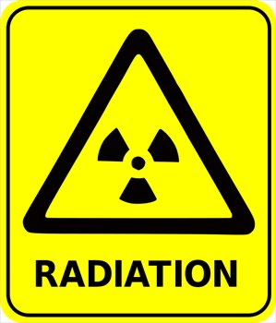
One-third of Radiation visitors came to EPA.gov to find radiation information because they see EPA as a trusted source for radiation concerns in their community. The majority of visitors view health effects topics during their visit.
Which of the following radiation information topics did you view during your site visit today?
(Select all that apply)
n=175
Radiation concerns
EPA reports on radiation
v
Health
Effects
40%
Basic radiation science
36%
Other
25%
v
Medical
(x-ray, CT scan)
15%
Nuclear Power
Issues
15%
Regulations
14%
Results are based on top answers I September 1, 2015 – November 30, 2016 | N: 320 | Sat: 67

Slide 12
Most visitors understand the radiation information on the site, those that did not find the radiation information clear attribute this to low volume or missing radiation information.
Sat
64
54
21
Please describe what was unclear about the radiation information that you viewed during your site visit today.
(n=26)
“It is no longer where it used to be & there is no link -if this information is still on the site.” (Sat 45, 07/22/2016)
“Historical data missing, standards are inconsistent without explanation.” (Sat 8, 05/22/2016)
“It Did Not Say Much About Radiation But It Had Enough Info For An Essay.” (Sat 0, 5/18/2016)
September 1, 2015 – November 30, 2016 | N: 320 | Sat: 67

Slide 13
Slightly over two-thirds of visitors have a better idea of EPA’s role in radiation and protection matters, however, 1 in 2 visitors does not know who to contact to get more information or report an incident after their visit.
After visiting the site, do you have a better idea of EPA’s role in radiation protection?
n=175
After visiting the site, do you know who to contact to get more information or to report an incident?
n=175
Sat 75
Sat 51
Sat 78
Sat 56
September 1, 2015 – November 30, 2016 | N: 320 | Sat: 67

Slide 14
One-third of radiation visitors are coming to the site for the first time and are the least satisfied visitor group. Slightly over one half of radiation visitors get to EPA.gov through a search engine. Those coming to the site from e-mail communications are the least satisfied group of visitors.
How did you get to the EPA website today?
n=320
Infrequent & First Time Visitors, 68%
Search engine
51%
Sat 68
Direct visit to EPA.gov
24%
Sat 68
Frequent Visitors, 32%
E-mail from EPA
Sat
Other
18%
Sat 60
Link on other government site
6%
Sat 63
64
68
71
69
77
60
September 1, 2015 – November 30, 2016 | N: 320 | Sat: 67
Individual Satisfaction scores represent average of scores between September 1, 2015 – November 30, 2016
Notes:
Other: Radar, satellite, Maps

Slide 15
Nearly one-half of radiation visitors struggle to find the information they were looking for. These visitors are looking for various types of radiation information including radiation levels, historical radiation information, and exposure to radiation and the EPA’s involvement in radiation laws and regulations.
Please tells us what you couldn’t find.
n=138
“How do I see the radiation readings current and historical for Sacramento California?”
(Sat 4, 11/12/2016)
“10 year data on background radiation levels.”
(Sat 8, 5/22/2016)
54%
Sat 83
n=173
“What is the EPA doing to prevent radiation and other toxic waste from seeping into the groundwater i.e. here locally at West Valley or i.e. Chernobyl?” (Sat 56, 9/22/2016)
“What specific laws and regulations the EPA has put into effect.”
Sat 67, 9/07/2016)
September 1, 2015 – November 30, 2016 | N: 320 | Sat: 67
Notes:
46% did not find it (31% partially found information, 15% did not find what they were looking for)

Slide 16
Radiation visitors coming to find information on health effects and medical, such as x-rays or CT scans, struggle the most to find what they were looking for.
Which of the following radiation information topics did you view during your site visit today? (Select all that apply)
X
Did you find the information you were looking for today?
n=175
Health Effects
60% Yes
14% No
Basic radiation science
56% Yes
Other
30% Yes
Medical (x-rays, CT scans, etc.)
Nuclear power issues
Regulations
26% Partially
10% No
35% Partially
35% No
35% Partially
63% Yes
17% No
30% Partially
54% Yes
8% No
38% Partially
54% Yes
8% No
38% Partially
Radiation concerns
EPA reports on radiation
Results are based on top answers I September 1, 2015 – November 30, 2016 | N: 320 | Sat: 67

Slide 17
Most visitors clicked on links within the page to look for information during their visit. 45% of visitors used one of the EPA’s search tools and half of those visitors stated the search tool worked well. However, 24% of visitors struggled to find relevant information during their search experience.
What search terms did you use?
n=72
Radiation Terms
“Radiation readings Sacramento California.” (sat 4, 11/12/2016)
“Radiation in California.” (Sat 56, 01/05/2016)
“Radiation, Solar Energy.” (Sat 0, 05/18/2016)
UV Index Terms
“MED, UV index, minimal erythema doses” (Sat 89, 09/29/2016)
“UV Index, UV-A, and UV-B.” (Sat 63, 12/04/2015)
“UV index and hazard rating.” (Sat 12/02/2015)
Results are based on top answers I September 1, 2015 – November 30, 2016 | N: 320 | Sat: 67
* Asked only to those who chose The EPA.gov basic search or The EPA.gov advanced search answer choices.
Notes:
Radiation and UV Index terms were the most searched terms

Slide 18
Visitors using the EPA advanced search tool are less likely to find the information they are looking for than those who clicked on links within the page or used the left navigation bar during their site visit.
Clicked on links within the page
48%
EPA.gov basic search
32%
Left navigation
bar
15%
EPA.gov advanced search
13%
Once you arrived on the site today, how did you look for information?
(Please check all that apply) X Did you find the information you were looking for today?
n=320
54% Yes
14% No
31% Partially
52% Yes
19% No
29% Partially
52% Yes
6% No
42% Partially
40% Yes
30% No
30% Partially
“Found the info, but then couldn't find it in the document it said my request contained.(Sat 4, 09/20/2015)
“Search function returned a browser error.(Sat 19, 10/14/2015)
Results are based on top answers I September 1, 2015 – November 30, 2016 | N: 320 | Sat: 67

Slide 19
1-in-5 visitors experience issues with navigation; of those visitors, 18% came across some sort of issue with links on the site.
Voice of the visitor suggest there are too many links to click to navigate the site and often times links take them to sites or documents that no longer work or exist.
Which of the following best describes your navigation experience during your visit to the site today?
(Please check all that apply)
n=233
Had Difficulties
Problems included
“Less links to click on and more of a natural flow with the topics discussed..” (Sat 85, 12/31/2015)
“Update links to functional websites.” (Sat 70, 04/27/2016)
“I was looking for hourly UV index and I found it but I don't know how. I'm afraid I will never find it again because you are changing your links.” (Sat 52, 10/10/2015)
“Lots of things within the site link to other internal sites that are no longer working.” (Sat 44, 06/01/2016)
Results are based on top answers I September 1, 2015 – November 30, 2016 | N: 320 | Sat: 67
* Asked only to those who chose clicked on links within the page, Left navigation bar and A-Z Index answer choices.

Slide 20
Visitors who viewed the document library, electronic radiation, and EPA emergency response capabilities experienced link issues at higher rates than visitors who viewed other types of radiation information topics.
The voice of the visitor suggests they would like to be able to easily find various types of radiation information on the site.
Which of the following radiation information topics did you view during your site visit today?
(Please check all that apply)
X
Which of the following best describes your navigation experience during your visit to the site today?
(Please check all that apply)
n=129
What is one change EPA could make to this site that would make it easier to use?
n=31
Document library
17% Links did not take me where I expected
Electronic radiation (cell phones, etc.)
7% Links did not take me where I expected
EPA emergency response capabilities
17% Links/Labels are difficult to understand
0% Too many links or navigational choices
21% Links/Labels are difficult to understand
14% Too many links or navigational choices
8% Links did not take me where I expected
17% Links/Labels are difficult to understand
0% Too many links or navigational choices
“Just put radiation level for the week, the last 7 days, make it easy to find.” (Sat 37, 04/26/2016)
“EPA should relate gamma radiation counts in a city to criteria of intervention.” (Sat 41, 04/07/2016)
“Show the Ultraviolet radiation level.” (Sat 41, 05/01/2016)
“I wanted to see a graph of the radiation samples taken in Great Falls, MT and have it simply displayed by counts per minute vs hourly sample or average for the day. Description or type of radioactive elements found ie alpha or beta particles, and the probable source, etc.” (Sat 19, 11/06/2015)
Results are based on navigational issues related to links on the site I September 1, 2015 – November 30, 2016 | N: 320 | Sat: 67

Slide 21
Key Findings & Recommendations

Slide 22
Key Findings & Recommendations
Priority Element | Key Finding | ForeSee Recommendation
Information Browsing | 46% of visitors were not able to find the information they were looking for. 18% of visitors encountered some type of link issue. | Consider a usability audit focused on the EPA basic and advanced search tools to identify specific pain points for visitors. Identify and remove unresponsive links. Audit link labels/names to ensure they properly direct visitors to the information they are looking for.
Site Information | 18% of visitors felt the information on the site was not clear or easily understood. 50% of visitors are unclear on who to contact to get more information or report an incident based on the information available on the site. | Review page resources and update content to address visitors’ questions and information needs about radiation. Further simplify information and organize by topics/audience. Include historical information on radiation topics. Simplify contact information or incident report information so visitors can have a clear understanding of who to contact when needed.
Navigation | 26% of visitors encountered some sort of navigation issues during their visit. | Reduce the number of links available to navigate Consider a usability audit focused on the radiation landing page and the top-5 most visited areas within the radiation section of the site.

Slide 23
Next Steps

Slide 24
Next Steps
Questionnaire Review
Review current questionnaire and update Radiation CQ’s
Automated Reports and Portal Access
Audit automated reports and ensure distribution list(s) and report list(s) are current.
Deliverable Planning
Potential SIR Topics-
Examine the overall site experience for radiation visitors who encountered search and link issues during their visit.

Slide 25
Appendix

Slide 26
EPA.gov scores below average for the eGov Satisfaction Index of 74.
Q3 2016 E-Government Satisfaction Index
Rank | Satisfaction | Website | Department
 | 74.8 | Aggregate Satisfaction Across Sites
1 | 90 | Extra Help with Medicare Prescription Drug Plan Costs—socialsecurity.gov/i1020 | SSA
2 | 90 | SSA iClaim—socialsecurity.gov/applyonline | SSA
3 | 89 | SSA - my Social Security -ssa.gov/myaccount | SSA
4 | 89 | SSA Retirement Estimator—ssa.gov/estimator | SSA
5 | 88 | Electronic Federal Tax Payment System—eftps.com | Treasury
77 | 69 | U.S. Environmental Protection Agency—epa.gov | EPA
97 | 56 | U.S. Department of Education—ed.gov | DOE
98 | 55 | Disability—Disability.gov | DOL
99 | 55 | U.S. Internal Revenue Service—irs.gov | Treasury
100 | 54 | U.S. Geological Survey—usgs.gov | DOI
101 | 53 | U.S. Department of Veterans Affairs—va.gov | VA
Top
5
Bottom
5
Individual Satisfaction Benchmark Scores are from the Quarterly ForeSee E-Government Satisfaction Index Report. For the full report click here

Slide 27
EPA.gov scores below average for the Federal Portals and Departments Main Websites index.
Q3 2016 E-Government Federal Portals and Departments Main Websites Index
Rank | Satisfaction | Website | Department
 | 72 | Aggregate Satisfaction for Federal Portals and Department Main Websites
1 | 83 | U.S. Citizenship and Immigration Services Español—uscis.gov/portal/site/uscis-es | DHS
2 | 82 | Centers for Disease Control and Prevention—cdc.gov | HHS
3 | 82 | National Library of Medicine—nlm.nih.gov | HHS
4 | 81 | NASA main website—nasa.gov | NASA
5 | 80 | National Cancer Institute—cancer.gov | HHS
22 | 69 | U.S. Environmental Protection Agency—epa.gov | EPA
29 | 65 | U.S. Patent and Trademark Office—uspto.gov | DOC
30 | 56 | U.S. Department of Education—ed.gov | DOE
31 | 55 | Disability—Disability.gov | DOL
32 | 55 | U.S. Internal Revenue Service—irs.gov | Treasury
33 | 53 | U.S. Department of Veterans Affairs—va.gov | VA
Top
5
Bottom
5
Individual Satisfaction Benchmark Scores are from the Quarterly ForeSee E-Government Satisfaction Index Report. For the full report click here

Slide 28
EPA.gov scores slightly below average among the Public Sector, Federal Government, and Informational benchmarks. In November 2016 EPA.gov scores 4 points above November 2015 score.
November 2016 Satisfaction Benchmark
November 2015 Averages | 66 | 68 | 72 | 68 | 74 | 71
See appendix for full benchmark membership.
Benchmark Scores are for the month of November 2016 only I Average scores shown for November 2015

Slide 29
Overall, radiation visitors also come to EPA.gov to find information about data, statistics, scientific methods or models or research one or more environmental issues.
September 1, 2015 – November 30, 2016 | N: 320 | Sat: 67

Slide 30
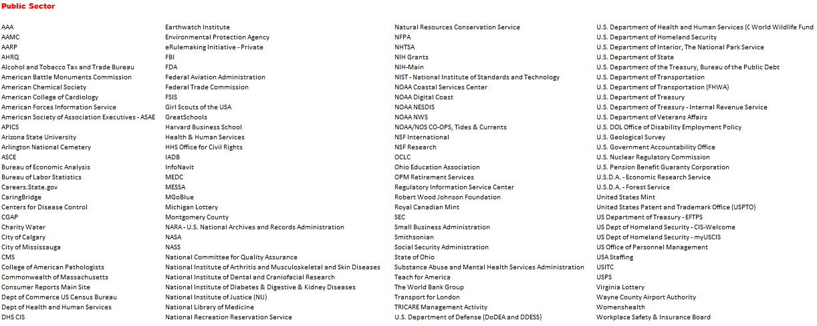
Benchmark Participants

Slide 31
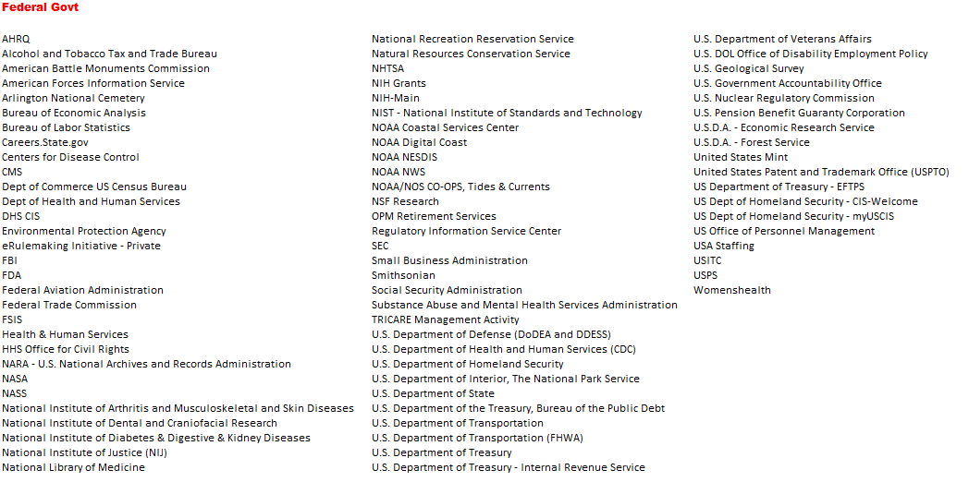
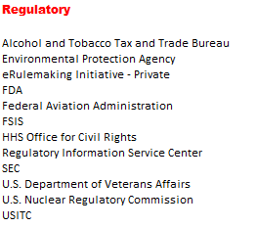
Benchmark Participants

Slide 32
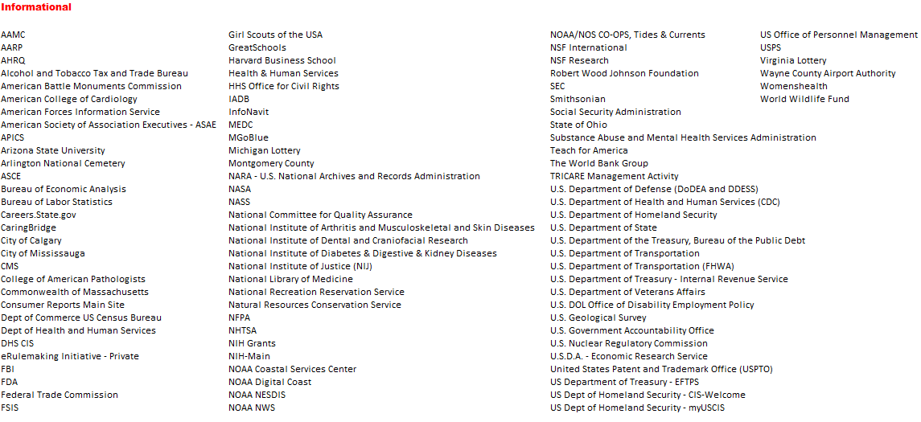
Benchmark Participants

Slide 33
Your ForeSee Team
Client Services Team
Survey design, code development, reporting, analysis and strategic planning
Andrea Rodriguez
Data Analyst
Andrea.Rodriguez@foresee.com
734-352-6213
Katie Bennett
Client Manager
Katherine.Bennett@foresee.com
734-205-2634
Account Management Team
Contracts, negotiations, relationship management, and strategic planning
Phil Pegher
Enterprise Account Manager
Phil.Pegher@foresee.com
734-352-6378

Slide 34
Thank You

