Slide 1
Environmental Protection Agency
Executive Presentation
Andrea Rodriguez, Client Data Analyst
Susan Lindstrom, Usability Analyst
Notes:
ForeSee is committed to providing EPA leadership with the voice of customer data, analysis, and recommendations to support the OneEPA Web initiative.
The ForeSee Executive Presentation will use voice of customer data combined with expert analysis to uncover opportunities to improve the experience to drive satisfaction and encourage visitors to recommend and (re)use EPA information.
The structure of the ForeSee Executive Presentation will cover the ForeSee methodology; overall top priority areas and specific audience segment needs; key findings, recommendations, and best practices based on the voice of customer data and usability audits; and next steps to optimize continuous measurement.

Slide 2
Agenda
Capturing the Voice of Visitors
Key Findings, Recommendations and Next Steps
Data and Usability Review

Slide 3
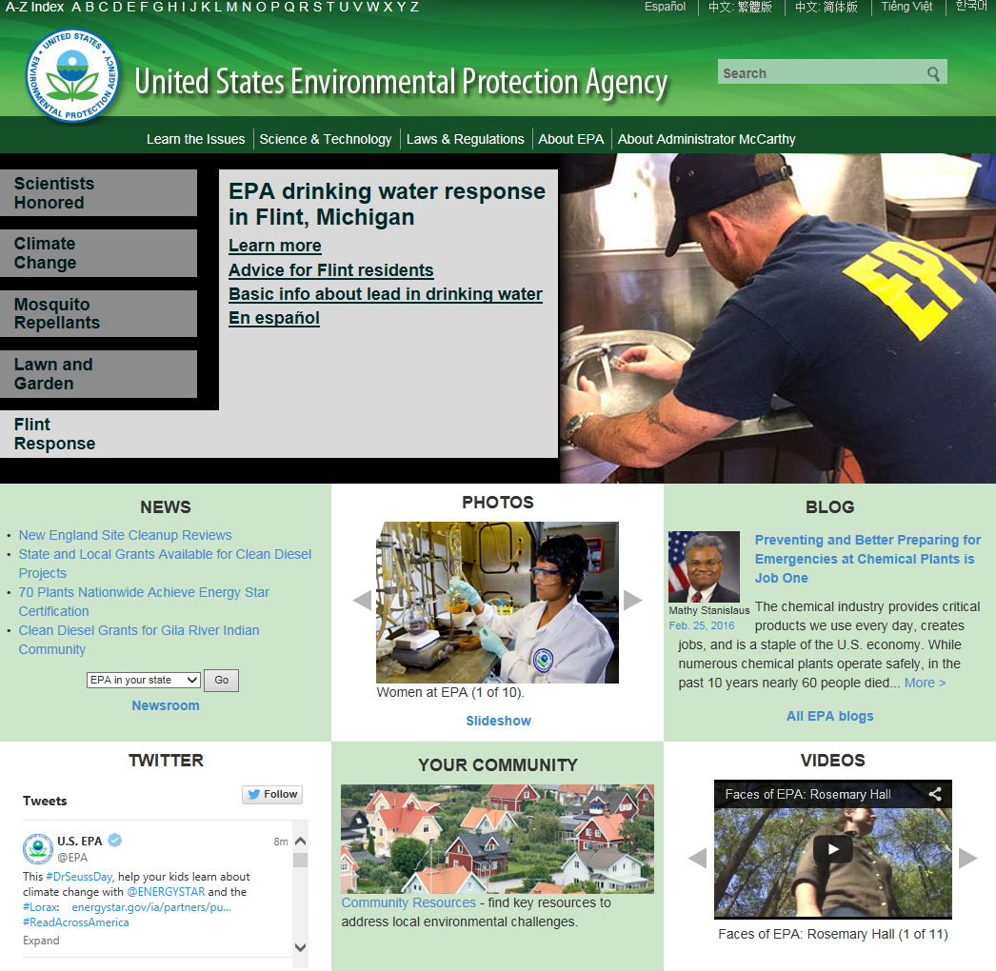
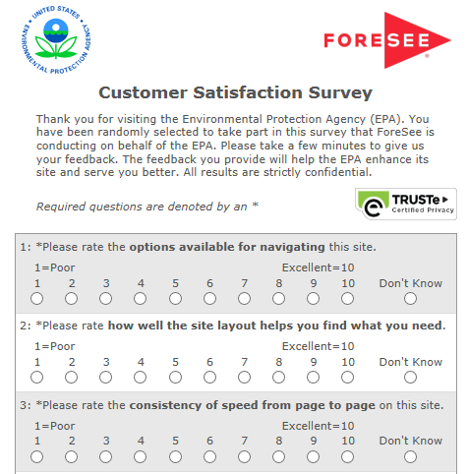
Capturing the Voice of Visitors
September 26, 2005
August 31, 2015
June 15, 2016
46%
100% of visitors who view 4 or more pages.
Start of Collection:
Analysis Date Range
Completion Percentage:
ForeSee Completion percentage:51%
Total number of surveys completed to June 15, 2016: 143,588
Collection Method:
Notes:
August 2015 – June 2016= 18, 385 surveys collected

Slide 4
Data and Usability Review

Slide 5
Improvements to information browsing, site information, and navigation will have the biggest impact on EPA’s satisfaction and desired outcomes.
August 31, 2015 – June 15, 2016
LEVERS
CX SCORE
OUTCOMES
Drivers of Satisfaction
Outcomes of the Customer Experience
Score
Impact
Impact
Score
65
Information Browsing
1.8
4.4
Recommend Agency
72
74
Look and Feel
0.7
66
4.3
Use Information
74
69
Navigation
1.4
0
100
70
Site Information
1.5
80
Site Performance
0.1
August 31, 2015 – June 15, 2016
N: 17,431
C.I. +/- 0.2 at 90% level of confidence
1
2
3
HOW ARE WE DOING?
WHAT SHOULD WE DO?
WHY SHOULD WE DO IT?

Slide 6
Information Browsing, Site Information, and Navigation are the top priority elements for EPA visitors.
August 31, 2015 – June 15, 2016
With relatively low scores and high impact on satisfaction, top priority elements offer the greatest opportunity to improve visitors’ overall satisfaction.
Information Browsing
…ability to sort information
…ability to narrow choices to find information
…site features help find what you need
6.9
6.8
6.8
Site Information
…thoroughness of information on site
…how understandable is information on site
…information provides answers to questions
7.5
7.7
6.9
Navigation
…site organization
…options available to navigate site
…site layout help find what you need
7.3
7.3
7.0

Slide 7
ForeSee data directly ties into the goals of OneEPA
Info
browsing
Site
info
Shine a Light on the “Needles in the Haystack”: Because critical content is often buried within vast amounts of more insignificant information, our visitors have difficulty finding the answers they’re looking for.
Produce Consistent Information: Web content is often produced with little coordination across headquarters program offices and regions. As a result, our visitors often find duplicate and even conflicting content on the site.
Move Beyond “Put it Up” Mentality: Our site reflects a “post everything” philosophy common in the early days of the web. It has become large and unwieldy, is poorly organized, and does not reflect EPA or the public’s highest priorities.
Manage Content More Effectively: Efficient management will make our budgets for producing web content stretch further. Greater reliance on Agency-wide web development resources will reduce burdens on organizational resources.
Prioritize Communicating through the Web: Although EPA.gov is considered our most valuable communications tool, web work in many offices is not a priority and is often assigned as a collateral duty.
Navigation
Site
info
Site
info
Info
browsing
Site
info
Navigation
Info
browsing
Site
info
Info
browsing
Information browsing Navigation Site Information

Slide 8
EPA’s satisfaction score recovered from previous losses in 2015 and remains stable with scores in the mid to high 60’s.
August 31, 2015 – June 15, 2016
(n=2,013) (n=2,045) (n=1,731) (n=1,515) (n=1,878) (n=1,936) (n=1,935) (n=1,826) (n=1,706) (n=795)
Indicates a statistically significant increase compared to previous month at 90% confidence interval
Indicates a statistically significant decrease compared to previous month at 90% confidence interval

Slide 9
EPA’s June satisfaction score is below average compared to other relevant benchmark categories.
June 2016
Satisfaction Benchmark
June 2016
June 2015 Averages | 68 | 68 | 71 | 67 | 72

Slide 10
EPA is in the bottom third of ForeSee’s quarterly eGov index for Portal and Department Main Websites.
August 31, 2015 – June 15, 2016
Federal: Portals and Department Main Websites Benchmarks
Rank | Satisfaction | Website | Department
 | 72 | Aggregate Satisfaction for Federal Portals and Department Main Websites
1 | 85 | NASA main website—nasa.gov | NASA
2 | 85 | U.S. Citizenship and Immigration Services Español—uscis.gov/portal/site/uscis-es | GHS
3 | 84 | NIAMS public website—niams.nih.gov | HHS
4 | 83 | CDC main website—cdc.gov | HHS
5 | 81 | National Institute of Dental and Craniofacial Research—nidcr.nih.gov | HHS
26 | 66 | U.S. Environmental Protection Agency—epa.gov | EPA
29 | 65 | NARA main public website—archives.gov | NARA
30 | 64 | GSA main website—gsa.gov | GSA
31 | 61 | U.S. Department of Education—ed.gov | DOE
32 | 58 | Disability—Disability.gov | DOL
33 | 51 | VA main website—va.gov | VA
Top
5
Bottom
5

Slide 11
Only 55 percent of visitors were able to find their desired content on the site during their visit. Visitors using the basic search feature to look for information are the least satisfied group.
August 31, 2015 – June 15, 2016
Custom Question | Reporting Period: August 31, 2015 – June 15, 2016
Sample Size | n= 17,431 | Sat 66
Look For Information | 51% = Click on links within the page (Sat 67, n=8,904) 32% = The EPA.gov basic search (Sat 62, n=5,517) 14% = Left navigation bar (Sat 65, n=2,427) 11% = Other (Sat 57, n=1,854)
Search Tools | 53% = Search worked well (Sat 81, n=3,362) 20% = Return results that were not relevant (Sat 35, n=1,260) 13% = Returned too many results or required too many refinements (Sat 49, n=841) 9% = Search returned zero results (Sat 23, n=550)
Navigation Difficulties | 69% = I did not have any difficulties (Sat 78, n=8,653) 12% = Links did not take me where I expected (Sat 33, n=1,573) 6% = Would often feel lost, not know where I was (Sat 32, n=782) 6% = Too many links or navigational choices (Sat 43, n=763)
Find What Looking For | 55% = Yes (Sat 82, n=9,626) 26% = Partially (Sat 60, n=4,578) 19% = No (Sat 25, n=3,227)
Water and air information
Search Engine
Google Search
Bolded items are statistically different at 90% level of confidence.
Top answer choices displayed
See Appendix for complete list of custom questions and answer choices

Slide 12
Visitors are critical of the Search Feature’s ability to help them find the information they are looking for. Visitors also reported issues with broken links during their visit.
August 31, 2015 – June 15, 2016
Information Browsing
Common Theme
Search Feature did not help find the information needed
“When I look for specific addresses it does not return results, but when I zoom in manually the facility is there, with the same address I typed in. Search function is garbage.” (SAT 33, 04/06/2016)
“Searched for 'lead'. Got zero results that were actual datasets.” (SAT 15, 03/05/2016)
Broken links
“Search returned a link that couldn't open document.” (SAT 70, 02/19/2016)
“Search returned broken links.” (SAT 0, 12/17/2015)
Notes:
Additional comments:
“The search returned results to items that have been moved, with no other information.” (SAT 0, 01/09/2016)
“Search gave results that were not at all what I was looking for.” (SAT 0, 12/21/2015)
“A search for PSA's returned a list of links, but all links were dead.” (SAT 44, 02/05/2016)

Slide 13
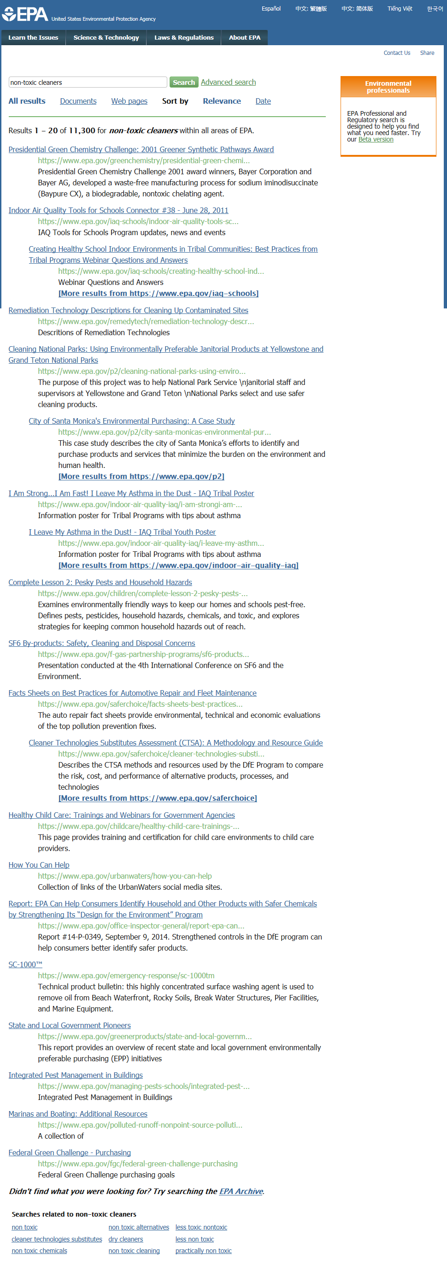
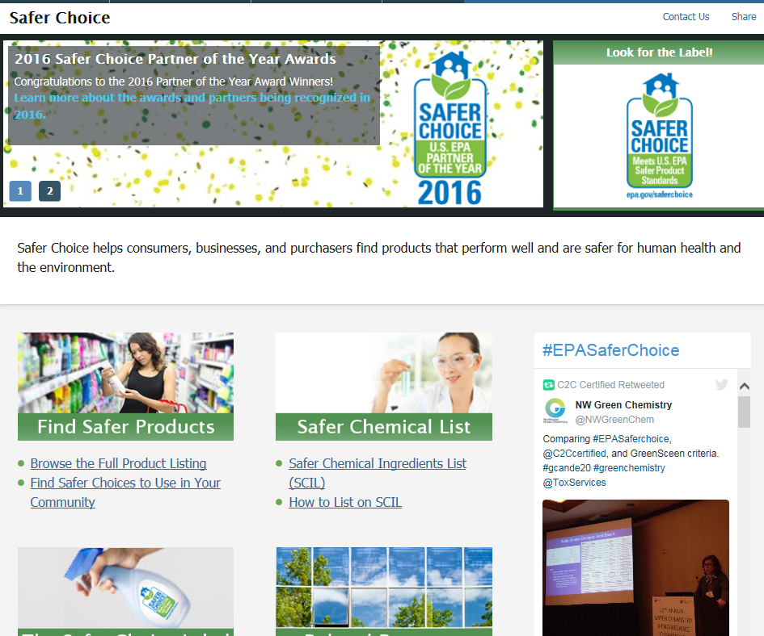
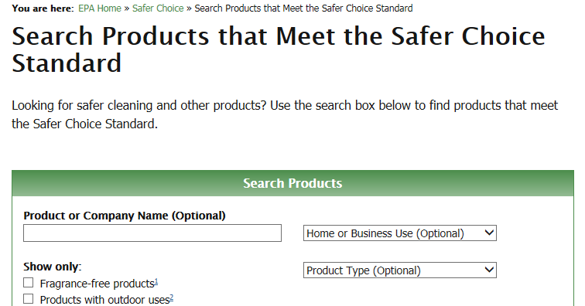
Content does not consistently produce relevant search results
❷
❶
❸
Recommendation: Ensure that page headings, content, and tagging contain meaningful keywords to ensure that Search provides the most accurate and relevant results.
Notes:
Search results do not always return expected content. For example, visitors searching for “non-toxic cleaners” ❶ are likely to be interested in content in the Safer Choice section ❷ ❸. However, no result for this content is listed on the first page of results. This risks that visitors may not find information of interest to them.

Slide 14
Search results lack useful descriptions
Recommendation: Ensure search results provide useful descriptions that include a summary of the content available on the destination pages.
Notes:
In this search for “asbestos exposure”, the item labeled Recordkeeping does not provide sufficient information to help visitors understand the content represented. Both the title and the description lack relevant keywords that indicate the scope of the page. Consequently, visitors are not sure whether this link answers their questions or if another result would offer more helpful information.

Slide 15
Concerned citizen or consumer visitors are the least satisfied group and struggle the most to accomplish their task on EPA.gov, while students and educators have the highest accomplishment rates and satisfaction scores.
August 31, 2015 – June 15, 2016
Researcher
SAT
64
63
74
64
75
65
60
Not all answer options shown.
n=17,431

Slide 16
Over half the concerned citizen or consumer visitors are first time visitors and their satisfaction is significantly lower than other groups.
August 31, 2015 – June 15, 2016
Custom Question | Segment: Concerned Citizen or Consumer
Sample Size | n= 3,802 | Sat 63
Frequency | 62% = This is my first time (Sat 62, n=2,350) 20% = A few times a year (Sat 68, n=779) 8% = About once a year (Sat 56, n=290) 5% = Monthly (Sat 68, n=192) 3% = Weekly (Sat 65, n=115) 2% = Daily (Sat 67, n=76)
Why Visit | 63% = Find something specific (Sat 60, n=2,400) 44% = A particular report, guidance document, booklet or other publication (Sat 63, n=1,051) 34% = Data, statistics, scientific methors or models (Sat 61, n=810) 38% = Learn about/research (Sat 72, n=1,454) 46% = One or more enviromental issues (Sat 73, n=673) 21% = An enviromental issues in my local area (Sat 69, n=409)
Find What Looking For | 48% = Yes (Sat 85, n=1,806) 28% = Partially (Sat 61, n=1,072) 24% = No (Sat 21, n=924)
Navigation Difficulties | 69% = I did not have any difficulties (Sat 78, n=8,653) 12% = Links did not take me where I expected (Sat 33, n=1,573) 6% = Would often feel lost, not know where I was (Sat 32, n=782) 6% = Too many links or navigational choices (Sat 43, n=763)
Bolded items are statistically different at 90% level of confidence.
Top answer choices displayed
See Appendix for complete list of custom questions and answer choices

Slide 17
Abbreviations reduce readability and hinder navigation
❶
❷
❹
Recommendation: Ensure that page headings and link labels are clear—avoid jargon and abbreviations in labels and content.
❸
Notes:
Abbreviations often occur in page headings❶ ❷ , links❸, and navigation menus ❹. Although the target audience may recognize these abbreviations, they still impose a cognitive load on visitors, which slows down their browsing. Labels should accurately reflect the content they represent.

Slide 18
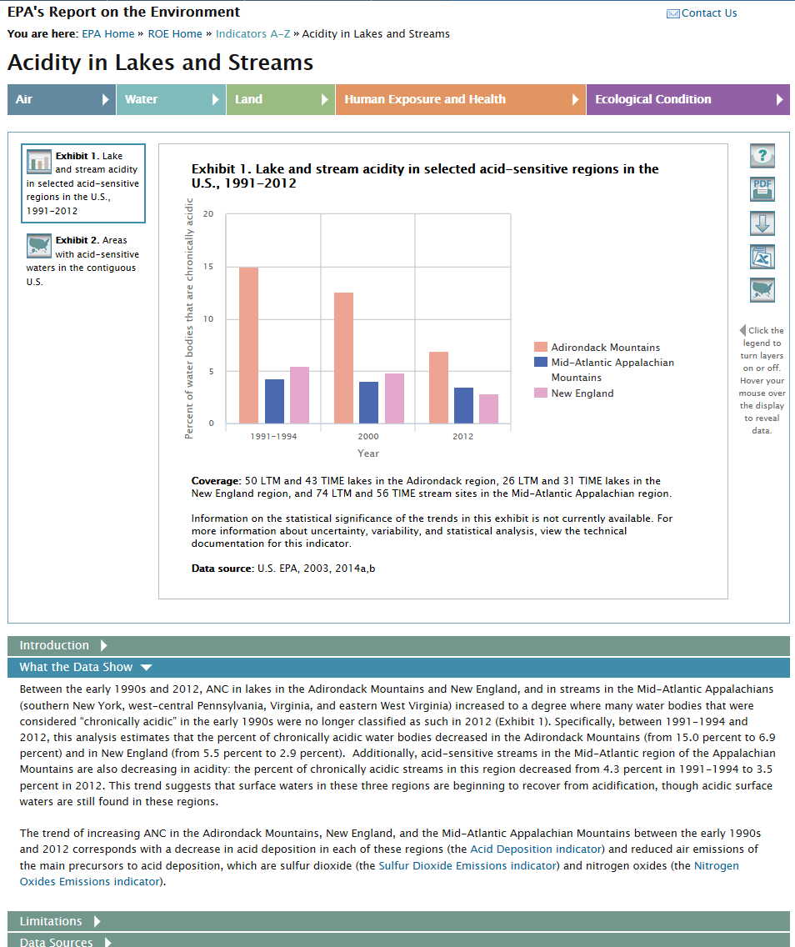
Organization of content does not support scanning
Recommendation: Present the most important content or main point before supporting details to improve readability.
Notes:
There are instances of content which is not effectively layered and organized to support scanning and comprehension. For example, in the Report on the Environment indicator on Acidity in Lakes and Streams, the main point of the What the Data Show division is stated at the end of a detailed paragraph. Visitors may miss or overlook this information, or they may decide the page is too difficult to understand.

Slide 19
Visitors struggle to find information regarding water pollution/quality, watersheds or wetlands, and information regarding cleanups, remediation or Superfund.
August 31, 2015 – June 15, 2016
SAT
64
59
68
77
65
60
70
Not all answer options shown.

Slide 20
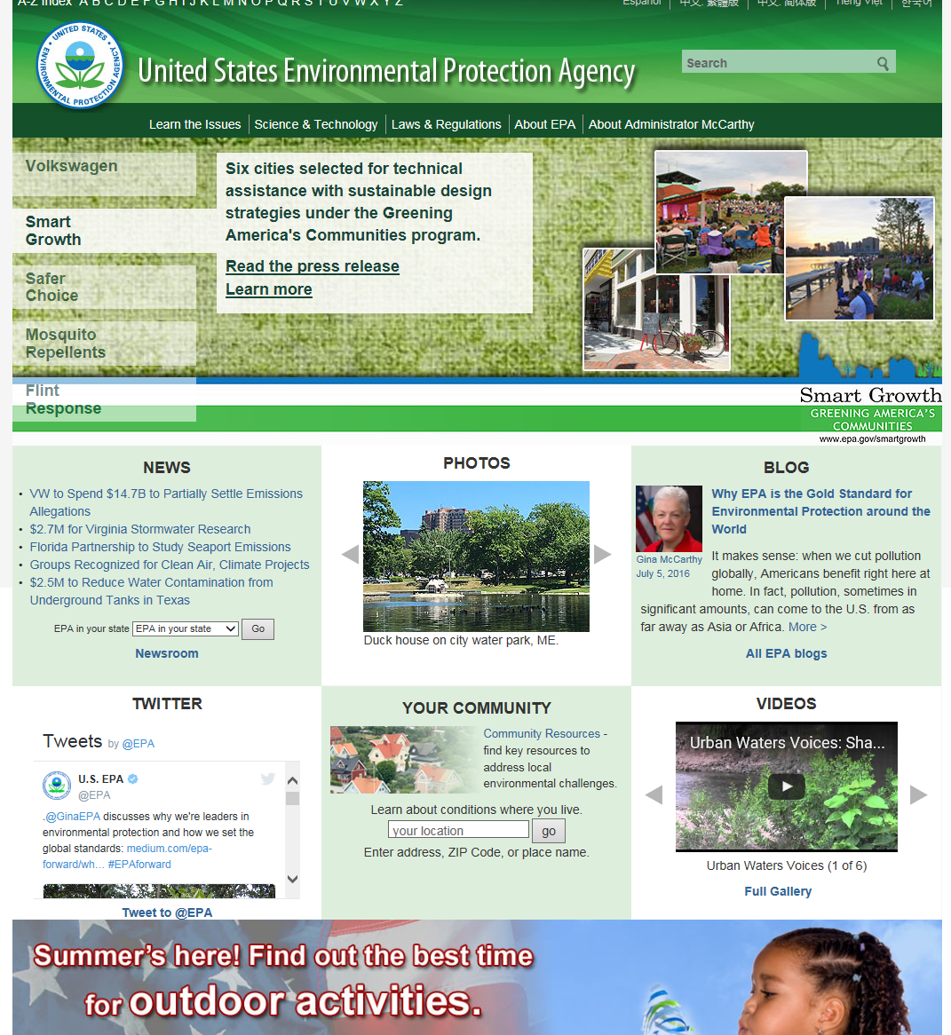
Homepage lacks direct paths to popular content
❶
Recommendation: Provide access to critical content and current issues in the homepage centerwell, ensuring that visitors can have immediate access to content of interest.
❷
Notes:
Visitors looking for information on water and cleanup issues are forced to rely on the link labels in the global navigation ❶ to guide them further into the site. Additionally, the homepage does not adequately link to topics of current concern. For example, visitors may be interested in information about preventing the spread of Zika virus or lead in local water supplies. Although content related to these topics is linked from the promotional block, as shown, the changing background often obscures these links ❷.

Slide 21
Visitors would like the EPA.gov site content to be further organized or categorized and updated more often to show case relevant information related to current events.
August 31, 2015 – June 15, 2016
Categorize/Organize Content
“Focus the content on helping people find useful information. Relocate the regurgitation of historical facts and figures, which seems to be focused on justifying the programs' existence, to another realm.” (SAT 22, 06/01/2016)
“Content should be further categorized.” (SAT 89, 01/19/2016)
Outdated Content
“Update regularly to accommodate new interests of your population base. Right now, lead is in the news. Maybe you could do a little hand holding on accessing meaningful lead content information.” (SAT 37, 04/26/2016)
“None except provide most up to date information on their contents because some of it is old.” (SAT 78, 03/10/2016)
Site Information
Common Theme
Notes:
Additional comments:
“Segregate the content into consumer and professional categories. I appreciate that many consumers also use the EPA website, although I am looking for an experience that isn't so consumer focused...” (SAT 22, 02/04/2016)
“Better direct links to technical content. Content that may be controversial or very recent did not seem to be on there. I did lose patience and left site.” (SAT 30, 02/03/2016)

Slide 22
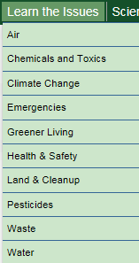
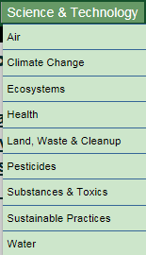
Organization of categories is unclear
❶
❷
Recommendation: Organize content primarily by topics and provide curated sections and paths to content for audience segments.
Notes:
The site segments topical content into categories for concerned citizens and scientific and technical use. However, this approach obscures topical categories which are hidden in the dropdown menus. Furthermore, visitors may not understand how the two categories, Learn the Issues ❶ and Science & Technology ❷, differ. Visitors who want to “learn about an issue” expect to find “scientific” descriptions and explanations. When they compare the menus for these categories, they find subcategory links which are nearly identical.
This organizational scheme requires visitors to waste time clicking through to several different pages to determine which links lead to content of interest, and also risks visitors missing relevant content which has been grouped in the other category.
Additionally, some links in Learn the Issues lead to sections which may have more technical content. The confusion of categories and subcategories increases the effort visitors must make to find content of interest.

Slide 23
Visitors struggle to find information while navigating the site, while others do not navigate the site, but access information through a direct link from a search engine.
August 31, 2015 – June 15, 2016
Navigation
Common Theme
Difficulty finding information navigating site
“I had to navigate through various links before I could get the information I needed.” (SAT 78, 03/24/2016)
“The site is not easily navigated if you are looking for any sort of real information” (SAT 11, 01/15/2016)
Did not navigate site, used direct link
“I didn't have difficulty - I didn't navigate. I found the sources from Google Scholar and searched for them directly by title on Google.” (SAT 63, 05/08/2016)
“I didn't need to navigate because I was taken to the information needed by a link from search engine on the internet.” (SAT 70, 02/19/2016)
Notes:
Additional Comments:
“Ugh -- this site was difficult to navigate and didn't provide any simple explanation” (SAT 0, 10/02/2015)
“Lots of text, too much information to properly navigate. No clear answer to my question.” (SAT 15, 12/23/2015)
“I didn't have to navigate. I used a link provided in a newspaper” (SAT 30, 02/24/2016)

Slide 24
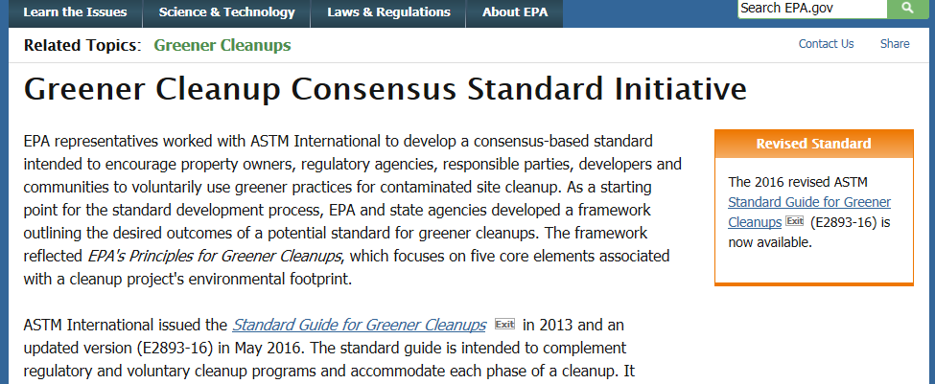
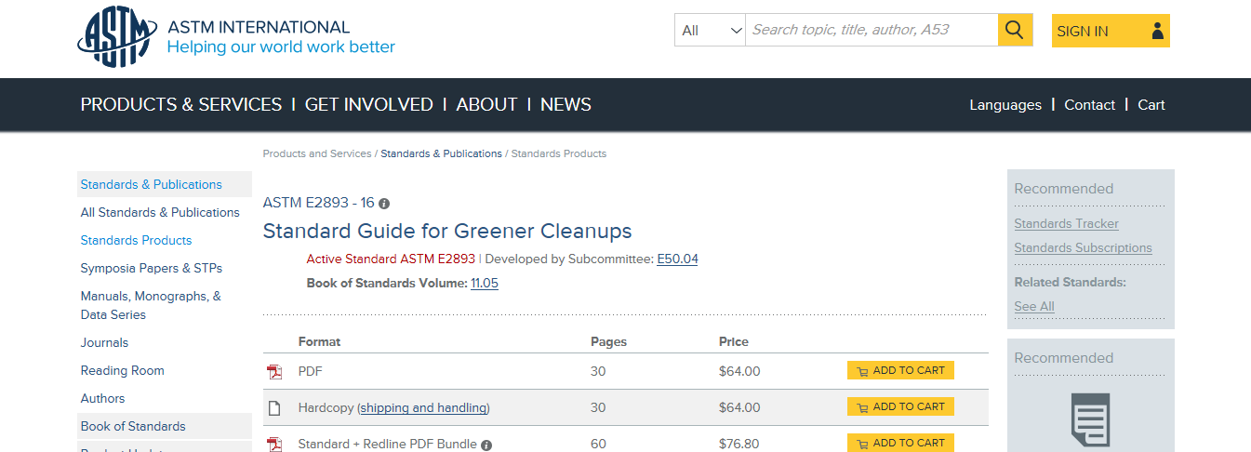
Link labels to the same content confuse visitors
Recommendation: Ensure multiple links to common destinations use common labels.
Notes:
On this page, text in the centerwell appears to link to the original 2013 version of the Standard Guide for Greener Cleanups while the highlighted link in the right column seems to link to the most recent revision. However, both links load the same page, potentially confusing visitors and causing them to waste time clicking on various links.

Slide 25
Key Findings, Recommendations & Next Steps

Slide 26
Summary of Key Findings
Improvements to Information Browsing, Site Information, and Navigation will have the biggest impact on EPA’s satisfaction and desired outcomes.
Information Browsing
Visitors using the basic search are the least satisfied group.
Including significant keywords in page headings, copy, and metadata tags will improve Search’s ability to retrieve relevant results.
Site Information
Visitors suggest that site content should be further organized, or categorized, and updated more often.
Nearly one-fifth of visitors struggle to find water and air related information.
Exposing the topical categories on the homepage and in the global navigation will help visitors find content.

Slide 27
Summary of Key Findings, Continued
Navigation
Visitors struggle to find information while navigating the site.
Other visitors access information directly from a search engine.
Accurate navigation menus and breadcrumb trails aid navigation and provide orientation cues for all visitors.
Visitor Groups
Concerned citizen or consumer visitors are the least satisfied group with the lowest task accomplishment.
Over half of the concerned citizen or consumer visitor group are first time visitors.
Students and educators have the highest accomplishment rates and satisfaction.
Explicit paths for audiences such as concerned citizens, educators, researchers and businesses may help visitors navigate to content of interest.

Slide 28
Recommendations
Address Search’s ability to narrow results and return relevant, updated information.
Provide meaningful keywords in page headings, content and metadata tags.
Provide useful descriptions for Search results.
Address site information issues by updating content regularly.
Provide access to critical content and current issues in the homepage centerwell.
Ensure copy presents the most important content or main point before supporting details.

Slide 29
Recommendations, Continued
Audit the content on the site and ensure it is properly categorized based on users expectations (i.e. Consumers vs. Non-consumers/Business).
Consider organizing content topically while providing explicit paths for audience segments.
Address site navigation issues, specifically the site’s organizational layout to help visitors find the information they are looking for.
Avoid jargon and abbreviations in labels and content.
Ensure navigation menus reflect the hierarchy of the entire section.
Indicate the location of the current page in the menu.
Provide common labels for links that lead to common destinations.

Slide 30
Next Steps
Review Questionnaire
Discuss next Satisfaction Insight Review timeframe
Automated Reporting
Portal Access & Training
Notes:
Review Questionnaire
Review custom questions to ensure they are up to date with OneEPA goals.
Discuss next Satisfaction Insight Review timeframe
An SIR is a deep dive review of the ForeSee data that focuses on a specific topic or audience segment. The SIR findings are presented in a one-hour WebEx presentation.
Automated Reporting
EPA currently receives monthly automated reports that include model data, custom question data, trend lines, open ends and benchmarks. There is no limit to the number of people that can receive these reports. Please let our team know if you would like to be added to the monthly reports.
Portal Access & Training
All of the data ForeSee collects is stored in our data portal and EPA can have an unlimited number of users with login credentials for this portal. Please let our team know if you would like portal access and we will set you up with a username and password. In addition, we will provide training on how to use the portal.

Slide 31
Your ForeSee Team
Client Services Team
Survey design, code development, reporting, analysis and strategic planning
Andrea Rodriguez
Data Analyst
Andrea.Rodriguez@foresee.com
734-352-6213
Katie Bennett
Client Manager
Katherine.Bennett@foresee.com
734-205-2634
Susan Lindstrom
Usability Analyst
Susan.Lindstrom@foresee.com
734-352-6402
Account Management Team
Contracts, negotiations, relationship management, and strategic planning
Phil Pegher
Enterprise Account Manager
Phil.Pegher@foresee.com
734-352-6378

