Slide 1
Epa.gov
Satisfaction Insight Review
Discovery
Katie Phelps
Customer Experience Analyst
Report date range: March 1, 2014 – May 31, 2014
Presentation date: July 2014

Slide 2
Agenda
Agenda and Table of Contents
ForeSee Methodology
SIR Objectives
Capturing the Voice of Visitor
Aggregate Results
Key Finding
Recommendations
Next Steps

Slide 3
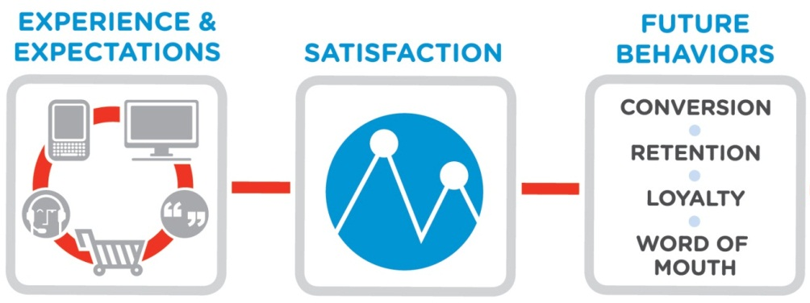
ForeSee Methodology
Measuring the Visitor Experience
  ForeSee applies proven science and technology to the measurement and analysis of the visitor experience through the lens of visitor satisfaction.
Analysis of the visitor experience will enable your organization to understand…
How are you doing?
What should you do?
Why should you do it?

Slide 4

Satisfaction Insight Reviews (SIR)
Discovery
Baseline
Overview
Multiple Site
Tracking Trending
Visitor Profile
Pre Post
AB Test
Pre-redesign
Multiple Measure
Cross Channel
This Discovery SIR offers a concentrated focus on a segment of visitors that is struggling with particular aspects of their website experience. Improvement opportunities are identified and recommendations are made to help guide enhancement efforts.

Slide 5
SIR Objectives
Measurement Objective
The objectives for the EPA site are as follows: to provide information that is current, useful, easy to use, to ensure that information and resources are accessible to all users (508 compliant) and to ensure and protect the privacy of children. As a result of visiting the site, ideally visitors should participate more in personal health and environmental protection, find credible information and encourage the industry and public to participate in environmental protection.
Today’s SIR Concentration
Review aggregate data. From a broad perspective, learn more about the visitor experience and how best to prioritize the areas that most greatly impact overall satisfaction with EPA.gov visitors.
Analyze the experiences of the visitors reporting that they have used the search feature on the site.

Slide 6
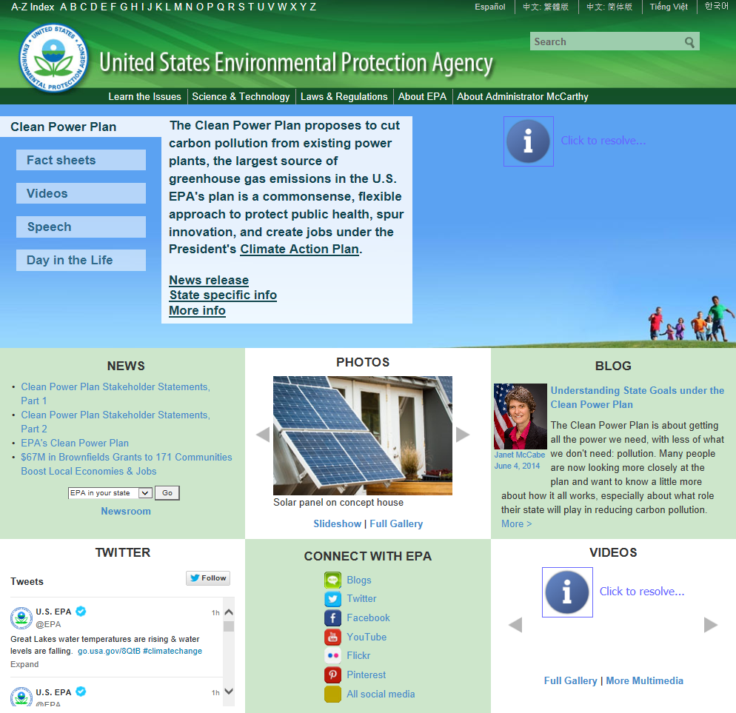
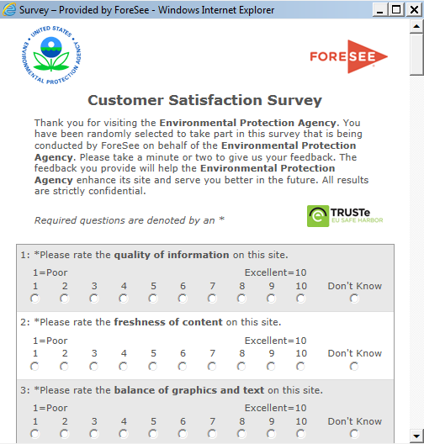
Capturing the Voice of Visitor
Vital Statistics
Start of Data Collection
December 1, 2011 (V4)
Original data collection began in
February 2007
Survey Placement: Browse
Reporting Period
March 1, 2014 – May 31, 2014
Surveys Completed: 1,898
Completion Percentage: 41.45%
Sampling Conditions
The survey invitation presents randomly to 10% of visitors who view 3 or more pages of your website. When visitors accept the invitation, the survey presents when they leave the site. A persistent cookie prevents visitors from seeing the invitation again for at least 90 days.

Slide 7
Aggregate Results
Satisfaction Summary
Satisfaction returned to previous levels in March 2014.
However, with an overall score of 68 in May, EPA.gov continues to underperform most of the averages of related groups of sites.
How is your site doing?
How does your site’s score compare with others?
Maximum
Average
Minimum
Where should you focus your efforts?
Why does improving satisfaction matter?
+2
-1
+2
+2
+2
+2
+1
+1
+1
+2
+2
+2
+3
+2
Satisfaction drives loyalty, retention and
word of mouth, which all drive website success.
C.I. +/-0.7 at 90% level of confidence
Differences shown occurred between the current (3/1/14 – 5/31/14) and previous reporting period (11/1/13-2/28/14).

Slide 8
Aggregate Results
Priority Area
Aggregate Results
Priority Area of Focus - Navigation
Navigation continues to be a top priority for visitors to EPA.gov.
With an overall score of 67 for May 2014, EPA.gov is currently underperforming the average navigation scores of similar sites. Within navigation, they struggle most with the number of clicks and how well the site layout helps.

Slide 9
Aggregate Results
Select Custom Questions Overview
Custom Question | Timeframe: March 1, 2014 – May 31, 2014 | Timeframe: November 1, 2013 – February 28, 2014
 | N: 2,128 │Sat: 69 | N: 3,007 │Sat: 67
Role | 24% = Business (Sat 66) ↑2 17% = Student (Sat 79) ↑3 14% = General public (Sat 64) ↑3 9% = Scientist (Sat 67) ↓1 | 24% = Business (Sat 64) 16% = Student (Sat 76) 15% = General public (Sat 61) 10% = Scientist (Sat 68)
Frequency | 24% = A couple of times a year (Sat 69) ↑1 23% = This is my first time (Sat 69) ↑3 22% = Monthly (Sat 70) ↑2 21% = Weekly (Sat 69) ↑2 | 24% = This is my first time (Sat 68) 23% = A couple of times a year (Sat 66) 23% = Monthly (Sat 68) 21% = Weekly (Sat 67)
Look For Info Multi-Select | 50% = Search box (Sat 66) ↑2 26% = Left navigation bar (Sat 65) 22% = Outside search engine (i.e., Google) (Sat 69) 14% = Advanced search (Sat 59) ↑2 12% = Other, please specify: (Sat 66) ↑2 | 56% = Search box (Sat 64) 25% = Left navigation bar (Sat 65) 17% = Advanced search (Sat 57) 14% = Other, please specify: (Sat 64) 12% = Did not use any of these tools (Sat 70)
Find | 58% = Yes (Sat 82) 28% = Partially (Sat 61) ↑2 14% = No (Sat 27) ↑1 | 55% = Yes (Sat 82) 29% = Partially (Sat 59) 15% = No (Sat 26)
Why Visit Multi-Select | 35% = Learn about an environmental issue (Sat 75) ↑3 29% = Other, please specify: (Sat 63) ↑3 20% = Find environmental info about my local area (Sat 66) ↓2 16% = Find out what EPA is doing about an issue (Sat 71) ↑1 | 34% = Learn about an environmental issue (Sat 72) 30% = Other, please specify: (Sat 60) 18% = Find environmental info about my local area (Sat 68) 16% = Find out what EPA is doing about an issue (Sat 70)
Reason for Visit | 20% = Water (Sat 66) 11% = Air (Sat 68) ↑1 11% = Other, please specify: (Sat 63) ↑6 | 21% = Water (Sat 66) 12% = Air (Sat 67) 11% = Other, please specify: (Sat 57)
NOTE: Not all answer choices and custom questions are included on this slide. A complete list can be found in the appendix.

Slide 10
Key Finding
Over half of respondents answer that they use one of the search features to find information on the site.
Of the various navigation methods, respondents using the search features score satisfaction lower than those using the other navigation methods resulting in a lower likelihood to return to the site, use it as a primary resource, recommend it to others or trust it.

Slide 11


Search Users
Relevant Group
4,341 Respondents
December 1, 2013 – May 31, 2014
Satisfaction 67
“How did you look for information on the site today?
(Please select all that apply.)”
Search Users*
Satisfaction 65
  58% / N: 2,528
Navigation Users**
Satisfaction 66
  53% / N: 2,291
Outside Search
Satisfaction 69
  11% / N: 459
Please note that question is multi-select, so respondents can choose as many answers as applicable.
*Search users include those answering “search box” and “advanced search”.
** Navigation users include those answering “left navigation bar”, “other”, “A-Z index”, and “did not use any of these tools”.

Slide 12
Search Users
Satisfaction Summaries
Search users were less satisfied than navigation users and less likely to return to the site, use it as a primary resource and recommend it. They were, however, more likely to participate with the EPA in the future.
Search users
0
0
+1
-1
0
0
-1
-2
-1
+3
-1
-1
-1
0
C.I. +/-0.7 at 90% level of confidence
Navigation users
C.I. +/-0.7 at 90% level of confidence
Reporting Period: December 1, 2013 – May 31, 2014

Slide 13
Search Users
Priority Maps
Search users
Navigation, search and functionality are the top priorities for visitors, regardless of how they found information.
Within the top priorities, however, there were differences in ratings. How well the site layout helps you find and the usefulness of the website tools stood out as particular pain points amongst search users on EPA.gov.
Navigation users
Reporting Period: December 1, 2013 – May 31, 2014

Slide 14
Search Users
Ability to Find
Whether or not they found what they needed on EPA.gov influenced satisfaction regardless of their method of looking for information.
Search users were less likely to be successful in finding what they needed on EPA.gov than navigation users. Nearly half of all search users were either only partially successful or unsuccessful in finding what they needed on the site.
“Did you find the information you were looking for today?”
Search users
-23
-55
Navigation
users
-23
-56
Reporting Period: December 1, 2013 – May 31, 2014

Slide 15
Search Users
Role
Roles in visiting the site varied by navigation method.
Search users had higher percentages of business representatives, scientists and educators. Navigation users had higher percentages of students and “other” roles. The biggest differences in satisfaction were between the members of the general public and those answering “other” as their role.
“For this visit to the EPA Web site, which of the following best describes you?”
63
62
77
56
62
75
65
66
73
66
75
63
+1
-6
-2
-1
-2
-3
Reporting Period: December 1, 2013 – May 31, 2014

Slide 16
Search Users
Reason for Visit
With the exception of “other”, both groups were the least satisfied when there to discover what their company has to do to comply.
In general, however, navigation users were more satisfied overall. The biggest differences in satisfaction between the two groups were between those there to find out what they can do about an environmental issue, “other”, to find out what the EPA is doing about an issue and to read EPA’s latest announcements.
“Why did you visit the EPA.gov site today? (Please check all that apply):”
72
73
57
59
64
65
68
70
76
75
70
71
62
61
74
72
71
75
-1
-2
-1
-2
-1
-1
+1
-2
-4
Reporting Period: December 1, 2013 – May 31, 2014

Slide 17
Search Users
Reason for Visit x Ability to Find
Search users struggle most when on the site for some “other” reason.
Over a quarter of this particular group of search users were unable to find what they needed on the site. Those there to find environmental information about their local areas and those there to discover what their companies have to do to comply with regulations also have higher percentages of unsuccessful visitors.
“Why did you visit the EPA.gov site today? (Please check all that apply):”
“Other” responses included looking for information regarding water (safety/quality, specific reports, tools), chemical research, copies of public reports, and details regarding specific regulations.
“Saw commercial on TV advertising site as source to identify safe drinking water” (Sat 11, 2/9/14)
“Looking for technical report on precipitation” (Sat 26, 3/17/14)
“Find details on a promogulated regulation.” (Sat 26, 3/13/14)
Reporting Period: December 1, 2013 – May 31, 2014

Slide 18
Search Users
Topic of Interest
The top five topics of interest were the same for both search users and navigation users.
There were several differences following the top five indicating that search users are looking for more specific detailed information than navigation users. Search users had visitors there looking for lead, mercury and metals information and had more interest in science & technology and pesticides. Navigation users had visitors on the site to find grants & contracts and showed more interest in climate change than the search users.
“Which of the following topics best describes the information you wanted today?”
Search users
Navigation users
22% = Water (Sat 63)
11% = Air (Sat 65)
10% = Other (Sat 53)
9% = Waste (Sat 68)
9% = Chemicals (Sat 64)
6% = Laws & Regulations (Sat 68)
4% = Science & Technology (Sat 72)
4% = Pesticides (Sat 61)
3% = Climate change (Sat 70)
3% = Lead, mercury, metals (Sat 61)
20% = Water (Sat 64)
12% = Air (Sat 65)
11% = Other (Sat 58)
7% = Waste (Sat 66)
7% = Chemicals (Sat 68)
6% = Laws & Regulations (Sat 64)
5% = Climate change (Sat 78)
4% = Science & Technology (Sat 72)
3% = Grants & contracts (Sat 67)
3% = Pesticides (Sat 61)
Reporting Period: December 1, 2013 – May 31, 2014

Slide 19
Search Users
Topic of Interest x Ability to Find
Search users struggle with certain topics more than others.
In addition to “other”, search users on the site for pesticides, water and lead, mercury and metals had higher percentages of unsuccessful visitors than those there for other topics.
“Which of the following topics best describes the information you wanted today?”
“Other” responses included requests for very specific information, including contact information for EPA locations and employees, reports and various data:
“EPA staff contact info” (Sat 0, 4/18/14)
“Actual chemical analysis for specific elements that could report as leachates.” (Sat 67, 5/23/14)
“the percentage of natural vs man made CO2” (Sat 0, 1/28/14)
Reporting Period: December 1, 2013 – May 31, 2014

Slide 20
Search Users
Topic of Interest x Reason for Visit
Looking at just the four topics with the lowest success rates, many search users reported that they were on the site to learn about an environmental issue.
Those interested in water also had higher percentages of visitors there to find environmental information about their local areas. Visitors on the site because they were interested in pesticides had higher percentages looking to find out what the EPA is doing about an issue, to discover what their company has to do to comply and to learn about EPA’s research efforts. Those interested in lead, mercury and metals have higher percentages there to do homework and to discover what their company has to do to comply.
“Why did you visit the EPA.gov site today? (Please check all that apply):”
Reporting Period: December 1, 2013 – May 31, 2014

Slide 21
Search Users
Search Experience
Nearly half of all search users reported some type of difficulty with the search tools.
The most frequently reported issues were that the features returned too many results and that they required too many refinements to get the information that they wanted. Satisfaction dropped anywhere from 27 to 53 points for search users that reported difficulties with the features.
“Which of the following best describes your experience with the Search Tools?”
81
52
-29
41
-40
51
-30
54
-27
36
-45
28
-53
Reporting Period: December 1, 2013 – May 31, 2014

Slide 22
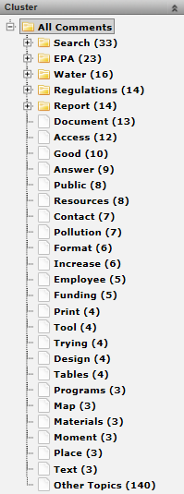
Search Users
Voice of the Visitor – One Improvement
“If you could make one improvement to EPA.gov, what would it be?”
Open ended feedback from search users further emphasizes their difficulty finding specific details on the site.
Key words like regulations, report, document, resources, tool, programs, map and materials often appeared in their suggestions for one improvement to be made to the site. Themes appearing throughout their suggestions included:
Providing more specific, relevant search results
Providing functionality that helps narrows results
Better tools to help them get and understand specifics.
The next several slides look at these comments in more detail and provide examples from the site for review.
Reporting Period: December 1, 2013 – May 31, 2014

Slide 23
Search Users
Voice of the Visitor – Finding Specifics
Search users tend to be looking for specific, detailed information on EPA.gov. Their comments suggest that they are struggling in using the site’s search feature to do so. Complaints are mainly regarding the search feature not providing results relevant to their searches and also the number of results, many of which are often irrelevant.
“If you could make one improvement to EPA.gov, what would it be?”
Search User Comments | Satisfaction | Date
“better search capability for compliance, may be have direct link to NEPA wordage” | Sat 12 | 2/28/14
“simplify searching for specific information” | Sat 0 | 5/17/14
“Make the document search easier. Publications were not easily located. Although a narrowed search was requested, all documents kept returning - not just those with the subject matter/title that I needed or requested.” | Sat 37 | 4/16/14
“I feel like the website is designed for the lowest common denominator. So much is trumpeted from general to specific, there is almost no help of finding detailed information. the internal search engine is terrible - no selectivity at all. Google allowed me to jump most of the website but i still didn't get what i really wanted.” | Sat 19 | 4/15/14
“It took long to get the results needed. It was not user friendly.” | Sat 56 | 5/29/14
“Your EPA site said the following: A single free printed copy of ASTM E 2121-09 is available from EPA upon request. Use EPA’s document number (402-K-07-007) when ordering from the National Service Center for Environmental Publications. Search brought up 1300 results not even close top the document I was looking for. No, I didn't search through 1300 records. Never found what I wanted” | Sat 0 | 3/11/14
“The search function was useless for my purposes and unable to return results for company violations” | Sat 0 | 2/10/14
“the search results were vague and often unrelated” | Sat 37 | 1/22/14
“Improve your search engine so it gives appropriate results.” | Sat 22 | 4/16/14
Reporting Period: December 1, 2013 – May 31, 2014

Slide 24
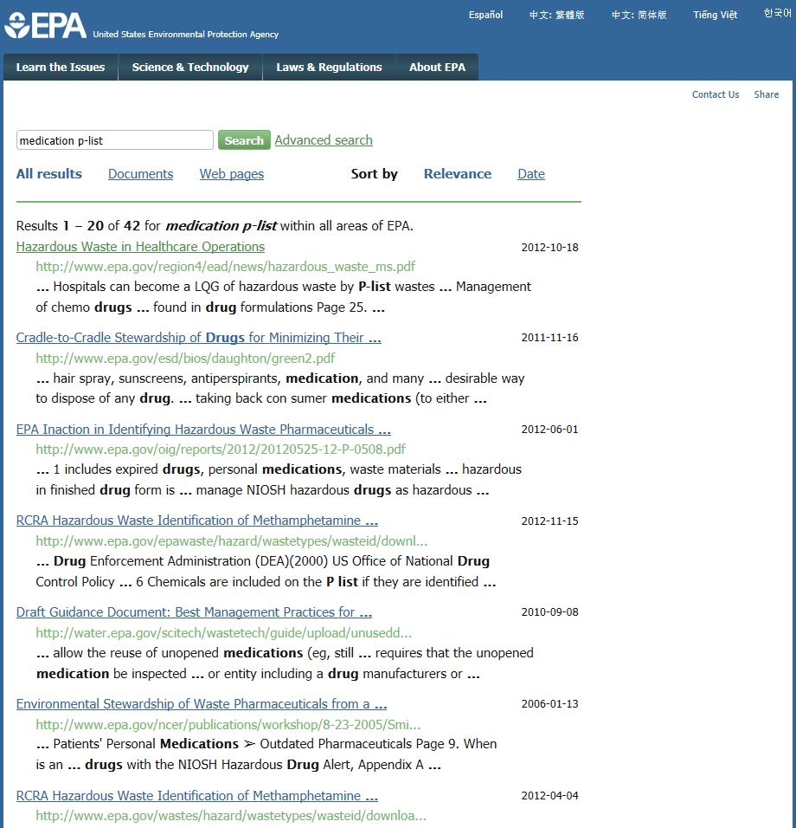
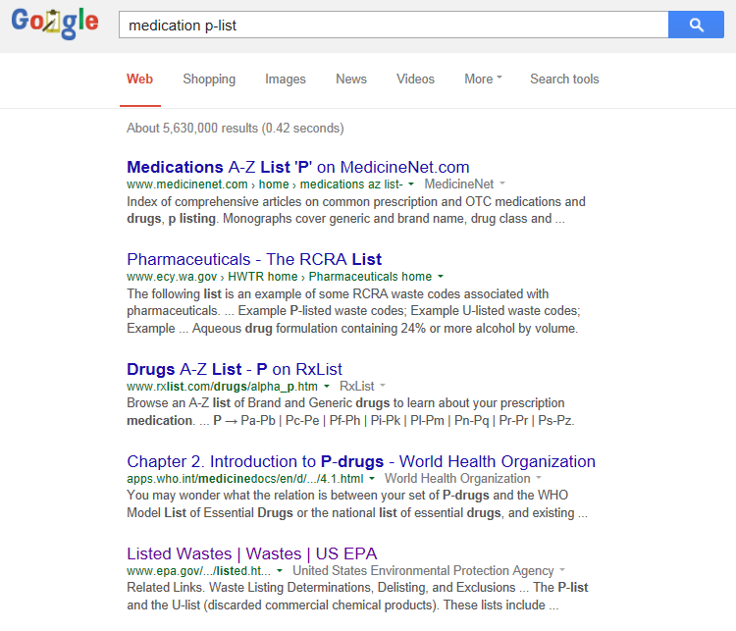
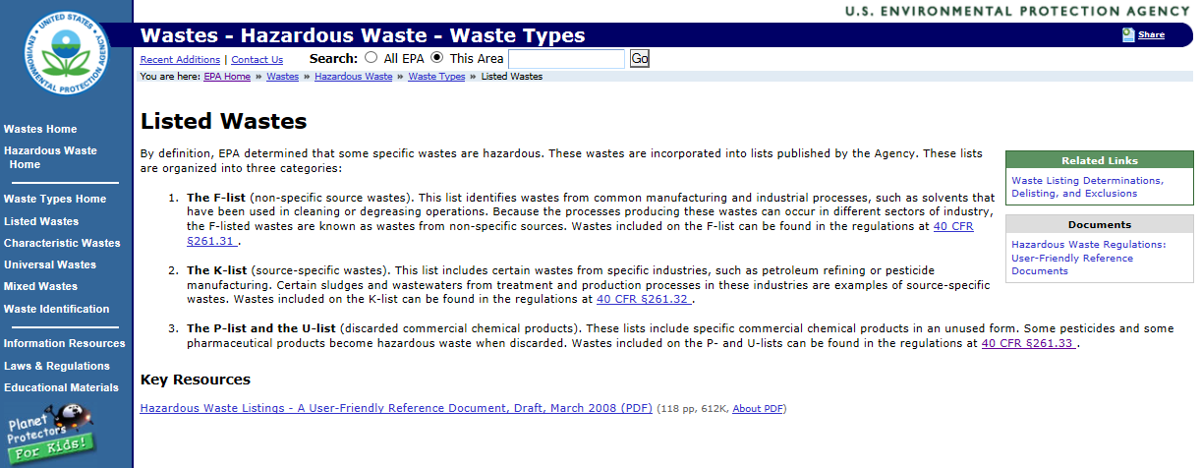
Search Users
Example – Finding Specifics
“If you could make one improvement to EPA.gov, what would it be?”
Entering “medication p-list” into the EPA.gov search (1) engine as this respondent reportedly did returns 42 results in no particular order.
1
“use google search. streamline site”
(Sat 4, 5/14/14)
3
The fifth result on the Google results page (2) is a link to EPA.gov providing a basic overview of the list with a link to the regulation itself (3).
2

Slide 25
Search Users
Voice of the Visitor – Additional Functionality
Additionally, search users request functionality to make the search feature more useful to them. Specifically, they would like to be able to search within date ranges and by document type. They also suggested improvements to the way in which results are displayed. For example, improving the relevancy sorting so that the original document requested appears before the commentary on it.
“If you could make one improvement to EPA.gov, what would it be?”
Search User Comments | Satisfaction | Date
“Would like to enter more than one phrase with "exact" wording. Too few "exact" words in my search returned too many documents. Too many "exact" words returned too few.” | Sat 33 | 5/26/14
“Be able to get data sets from EPA like you can from US Census-- determine your search criteria and the data you want and be able to get files with those data elements.” | Sat 19 | 4/21/14
“When searching for a specific method or regulation, don't give met the results in reverse chronology because I get the little changes and specific applications first and have to go back in time to find what I'm actually looking for, which is the original method or regulation for the big picture. There should be a way to get the original info first and then the modifications to it…The adaptations are too often presented first.” | Sat 41 | 5/13/14
“have an option to narrow searches to more specific items and time frames (specify that I am looking for a video, or a PDF within a specific date range.)” | Sat 96 | 5/1/14
“Make the document search easier. Publications were not easily located. Although a narrowed search was requested, all documents kept returning - not just those with the subject matter/title that I needed or requested.” | Sat 37 | 4/16/14
“Access to EPA's underlying database for customized Search & report generation.” | Sat 96 | 4/11/14
“I wish someone would develop a search engine based on narrowing choices”. | Sat 33 | 5/9/14
“Let me search superfund sites by address.” | Sat 33 | 5/5/14
Reporting Period: December 1, 2013 – May 31, 2014

Slide 26
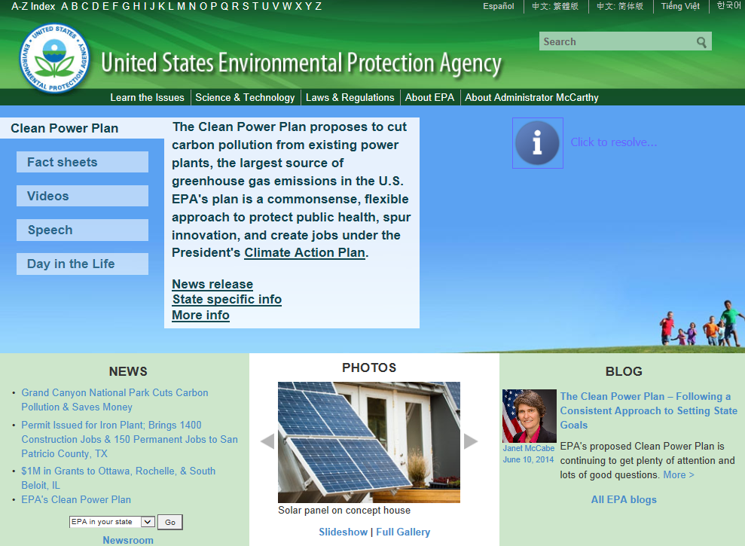
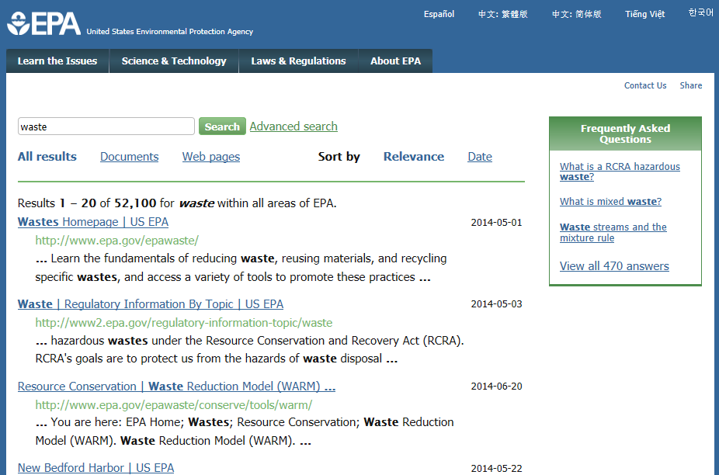
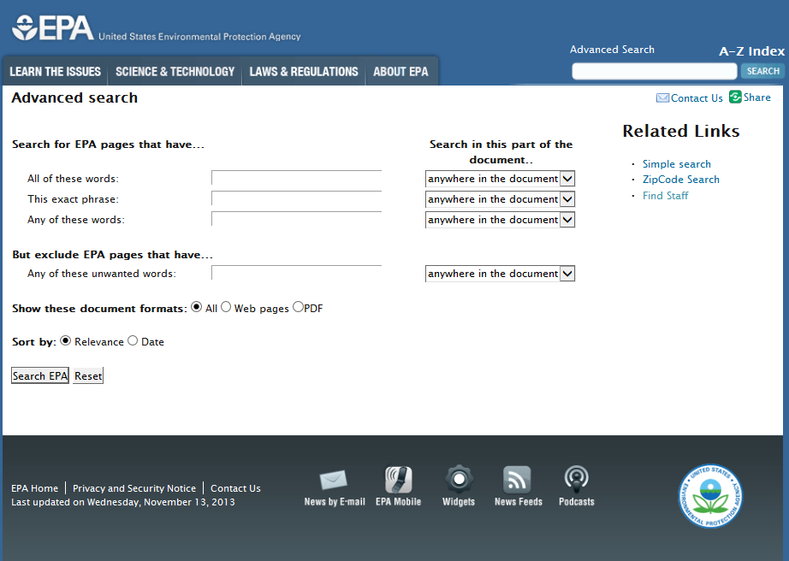
Search Users
Example – Additional Functionality
“If you could make one improvement to EPA.gov, what would it be?”
“have an option to narrow searches to more specific items and time frames (specify that I am looking for a video, or a PDF within a specific date range.)”
2
3
1
Search users often ask for more options to narrow results such as by date and type of document. The advanced search feature (1) contains additional tools like the ones that they mention, but there is no link to it on the home page (2). Visitors cannot access it until they try basic search first (3).

Slide 27
Search Users
Voice of the Visitor – Better Tools
Search users also suggest adding additional tools and organizing the available information differently to help them access details quickly. Requests included adding menu items on tool bars, creating thumbnails and general lists of what is available to them with regards to data sets. They want to be able to access a lot of very specific data quickly on the site.
“If you could make one improvement to EPA.gov, what would it be?”
Search User Comments | Satisfaction | Date
“An easier way to find the tables that define the standards for each class and water type :)” | Sat 63 | 5/27/14
“Make it easier to understand and see maps and what is wrong with water etc. and how to fix...” | Sat 44 | 4/19/14
“Clearly show how to access detailed reports on clean-up projects.” | Sat 38 | 5/25/14
“Have a menu item on the tool bar for adverse event reporting” | Sat 30 | 5/8/14
“Make thumbnails of documents available on site.” | Sat 67 | 5/23/14
“Make a general list of all the on-line document which can be downloaded, and link every file with key words stricktly dealing with the content” | Sat 60 | 4/24/14
“Have an easily accessible data base on the basics of pesticides and other contaminants including chemical characteristics, toxicity information, and related materials” | Sat 19 | 5/29/14
“Make access to historical and forecasted data easier to find and if it does not exist, would be good to add…” | Sat 89 | 5/21/14
“Make it easier to figure out how to access the entire data set, not just the most concerning pollutants.” | Sat 74 | 4/22/14
“Add all regulated SDWA systems to database with links to state sites for facilities that do not have detailed info in icis.” | Sat 44 | 4/12/14
Reporting Period: December 1, 2013 – May 31, 2014

Slide 28
Search Users
Benefit
Frequently Reported Issues:
More specific, relevant results
Improved functionality
More tools
58% search users
Satisfaction 65 Future Participation 53 Return 81 Primary Resource 72 Recommend 73 Trust 70
Focusing on helping them find more specific information should result in improved overall satisfaction.
Hypothetically, if you can convert 1% of those who do not able to download their trial to a purchase…
Satisfaction
65
70
58% search users
Future Participation 53 Return 81 Primary Resource 72 Recommend 73 Trust 70
58% search users
Future Participation +1 Return +3 Primary Resource +4 Recommend +4 Trust +3

Slide 29
Recommendations
Key Finding
Over half of respondents answer that they use one of the search features to find information on the site. Of the various navigation methods, respondents using the search features score satisfaction lower than those using the other navigation methods resulting in a lower likelihood to return to the site, use it as a primary resource, recommend it to others or trust it.
Recommendations
Focus on top priorities for search users, including navigation, search and functionality. Specifically, investigate ways in which to provide them with more specific and relevant information.
  Audit the basic search feature to ensure that it is returning a reasonable number of results that are relevant to the terms searched.
  Consider making the advanced search feature more accessible to visitors.
  Review the process of finding detailed reports, documents and tables on the site. Determine whether or not it would be useful to add additional features, like a separate search feature, a link on the homepage or lists of available reporting.
  Reconsider the organization of available data and reports. A different format or structure might help visitors find information faster.

Slide 30
Next Steps
Update Custom Questions
Revised the current questionnaire at the beginning of July.
Are there any additional questions or information that you would like from site visitors?
Set up automated segmented reports for monthly delivery
Possible segments include:
  Visitors using the search feature to find information on the site
Mobile Portal
Access an at-a-glance snapshot of your satisfaction, model scores and trendlines using a free iPhone / iPad or Android application. Download the iPhone/iPad app from the iTunes App Store or the Android app from Google Play.
Discuss next SIR timeframe
December 2014
Possible segments could include:
Visitors on the site for business
Visitors scoring navigation low

Slide 31
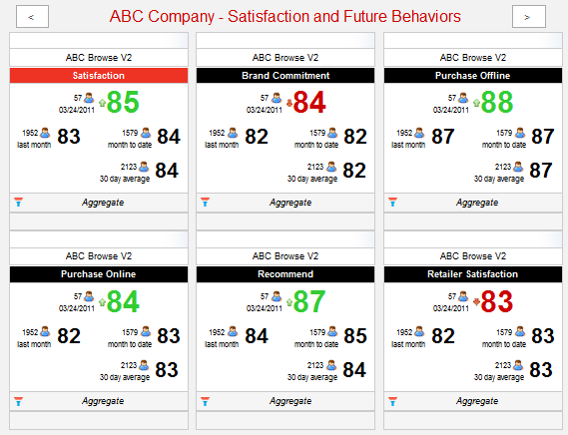
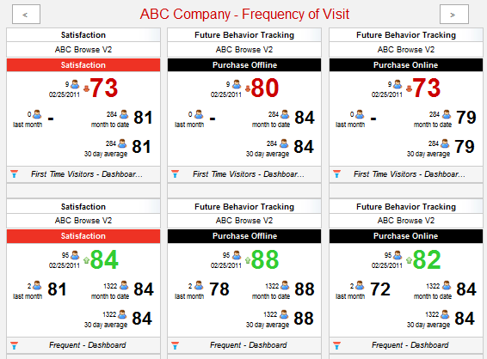
Advanced Analytics Portal
Summarize key measurement statistics in a single view with the Executive Dashboard
Compare Satisfaction data of two key segments or timeframes with the Filter or Date Comparison functionality
Calculate the impact of Satisfaction improvements on several key performance indicators (Traffic, Conversion, Avg. Transaction Value, Contact Center Deflection) with the Advanced Calculators
Manage on-demand reports and subscriptions with Reporting

Slide 32
Appendix

Slide 33
Appendix
Continuous Measurement – First Time Visitors
March 1, 2014 – May 31, 2014
Satisfaction Over Time
Percent of Visitors
Satisfaction Summary
Satisfaction drives loyalty, retention and word-of-mouth, which all drive website success.
C.I. +/-1.5 at 90% level of confidence

Slide 34
Appendix
Continuous Measurement – Repeat Visitors
March 1, 2014 – May 31, 2014
Satisfaction Over Time
Percent of Visitors
Satisfaction Summary
Satisfaction drives loyalty, retention and word-of-mouth, which all drive website success.
C.I. +/-0.8 at 90% level of confidence

Slide 35
Appendix
Social Media Value Definition and Score Calculation
Social Media Value Calculation
The purpose of the social media value calculation is to help companies better gauge the effectiveness of social media as an acquisition source for their website.
The calculation categorizes visitors based on three primary components:
Referring URL
Custom question response
Spend*
Capturing the acquisition source
To capture the acquisition source of respondents, one primary custom question is added to the survey. “Which of the following sources drove you to the site today? Please rank the top three.”
Index score and benchmark
Respondent scores are averaged to calculate the overall social media index
There are many acquisitions driving traffic to the clients website, social media is a part of that and should not be the entire traffic driver (meaning a score of 100 is very improbable)
Compare to other companies who are also measuring social media value
*Only for surveys colleting True Conversion

Slide 36
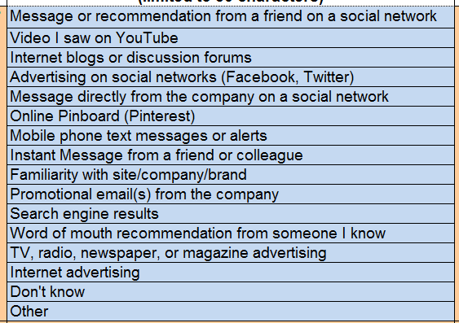
Appendix
Social Media Value Custom Question – Answer Choices
v
Social Media answer choices
are consistent and allow us to Benchmark Social Media Value on all participating surveys.
v
Non-Social Media answer choices can be personalized or changed and are not a part of the Benchmark.
v
Because the first ranking is required, there must be answer choices for those who don’t see another appropriate response.

Slide 37
Appendix
Social Media Value Reporting
March 1, 2014 – May 31, 2014
Social Media Index Score = 4.3 / N: 2128
ForeSee Benchmark: Social Media Index Score = 7 *
*Social Media Index benchmark is for May 2014 only.

Slide 38
Appendix
Social Media Value Reporting
March 1, 2014 – May 31, 2014
Satisfaction and Respondents

Slide 39
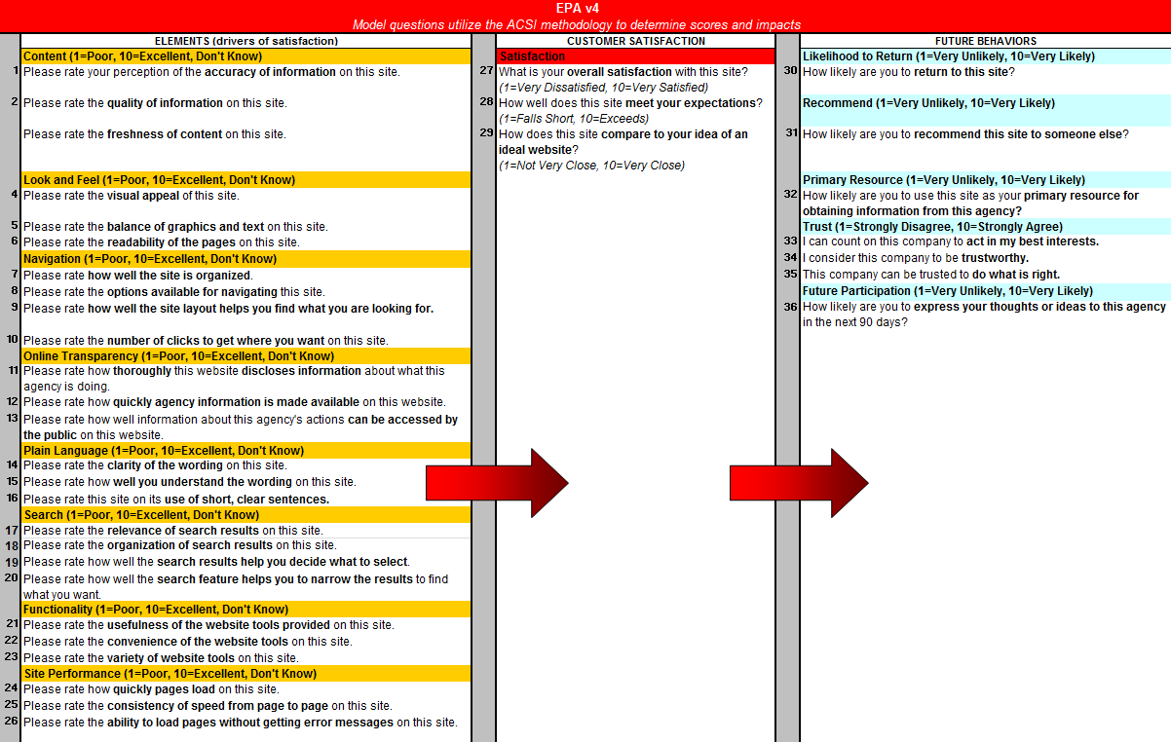
Appendix
Model Questions

Slide 40
Appendix
Custom Questions

Slide 41
Appendix
Custom Questions

Slide 42
Appendix
Custom Questions

Slide 43
Appendix
Custom Questions

Slide 44
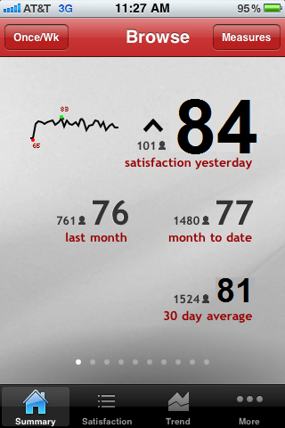
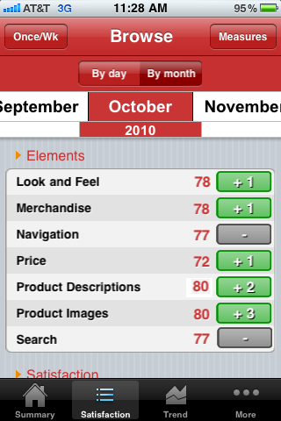
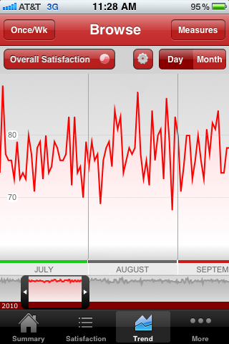
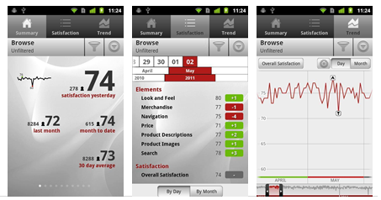
Appendix
Mobile Portal: Access your data on the move
Key Features
Access an at-a-glance snapshot of your Satisfaction, model scores and trend lines using a free iPhone / iPad or Android application.
Data updated nightly
Anytime, Anywhere Access
  Free Applications
  Supports iPhone 3,
  3GS & 4
  iOS 4
  Android 2.0 and up

Slide 45
Appendix
Benchmark Descriptions
Benchmarking Your Site’s Performance
Benchmarking provides a powerful context for your ForeSee scores.
To most efficiently use benchmarks:
  Monitor your performance on high-impact elements identified by your satisfaction research analyst. Your most important benchmark is set by your results.
  Compare ranking within your industry peer group to make sure that you are keeping up with your immediate competitors.
  Assess your score within the entire landscape of website satisfaction to see if you are ahead of the game. There may be lessons that can be learned from particularly high-scoring categories.
Who’s in the Benchmarks?
ForeSee Website Index:
  All companies and organizations measured by ForeSee.
  More than 500 clients with more than 850 measures.
Benchmark Specificity
Because ForeSee works with many different types of organizations throughout many different industries, we are able to offer over 180 categories of benchmarking to provide you with more comparability in benchmarking your scores.

Slide 46
Appendix
Benchmark Participants
Public

Slide 47
Appendix
Benchmark Participants
Federal Government

Slide 48
Appendix
Benchmark Participants
eGov

Slide 49
Appendix
Benchmark Participants
Regulatory
Agencies with Statistical Resources

Slide 50
Appendix
Glossary of ForeSee Terminology
The ForeSee ® CXASM Methodology: The ForeSee CXA methodology is an advanced statistical engine proven by years of research that measures the customer experience and utilizes cause-and-effect modeling to radically change the way that organizations make strategic investments and decisions for better bottom-line results. Backed by three decades of rigorous scientific research, ForeSee CXA methodology has a rich heritage of highly diagnostic performance measurements coupled with sensitive improvement prescriptions and powerful prognostic capabilities.
Custom Questions: Each Customer Satisfaction Survey includes two different types of questions: model questions and custom questions. Custom questions are unique to each survey and can take a variety of different forms, including radio buttons, drop-down menus, check boxes, and open-ended text. The custom question responses are not used to derive the results using the ForeSee CXA methodology; so custom question results are reported separately in the Online Reporting Facility. Custom questions provide an excellent opportunity for data segment analysis.
Elements: An element is a measure of the customer's experience with a defined and manageable property of a website (e.g., Look and Feel, Navigation, etc.). It is composed of several survey items that provide performance ratings about various aspects of the customer's experience with the website property being measured. The separate ratings are combined as part of the modeling process into a summary score reflecting the overall experience of the customer with the website property.
Random Sampling: We use a Sampling Percentage to determine the proportion of site visitors that will receive a survey invitation on your site. We try to attain a good balance between collecting enough information to provide you with in-depth analysis, while remaining unobtrusive to your site visitors.
Impact: Impact is the numeric representation of the cause-and-effect relationship between an element (e.g., Site Navigation) and customer satisfaction or customer satisfaction and a future behavior (e.g., Likelihood to Purchase). An impact represents the increase in customer satisfaction resulting from a 5-point increase in an element score. For example, if the impact of Site Navigation is 1.2, then a 5-point increase in Site Navigation’s score would lead to an increase in customer satisfaction by 1.2 points.
Loyalty Factor: The Loyalty Factor is a number that establishes how many pages with survey code a site visitor must visit before they are eligible to receive a survey. Loyalty Factors are utilized to ensure that respondents have experienced enough of a site before completing the Customer Satisfaction Survey.
Model Questions: In order to utilize the ForeSee CXA methodology to calculate Satisfaction and Future Behavior scores and impacts, ForeSee asks standard model questions. These model questions are targeted toward the key Elements (i.e., “main areas”) of the site that drive customer satisfaction (e.g., Functionality, Navigation, Product Browsing, etc.), Overall Satisfaction, and Future Behaviors such as Likelihood to Recommend or Likelihood to Purchase.
Future Behaviors: Future Behaviors are the things you want your customers to do more of as a result of visiting your website, such as recommend your site to others or complete a purchase. The cause-and-effect ForeSee CXA methodology enables us to quantify the impact that improving satisfaction with your site would have on increasing future behaviors such as site visitors’ likelihood to recommend your site.

Slide 51
Appendix
Understanding Impacts
Impact of Navigation on Customer Satisfaction
Y
The rate of change between an element and satisfaction is represented by an Impact. In simple terms, an impact can be understood as something like a slope of a line defining the relationship between two variables.
Y+1.5
1.5
Y
Customer Satisfaction
5-point change in Navigation = 1.5-point change in Satisfaction
5.0
X
X+5
X
Navigation

Slide 52
Your ForeSee Team
Client Services Team
Survey design, code development, reporting, analysis and strategic planning
  Katie Phelps
  Customer Experience Analyst
  Katie.Phelps@foresee.com
  (734) 352-6385
  Erica Noble
  Client Services Manager
  Erica.Noble@foresee.com
  (734) 327-3818
Account Management Team
Contracts, negotiations, relationship management, and strategic planning
  Howard Merkel
  Senior Federal Account Manager
  Howard.Merkel@foresee.com
  (734) 205-2562

