Slide 1
EPA.gov
Usability Audit Review
Search
Susan Lindstrom, Usability Auditor
July 2014

Slide 2
Agenda
Overview of Usability Audit Review
Specifications and Scope
Usability Compliance Rating
Top 10 Critical Usability Issues
Bottom Line

Slide 3
Overview of Usability Audit Review
The ForeSee Usability Audit Review (UAR) extends the value of ForeSee CXA methodology-based analysis of key drivers of satisfaction by uncovering usability concerns within the context of “voice of customer” data. Starting with specific elements or tasks diagnosed as “areas of focus” during the satisfaction analysis, the UAR provides a prescription for how to specifically address the most important usability concerns affecting your visitors.
Audit Scope The selection of a specific area of focus is based on analysis of website Satisfaction Scores and Impacts. Instead of conducting a usability audit of an entire site, a Usability Audit Review targets a specific scope, based on the scores and impacts. By focusing a UAR on a specific area, the implementation of recommendations in this report will be aligned with those changes that will result in the most positive impact on customer satisfaction.
Usability Compliance Rating
ForeSee compares specific areas of your site against usability best practices to uncover targeted improvement opportunities. The analysis is centered around the defined area of focus. This review includes a Usability Compliance Rating (UCR). The UCR is a score based on your site’s usability performance as gauged by the application of approximately 50 usability indicators.
Usability Indicators
The Foresee Usability Knowledge Base contains over 3000 usability indicators, a subset of which is applied to your site based on the area of focus. Each indicator measures a specific aspect of usability and was developed using the latest usability findings from both academic and professional research, as well as the collective intelligence gained from our analysis of hundreds of websites.
Top 10 Critical Usability Issues The largest part of the report, this section is a comprehensive analysis of your site’s ten most critical usability issues, including a description of each violation along with an explanation of the associated negative implications for your site visitors. ForeSee includes specific, actionable recommendations to address each of the violations, enabling you to improve specific aspects of your website to positively affect satisfaction and desired future behaviors.
Notes:
3

Slide 4
Usability Audit Review
Voice of customer data captured using the ForeSee CXA methodology is leveraged to determine the portion of the site that the Usability Audit Review will evaluate.

Slide 5
Usability Audit Review
UAR
Each ForeSee Usability Audit Review comprises two components; the Audit, which tests compliance against a set of usability best practices, followed by a detailed analysis of the audit data.

Slide 6
Usability Indicators
Individual Application
Pass/Fail Metric
Measures Specific Aspect of Usability
Proprietary to ForeSee
Website Analysis and External Research
Best Practice

Slide 7
How The Audit Works
Usability Violation
Localized Negative Implications
Tactical Recommendations

Slide 8
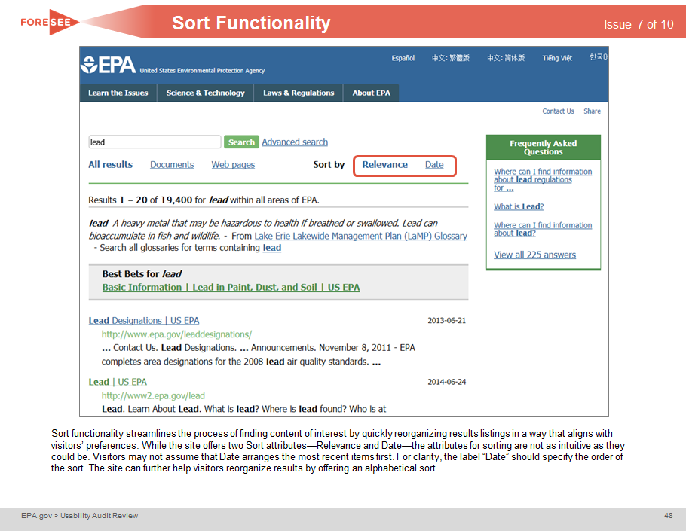
Deliverables

Slide 9
“There’s A Good Reason We Do It That Way”
History Behind Usability Violations
Independent Perspective
What Customers Want and Expect
Seamless and Intuitive Online Experience

Slide 10
Agenda
Overview of Usability Audit Review
Specifications and Scope
Usability Compliance Rating
Top 10 Critical Usability Issues
Bottom Line

Slide 11
Specifications
June - July 2014
1024 x 768
Iterative Evaluation

Slide 12
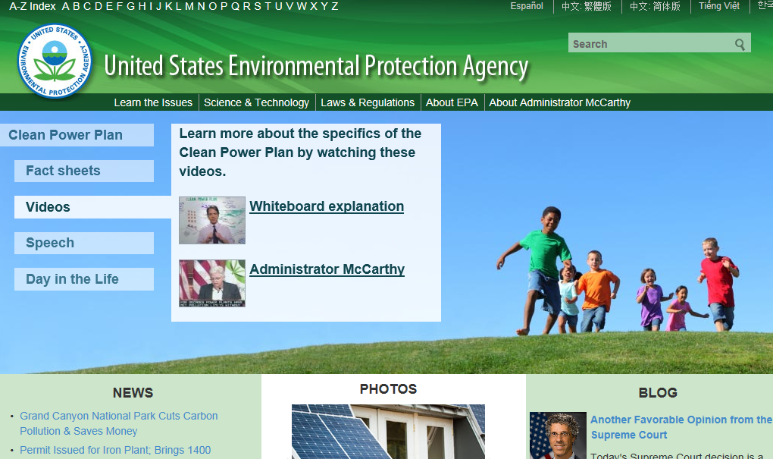
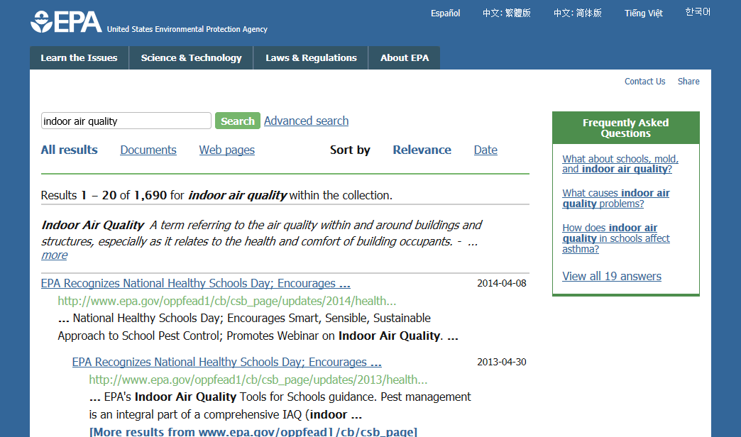
Search
Search functionality is assessed to gauge the effectiveness of searching content. The audit evaluates whether Search functionality provides visitors with the information, features, and functionalities necessary to home in on accurate and relevant information of interest. The audit also assesses the degree to which visitors are provided with implicit and explicit assistance during the search process.

Slide 13
Agenda
Overview of Usability Audit Review
Specifications and Scope
Usability Compliance Rating
Top 10 Critical Usability Issues
Bottom Line

Slide 14
How Search Measures Up
Number of Indicators Applied: 65
Number of Usability Violations: 25
Usability Compliance Rating
62%
The Usability Compliance Rating measures compliance with pass or fail metrics that are all weighted equally. The average rating across all Usability Audit Reviews conducted by ForeSee is approximately 55%, so this score is above that of other ForeSee clients. Keep in mind that each Usability Audit Review is focused on a specific area, so the compliance rating is not indicative of the usability of the site as a whole. This report exclusively outlines those instances of failure to comply with best practice; instances where EPA.gov exhibits strong usability are not the focus.
Notes:
14

Slide 15
Agenda
Overview of Usability Audit Review
Specifications and Scope
Usability Compliance Rating
Top 10 Critical Usability Issues
Bottom Line

Slide 16
Top 10 Critical Usability Issues
Search Scope Misspellings Synonyms Multi-Word Queries Input Protocol Descriptions Sort Functionality Refine Functionality Adequate Linkage Better Search Suggestions

Slide 17
Search Scope

Slide 18
Search Scope
Issue 1 of 10
While Search on EPA.gov’s homepage and top-level category pages returns results for all areas of EPA, visitors can easily reach pages within the site where search may be limited to the current area. This functionality provides a way for visitors to narrow their searches. However, the option to limit the scope to the current section only is preselected—and this risks that visitors may overlook the scope selection and receive a smaller results set missing out on content of interest that is elsewhere within EPA.gov . To prevent this, the scope of Search on all pages must default to the entire site.
Notes:
18

Slide 19
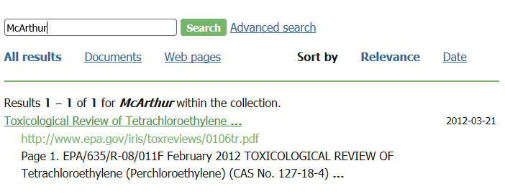
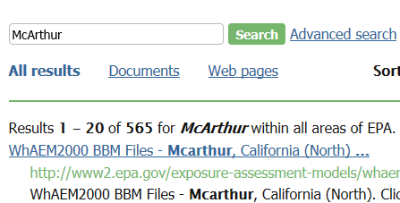
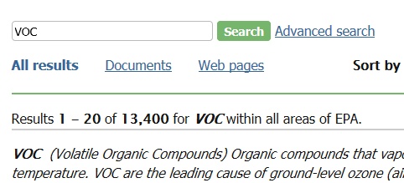
Search Scope
Issue 1 of 10
Next, Results pages do not adequately inform visitors of the scope of their search. The phrase “within the collection” is insufficient to notify visitors which section of EPA.gov was searched. This risks them not realizing that more results may be available elsewhere on the site. Instead, the page must clearly define which section of the site was searched.
Notes:
19

Slide 20
Search Scope
Issue 1 of 10
❶
❷
This site allows visitors to search within specific areas of the site, but defaults to the entire site to prevent visitors accidentally searching a smaller collection❶. The scope of the search is clearly stated in the dropdown list ❷.
Notes:
20

Slide 21
Search Scope
Issue 1 of 10
Recommendation
Ensure Search, on all pages, defaults to the entire site.
Ensure Results pages clearly indicate the area of the site which was searched.

Slide 22
Misspellings

Slide 23
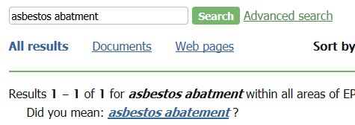
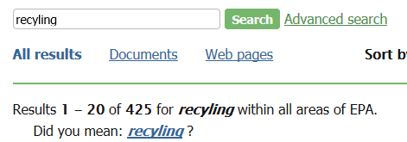
Misspellings
Issue 2 of 10
❶
❷
❸
❹
It is critical that Search functionality be consistently tolerant of its visitors shortcomings in order to return search results for their queries. When Search is unforgiving in the area of misspelled search terms, visitors may miss out on locating content of interest. For instance, when visitors search for “asbestos abatement", they receive 3470 hits❶; however, when they misspell the word and enter “asbestos abatment", the site returns only 1 result ❷ . Similarly, visitors’ search for “recycling” yields 16,100 results❸, but the site returns only 425 results when visitors misspell the term and enter “recyling” ❹. EPA.gov must ensure that it does not place an undue burden on its visitors by being exacting rather than flexible in helping them find content.
Notes:
23

Slide 24
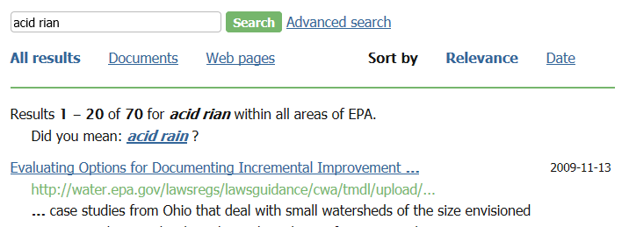
Misspellings
Issue 2 of 10
The site seeks to help visitors who have misspelled their search term by offering Did You Mean? links to the corrected search term. However, this approach places an unnecessary burden on visitors, requiring them to recognize the error and click through to the corrected results. Instead the site should automatically display results for the corrected term on Results pages with messaging letting visitors know this has occurred, and without the extraneous Did You Mean? link.
Notes:
24

Slide 25
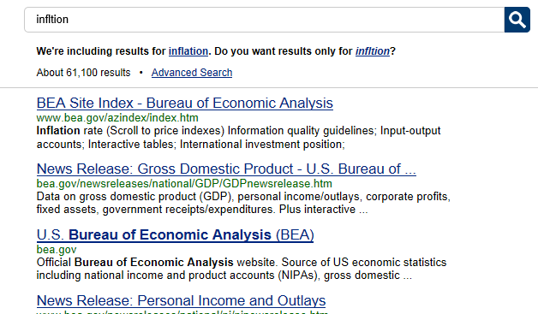
Misspellings
Issue 2 of 10
❶
❷
The site shown above exhibits the best practice of autocorrecting misspelled terms and informing visitors. As the messaging indicates, when visitors search for “infltion” ❶, the site recognizes this error and correctly returns results for “inflation” ❷. Returning results for the correct phrase saves visitors the effort of figuring out what is wrong with the query they entered, reducing the cognitive load of searching.
Notes:
25

Slide 26
Misspellings
Issue 2 of 10
❶
❷
❸
Additionally, the site can help visitors avoid misspellings through the effective implementation of Autocomplete functionality. While EPA.gov provides it—a usability best practice—the execution could be improved. Although the functionality is present on most pages of the site, it is absent from the Homepage ❶, the Results pages❷ and the No Results pages❸. Thus visitors who initiate their search on the Homepage, or who need to modify their search terms during a search session, are denied the valuable assistance provided by Autocomplete.
Notes:
26

Slide 27
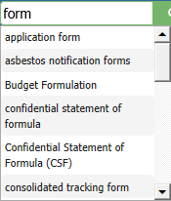
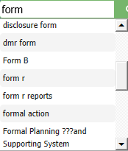
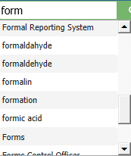
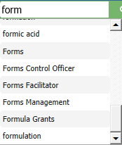
Misspellings
Issue 2 of 10
❹
❷
❶
❸
Furthermore, Autocomplete provides some suggestions which are duplicative ❶, incorrectly spelled ❷, or unclear❸. These erroneous suggestions inflate the list which provides so many options that visitors are likely to be overwhelmed. This defeats the purpose of the functionality in helping visitors to easily narrow down the search term to use. Also the presentation of the suggestions in a frame is problematic because visitors are forced to contend with an interior scrollbar ❹ which necessitates unwieldy maneuvering yet only allows them to view a small portion of the list at once. The site should provide a maximum of 7-10 Autocomplete suggestions in an unrestricted dropdown list.
Notes:
27

Slide 28
Misspellings
Issue 2 of 10
Recommendation
Ensure Search functionality supports misspelled search keywords. Ensure Search automatically returns results for the corrected spelling of misspelled search terms, instead of providing a link. Include the misspelled term and messaging indicating results for the corrected term are being shown on Results pages. Offer a maximum of 7-10 Autocomplete suggestions; avoid the use of frames to display Autocomplete suggestions.

Slide 29
Synonyms

Slide 30
Synonyms
Issue 3 of 10
❶
❷
❸
❹
EPA.gov fails to return the same results when visitors use synonyms or alternative versions of the same phrase, depriving them access to information that may be relevant. For instance, those who enter “radon drinking water” receive 2,270 results❶, while those who input “radon potable water” receive 1,160 returns❷. In a second example, those who enter “clear air act” receive 21,200 results❸, while those who input “caa” receive 11,900 returns❹. For common synonyms related to the focus of the site, dynamically providing all related results, regardless of which term was entered, will enable visitors to access the same information regardless of which term they happen to use.
Notes:
30

Slide 31
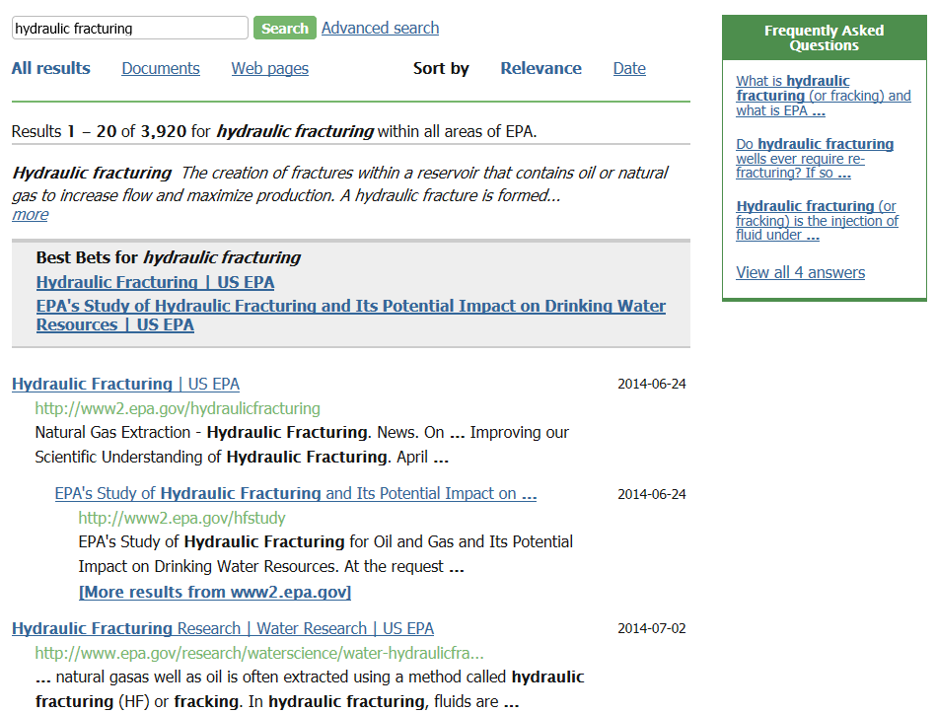
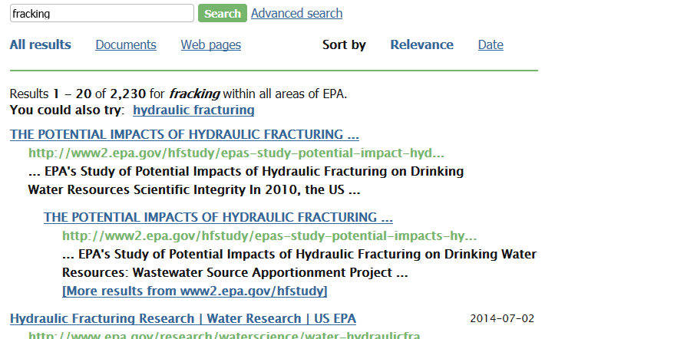
Synonyms
Issue 3 of 10
Likewise, Search does not provide the same experience for visitors using synonyms that are not phrase variants . As shown, visitors searching for “hydraulic fracturing” are provided with a Best Bets link as well as links to related content in Frequently Asked Questions, while visitors searching for “fracking” are not supplied with these features. These items ensure that visitors have access to content which is most likely to be helpful to them. Failing to provide them for searches on synonyms risks that some visitors will not locate useful content.
Notes:
31

Slide 32
Synonyms
Issue 3 of 10
Recommendation
Ensure Search responds flexibly and robustly to common synonyms.
Provide Best Bets and Frequently Asked Questions for all synonyms of treated terms.

Slide 33
Multi-Word Queries

Slide 34
Multi-Word Queries
Issue 4 of 10
❺
❶
❷
❹
❸
Search fails to consistently return identical results for multi-word queries regardless of the order of the keywords entered. For instance, if a visitor types “environment report” as their query, they receive 66,500 results❶, versus 51,100 results if they use the term “report environment” ❷. Additionally, a similar query, “report on the environment❸,” supplies a Frequently Asked Questions link ❹ which is relevant, but absent for the first two queries ❺.
Notes:
34

Slide 35
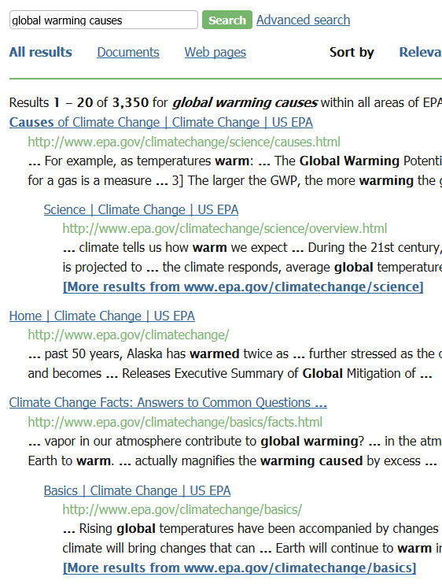
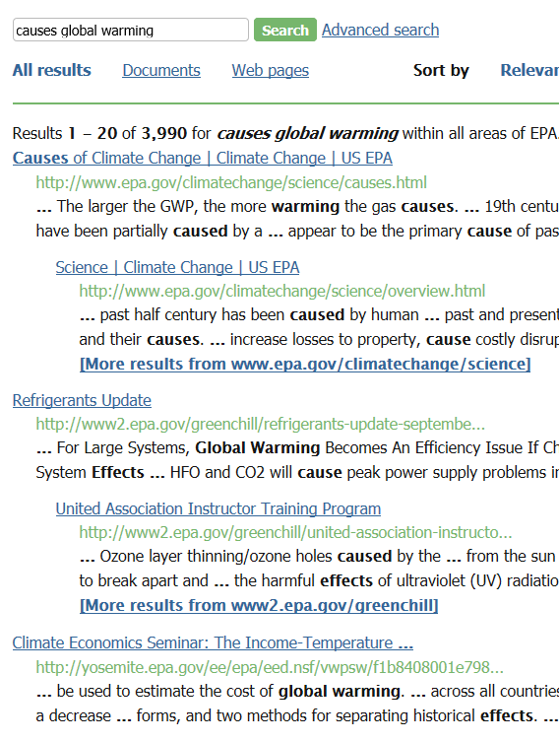
Multi-Word Queries
Issue 4 of 10
❶
❷
❸
In another example, the phrase “global warming causes” returns 3,350 results ❶ with the first five results linking to basic and introductory pages on the topic. The inverted phrase “causes global warming” receives 3,990 results ❷, and although the first two results guide visitors to overviews of the topic, subsequent results ❸ link to narrow topics of less relevance to the general query. Failing to provide a similar results set means some visitors may not locate the information they seek.
Notes:
35

Slide 36
Multi-Word Queries
Issue 4 of 10
Recommendation
Ensure Search responds flexibly and robustly to multi-word queries.

Slide 37
Input Protocol

Slide 38
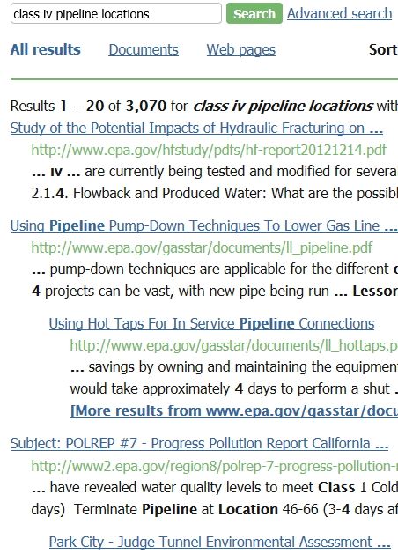
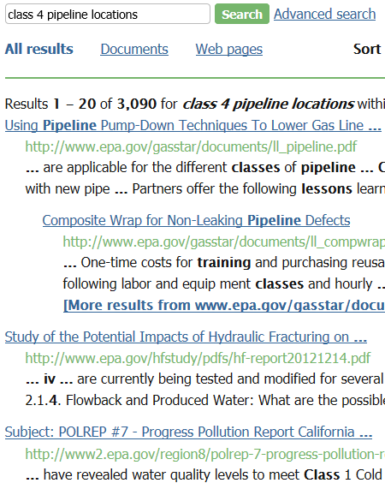
Input Protocol
Issue 5 of 10
Search fails to accommodate common variations in how numeric terms are entered; for instance, “class iv pipeline locations” returns approximately the same number of results as “class 4 pipeline locations” but the results are reordered and each term returns a reference among the top results which is not returned for the other term ❶ ❷. This risks visitors not finding relevant content as many view only the first three to five results.
Notes:
38

Slide 39
Input Protocol
Issue 5 of 10
❸
❶
❹
❷
Other similar searches, such as “Stage ii Disinfectants” and “Stage 2 Disinfectants” return approximately the same number or results ❶ ❷, however, the results for some variants lack the Frequently Asked Questions link ❸ ❹, which means that some visitors will miss this useful content. To ensure all relevant results are provided and visitors are able to locate the information they seek, variations between numerals should return the same number of results and in the same order. The same supplementary links, such as the Frequently Asked Questions, must be provided for all variants as well .
Notes:
39

Slide 40
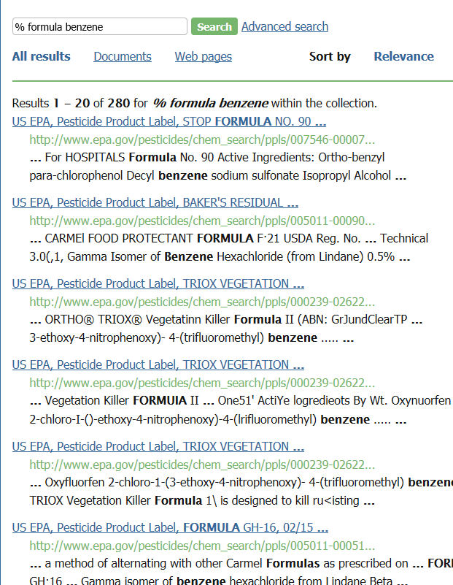
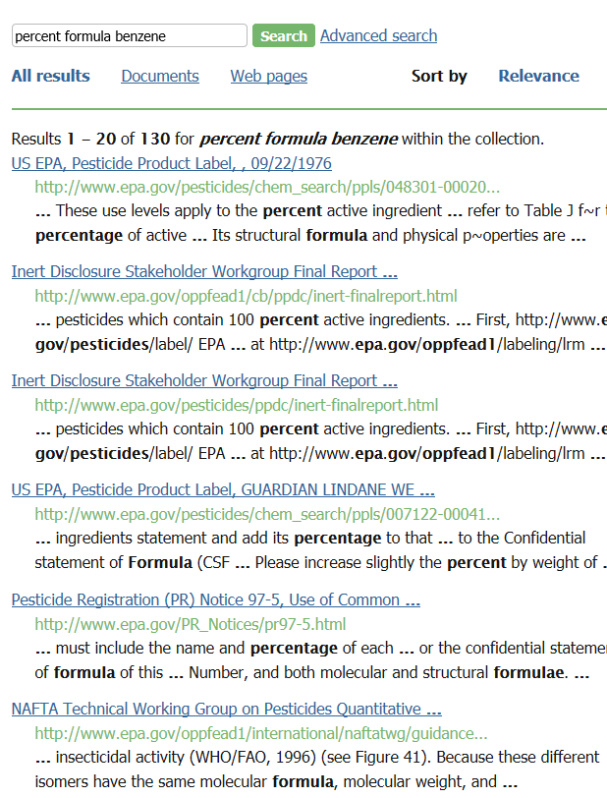
Input Protocol
Issue 5 of 10
Furthermore, the site does not consistently account for visitors using special characters in Search. For instance, the search phrases “% formula benzene” ❶ and “percent formula benzene” should return identical search sets, yet Search appears to ignore the % sign and returns different results for the two variations. This is the case for the special characters %, / and ‘. For instances where including a special character would match labeling and messaging used on the site, Search should be accommodating.
Notes:
40

Slide 41
Input Protocol
Issue 5 of 10
Recommendation
Ensure Search responds flexibly and robustly to variations in numerals, special characters, and punctuation.
Ensure supplemental links and features, such as glossary entries and Frequently Asked Questions are supplied for all keyword variants.

Slide 42
Descriptions

Slide 43
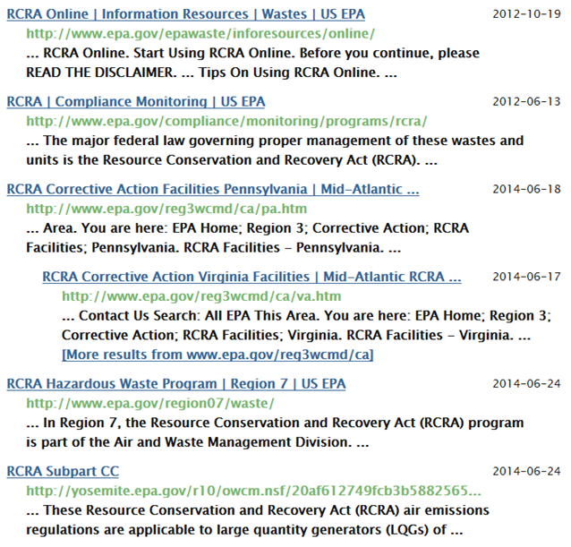
Descriptions
Issue 6 of 10
❶
❷
❸
The goal of the Results page is to accurately describe the underlying content to enable visitors to determine which results are relevant to their needs. To do this Search Results pages must provide useful titles and excerpts. However, excerpts are often unhelpful, failing to help visitors decide if the link will be of use to them. As shown above, they are often fragmented making them difficult to read and understand ❶. Other excerpts contain navigational elements rather than useful descriptions ❷ ❸. Without a helpful and descriptive introduction to each result, visitors must spend more time and effort clicking through to each result to find the answer they need.
Notes:
43

Slide 44
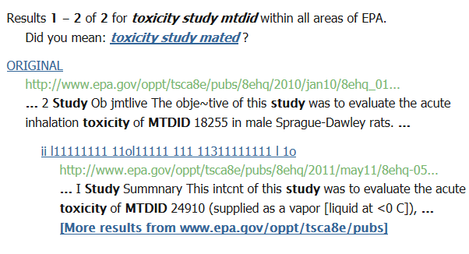
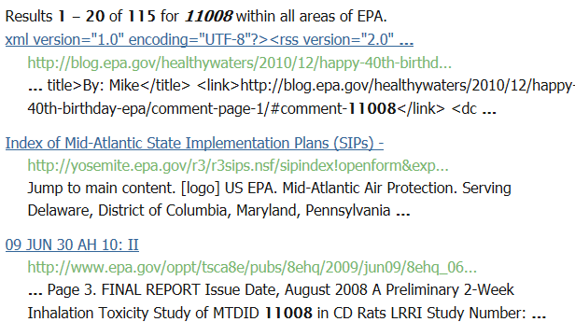
Descriptions
Issue 6 of 10
❶
❸
❹
❷
In addition, Search Results pages display poor usability by failing to consistently provide useful titles. Examples shown include non-descriptive text ❶ ❷ and codes ❸ ❹ that give no indication of what the link or document contains.
Notes:
44

Slide 45
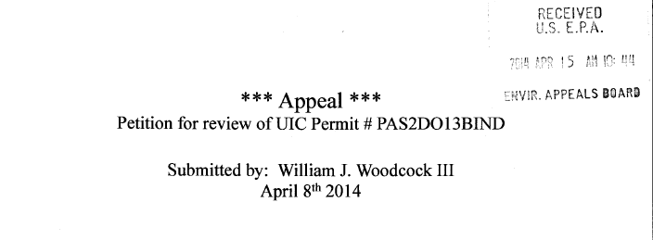
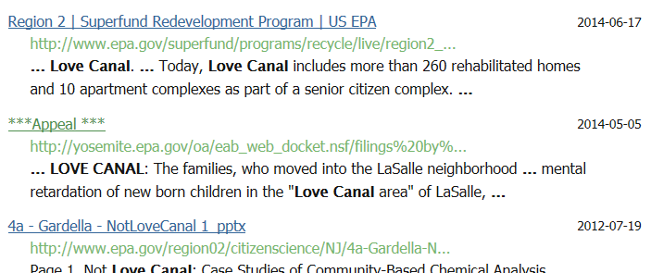
Descriptions
Issue 6 of 10
Finally, it is a best practice to ensure every page has a unique heading. Not only does this help to orient visitors as they move throughout the site, it also improves findability within the context of Search. Page headings are leveraged to provide descriptive titles for Search results. Frequently, documents on EPA.gov lack accurate or descriptive page headings. In this example, the first line of text on a document is given as the link title on the Search Results page even though it does not adequately indicate the contents of the document. In failing to supply accurate page headings for documents, the site deprives visitors of a means of easily differentiating between links on Results pages.
Notes:
45

Slide 46
Descriptions
Issue 6 of 10
Recommendation
Ensure result titles and descriptions are relevant and useful. Ensure all pages on the site have unique headings and leverage those as part of the abstract on Results pages.

Slide 47
Sort Functionality

Slide 48
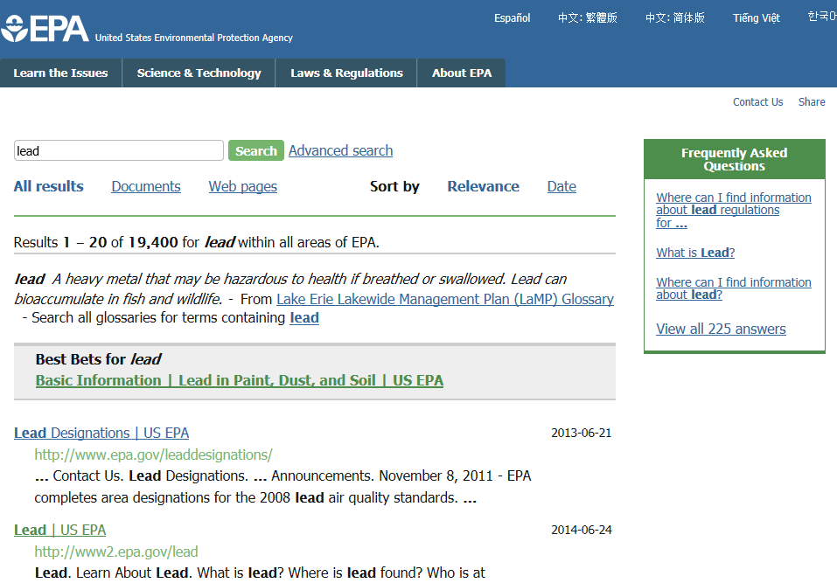
Sort Functionality
Issue 7 of 10
Sort functionality streamlines the process of finding content of interest by quickly reorganizing results listings in a way that aligns with visitors’ preferences. While the site offers two Sort attributes—Relevance and Date—the attributes for sorting are not as intuitive as they could be. Visitors may not assume that Date arranges the most recent items first. For clarity, the label “Date” should specify the order of the sort. The site can further help visitors reorganize results by offering an alphabetical sort.
Notes:
48

Slide 49
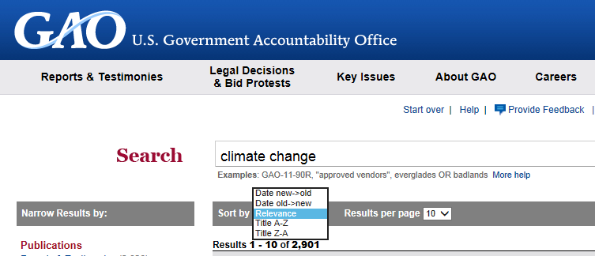
Sort Functionality
Issue 7 of 10
❶
❷
In this example, a site clearly indicates that results can be sorted from new to old, or old to new ❶. This site also offers ascending and descending alphabetical sort options which are unambiguously labeled A-Z and Z-A ❷.
Notes:
49

Slide 50
Sort Functionality
Issue 7 of 10
❶
❹
❷
❸
❺
Next, Sort Functionality fails to perform as expected. The purpose of Sort is to allow visitors to change the list order of the Search Results without removing results from the set. However, Sort occasionally reduces the number of results. Here a search for “water pollution” returns 19,300 results❶, but when the order is changed to Date❷, the results are reduced to 3,980 ❸. Furthermore, the criteria “within all areas of EPA” ❹ has changed to “within the collection.” ❺ This behavior is unexpected, disconcerting, and risks visitors not finding the content they are seeking. The site must ensure that Sort performs reliably without changing the scope or number of results.
Notes:
50

Slide 51
Sort Functionality
Issue 7 of 10
Recommendation
Provide unambiguous labels for sort options such as “Most Recent” or “New to Old”.
Add A-Z and Z-A alphabetical sort options for documents.
Ensure that Sort Functionality performs reliably without changing the scope or number of the results.

Slide 52
Refine Functionality

Slide 53
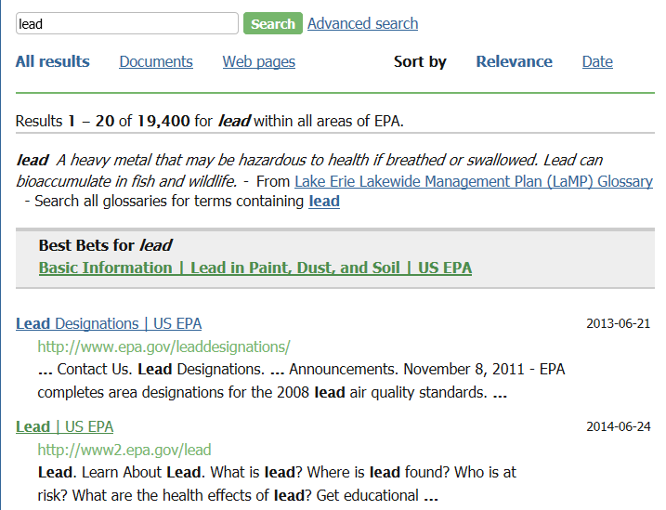
Refine Functionality
Issue 8 of 10
The site does not provide adequate Refine functionality in conjunction with Search. For example, visitors conducting a site search may want to limit results to a specific type of content, document type or topic. The site provides the same two Refine options of Documents and Web pages for all results sets, providing additional Refine attributes that are contextual to the current results set would allow visitors to narrow the set of results even further. Without sufficient Refine functionality, visitors are forced to either review a large number of results or conduct a new search with more specific terms in an attempt to answer their questions.
Notes:
53

Slide 54
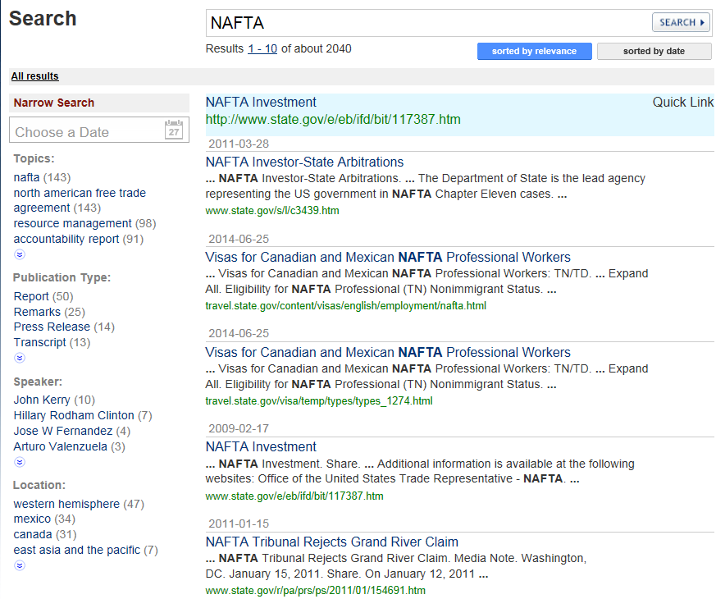
Refine Functionality
Issue 8 of 10
❶
❷
This site provides Refine attributes which are relevant to the current set of results ❶. EPA.gov can help visitors locate answers to their specific questions by enabling visitors to narrow results using similar attribute categories: Topics, Document Type, Speaker/Author, and Location. As shown, Refine attributes should display the number of items associated with each ❷, helping set visitors’ expectations as to the extent of the content contained there.
Notes:
54

Slide 55
Refine Functionality
Issue 8 of 10
❶
❷
❸
❹
Finally, Refine functionality fails to be easy and intuitive for visitors. Occasionally, applying Refine attributes yields unexpected results. As shown, a search for “indoor air quality” returns 7,300 results within all areas of EPA ❶. Applying the Documents attribute apparently changes the scope of the search to within the collection ❷. Changing the attribute selection to Web pages seems to reset the scope to all areas again ❸, but reselecting All results returns fewer results which are limited to within the collection ❹. This unexpected performance may cause visitors to lose confidence in the site and risks some visitors not finding the information they are seeking. Refine functionality must allow visitors to remove attributes and return to the full set of results.
Notes:
55

Slide 56
Refine Functionality
Issue 8 of 10
Recommendation
Provide a robust menu of contextual Refine attributes in the categories of Topics, Document Type, Author, and Location. Display the number of items associated with each Refine attribute. Ensure Refine Functionality performs reliably and permits the removal of attributes.

Slide 57
Adequate Linkage

Slide 58
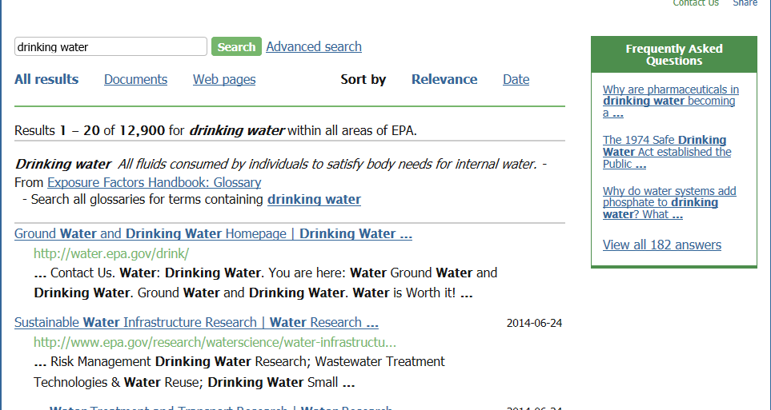
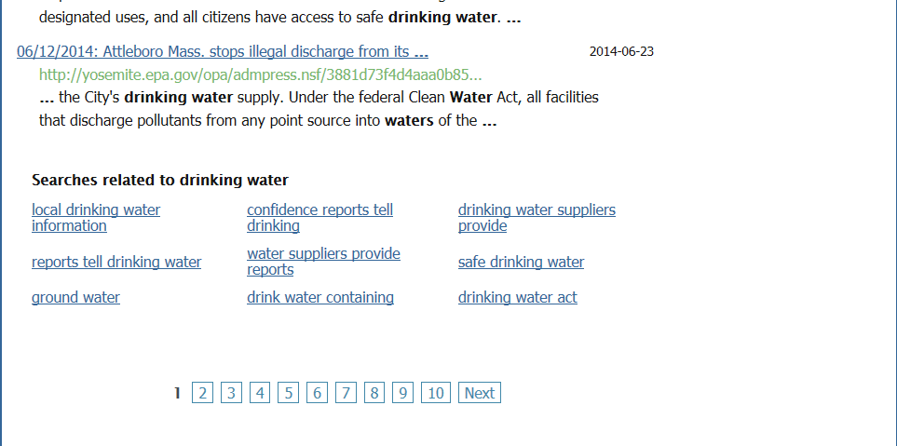
Adequate Linkage
Issue 9 of 10
❷
❶
EPA.gov shows good usability in providing links to related searches which guide visitors to more focused results sets ❶. The site can further assist visitors by also providing links to recent searches ❷. This feature enables visitors to retrieve results from previous searches without the hassle of having to remember search terms and enter them into a Search box.
Notes:
58

Slide 59
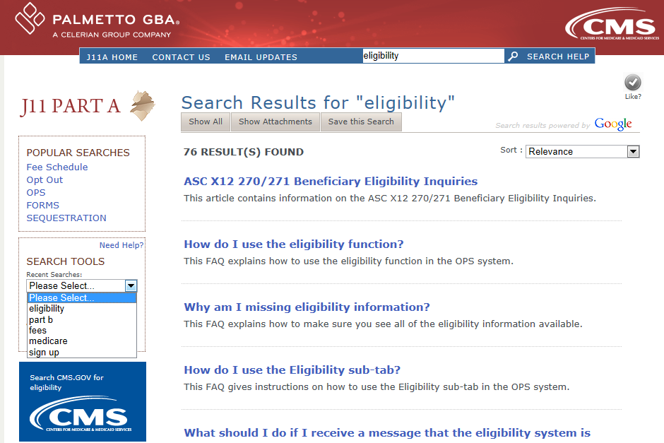
Adequate Linkage
Issue 9 of 10
This site provides access to recent searches in a dropdown list. By tailoring Results pages to include the most recent searches, the site facilitates visitors’ tasks as they retrieve and work with the sites’ content.
Notes:
59

Slide 60
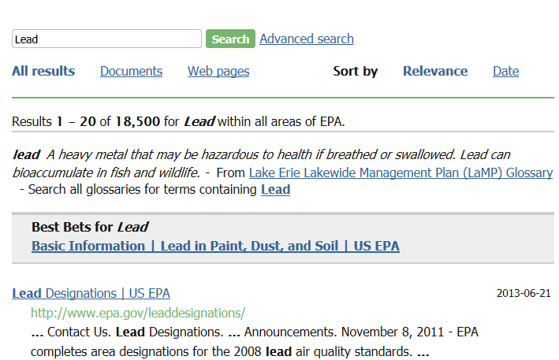
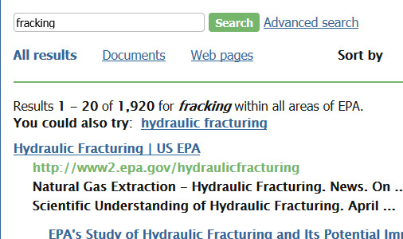
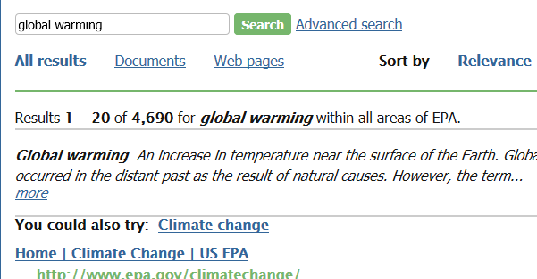
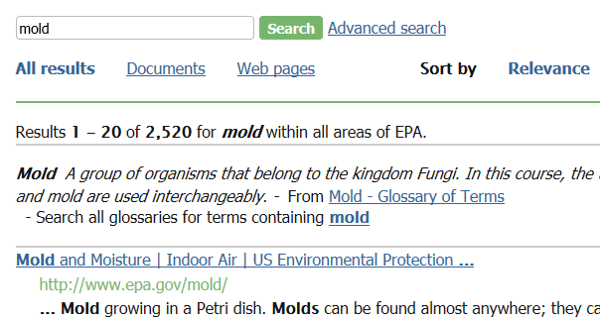
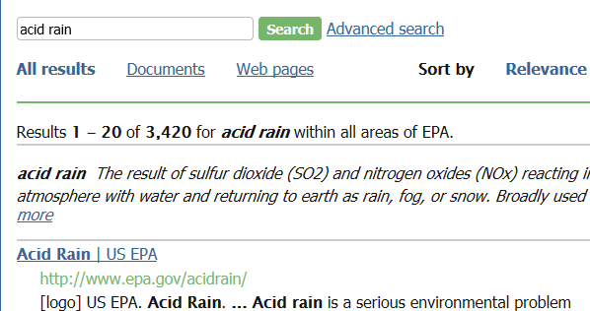
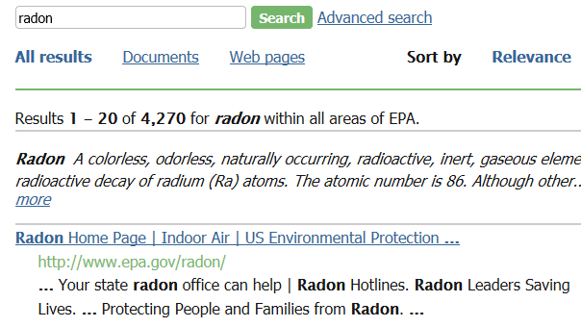
Adequate Linkage
Issue 9 of 10
❶
❷
EPA.gov adheres to usability best practices in providing Best Bets links for frequently requested content ❶. These links help visitors by suggesting popular or introductory pages that is likely to be of use to many visitors, and ensure it receives the most prominent placement. However, the site fails to provide this feature for all of its top search terms. As shown, Results pages for “radon,” “acid rain,” “mold,” “global warming” and “fracking,” all among the top ten frequently searched terms, do not supply Best Bets links ❷ . To improve the Search experience for more visitors, EPA.gov must provide Best Bets for all frequently searched terms.
Notes:
60

Slide 61
Adequate Linkage
Issue 9 of 10
Recommendation
Provide links to recent searches on the Results page. Provide Best Bets for frequently searched terms.

Slide 62
Better Search Suggestions

Slide 63
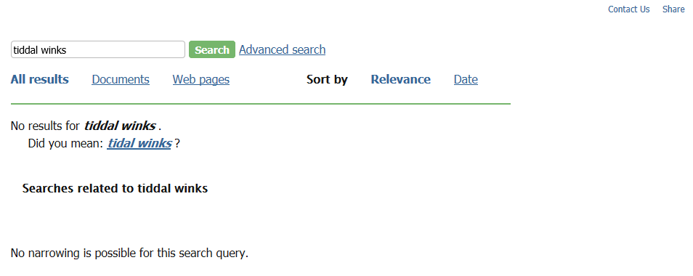
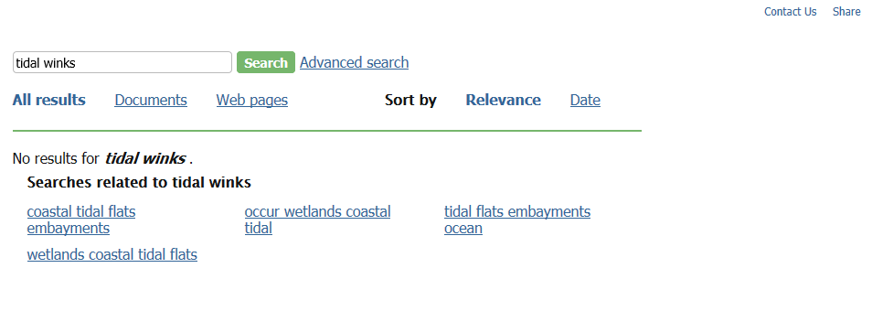
Better Search Suggestions
Issue 10 of 10
❶
❷
When visitors receive a No Results page, they should be provided with as much assistance as possible to ensure they have a successful subsequent search. EPA.gov shows good usability in recommending similar search terms. However, Search must ensure that these Did you mean? links lead to actual results pages. As shown, a suggested link generates a second No Results page ❶ with more related searches ❷. This requires extra clicks to reach content. Instead these search terms should be presented on the first No Results page.
Notes:
63

Slide 64
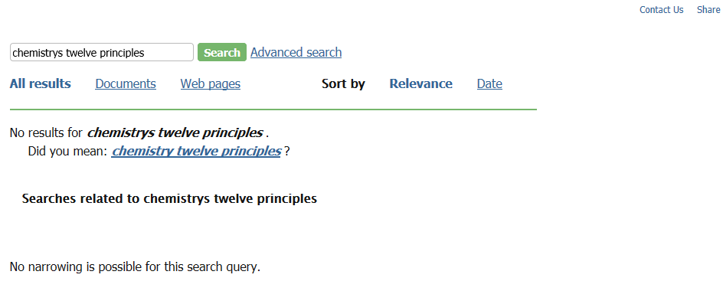
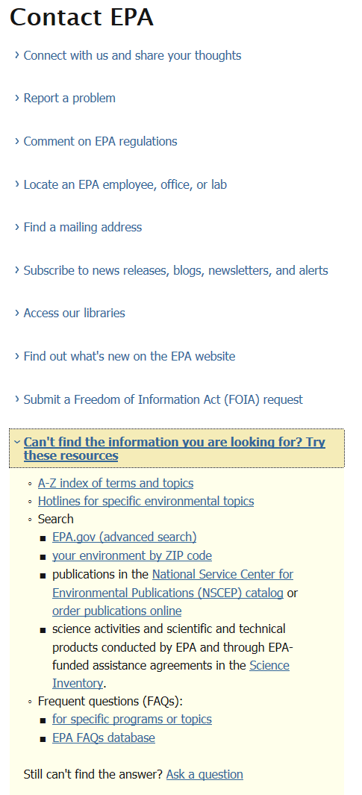
Better Search Suggestions
Issue 10 of 10
❷
❶
In addition, Search can further assist visitors to recover from an unsuccessful query by providing explicit suggestions for improving the query such as checking for spelling mistakes or using a broader term❶. Furthermore, the Contact EPA page offers extensive resources which may benefit visitors who are unable to locate information through Search. However the small size of the link and its location at the edge of the page risks that visitors will overlook it and miss out on the assistance offered there❷. Instead the site can relocate the link to a more prominent place in the center of the page near the No Results message.
Notes:
64

Slide 65
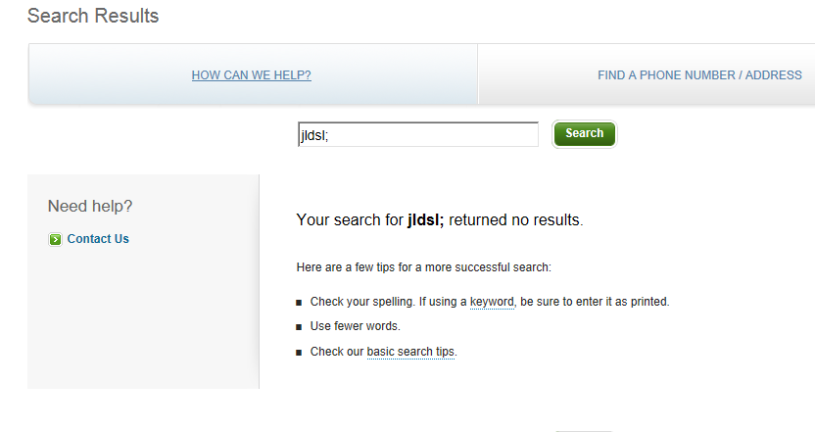
Better Search Suggestions
Issue 10 of 10
❷
❶
This site assists visitors by recommending tips for a successful search ❶ and prominently placing the Contact Us link near the No Results message ❷.
Notes:
65

Slide 66
Better Search Suggestions
Issue 10 of 10
Recommendation
Ensure suggested search terms link to results pages.
Add suggestions for conducting a better Search.
Move the Contact Us link to the center of the No Results pages.

Slide 67
Agenda
Overview of Usability Audit Review
Specifications and Scope
Usability Compliance Rating
Top 10 Critical Usability Issues
Bottom Line

Slide 68
Bottom Line
To help visitors find answers to their questions, EPA.gov must ensure that Search returns the same results sets and featured content for common variants of search terms and facilitates comparison between results by providing descriptions that are accurate and meaningful.

